Slide 1
Welcome!
The webinar will begin at
2:00 Eastern/11:00 Pacific

Slide 2
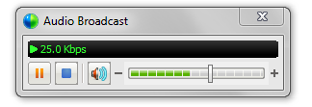
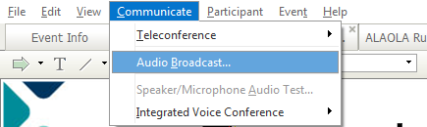

Audio Tips
Today’s audio is streaming to your computer’s speakers or headphones.
Too loud or soft? Adjust volume level in the Audio broadcast box:
Lost all sound? Hear an echo? Click on the small radio tower icon (above chat box) OR go to the Communicate menu (at the top of the screen) and select Audio Broadcast to refresh your connection.
Notes:
2

Slide 3
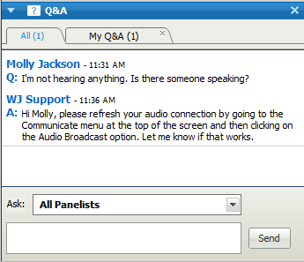
Need Help?
Please post technical support questions into the Q&A Panel.
Step 1: Type the problem in
the dialog box.
Step 2: Click Send.

Slide 4
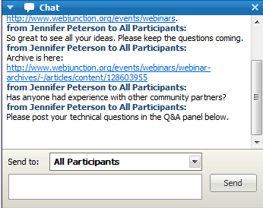
Chat Etiquette
Use Chat to talk with attendees and presenters about the topic.
Do not post technical questions to Chat.
And if you’re tweeting, use this hashtag: #wjwebinar

Slide 5
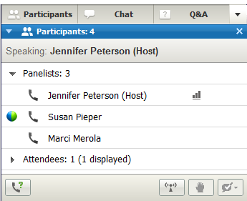
Telephone Access
If you not able to listen via your computer, you may join by phone.
Step 1: Click on Phone Icon under the Participants list.
Step 2: Call the toll-free number provided.
Step 3: Enter the Access Code and Attendee ID provided.
Notes:
http://www.webjunction.org/membercenter/userguide#webex

Slide 6
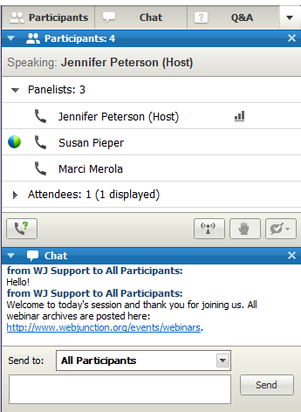
Customize your experience
Panels can be opened or closed by clicking on the panel name at the top of the column, or by using the X in the individual panel.
Hover over edge of
panels to drag and resize.

Slide 7
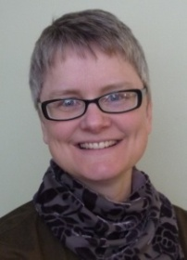
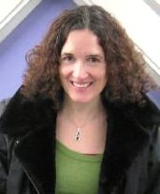
Remember to post to Q&A panel if you need technical assistance.
Other Technical problems?
Contact WebEx support
Event Number: 714 852 202
Phone: 1-866-229-3239
Co-Produced by:
Jennifer Peterson
WebJunction Community Manager
Co-Produced by:
Sharon Streams
Senior Program Manager,
Community Relations,
OCLC
Notes:
7

Slide 8

Thanks to the generous support of the following state library agencies, WebJunction offers webinar programs for free to all who wish to attend:
Arizona State Library, Archives and Public Records
Connecticut State Library
Florida Department of State’s Division of Library and Information Services
Georgia Public Library Service
Idaho Commission for Libraries
Illinois State Library
Indiana State Library
State Library of Kansas
Maine State Library
Minnesota State Library Agency & Minitex
Missouri State Library
State Library of North Carolina
State Library of Ohio
Access Pennsylvania
Texas State Library & Archives Commission
Library of Virginia
Washington State Library

Slide 9
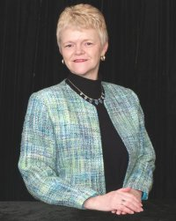
Today’s Presenter
Linda Bruno
Trainer, Facilitator, LindasWorkshops.com and Project Compass Trainer,
Ocala, Florida

Slide 10
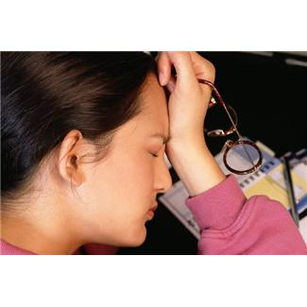
Understanding
Compassion Fatigue
in Your Library
Linda Bruno
www.LindasWorkshops.com
www.LindasWorkshops.blogspot.com
Linda@LindasWorkshops.com

Slide 11
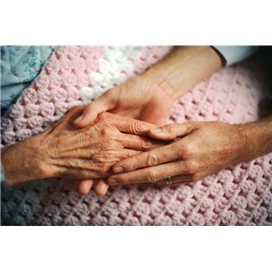
“Compassion Fatigue” ~
What is it?
What brings it about?

Slide 12
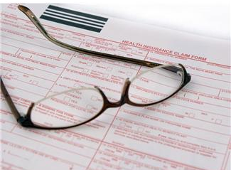
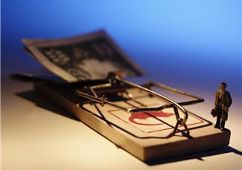
What else might contribute to or “aggravate” your
compassion fatigue?

Slide 13
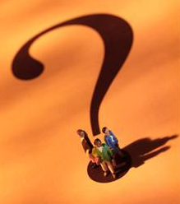
Let’s look at the “actors” in this “play” ~
POWERFUL CHOLERIC
POPULAR SANGUINE
PERFECT MELANCHOLY
PEACEFUL PHLEGMATIC

Slide 14
If your patron is a “Popular Sanguine,” how might that affect their behavior
when they are stressed from struggling with unemployment, etc.?

Slide 15
If you are a “Popular Sanguine,” how might dealing with “needy patrons” be affecting YOU and how might YOU be perceived by THEM?

Slide 16
If your patron is a “Powerful Choleric,” how might that affect their behavior
when they are stressed from struggling with unemployment, etc.?

Slide 17
If you are a “Powerful Choleric,” how might dealing with “needy patrons” be affecting YOU and how might YOU be perceived by THEM?

Slide 18
If your patron is a “Perfect Melancholy,” how might that affect their behavior
when they are stressed from struggling with unemployment, etc.?

Slide 19
If you are a “Perfect Melancholy,” how might dealing with “needy patrons” be affecting YOU and how might YOU be perceived by THEM?

Slide 20
If your patron is a “Peaceful Phlegmatic,” how might that affect their behavior
when they are stressed from struggling with unemployment, etc.?

Slide 21
If you are a “Peaceful Phlegmatic,” how might dealing with “needy patrons” be affecting YOU and how might YOU be perceived by THEM?

Slide 22
Let’s Take a Quick Look at
“Emotional Intelligence” ~
Self-Awareness

Slide 23
Self-Awareness
is…your ability to recognize your own emotions as they happen
and understand your tendency in various conditions.
1. What are some aspects of self-awareness?
Knowing which emotions I’m feeling and
b. Realizing the connection between my feelings and what I
, , and
why
think
do
say

Slide 24
Self-management
is…when you act – or don’t act – on your emotions. It’s your ability to use
your awareness of your emotions to manage your own behavior in a
positive way. In other words, it’s managing your emotional reactions
to situations and people.
1. Some aspects of self-management are:
Managing emotions and impulses.
Staying in upsetting situations.
disruptive
calm, composed

Slide 25
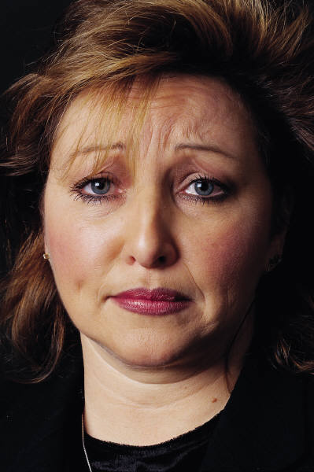
How might this information
affect how I interact with
patrons and respond/react
to their needs?

Slide 26
What are some ways I can deal with compassion fatigue considering my personality?
POWERFUL CHOLERIC
POPULAR SANGUINE
PERFECT MELANCHOLY
PEACEFUL PHLEGMATIC

Slide 27
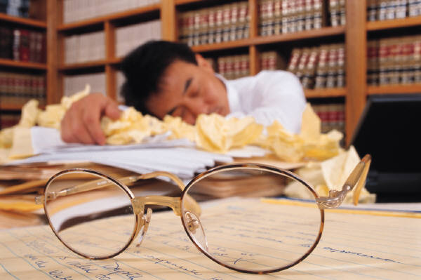
How can I increase awareness
and build understanding
in my library?

Slide 28
Thanks for being here ~
and thanks for helping!

Slide 29
Stay Involved
On WebJunction
  webjunction.org
Crossroads (monthly newsletter)
  Subscribe on homepage
Events
  webjunction.org/events/wj
Notes:
Thank you everyone for coming to today’s webinar. I will send an email out afterwards with links to the archive.
You will be sent to a survey as you leave. We really appreciate your feedback on our webinar series.

