Slide 1
Welcome!
The webinar will begin at
2:00 Eastern/11:00 Pacific

Slide 2

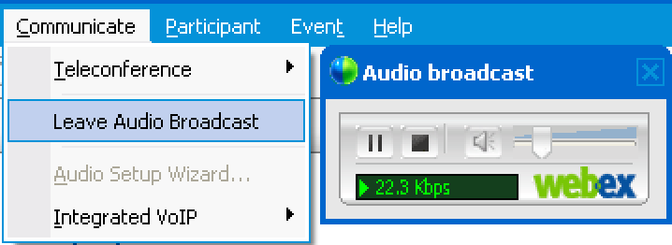
Audio Tips
Today’s audio is streaming to your computer’s speakers or headphones.
Too loud or soft? Adjust volume level in the Audio broadcast box:
Lost all sound? Hear an echo? Select Leave Audio Broadcast or click X to close box(es). Then rejoin.
Notes:
2

Slide 3

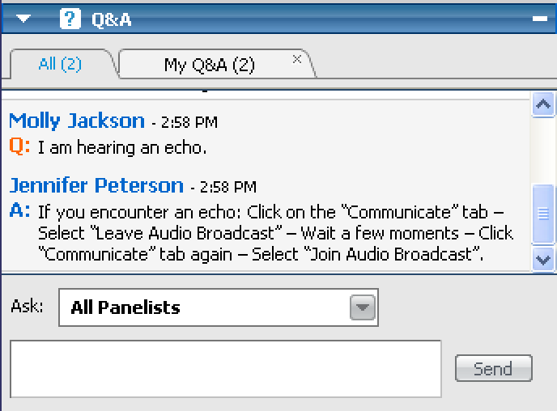
Need Help?
Please post technical support questions into the Q&A Panel.
Step 1: Type problem in the dialog box.
Step 2: Click Send.

Slide 4

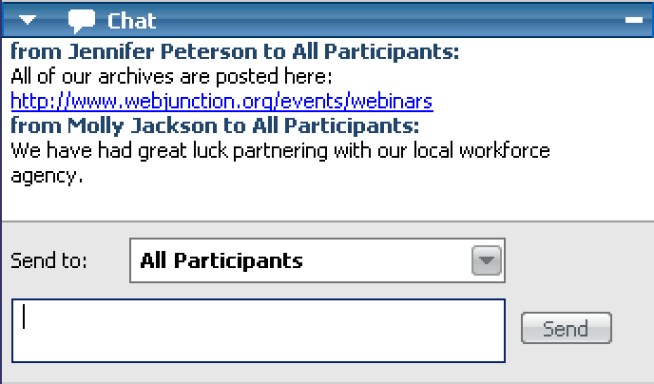
Chat Etiquette
Use Chat to talk with attendees and presenters about the topic.
Do not post technical questions to Chat.
Today’s hashtag: #entlib

Slide 5
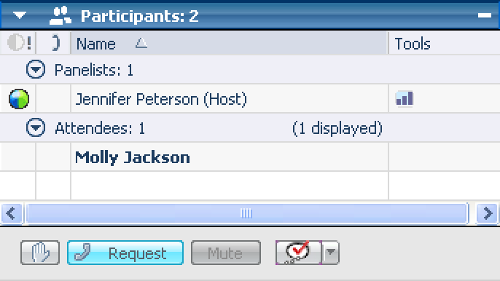
Telephone Access
If you not able to listen via your computer, you may join by phone.
Step 1: Click on Request under the participants list.
Step 2: Call the toll-free number provided.
Step 3: Enter “#” following Access Code and Attendee ID.
Notes:
http://www.webjunction.org/membercenter/userguide#webex

Slide 6
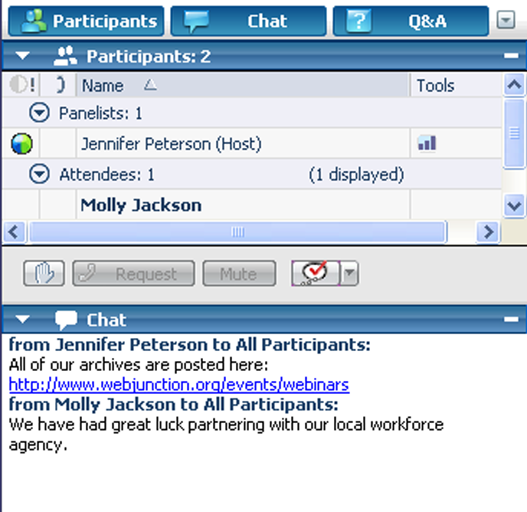
Customize your experience
Panels can be minimized or expanded
Hover over edge of
panels to drag and resize

Slide 7
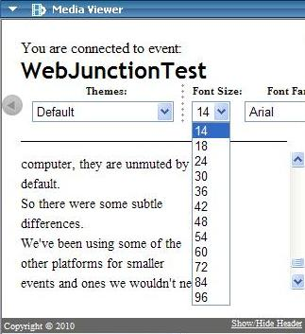
Closed Captioning is available
Open Media Viewer from Panel options.
Adjust font.
Select Show/Hide Header.

Slide 8
Remember to post to Q&A panel if you need technical assistance.
Other Technical problems?
Contact WebEx support
Event Number: 714 079 297
Phone: 1-866-229-3239
Notes:
8

Slide 9


Brought to you in collaboration:
Today’s hashtag: #entlib

Slide 10

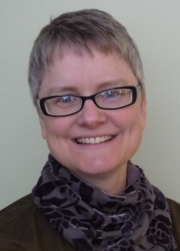

Today’s Presenter
Andrea Berstler
Branch Manager
Henrietta Hankin Branch Library
Today’s Producers
Jennifer Peterson
WebJunction Community Manager
Kendra Morgan
WebJunction Program Manager

Slide 11

The Entrepreneurial Librarian
Running the “business” of your library
Library Card

Slide 12
Objectives
To offer librarians:
an understanding of the basic strategy of the successful entrepreneur
a list of steps to take to formulate a practical long range plan
descriptions of their roles as leaders, managers and coaches
You will leave the session with
a list of prioritized goals for their library
a scheme for how to market their library that will work with both traditional and social networking sites

Slide 13
Define “Entrepreneur”
The Random House Dictionary defines Entrepreneur as:
“a person who organizes and manages any
enterprise, esp. a business, usually with
considerable initiative and risk.”
Merriam-Webster Dictionary – Etymology: French, from Old French, from entreprendre - to undertake.
One who organizes, manages, and assumes the
risks of a business or enterprise

Slide 14
What is an Entrepreneur?
A Successful Entrepreneur
starts or takes over a business and using
creativity, strategic planning,
targeted marketing and innovation,
places that business in the best possible position to
take advantage of every opportunity to
become as successful as possible.
Notes:
Some examples of successful entrepreneurs –
Mary Kay - Ash Cosmetics (Mary Kay)
P.T. Barnum - (Barnum & Bailey)
Michael Bloomberg - Financial Information
Oprah Windfrey – Harpo Inc
Richard Branson - Several (Virgin)
Andrew Carnegie - Steel (US Steel)
Michael Dell - Computers (Dell Computer)
Walt Disney - Entertainment
Debbi Fields - Cookies (Mrs. Fields)
Ernest & Julio Gallo - Wine
Bill Gates - Software (Microsoft)
William Randolph Hearst - (Hearst Newspapers)
Milton Hershey - Chocolate
Steve Jobs - Computers (Apple)
Ray Kroc - Fast Food (McDonald's)
Estee Lauder - Cosmetics
William Levitt - Housing
J. W. Marriott - Hospitality
Louis B. Mayer - Entertainment (MGM)
Pierre Omidyar - Internet (Ebay)
Ralph Roberts - Cable TV (Comcast)
John D. Rockefeller - Oil (Standard Oil)
Howard Schultz - Coffee (Starbucks)
Richard W. Sears - (Sears-Roebuck)
Leo Goodwin - Insurance

Slide 15
What is an Entrepreneurial Librarian?
Focusing this on the library world…
The Successful Entrepreneurial Librarian uses:
creativity, strategic planning,
targeted marketing and innovation,
and continually looks for ways to place their library in the best possible position to take advantage of opportunities to meet the needs of their community, both present and future, and thereby be foundational in the success of the community they serve.

Slide 16
An Entrepreneurial Librarian
Creates a library that is foundational to the success of the community they serve…your library’s success is tied directly to the success of your community.
Your library cannot succeed without taking it’s community with it. . . If your library is successful, your community must also be successful.
You do not dare allow your community to find a way to succeed without your library being involved in that success.

Slide 17
25 Common Characteristics of a Successful Entrepreneur
Do what you enjoy.
Take what you do seriously.
Plan everything.
Manage money wisely.
Ask for the sale.
Remember it's all about the customer.
Become a shameless self-promoter. (without becoming obnoxious).
Project a positive business image.
Get to know your customers.
Level the playing field with technology.
Build a top-notch business team.
Become known as an expert.
13. Create a competitive advantage.
14. Invest in yourself.
15. Be accessible.
16. Build a rock-solid reputation.
17. Sell benefits.
18. Get involved.
19. Grab attention.
20. Master the art of negotiations.
21. Design Your workspace for success.
22. Get and stay organized.
23. Take time off.
24. Limit the number of hats you wear.
25. Follow-up constantly.
excerpted from the Ultimate Home Based Business Handbook , by James Stephenson as published on Enterpreneur.Com website - Oct 2010. http://www.entrepreneur.com/homebasedbiz/article200730.html
Notes:
Which 5 are you already doing?

Slide 18
25 Common Characteristics of a Successful Entrepreneur
Do what you enjoy.
Take what you do seriously.
Plan everything.
Manage money wisely.
Ask for the sale.
Remember it's all about the customer.
Become a shameless self-promoter. (without becoming obnoxious).
Project a positive business image.
Get to know your customers.
Level the playing field with technology.
Build a top-notch business team.
Become known as an expert.
13. Create a competitive advantage.
14. Invest in yourself.
15. Be accessible.
16. Build a rock-solid reputation.
17. Sell benefits.
18. Get involved.
19. Grab attention.
20. Master the art of negotiations.
21. Design your workspace for success.
22. Get and stay organized.
23. Take time off.
24. Limit the number of hats you wear.
25. Follow-up constantly.
excerpted from the Ultimate Home Based Business Handbook , by James Stephenson as published on Enterpreneur.Com website - Oct 2010. http://www.entrepreneur.com/homebasedbiz/article200730.html
Notes:
Which 5 do you need to work on?

Slide 19
25 Common Characteristics of a Successful Entrepreneur
Do what you enjoy.
Take what you do seriously.
Plan everything.
Manage money wisely.
Ask for the sale.
Remember it's all about the customer.
Become a shameless self-promoter. (without becoming obnoxious).
Project a positive business image.
Get to know your customers.
Level the playing field with technology.
Build a top-notch business team.
Become known as an expert.
13. Create a competitive advantage.
14. Invest in yourself.
15. Be accessible.
16. Build a rock-solid reputation.
17. Sell the benefits.
18. Get involved.
19. Grab attention.
20. Master the art of negotiations.
21. Design your workspace for success.
22. Get and stay organized.
23. Take time off.
24. Limit the number of hats you wear.
25. Follow-up constantly.
excerpted from the Ultimate Home Based Business Handbook , by James Stephenson as published on Enterpreneur.Com website - Oct 2010. http://www.entrepreneur.com/homebasedbiz/article200730.html

Slide 20
This will be work . . .
“It thus takes special effort for the existing business to become entrepreneurial and innovative.
The “normal” reaction is to allocate productive resources to the existing business, to the daily crisis, and to getting a little more out of what we already have. The temptation in the existing business is always to feed yesterday and to starve tomorrow. It is, of course, a deadly temptation.
Innovation and Entrepreneurship – Peter F Drucker 1985 p 149
The enterprise that does not innovate inevitably ages and declines. And in a period of rapid change, such as the present, an entrepreneurial period, the decline will be fast.”

Slide 21
What makes a Librarian “Entrepreneurial”?
Entrepreneurial Librarian
Plans to succeed
Proactive
Hires the Person
Manages, Coaches & Leads
Builds a Curriculum
Targeted Marketing
Cultivates “Loyalists”
Prioritizes “Upgrades”
Community-based, organic organization

Slide 22
What makes a Librarian “Entrepreneurial”?
Entrepreneurial Librarian
Community-based, organic organization
Proactive
Hires the Person
Manages, Coaches & Leads
Builds a Curriculum
Targeted Marketing
Cultivates “Loyalists”
Prioritizes “Upgrades”
Plans to succeed
Has a set of measurable, prioritized goals
for their library with an ideal timeline for reaching those goals.
Notes:
Wants to succeed
Has a set of goals for their library
If you aim at nothing you will hit it every time
Plans to succeed
Has a set of measurable, time defined, prioritized goals for their library with an ideal timeline for reaching those goals. (in 3 years we will have additional 2 staff members, trained in customer service and able to assist in basic computer support for customers)
These goals are prioritized so that if funding changes they are able to stay focuses on the items that are most important.

Slide 23
What makes a Librarian “Entrepreneurial”?
Entrepreneurial Librarian
Community-based, organic organization
Plans to succeed
Pro active
Hires the Person
Manages, Coaches & Leads
Builds a Curriculum
Targeted Marketing
Cultivates “Loyalists”
Prioritizes “Upgrades”
Anticipates issues
Institutes policies, procedures and programs to meet the needs, solve the problems and assimilate necessary changes
Notes:
Reactive
Works toward a solution to meet a need, deal with a change or solve a problem.
Proactive
Through strategic planning has anticipated issues and has instituted policies, procedures and programs to meet the needs, solve the problems and assimilate necessary changes.

Slide 24
What makes a Librarian “Entrepreneurial”?
Entrepreneurial Librarian
Community-based, organic organization
Plans to succeed
Pro active
Hires the Person
Manages, Coaches & Leads
Builds a Curriculum
Targeted Marketing
Cultivates “Loyalists”
Prioritizes “Upgrades”
Hires based on talents and personality.
“The successful candidate likes working with people, has a strong desire for good customer service and is able to be taught.”
Notes:
Hires the Skills
Hires based on skills and experience.
The successful candidate has ability to work with computer, shelf books, help with reader’s advisory and has experience in library work.
Hires the Person
Hires based on talents and personality.
The successful candidate likes working with people, has a strong desire for good customer service and is able to be taught.

Slide 25
What makes a Librarian “Entrepreneurial”?
Entrepreneurial Librarian
Manages, Coaches & Leads
Builds a Curriculum
Targeted Marketing
Cultivates “Loyalists”
Prioritizes “Upgrades”
Hires the Person
Community-based, organic organization
Plans to succeed
Pro active
Models leadership by regular, open communication, and by allowing the team to work as a unit within the framework of the strategic plan.
Notes:
Manages their staff
Does yearly staff reviews, keeps the board updated on programs and circulation figures. Welcomes volunteers and spends time making sure they understand what is needed of them.
Manages, Coaches & Leads the team
Meets with stakeholders on a regular basis and discusses their part in the overall success of the library. Models leadership by regular, open communication, and by allowing the team to work as a unit within the framework of the strategic plan.

Slide 26
What makes a Librarian “Entrepreneurial”?
Entrepreneurial Librarian
Manages, Coaches & Leads
Builds a Curriculum
Targeted Marketing
Cultivates “Loyalists”
Prioritizes “Upgrades”
Hires the Person
Community-based, organic organization
Plans to succeed
Pro active
Develops seminars and workshops based on the needs of their community.
Notes:
Schedules Programs
Schedules the programs for the library: book groups, storytimes, computer classes, etc.
Constructs a library curriculum
Considers alternative classes.
Develops seminars and workshops based on the needs of their community.
Is willing to try new and innovative
classes even if it is not know if
anyone will show up.

Slide 27
What makes a Librarian “Entrepreneurial”?
Entrepreneurial Librarian
Manages, Coaches & Leads
Builds a Curriculum
Targeted Marketing
Cultivates “Loyalists”
Prioritizes “Upgrades”
Hires the Person
Community-based, organic organization
Plans to succeed
Pro active
Has considered who they wish to reach with marketing
Notes:
Shotgun Marketing
Marketing plan involves an occasional press release, an in-house newsletter and perhaps a Facebook page or Twitter account.
Targeted Marketing
Has considered who they wish to reach with marketing and uses the marketing available to them to market programs designed to interest and meet the needs of these people groups.

Slide 28
What makes a Librarian “Entrepreneurial”?
Entrepreneurial Librarian
Targeted Marketing
Cultivate Loyalists
Prioritizes “Upgrades”
Community-based, organic organization
Plans to succeed
Pro active
Hires the Person
Manages, Coaches & Leads
Builds a Curriculum
Develops loyal customers who not only use but believe in the work of the library and who are willing to volunteer, advocate and financially support the library.
Notes:
Has “Regulars”
Develops a regular customer base who will use the library but who often disappear when they are needed to stand up for or advocate for the library.
Cultivates “Loyalists”
By aligning their library to the needs of their community, they develop loyal customers who not only use but believe in the work of the library and who are willing to volunteer, advocate and financially support the library.

Slide 29
What makes a Librarian “Entrepreneurial”?
Entrepreneurial Librarian
Targeted Marketing
Cultivate Loyalists
Prioritize Upgrades
Community-based, organic organization
Plans to succeed
Pro active
Hires the Person
Manages, Coaches & Leads
Builds a Curriculum
Encourages stakeholders to attend training and makes training a priority by attending sessions themselves.
Notes:
Too busy
Knows they should provide training, attend training or provide training for their staff but never seems to have the time or money.
Prioritizes “Upgrades”
Encourages stakeholders to attend training and makes training a priority by attending sessions themselves. Convinces their board/supervisors of the importance of keeping current, even if you have to (Gasp) close the library for a day or two to do it.

Slide 30
What makes a Librarian “Entrepreneurial”?
Entrepreneurial Librarian
Targeted Marketing
Cultivate Loyalists
Prioritize Upgrades
Community -based, organic
Plans to succeed
Pro active
Hires the Person
Manages, Coaches & Leads
Builds a Curriculum
Able to adjust and adapt to unexpected changes with minimum delay or resistance
Notes:
A solid, traditional institution
Adapts to changes when needed, but often with resistance from board, staff or even customers which causes delays in responding
A Community-based, organic organization
Nimble organization, able to adjust and adapt to unexpected changes with minimum delay or resistance.

Slide 31
Entrepreneurial Librarian
Plans to succeed
Proactive
Hires the Person
Manages, Coaches & Leads
Builds a Curriculum
Targeted Marketing
Cultivates “Loyalists”
Prioritizes “Upgrades”
Community-based, organic organization

Slide 32

The Key is . . .
the Strategic Plan.
The well written strategic plan performs several important, functional purposes:
Causes the organization’s shareholders to think about, discuss and put down on paper their goals for the library’s future.
Sets measurable, defined and time specific goals
Notes:
A well written strategic plan:
Causes the organization’s shareholders to think about, discuss and put down on paper their goals and wishes for the library’s future. Putting them on paper solidifies them, forces one to consider their importance, their implications and the intent of these goals.
Writing these goals out is very important. It takes thoughts, ideas, dreams, worries, and concepts from the undefined world of thought and brings them into the world of paper and concrete and ink. It allows everyone to share and build and develop them into something real and measurable and possible. It also shows what areas are foremost in the minds of the library shareholders.
Sets measurable, defined and time specific goals
Goals must have three things to be good goals – they must be measurable they must be defined and they must have a timeline attached to them.
We want to increase circulation – not a good goal
We want to increase circulation of our young adult collection by 10% over the next 4 years. Better - now you can tell if you reached your goal.
**Shareholder – a person, group of people or organization with a
vested interest in seeing the library grow, develop and
be successful within its community.

Slide 33
The Key is . . .
the Strategic Plan.
The well written strategic plan performs several important, functional purposes:
Brings the mission and vision statement in down to earth
Defines the organization’s priorities and keeps the library “on task”
Stick with the Plan - Do not allow “good ideas” to get you off the track of a “great idea”.

Slide 34
The Key is . . .
the Strategic Plan.
The well written strategic plan performs several important, functional purposes:
Allows the board, director, staff, volunteers and customers to know where the organization is going - Keeps the director, staff and the board accountable
Defines what is “success” for that library.

Slide 35

How can you say you have a “successful library” if you cannot define what success
looks like?

Slide 36
How does a Strategic Plan differ from a 5-Year Plan or a
Long-Range Plan?
Sets goals for the coming weeks and months
An organic document
Defines the strategy of the library
Notes:
Sets goals for the coming weeks and months as well as years.
An organic document, with an ability to be evaluated, altered and changed according to the needs of the community, the situation of the organization and the talents and abilities of the staff and board members.
A strategic plan defines the strategy of the library. It not only shows what will be done but what steps will be taken to get there and what the timetable is for those steps.

Slide 37

  Steps to a Strategic Plan
Brainstorm and Dream
Organize
Prioritize
Plan
Commit
Implement
The time to prepare isn’t after you have been given the opportunity. It’s long before that opportunity arises.
Once the opportunity arrives, it’s too late to prepare.
- John Wooden, basketball coach of ten championships teams at UCLA

Slide 38

  Steps to a Strategic Plan
Brainstorm and Dream
Put it all on the table. There are no wrong answers.
This will give you insight into where each person sees the library going
Notes:
1. Brainstorm and dream
In a Board workshop, begin to brainstorm - Where do you see your library in 3-5 years? What are you doing? Who are you serving? What technologies are you using? What programs, classes, and events are you holding? Who are you serving and what are you doing for them?
Take money out of the picture and put all your ideas on the table. Put it all on the table. This is the time for each shareholder to put in their desires and dreams for the library. There are no wrong answers.
This will give you insight into where each person sees the library going, what the library’s priorities should be and what is important to that person.
To do this properly, you have to do some prep work. Consider what your community needs from its library, who you serve, what events & programs are in high demand? What needs have been vocalized by your customers?
Ask your Friends for input, talk to your township/borough manager, school librarian, teachers or principal, get all possible shareholders to share their thoughts. Attend local community functions and talk to people, one-on-one, about the library, why they do or don’t use it and what they see as the biggest, best thing the library could do for the community.
Do your homework for this - compile survey results (formal and informal), programming and circ stats and even have 1 or 2 focus groups to discuss the library’s position in the community.

Slide 39
  Steps to a Strategic Plan
Brainstorm and Dream
Organize
Take each idea and assign it to a “Department”.
It may be any of these:
Buildings & Facilities
Staff
Collection
Resources
Outreach
Training
Technology
Programming / Instruction
You are still not removing anything from the list – just organizing them.

Slide 40
  Steps to a Strategic Plan
Brainstorm and Dream
Organize
Prioritize
This is where you place the items in order of which are going to be most important in each category.
Notes:
3. Prioritize
Begin to number your “wish list”. What are the most important? less important? impossible right now? Which ones align with your mission statement and vision? This is where you make the hard choices.

Slide 41
  Steps to a Strategic Plan
Brainstorm and Dream
Organize
Prioritize
Plan
create goals and objectives and describe how you are going to get there and when you want to arrive.
This is where you define the changes you need to make.
Insanity: doing the same thing over and over again and expecting different results. - Albert Einstein
Notes:
This is the step most people think when discussing a long range or 5 year plan. But you have the have the first 3 steps before you can do your actual planning.

Slide 42
  Steps to a Strategic Plan
Brainstorm and Dream
Organize
Prioritize
Plan
Commit
Everyone involved in the process of implementing this plan must buy in to the plan. They should have had input into the plan and now is the time for them to take ownership of the plan and invest personally into the plan’s success.
Notes:
Choose which goal(s) are the most urgent, important or are in the realm of possible and commit to making them a part of your organization.
Design steps for how you are going to make them a reality, set up a timetable to keep you on task and a time for review to assess how you are doing so far. Post these goals in the staff areas and make them a part of staff meetings, board meetings. Hold each other accountable to staying the course.
Everyone involved in the process of implementing this plan must buy in to the plan. They should have had input into the plan and now is the time for them to take ownership of the plan and invest personally into the plans’ success.

Slide 43
  Steps to a Strategic Plan
Brainstorm and Dream
Organize
Prioritize
Plan
Commit
Implement
Don’t waste your time or energy by creating a plan that you cannot or will not implement. Many organizations create a plan just to have a plan.
Notes:
It is all well and good to plan and prepare, but without putting feet to your plan, you have spent a good deal of time for nothing. Start with your top propriety and put it in action. Make it part of the fabric of your library, interwoven in all aspects of daily operations.
Consider every aspect of your library – collection, programming, outreach, marketing, etc. all of these aspects need to flow together in the scope of your plan.

Slide 44
  Steps to a Strategic Plan
The mini-plan
Increase use of the library
by those 20-30 years old. . . how?
Who? Why?
Do a “mini-plan” for them.
Notes:
Let’s walk through an example – a mini-plan
Example – the number 1 priority of your plan is to increase use of the library by those 20-30 years old. . . how? Who you do know that is 20-30? Why are they not using the library? Can you get a group of them together to share what they are doing, need, want, what would like to have in their library? Do a “mini-plan” for them –
Brainstorm with them – what do you want in your library? (remember, no wrong answers)
Organize – what are programs? Collections? Activities? Etc
Prioritize – which of these things are most important? would have the most impact?
Commit – this is a big step – commit to the group that you will institute these things in the library. They need to commit to using them and telling others about them. (You have, by the way, just created an advisory committee, but don’t tell them this)
Carry it out – follow through with this or your name is mud
Do not allow the plan to micro manage your library, but instead use it as a compass. It should point you in the right direction, allow you to make course corrections as needed and by holding it up to whatever you are considering, guide you to decisions that will promote the overall goals.

Slide 45
  Steps to a Strategic Plan
Do a “mini-plan” for them:
Brainstorm With Them
Organize
Prioritize
Commit
Implement
Notes:
Let’s walk through an example – a mini-plan
Example – the number 1 priority of your plan is to increase use of the library by those 20-30 years old. . . how? Who you do know that is 20-30? Why are they not using the library? Can you get a group of them together to share what they are doing, need, want, what would like to have in their library? Do a “mini-plan” for them –
Brainstorm with them – what do you want in your library? (remember, no wrong answers)
Organize – what are programs? Collections? Activities? Etc
Prioritize – which of these things are most important? would have the most impact?
Commit – this is a big step – commit to the group that you will institute these things in the library. They need to commit to using them and telling others about them. (You have, by the way, just created an advisory committee, but don’t tell them this)
Carry it out – follow through with this or your name is mud
Do not allow the plan to micro manage your library, but instead use it as a compass. It should point you in the right direction, allow you to make course corrections as needed and by holding it up to whatever you are considering, guide you to decisions that will promote the overall goals.

Slide 46

The Key is . . .
the Strategic Plan.
Caution
Do not allow the plan to micromanage your library,
instead use it as a compass.
It should:
point you in the right direction,
allow you to make course corrections
guide you to decisions
promote the overall goals
Notes:
It should point you in the right direction, allow you to make course corrections as needed and by holding it up to whatever you are considering, guide you to decisions that will promote the overall goals.
A good strategic plan will affect every aspect of library operations. If the plan is implemented properly, it should cause you and your staff to evaluate and often adjust most day to day functions. This does not have to happen in 1 week or 1 month or even 1 year. The timeline for your plan will have implementation spelled out.

Slide 47
Let’s give it a try . . .
Create a list of 5 goals for your library.
There are no “right” or “wrong” answers.
Think about:
Who you serve
Who you want to serve?
Where you what to be in the coming years?
What technology is coming that you want to take advantage of?
Notes:
Think about:
Who you serve? (How do you want to serve them better?)
Who you want to serve?
Where you what to be in the coming years? (physically, financially, etc)
What technology is coming that you want to take advantage of?
Write down 5 goals for your library by answering these questions.

Slide 48

You have a plan – but can you sell it?
Focused and Targeted Marketing

Slide 49
You have a plan – but can you sell it?
Who are you trying to reach?
What are you offering them?
Where will you find them?
How can you get in front of them?
Why should they come? Sell the benefit, not the product
Notes:
Who are you trying to reach
What are you offering them?
Where will you find them?
How do they get their information?
Why should they come?
You need to sell the benefits – not just the product. Pushing product features is for inexperienced or wannabe entrepreneurs. Selling the benefits associated with owning and using the products and services you carry is what sales professionals worldwide focus on to create buying excitement and to sell, sell more, and sell more frequently to their customers.
Your advertising, sales presentations, printed marketing materials, product packaging, website, newsletters, trade show exhibit and signage are vital.
Every time and every medium used to communicate with your target audience must always be selling the benefits associated with owning your product or using your service.
Your publicity needs to outline the benefits of this new program, the ease of attending and that your library and staff are child and mom friendly (and then they need to be so.) This is where you Sell the program by selling the benefits. .
So why should they come – free food, prizes, networking, opportunity to meet new clients, spend time with someone they might not otherwise see; whatever the event, the reason people need to be there should be in the publicity. There are just too many choices for it to be hidden. (be a shameless self-promoter)
This does not require a professional marketing company or even money.
It does require time spent really thinking about who and what and where.

Slide 50
You have a plan – but can you sell it?
Who are you trying to reach?
New mothers
What are you offering them?
Baby Lapsits, New parenting collection
Where will you find them?
Pediatricians office, Wal-Mart, McDonalds, children’s store in town, playground
How can you get in front of them?
Flyers in Pediatricians office, Storytimes in Wal-mart or McDonalds once/twice month, combined program with children’s store (fashion show, new “baby gadget” show)
Why should they come?
Meet other mothers, network and playgroup information, free day out, a chance for grown up talk.
Notes:
Who are you trying to reach? Your new strategic plan states that you are going to prepare, schedule and conduct programs for new mothers in your community including a lapsit and a new parenting collection. To grow this part of your program - you are trying to reach new mothers who have not been library users before.
What are you offering them? A program to help them bond with their new baby. In addition to baby story times, you will bring in health, diet and learning experts to guide them through their child’s first year.
Where will you find them? How do they get their information? Placing notices in your newsletter about a new mother’s program is not going to do much. They are not using your library now.
How can you get in front of them? If you find, however, that many of these new mothers are using the services of a local pediatric practice, perhaps you can work with that office to post information about the library, put out newsletter there, create a brochure about this and all your programs for mothers of small children and make it available in their office, etc. Perhaps these new moms are online – facebook, etc. then develop a Facebook page for those programs, make sure to post to it often and keep it up to date.
Why should they come? You need to sell the benefits – not just the product. Pushing product features is for inexperienced or wannabe entrepreneurs. Selling the benefits associated with owning and using the products and services you carry is what sales professionals worldwide focus on to create buying excitement and to sell, sell more, and sell more frequently to their customers.
Your advertising, sales presentations, printed marketing materials, product packaging, website, newsletters, trade show exhibit and signage are vital.
Every time and every medium used to communicate with your target audience must always be selling the benefits associated with owning your product or using your service.
Your publicity needs to outline the benefits of this new program, the ease of attending and that your library and staff are child and mom friendly (and then they need to be so.) This is where you Sell the program by selling the benefits. .
So why should they come – free food, prizes, networking, opportunity to meet new clients, spend time with someone they might not otherwise see; whatever the event, the reason people need to be there should be in the publicity. There are just too many choices for it to be hidden. (be a shameless self-promoter)

Slide 51

Leader, Manager or Coach?
Which one do you need to be?

Slide 52
Leader, Manager or Coach?
Manager
Leader
Coach
Focuses on problem solving and day to day operations
Focuses on the “big picture”
Focuses on the people in your organization, helping them to reach their goals and in turn, to help the library meet its goals.
Notes:
Manager – manages resources (money, materials, people), finding the best place to utilize these resources to meet the goals of the organization. Focuses on problem solving and day to day operations
Leader – sets a vision and provides the path to reach that vision. Focus on long range planning, the “big picture” and getting everyone to row in the same direction
Coach – finds out what their staff wants and where they want to be within the organization, how their goals mesh with the organization’s goals and what is the best way to reach both goals. Focus on the people in your organization, helping them to reach their goals and in turn, to help the library meet its goals.

Slide 53
Leader, Manager or Coach?
You need to be all three.
A good manager is best when people barely know that he exists.
Not so good when people obey and acclaim him.
Worse when they despise him.
Lao-Tzu Chinese philosopher (604 BC - 531 BC)
Notes:
All three are needed;
The key is wearing the right hat in the right circumstances:
Your staff needs a coach
Your board, Friends or township officers need a leader
Your library as an entity needs a manager

Slide 54

What’s next?
Library Card
Are you ready to be an
Entrepreneurial Librarian?
creative thinking, strategic planning,
targeted marketing, innovation
and at times, be a risk taker

Slide 55
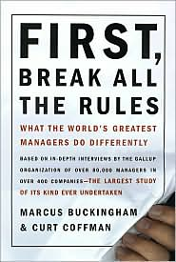
The Entrepreneurial Librarian
Suggested Reading List
First Break all the Rules – written by Marcus Buckingham and Curt Coffman, Published by Simon and Schuster Adult
Fish: A remarkable way to boost morale and improve results – Written by Paul Harry and John Christensen, Published by Hyperion
Innovation and Entrepreneurship – Written by Peter F. Drucker, published by HarperCollins Publishers
One Minute Manager – Written by Ken Blanchard, Spencer Johnson, and Constance Johnson, published by HarperCollins Publishers
Strategic Planning for Results – Written by Sandra Nelson, published by the American Library Association
Transforming our Image through Words that Work: Perception is Everything. Valerie Gross, Public Libraries, Volume 48, Number 5, (2009): pages 24-32.

Slide 56
The Entrepreneurial Librarian
Andrea Berstler
www.TheEntrepreneurialLibrarian.blogspot.com
Twitter – AbintheLibrary
Library Card

Slide 57
Stay Involved
On WebJunction
  webjunction.org/rural
  webjunction.org/management
Association for Rural & Small Libraries
  www.arsl.info
Mark your Calendar!
September 8-11, ARSL Annual Conference
  Frisco, Texas
Notes:
Thank you everyone for coming to today’s webinar. I will send an email out afterwards with links to the archive, more resources and where the post-webinar discussion will be occurring.
I have pushed out a survey that I hope you will have time to take. We really appreciate your feedback on our webinar series.

