Slide 1
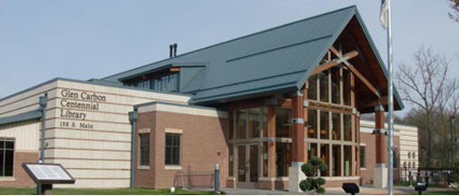
Glen Carbon Centennial Library
198 South Main Street
Glen Carbon, IL 62034
www.glencarbonlibrary.org

Slide 2
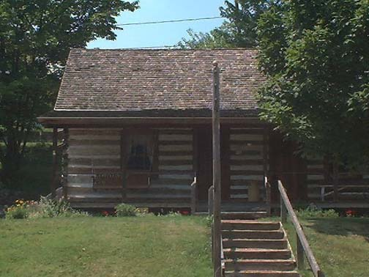
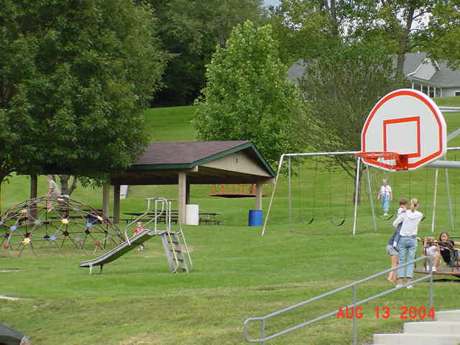
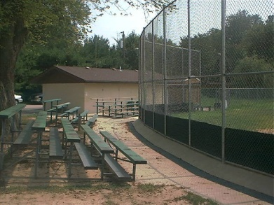
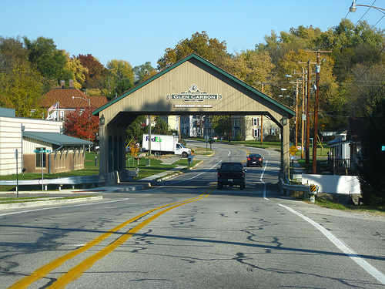
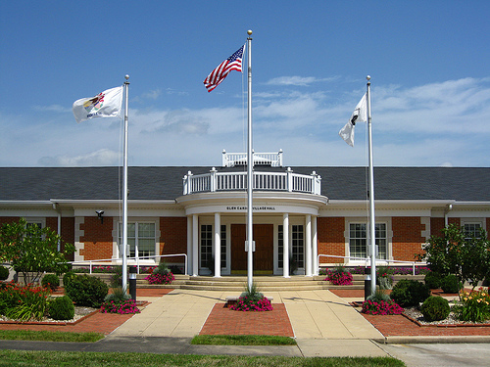
Village of Glen Carbon Ranked
Among Top 100 Best Places To Live in USA
By
Population: 12,500
Established: 1892

Slide 3
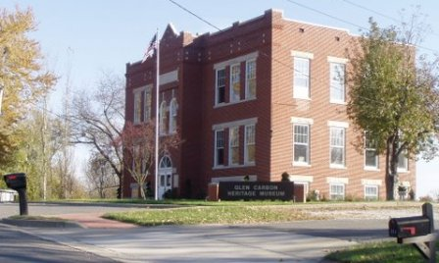
LIBRARY HISTORY
1975 A READING CENTER STAFFED BY VOLUNTEERS
1976 MOVED TO 100 YEAR OLD FORMER SCHOOL HOUSE
1992 REFERENDUM PASSED TO ESTABLISH A TAX BASED LIBRARY
2002 2.4 MILLION BOND ISSUE
PASSED TO BUILD A NEW LIBRARY
OCTOBER 4, 2004 – DOORS OPENED TO 14,000 sq. ft. NEW LIBRARY

Slide 5
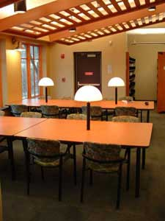
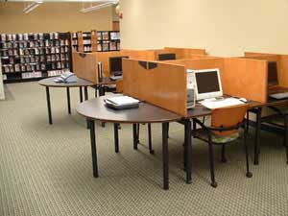
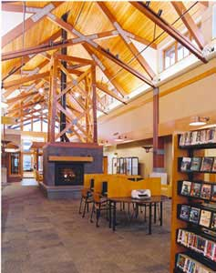
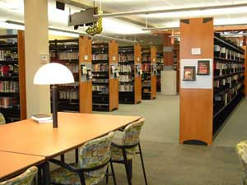

Slide 6
WHY?
RECOGNIZE HARD WORK OF STAFF
ELEVATE GCCL WITHIN THE COMMUNITY
FULFILL PROMISE MADE @ 2006 SYNERGY
Runner-Up Status

Slide 7
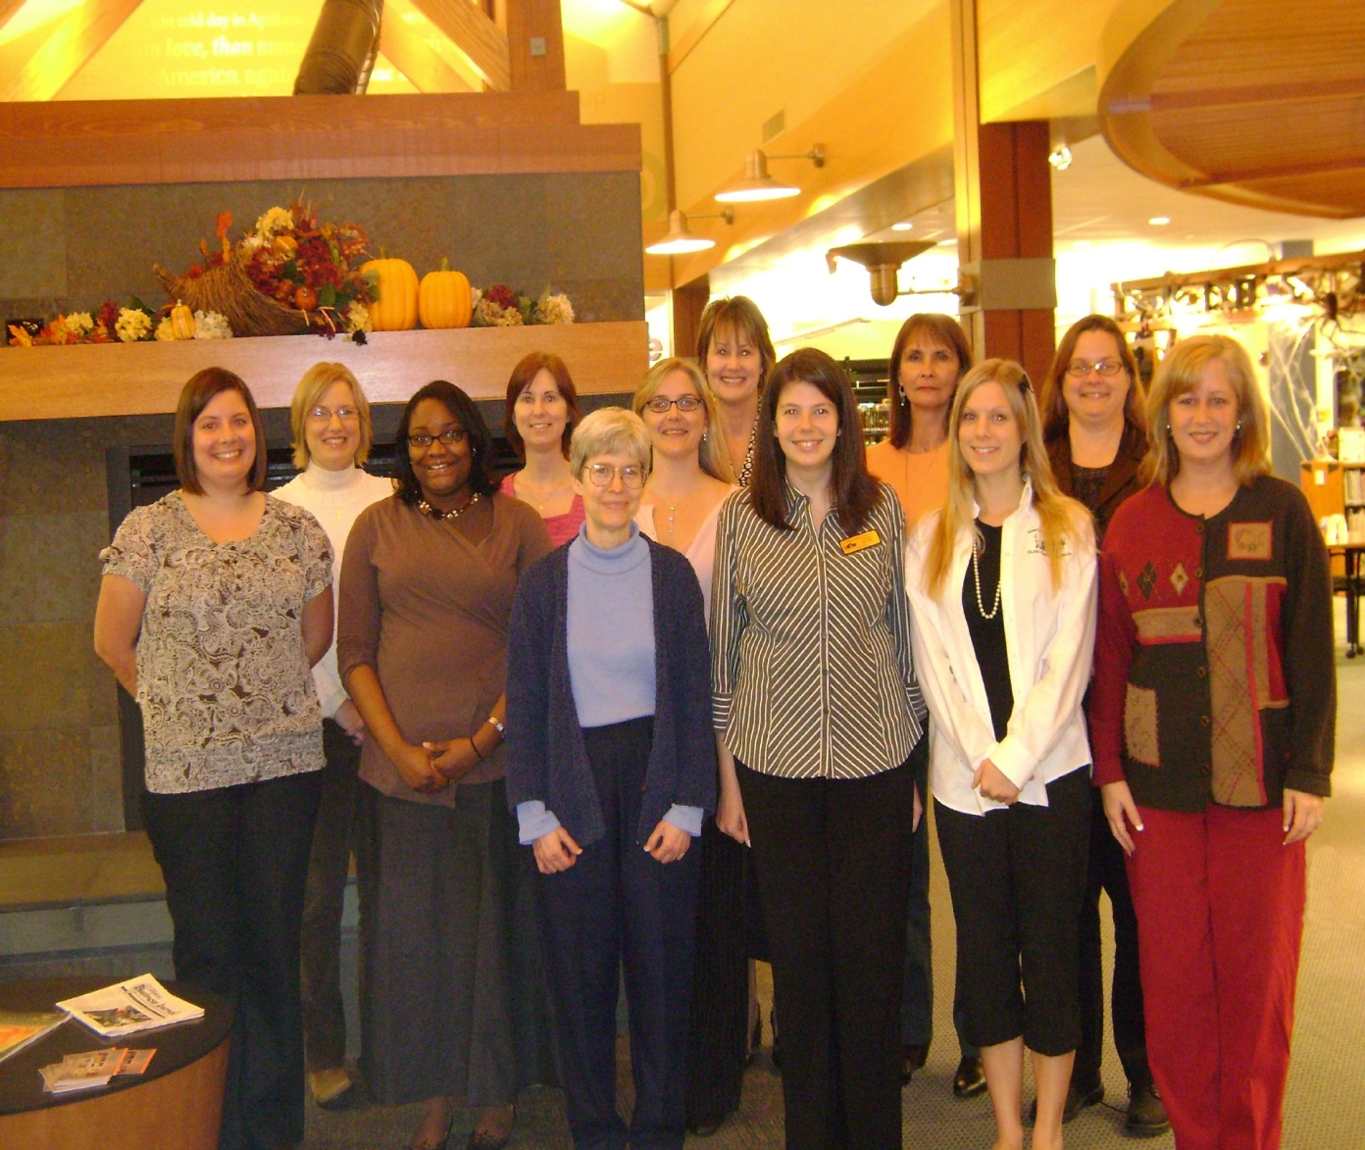
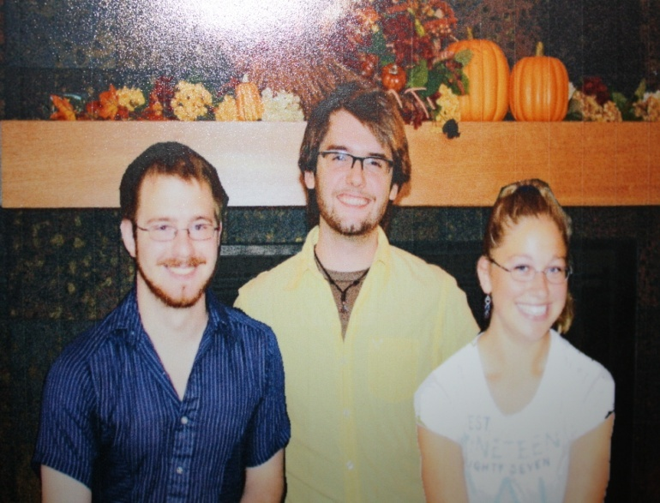

Slide 8
KEY CRITERIA
USE OF TECHNOLOGY TO EXPAND THE REACH OF LIBRARY SERVICES
SUCCESS IN EDUCATING PATRONS IN COMPUTER USE
CUSTOMER SERVICE
CREATIVITY IN DEVELOPING SERICES AND PROGRAMS THAT CAN BE REPLICATED BY OTHER LIBRARIES
SUSTAINTED COOPERATION WITH OTHER LIBRARIES
PARTNERSHIPS
EVIDENCE OF LIBRARY’S ROLE AS COMMUNITY CENTER
INCREASE IN LIBRARY USE, PARTICULARLY BY NEW USERS

Slide 9
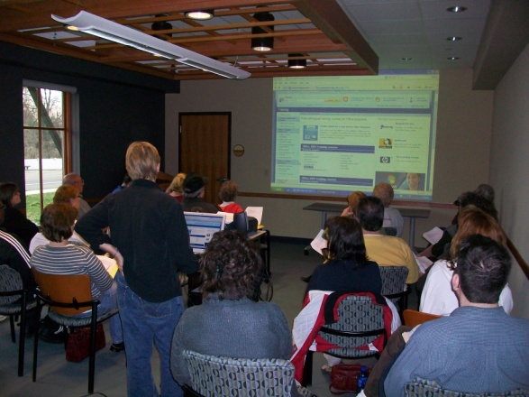
Innovation in introducing and
supporting public access computing
Success in educating patrons in computer use
Use of technology to expand the
reach of library services

Slide 10
Technology Related Programming:
Senior Memoirs
24/7 Storytime
Oprah Online Book Club
Adult and Senior Computer Classes
CLASP - Connecting Libraries and Schools Program
Online Meeting Room Reservation
FAFSA Workshop with Laptops
Rosetta Stone on Laptops
Senior Wii Gaming Days
Facebook, Flickr, & Twitter

Slide 11
Customer Service

Slide 12
Disney Keys of Excellence
Be Our Guest: Perfecting the Art of Customer Service by Ted Kinni
Who is Disney’s primary concern?
In other words, who do they strive to keep happy?

Slide 13
Library Staff

Slide 14
More than you Expect!
Stereotypes
Un-welcoming
Un-helpful
Un-friendly
Intimidating
What we do
Greet the patrons
Blur Hierarchy/Embrace Flexibility
Recognize everyone’s abilities

Slide 15
Ideas driven by Staff
Read dating
Dewey & Dot’s Wrap N Roll
Author programs
Sit Together And Read w/ Dogs (STARS w/ Dogs)
Movie discussions
Staff Association Events
No to Yes Log

Slide 16
Re-defining our role in our community
Old - Mission Statement
To provide all residents of the library community with reliable information which meets their needs and interests, as well as to provide materials for leisurely and recreational pursuits. The Library shall seek to identify with community needs, to provide services and cooperate with organizations, agencies and institutions which shall enable the library to provide an efficient center for personal enrichment.

Slide 17
Re-defining our role in our community
New - Library Mission Statement
Glen Carbon Centennial Library is nationally recognized for anticipating and meeting the needs of the community with innovative programs, strong community partnerships, and a staff committed to excellence and personal service.

Slide 18
Creativity in developing services and
programs that can be replicated by other libraries
including outreach to special populations

Slide 19
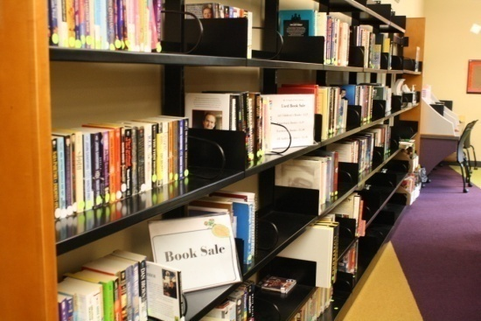
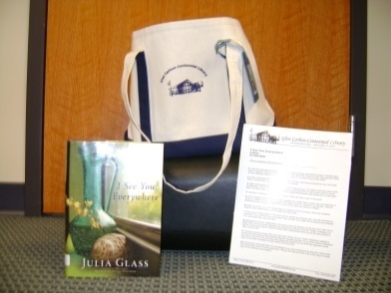
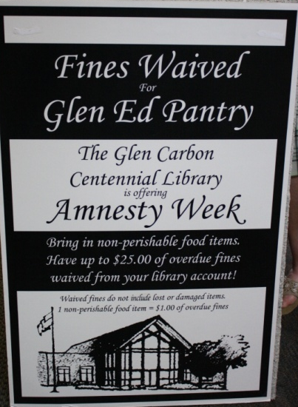
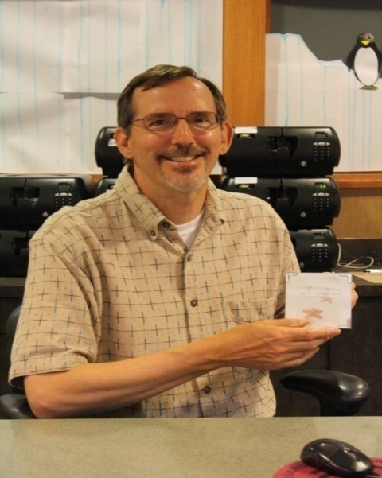
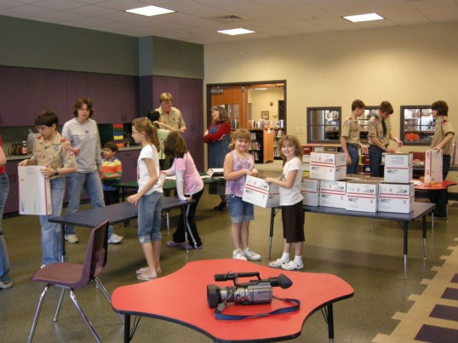
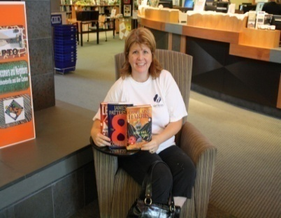
Amnesty Week
Book Club Kits
Adopt-A-Platoon
Gotcha Staff Awards
Adult Summer Reading Program

Slide 20
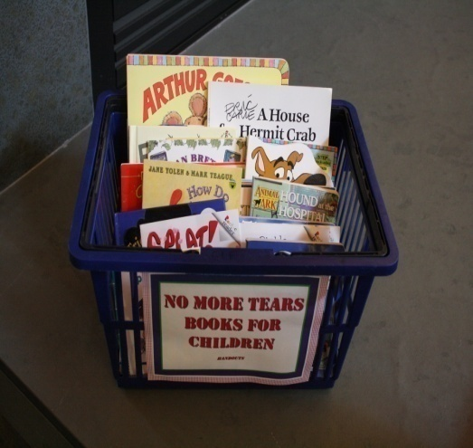
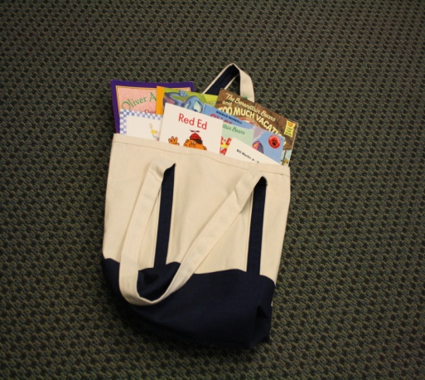
Police Car Book Bags
No Tears Children’s Books
Literacy Initiatives at Juvenile Detention Center

Slide 21
Sustained Cooperation with other libraries

Slide 22
&
Bring in the Arts Kiosks Storytelling & Theatre
Arts & Crafts
Music & Dance

Slide 23
Partnerships with other agencies and businesses

Slide 24
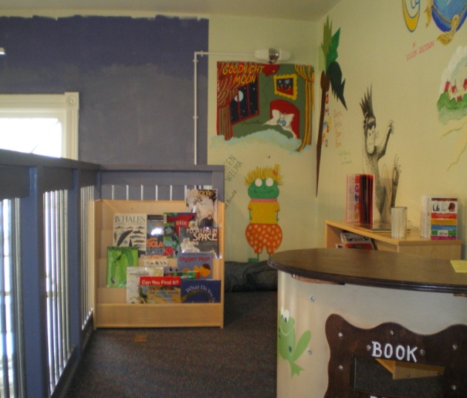
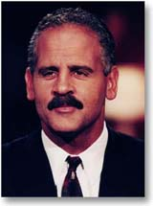
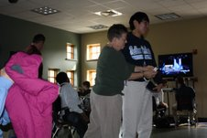
Ed-Glen Chamber of Commerce –
Chamber Leadership Speaker Series
Edwardsville Children’s Museum
Miniature Library
Senior Citizens Center
Senior Gaming Events
Videography and Digital Photography Classes
Madison County Juvenile Detention Center
Alice and Scratch Computer Programming Classes
All partnerships made possible with LSTA grant funding.

Slide 25
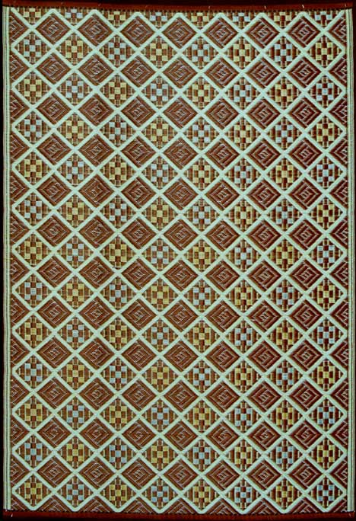
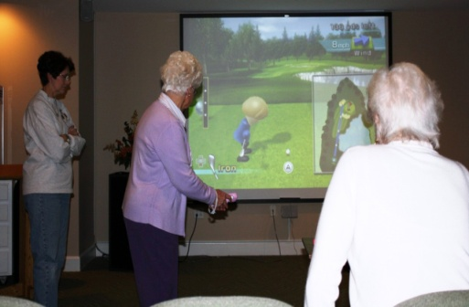
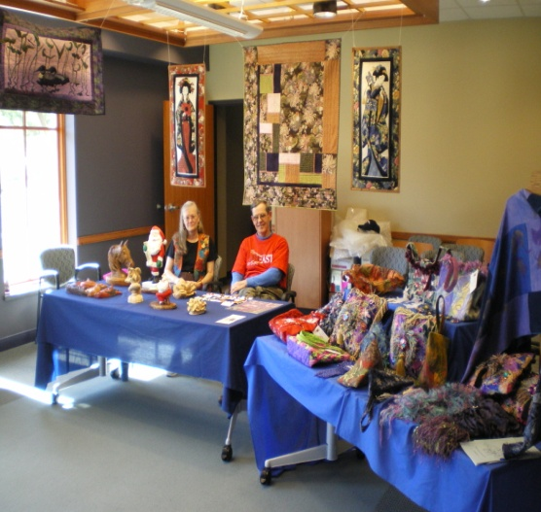
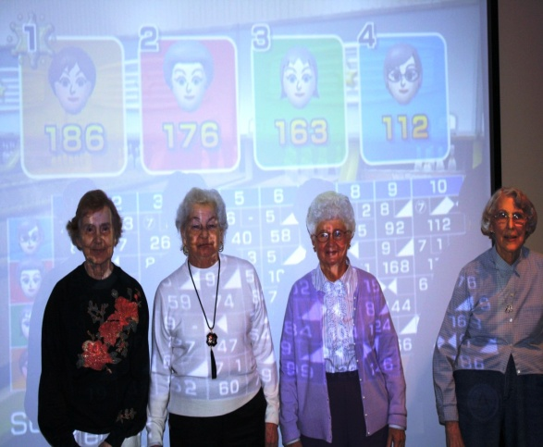
Partnerships in the Community
Library hosts artists for ArtEast – community wide art event
Pioneer Days – Library, School, & Museum
Business After Hours – Chamber of Commerce
Senior Memoirs- Southern Illinois University Edwardsville
Blood Drives – American Red Cross & Central Illinois Blood Bank
Senior Gaming Events – Eden Village & Meridian Village

Slide 26
Evidence of library’s role as community center

Slide 27
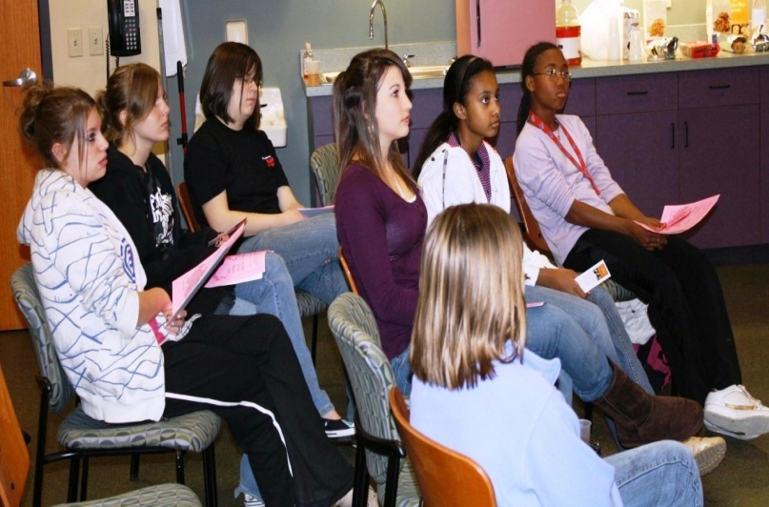
Homebound Delivery
CPR and First Aid Classes
Babysitting Classes
Illinois Treasure’s & Attorney General’s Office Workshops
Boy Scouts
Newcomers and Neighbors
Habitat For Humanity
Mom and Me

Slide 28
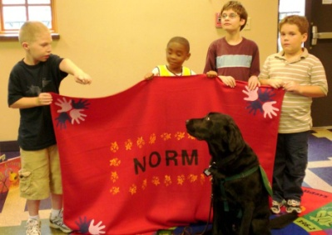
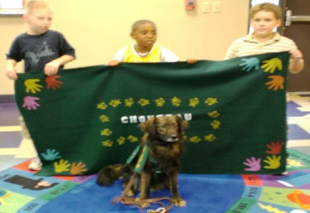
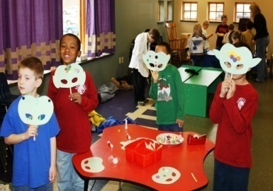
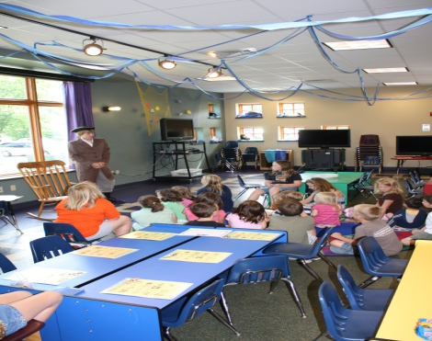
Princess Day w/ EHS Theatre Dept.
Citizen Me, Citizen Wee w/ Paul Simon Museum
Family Gardening
Art Classes
Santa and Mrs. Claus sponsored by Kiwanis
School Field Trips
Classroom Project Displays
Daycare Story Times
Free Comic Book Day

Slide 29
Increase in library usage,
particularly with new users

Slide 30
Peter Fletcher Guitar Performances
Author Book Signings and Talks
Book to Movie Nights
Adult Art Classes
Movie Talks
Book Club
Yoga Classes
Psychic Sherri Lynn
Life Writing Seminar
Veteran’s Day Display
Genealogy Workshops
Nat’l Lib.Week Celebration
Handwriting Analysis

Slide 31
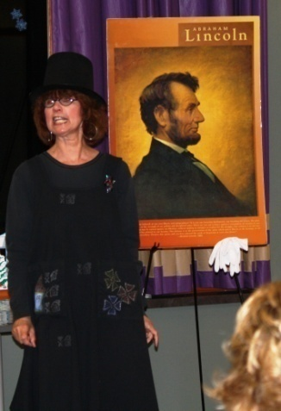
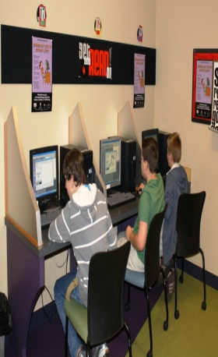
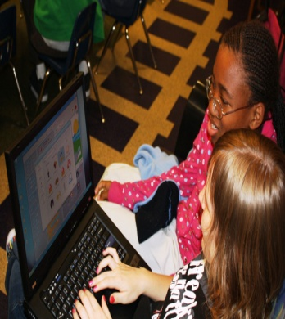
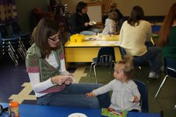
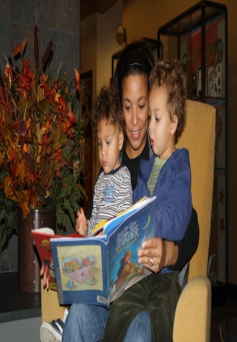
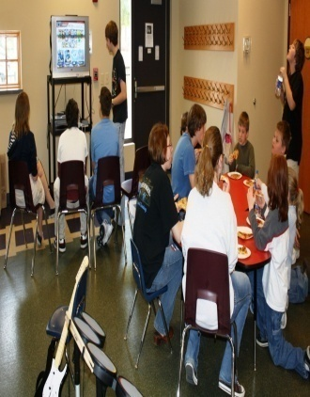
Home School Book Club
Summer Reading Program
Lincoln’s 200th Birthday Celebration
Junior Friends of the Library
National Gaming Day
Teen Computer Programming Classes
Grandparent Bags
S.I.C.K. Bags
Family Reading Night
Teen Read Week

Slide 32
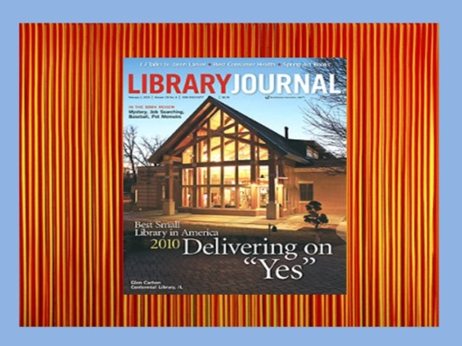
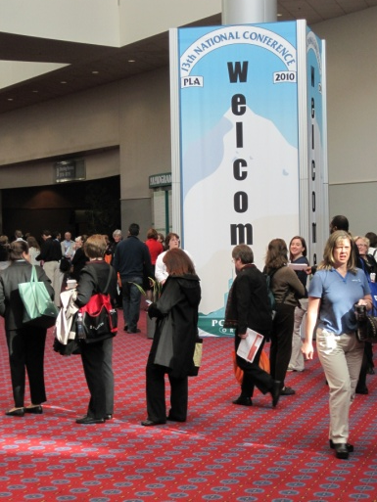
WHAT WE GOT!
$15,000 CASH AWARD
FEATURE STORY IN LIBRARY JOURAL
PLA MEMBERSHIP FOR 2 EMPLOYEES
CONFERENCE COSTS FOR 2 EMPLOYEES TO ATTEND PLA – PORTLAND, OREGON
GALA RECEPTION @ THE CONFERENCE
Catered party for Staff & Personal Day

Slide 33
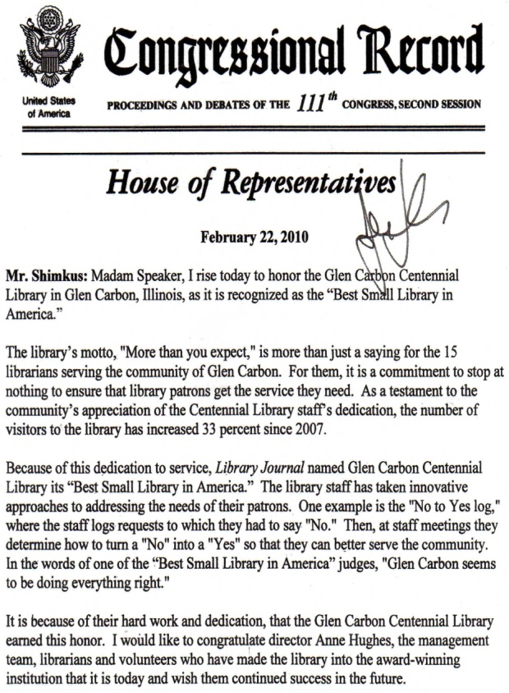
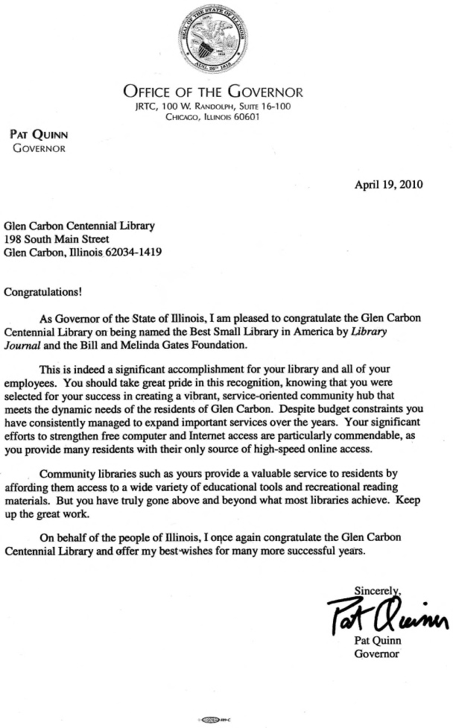
LOTS OF WONDERFUL PUBLICITY
U.S. CONGRESSIONAL RECORD & HOUSE OF REPRESENTATIVES Mentions
LETTER FROM THE GOVERNOR

Slide 34
Headlines…
Glen Carbon library ranked best in nation
Metro-East library wins national honor
Glen Carbon's Library Grabs National Award
Library wins title of "Best Small Library in America“
Glen Carbon Library wins national award

Slide 35
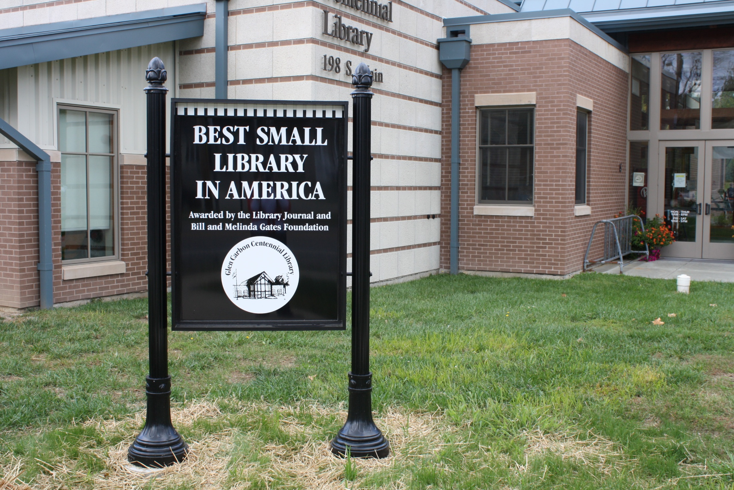

Slide 37
Your Library named
Best Small Library in America!

