Slide 1
Idaho Commission for Libraries
Partnering for Workforce Development in Idaho
State Librarian Ann Joslin
Presented by Teresa Lipus, Public Information Specialist
teresa.lipus@libraries.idaho.gov • 208-334-2150

Slide 2
ICFL Mission
The Idaho Commission for Libraries (ICFL) assists libraries to build the capacity to better serve their clientele.

Slide 3
Overview
A two-fold approach - Workforce development tools at public libraries - Broadband grant proposal
Workshops and Key Partners
Broadband Proposal Overview and Budget
Outcomes
Comments

Slide 4
A Two-Fold Approach
Fall 2009 Make available to Idaho public libraries workforce development tools—Idaho Career Information System (CIS) and IdahoWorks
Description: Offer CIS to public libraries and train staff how to use CIS and IdahoWorks effectively
Early 2010 Develop and submit Broadband Technology Opportunities Program (BTOP) proposal — “High Quality Public Computing in Idaho Libraries”
Description: Increase connectivity rates in least connected public libraries, upgrade public computing resources, and leverage partnerships to offer services in workforce development, education, and e-government
Notes:
A two-fold approach - Workforce development tools at public libraries The Commission began collaborating with the Idaho Department of Labor in the spring of 2009 to bring additional workforce resources to the citizens of Idaho through public libraries. In fall 2009, participating libraries received a year’s subscription to the department’s Career Information System (CIS) at no cost. CIS is a computerized system for career development where people can explore career opportunities and identify education and training opportunities.
Labor and Commission staff collaborated to train public library staff in eight locations throughout the state in the fall of 2009. Librarians were trained on CIS and the workforce development tool IdahoWorks. Job seekers can use IdahoWorks to create and update résumés, find jobs, and file benefit claims.
- Broadband grant proposal In early 2010 the Commission, in partnership with the Bill & Melinda Gates Foundation, developed a Broadband Technology Opportunities Program (BTOP) grant proposal (submitted to the National Telecommunications & Information Administration [NTIA]). The objectives of this BTOP project, “High Quality Public Computing in Idaho Libraries,” are to increase connectivity rates in Idaho’s least connected public libraries, upgrade public computing resources in those libraries, and leverage partnerships to offer services in workforce development, education, and e-government to library patrons statewide. The BTOP project has advanced to the “due-diligence” process, which will last about 3 weeks and includes a Supplemental Information Request with the reviewers’ follow-up questions. This is another step in the evaluation process, and does not necessarily mean that the Commission’s application will be funded.
The Commission plans to partner with community colleges, state government agencies, and non-profit entities to serve 376,512 underserved or vulnerable Idahoans—including low-income, disabled, rural, and unemployed populations.
NTIA intends to announce BTOP awards starting in June 2010, and to award all grants by September 30.

Slide 5
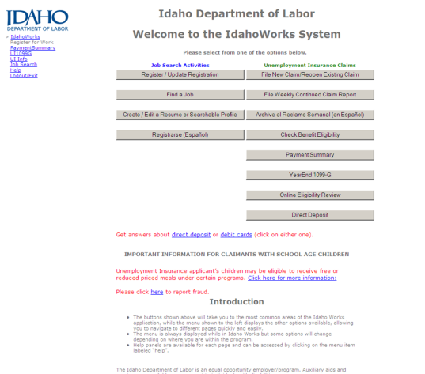
CIS/IdahoWorks Training
Fall 2009
17 training sessions
8 locations throughout the state

Slide 6
Broadband Stakeholder Workshop
February 2010: 26 partners and stakeholders gather face-to-face and remotely to help us focus and strengthen the programmatic elements of our broadband proposal

Slide 7
Key Partners
Workforce Development
Broadband Proposal
Idaho Department of Labor
Idaho Career Information System (CIS)
Bill & Melinda Gates Foundation
Department of Labor
IdahoPTV
Idaho Regional Optic Network (IRON)
Department of Education
PTE/Adult Basic Education
Idaho Digital Learning Academy
Community Colleges
Notes:
ABE-Adult Basic Education
CIS-Career Information System
IDOL-Idaho Department of Labor IDLA-Idaho Digital Learning Academy
PTE-Professional Technical Education
Content providers
IRON-Idaho Regional Optical Network: Internet 2 K-12 Initiative(Internet2.edu)
IPTV- Idaho Public Television: Idaho Teachers Domain
Idaho Department of Education: Plato, Apangea tutor services

Slide 8
Broadband Project Overview

Slide 9
Broadband Proposal Budget
Overall budget: $2,850,346
Federal Grant request: $1,907,531
Match: $942,816 (33.1% match: both in-kind and cash from some of our state agency partners and the Bill & Melinda Gates Foundation; Commission's contribution is all in-kind)
Notes:
The project will be completed within two years (60% complete in the first year). The submitted project budget total is $2,850,347 and includes a Federal grant request of $1,907,531 and a total match amount of $942, 816.

Slide 10
Outcomes
Workforce Development
Broadband Proposal
Nearly 2,000 people logged in to CIS during first 6.5 months
CIS subscriptions to currently participating libraries to continue at no cost
CIS Public Access model available to all Idaho libraries in 2011
Due diligence phase
Even if project is not funded, we will expand resources to libraries through the partnerships we have established

Slide 11
Comments
“In stressed and challenged communities, the public library serves as a resource where people of all ages take part in their community and access information that can improve their life circumstances.”
– Alyce Kelley, Director, Emmett Public Library

Slide 12
Questions?

Slide 13
Comments-CIS and IdahoWorks
“Both the Department of Labor and libraries have been investing in technology. To combine those efforts is the way to make it the most cost effective…it brings more technology infrastructure to reach more constituents.” – Gordon Graff, Department of Labor
“I have assisted about 10 people with this website who have been seeking employment. The last group was a group of three older women who were looking for work and they all left with some idea of where they would be going and a hope for their future. This is a great website! I am having another training on May 20th.” - Linda Henderson Buhl Public Library
“It is great to hear that the access will continue free of charge after September!” – Camille Wood, Nampa Public Library

Slide 14
Comments-Broadband proposal
During the past year the [Labor] department dedicated resources to provide Career Information Service licenses to public libraries in Idaho and to provide training to library staff on CIS and our IdahoWorks services. We believe the BTOP will allow us to greatly expand and enhance this positive partnership with libraries to expand service accessibility, particularly to our rural customers. - Rodger B. Madsen, Director, Idaho Department of Labor
Through this grant the Commission will be able to expand effective educational programs to public libraries so students have access outside of school….The Broadband Technology Opportunities Program (BTOP) Grant would greatly help expand broadband in education efforts to ensure students have access through the community. -Tom Luna, State Superintendent of Public Instruction

Slide 15
Comments-Broadband proposal
“In stressed and challenged communities, the public library serves as a resource where people of all ages take part in their community and access information that can improve their life circumstances.” – Alyce Kelley, Emmett Public Library Director
“Computer access at the libraries is a key component for the sustainability of our rural communities, as a place where people can go for government information, for home-work assignments, for doing their business and banking, for keeping in touch with the troops overseas, for job search, training on using computers and the skills needed for the 21st Century.” - Mike Field, Idaho Rural Partnership

Slide 16
Comments-Governor Highly Recommends Broadband Proposal
www2.ntia.doc.gov/comments

