Slide 1
Welcome!
WebJunction CQ Training - Creating an Event Listing
Why & How
Welcome

Slide 2
Today we will review:
Elements of an Event Listing
Recent examples of Event Listings on the live site
Workflow of creating & surfacing Event Listings

Slide 3
Events
Event details elements
Title
- Date and Time
- Short description (250 characters or less)
- Event Status
- Optional Registration Message
- Optional City, State, Venue and Venue Link
- Optional link to Registration form
- Long description
- Link to the archive
- Attached files for supporting materials

Slide 4
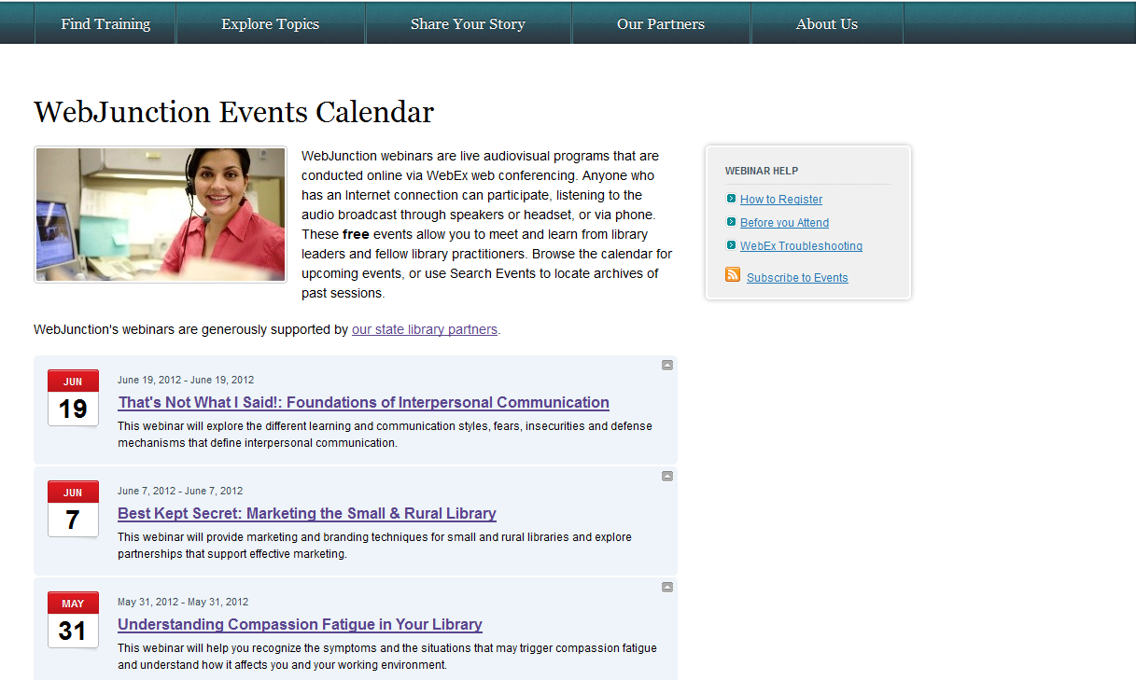
Events pages are a way to publish a calendar of upcoming events
in one central location & on specific topic pages.

Slide 5
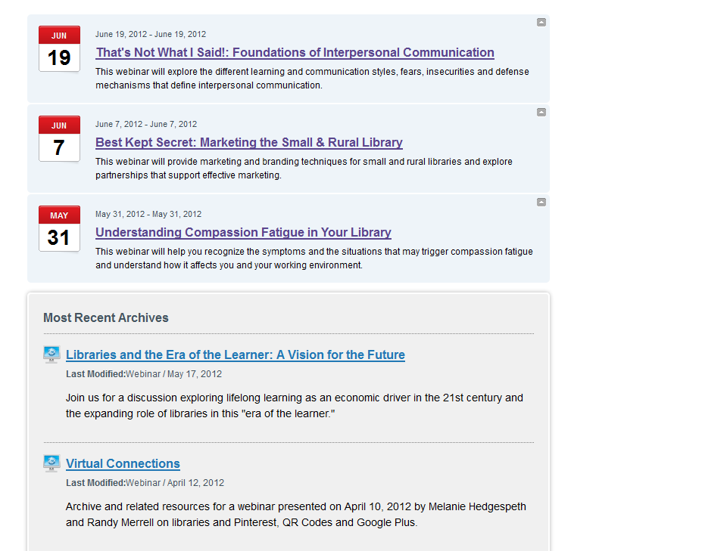
Examples
You can include both Upcoming Events and Most Recent Archives componentson a page

Slide 6
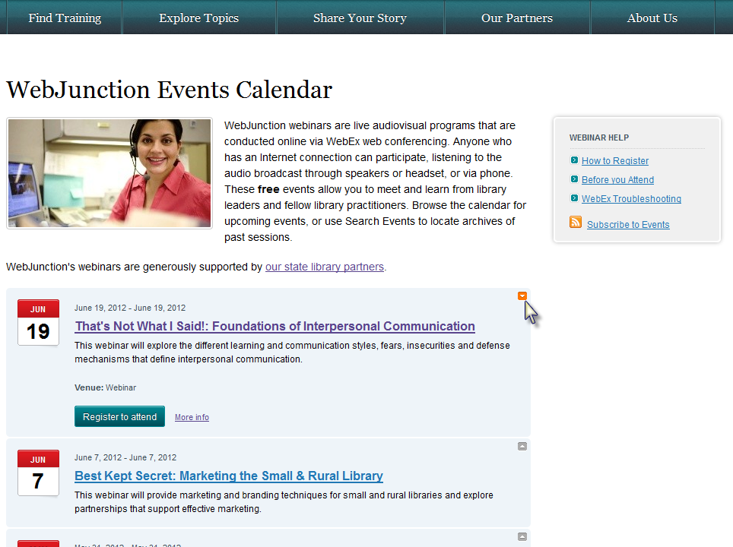
By selecting the arrow next to the event, you can expand the view for that listing and Register to attend or view More info about the event

Slide 7
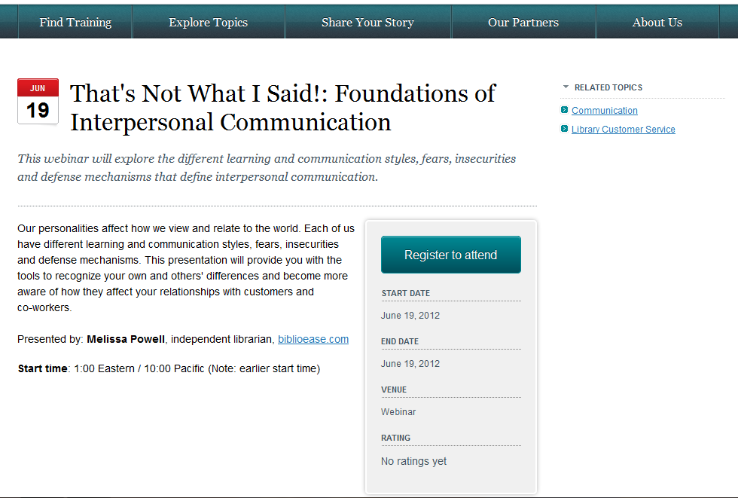
Selecting More info will take you to a new page view where you can read the full description and start time details.

Slide 8
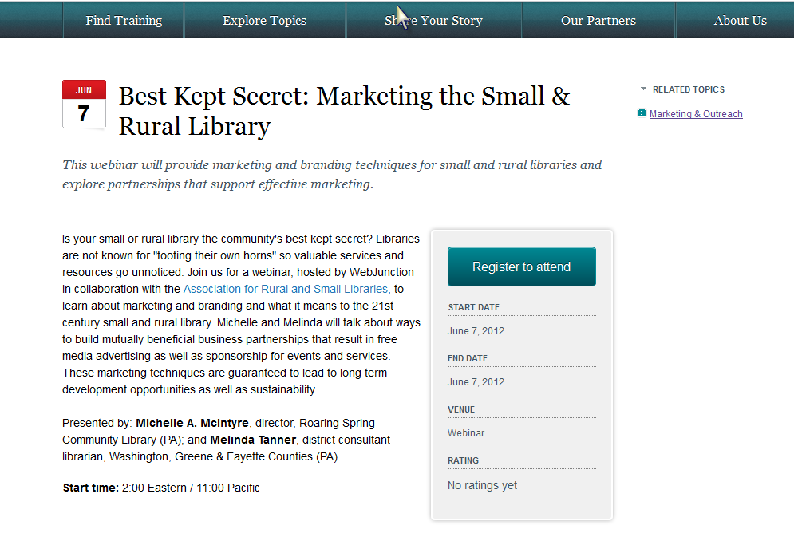
Examples
From the detail page of a specific event listing, you can view the Related Topics pages that correlate to the topic of your event.

Slide 9
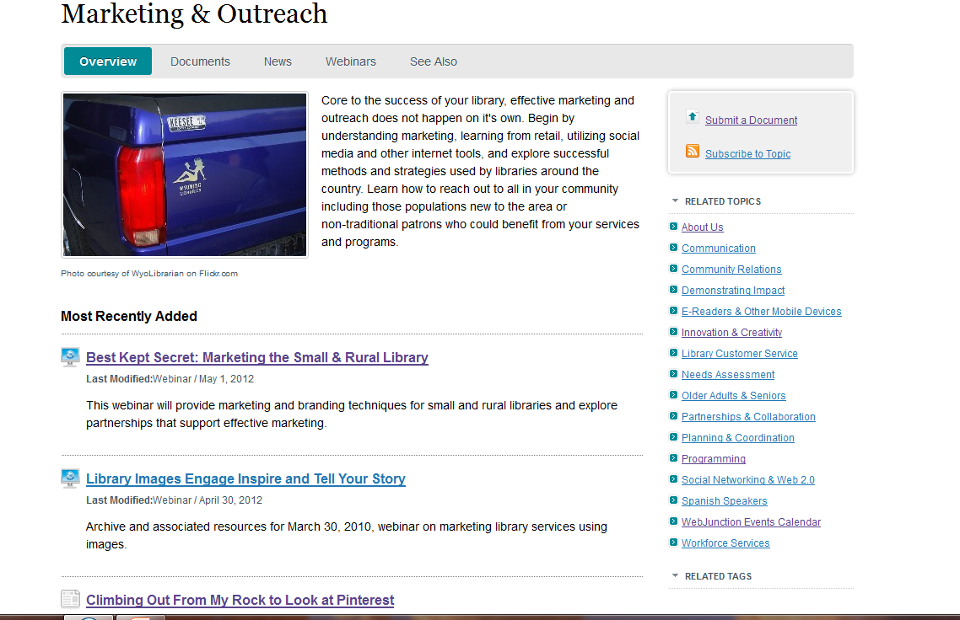
Examples
From a specific topic page, you can view Most Recently Added Events

Slide 10
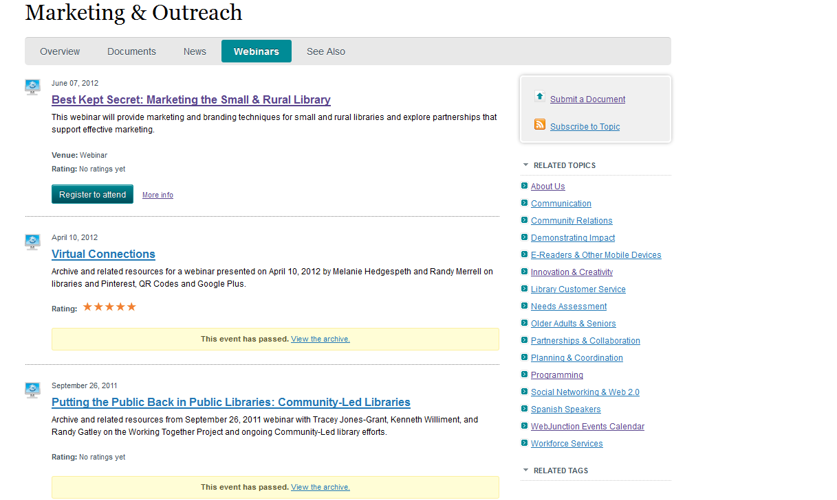
Examples
From the Webinars tab within a specific topic page, you can view both upcoming and archived webinars.

Slide 11
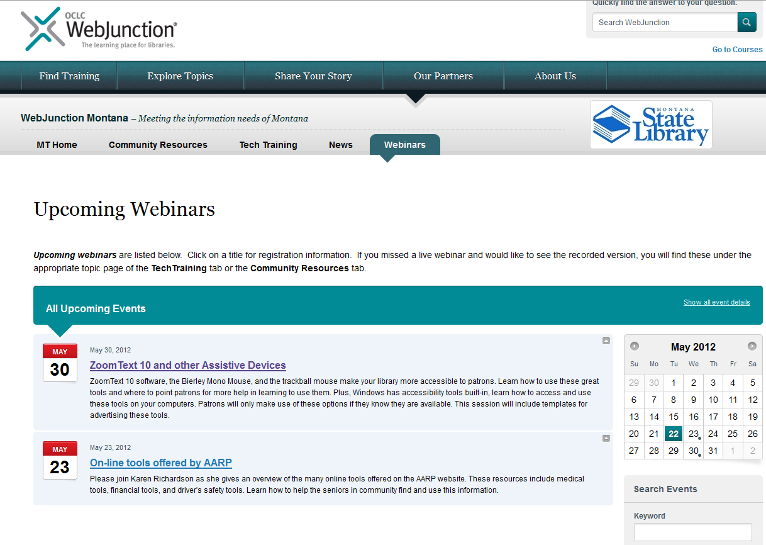
Examples
Here is an example of a state partner showcasing all of their upcoming webinars from a top level tab.

Slide 12
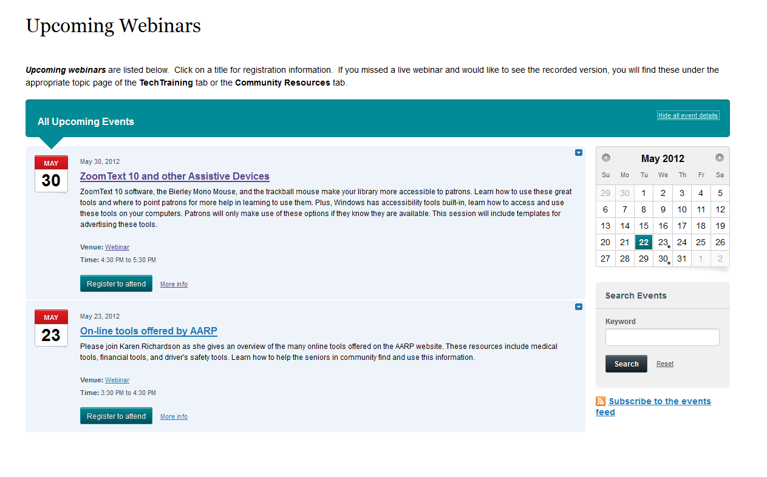
Examples
Selecting Show all event details allows you to view the Short Description, Time and Register to attend button.

Slide 13
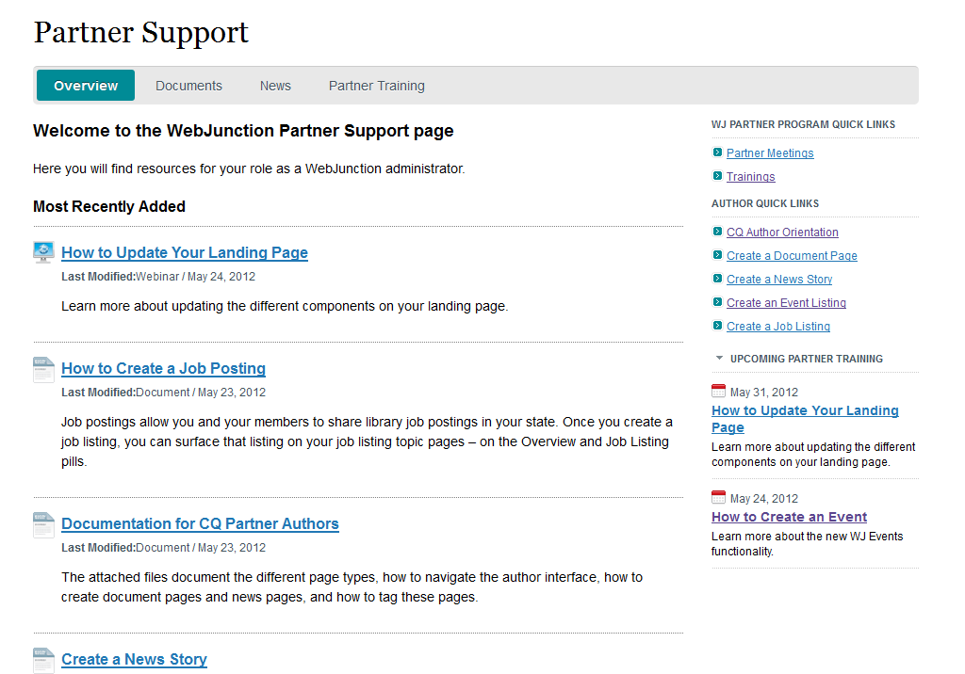
Examples
A list component can be added to your landing page to highlight upcoming trainings directly from that view.

Slide 14
Today’s Exercise
The steps to publish an event page are:
Create the event from the sample page
Create a unique title for page
Tag the page
Edit the content
Preview and activate

Slide 15
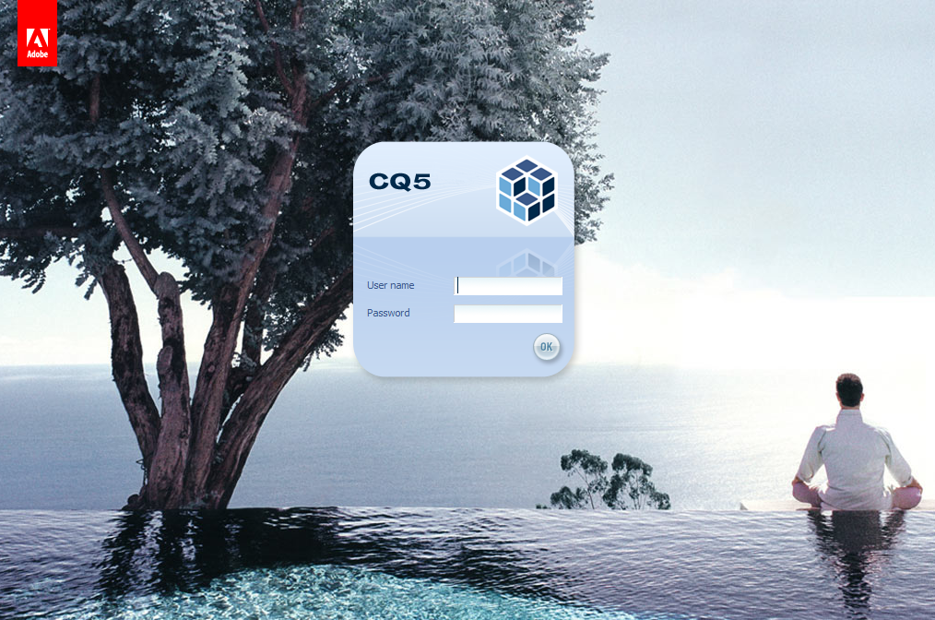
URL: https://cmsauthor-ext.oclc.org

Slide 16
Create an Event Listing

Slide 17
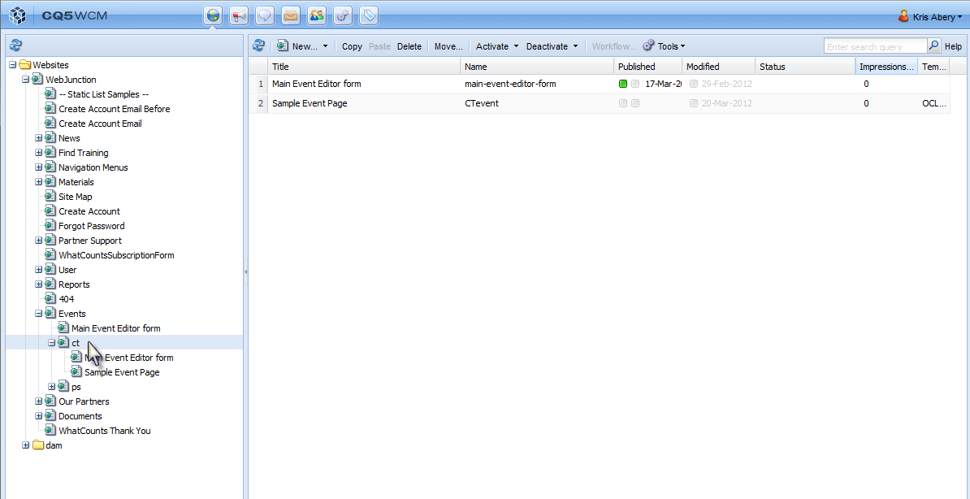
Navigate to Events node. Expand your state node.
Click on your state initials.
This will allow you to see all of your events pages in the center pane.

Slide 18
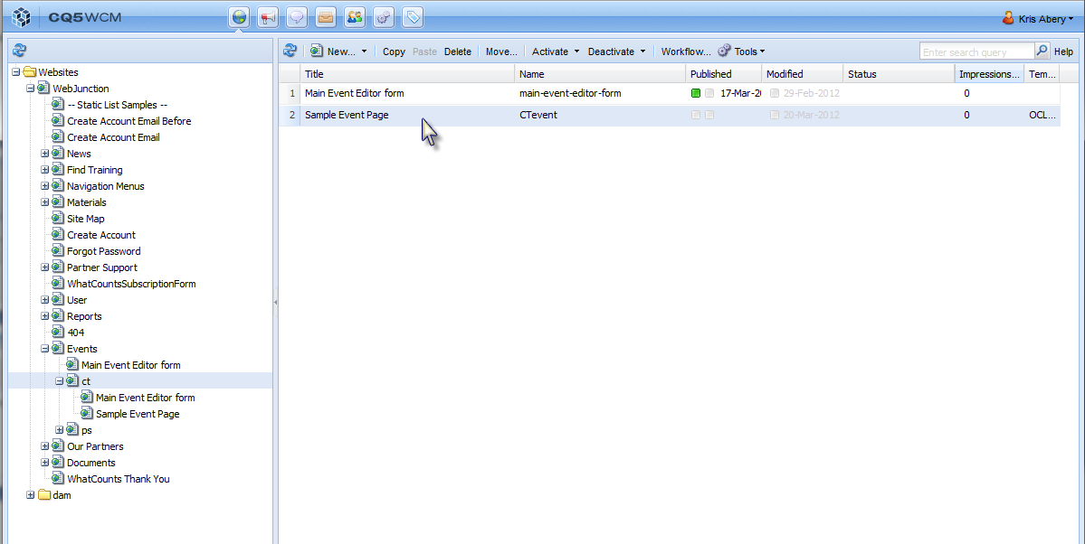
To copy an event page -Select Sample Event Page
-Select Copy

Slide 19
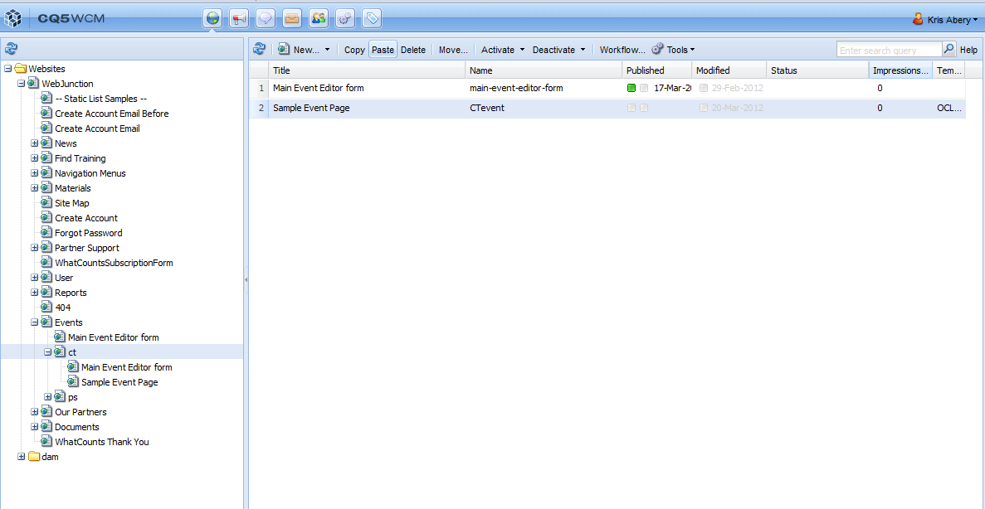
Then select Paste

Slide 20
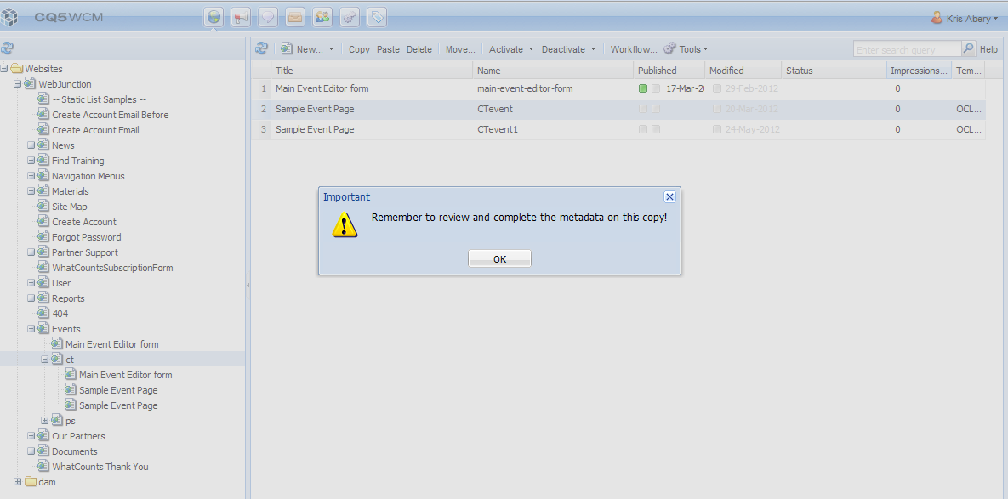
Select OK
You will need to update

Slide 21
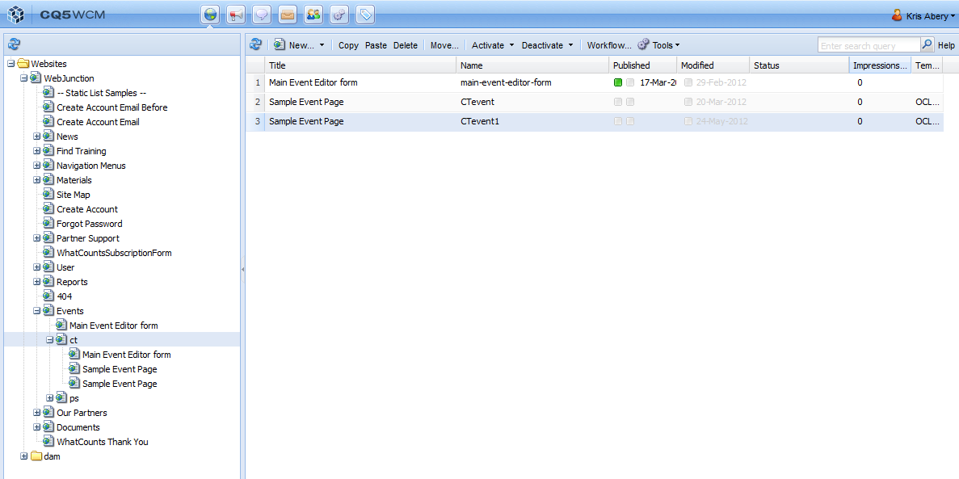
You now have an Event Page ready for editing.

Slide 22
Edit Event Page Properties

Slide 23
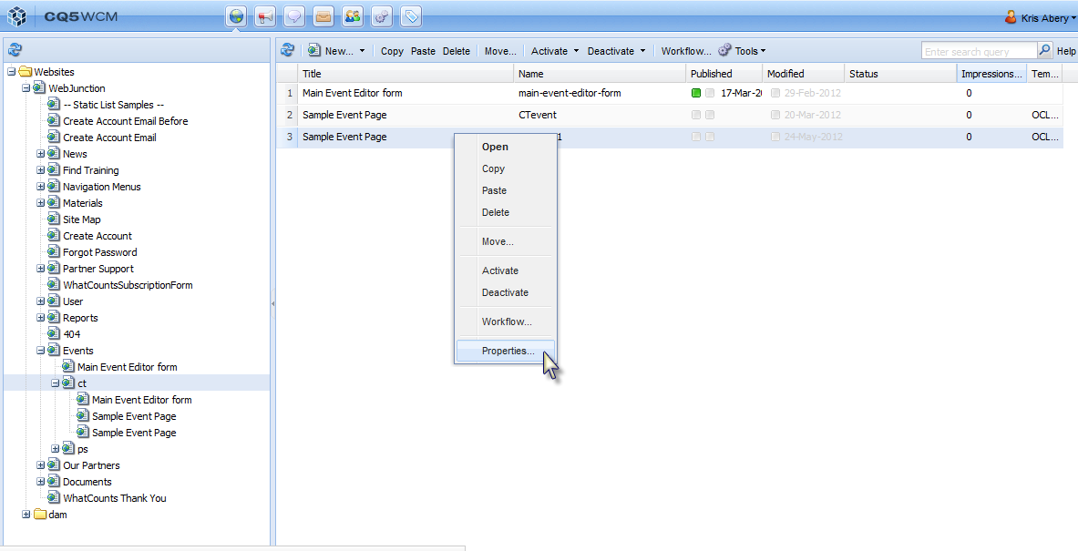
Change the Title & Add Tag to your Event - Properties

Slide 24
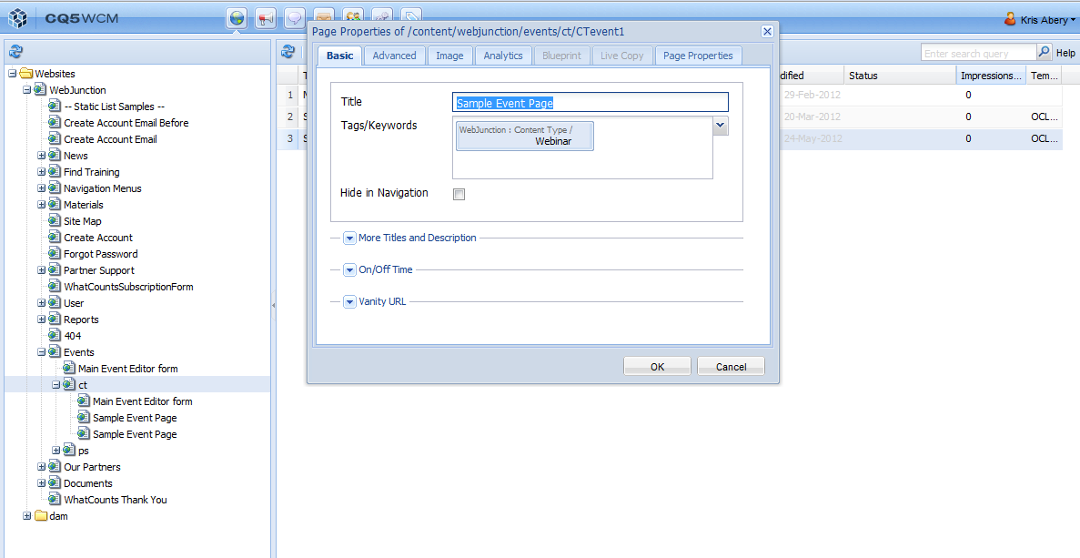
Update Title
the actual title of the event
Add Tags
- for the pages you wish to display the event on. By default, the Content Type / Webinar tag will already be set.

Slide 25
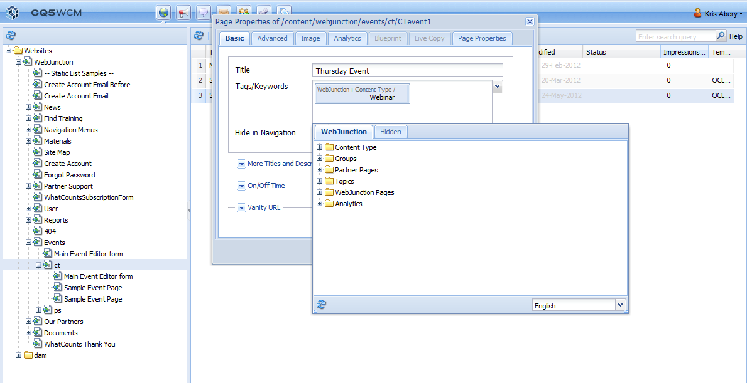
WebJunction Tags
Use the Partner Pages tags to match content page types (i.e. Webinar) with content aggregation pages (i.e. Sample Topic Page)

Slide 26
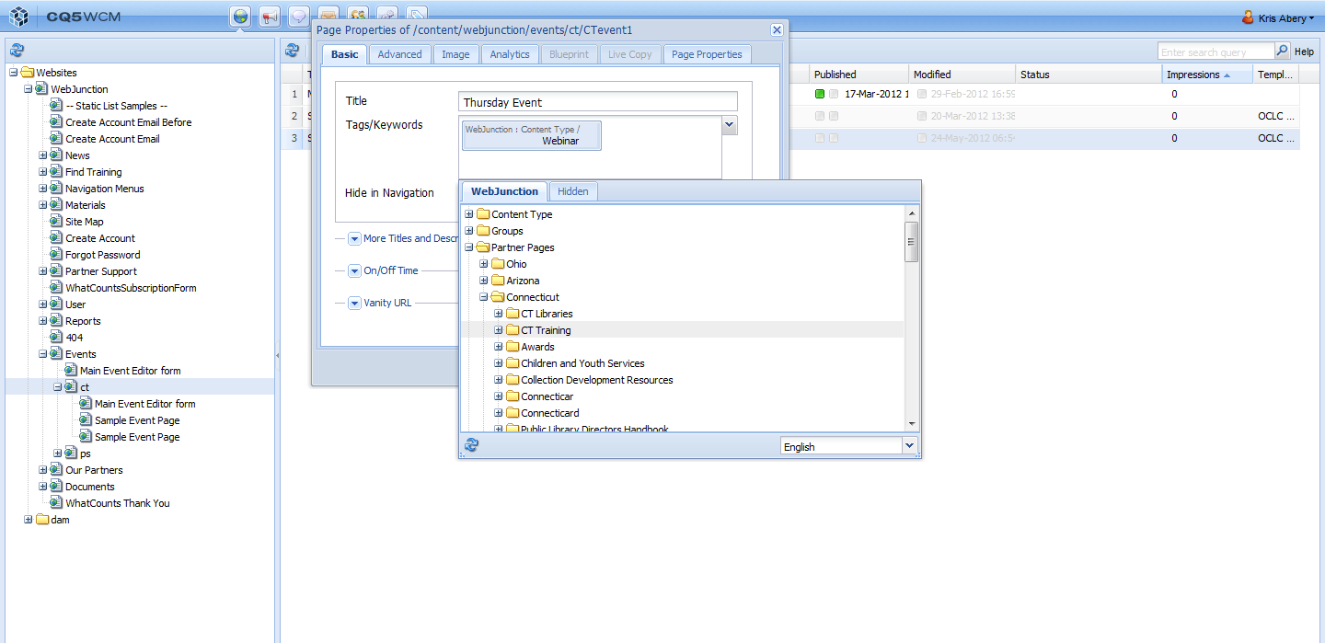
WebJunction Tags
Expand Partner Pages. Expand your state name. Then, click on the name of the page you would like this Event to surface (i.e. CT Training)

Slide 27
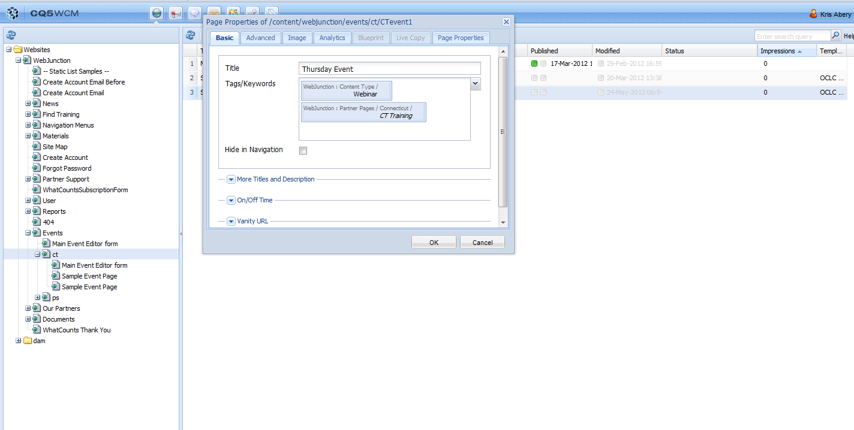
WebJunction Tags
- Content Type Tag - default
Partner Pages Tag - selected

Slide 28
Select OK

Slide 29
Edit Your Event Page Content

Slide 30
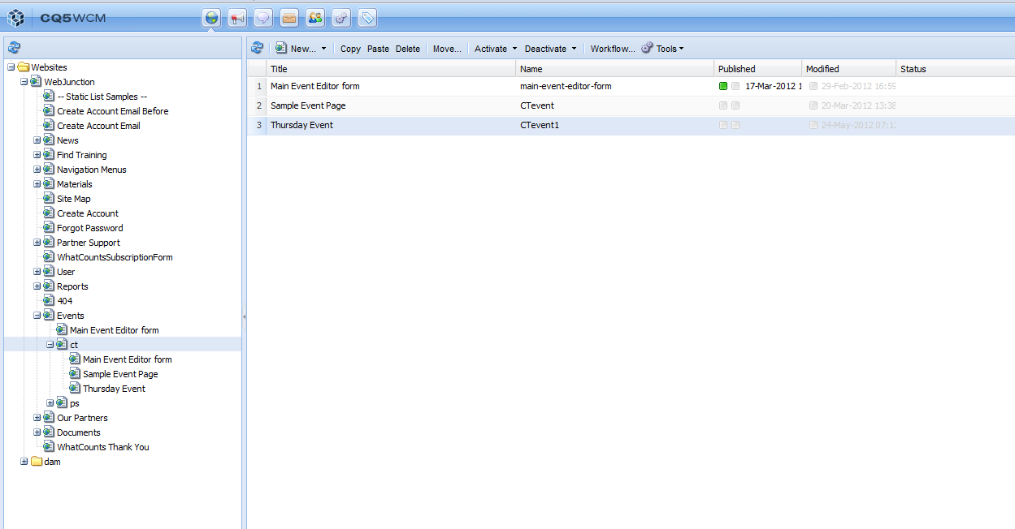
Open Your Event Page -Select the row you want to open.

Slide 31
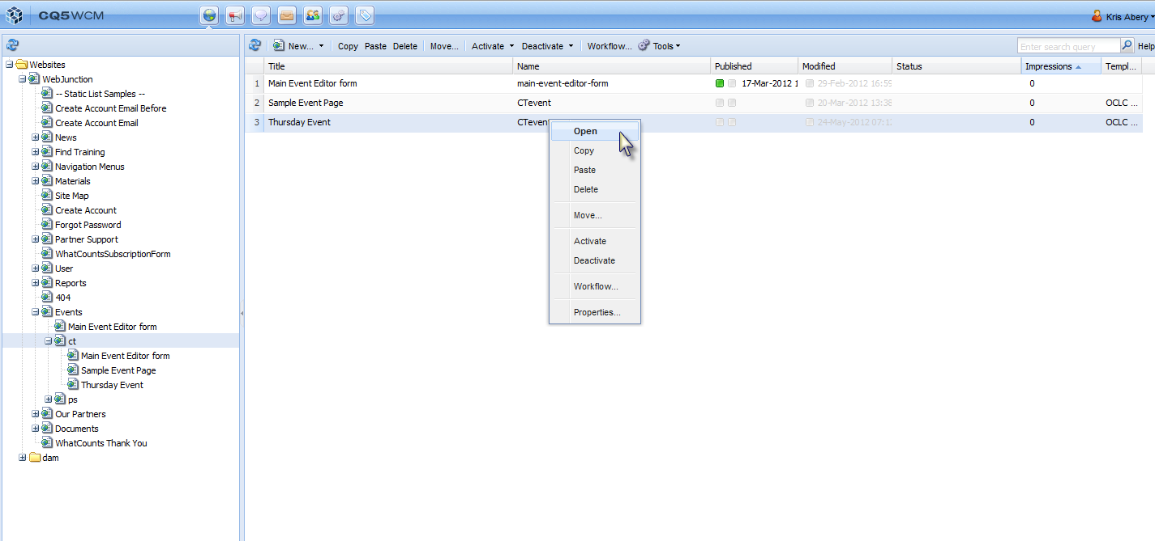
Open Your Event Page - Right click to select Open.

Slide 32
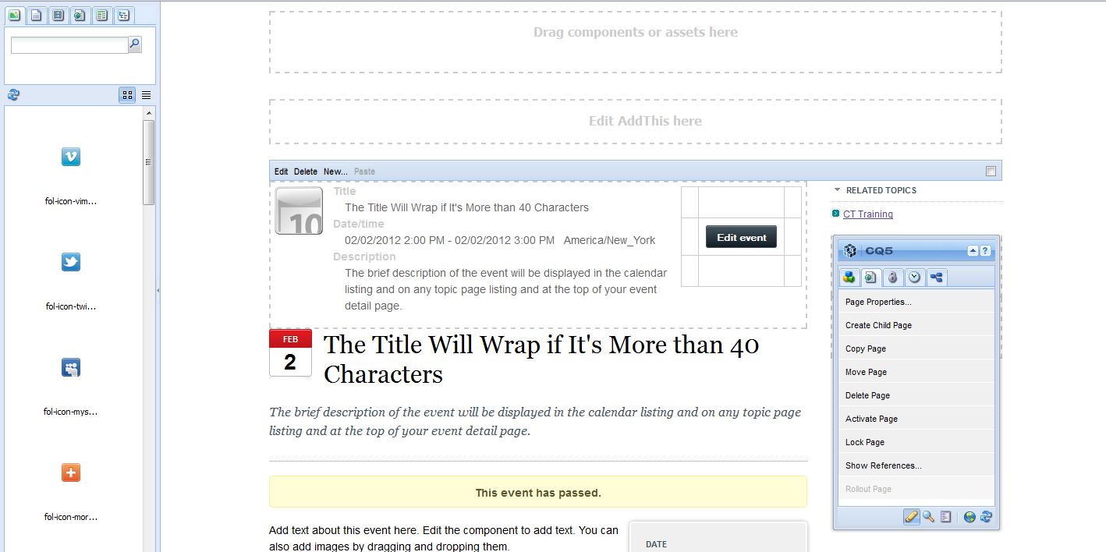
Your Page Opens in a New Tab -Select Edit Event.

Slide 33
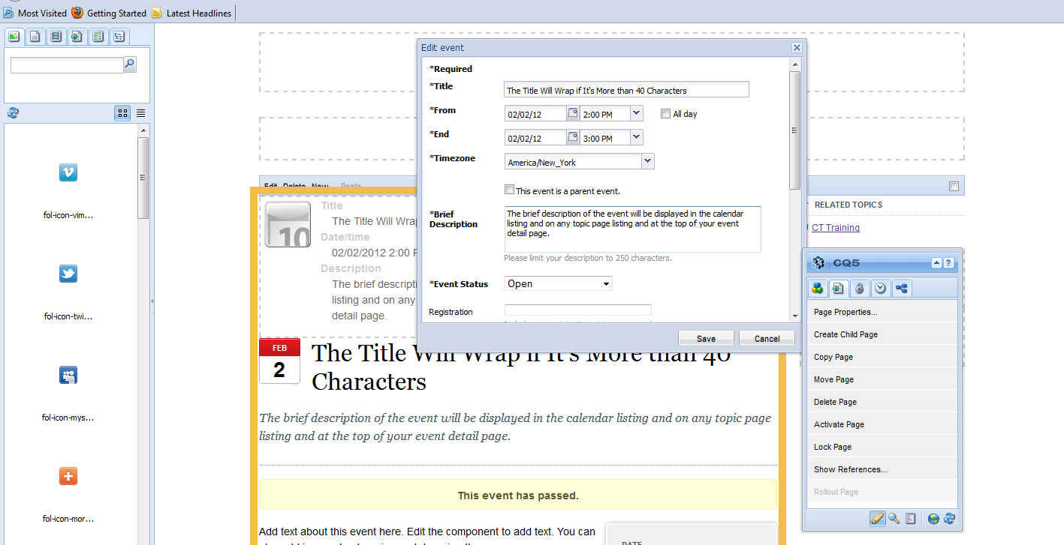
Enter your Event info (required) -Title
-Event Date (From/End)
-Timezone
-Brief Description
-Event Status (Ex. Open)

Slide 34
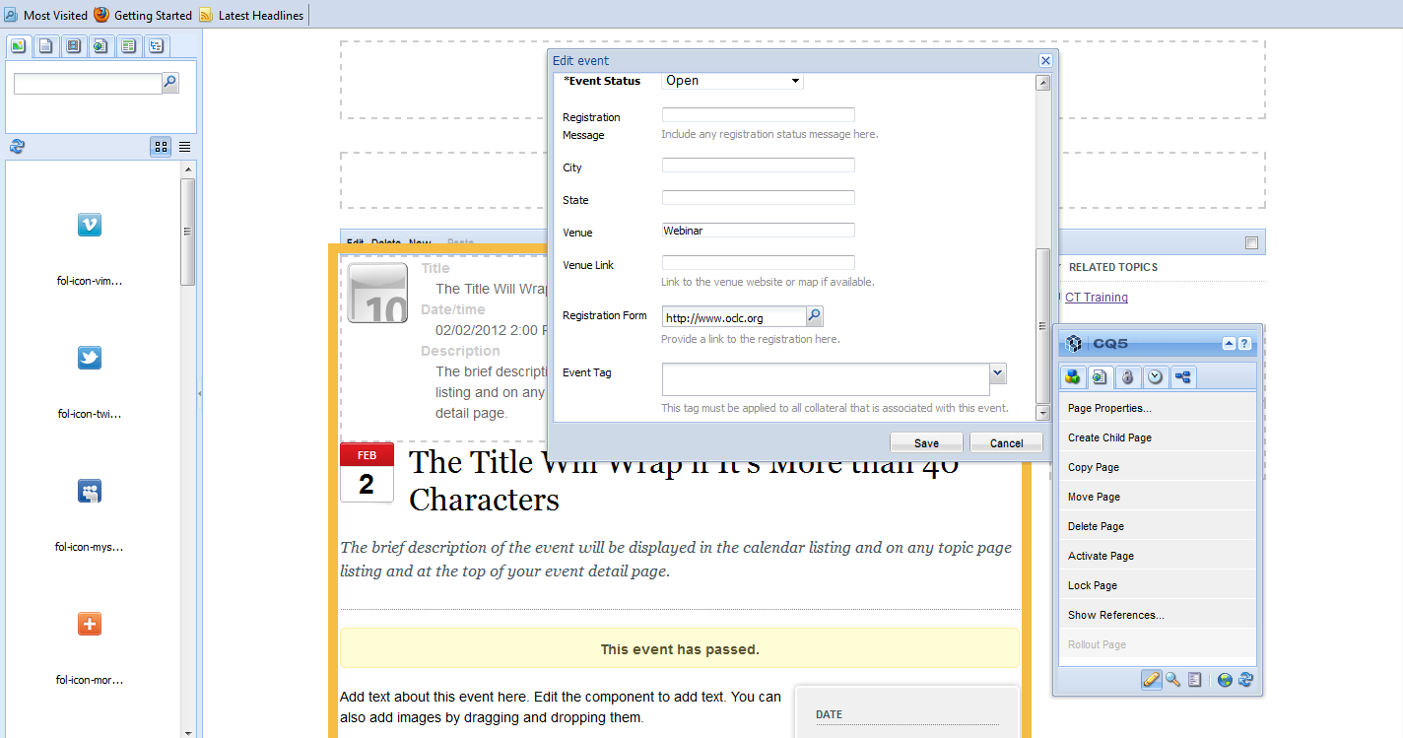
Enter your Event info, cont. (optional) -Registration Message
-City / State
-Venue (Ex. State library)
-Venue Link (state lib. website)
-Registration Form
Select Edit to begin editing the copy text

Slide 35
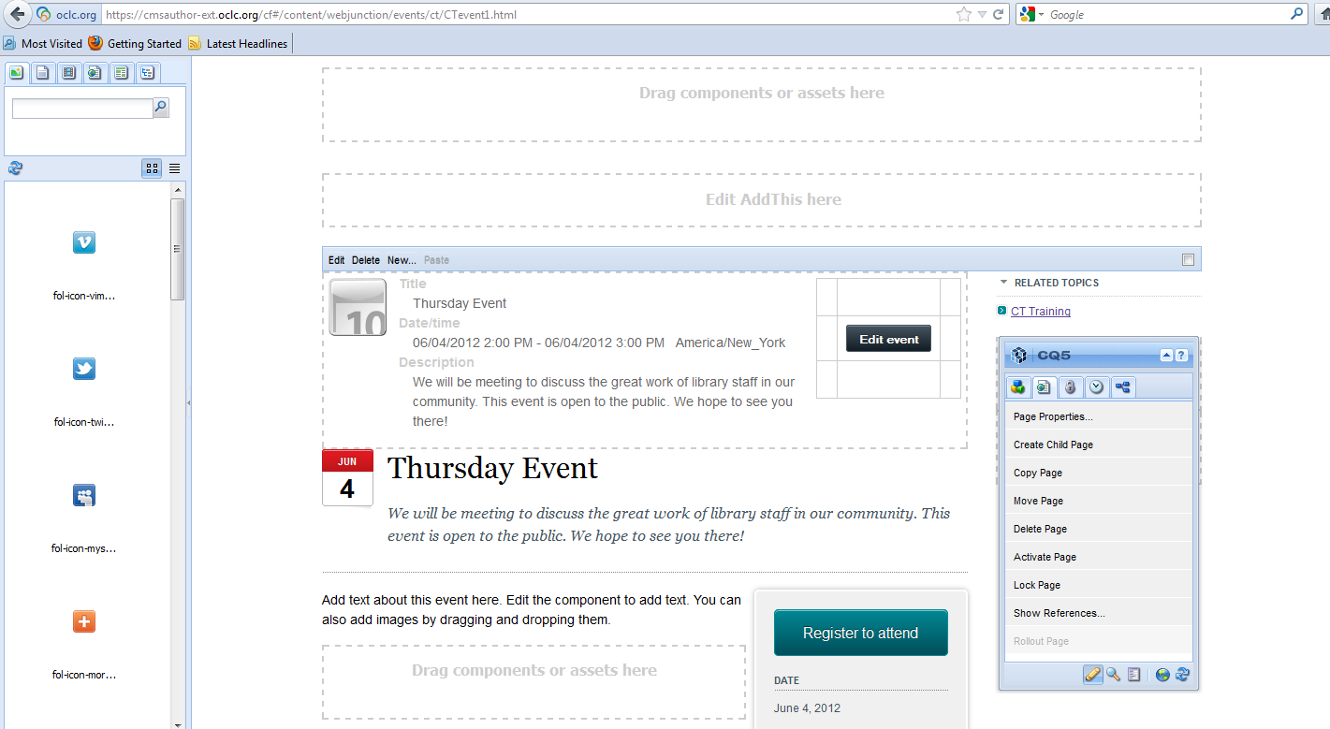
Once you select Save, you will be taken back to the Event Edit Mode and you will see your new Title, Event date/time, and Description.

Slide 36
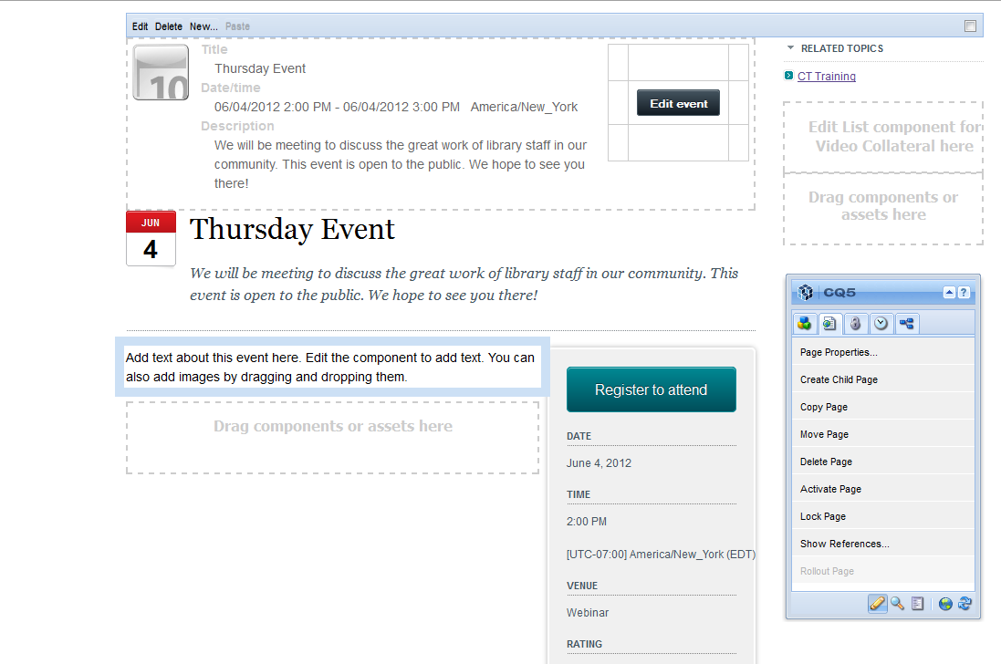
Place your curser inside the main Description component box and Right-click to Edit

Slide 37
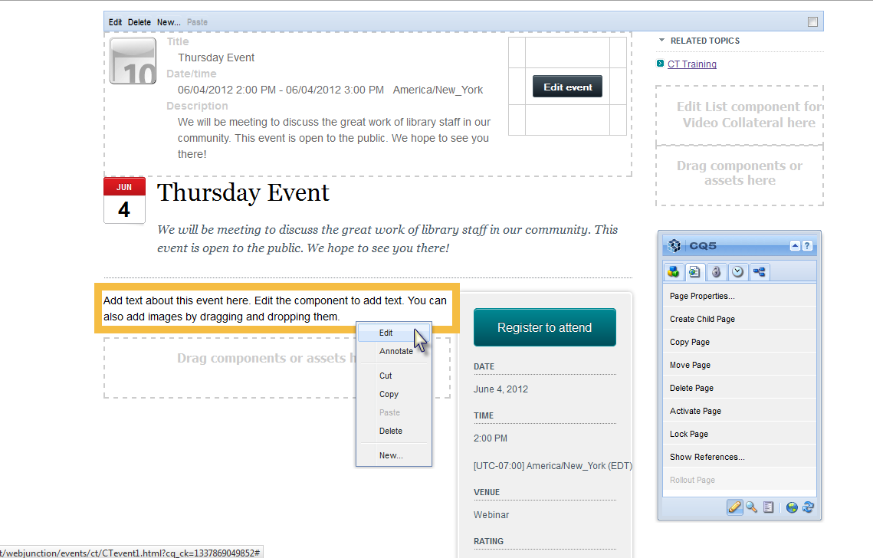
Select Edit to begin editing the copy text

Slide 38
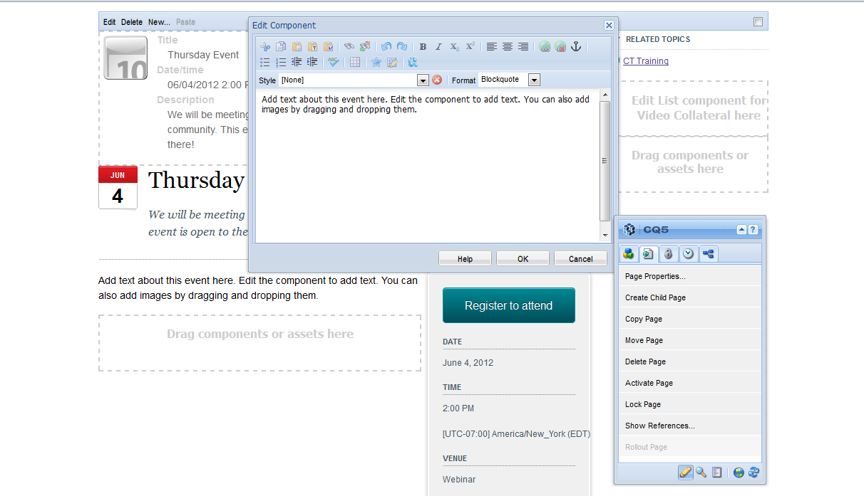
Enter the body of your Event Page Text
in the text editor and select OK.

Slide 39
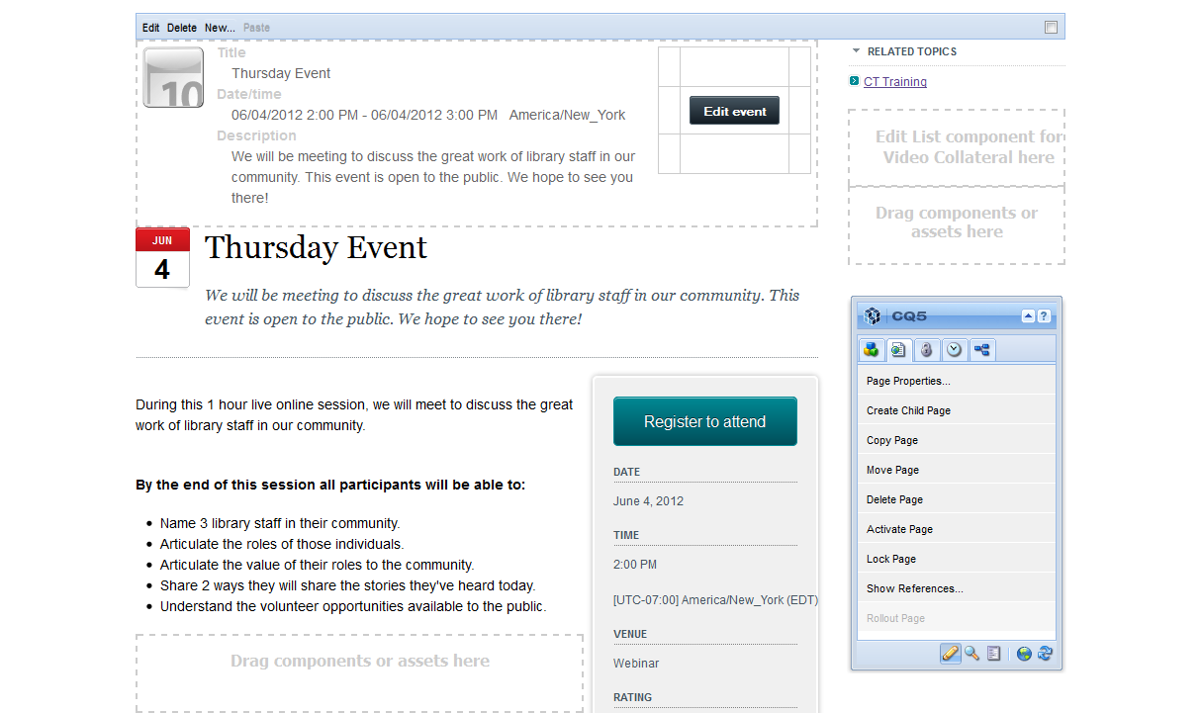
After you select OK, you will see your updated text.

Slide 40
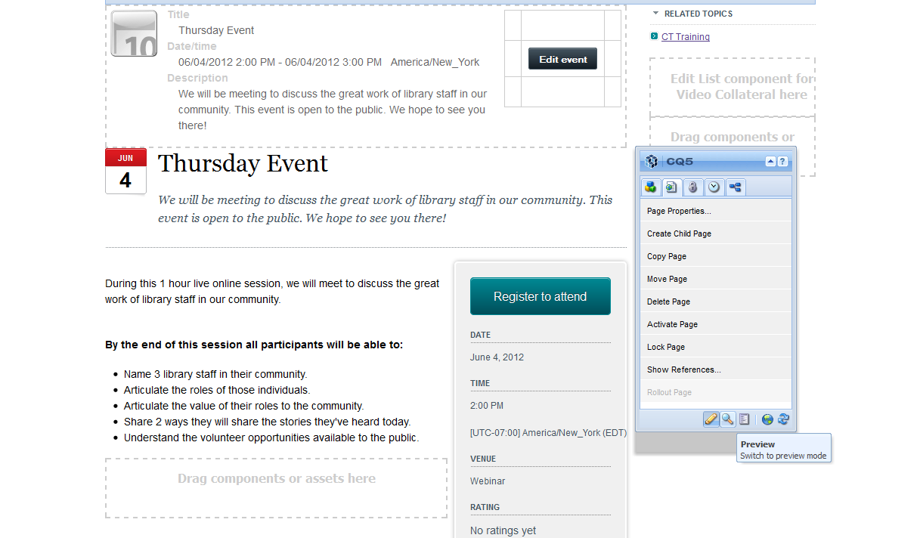
To Preview your new Event select the magnifying glass in the Sidekick

Slide 41
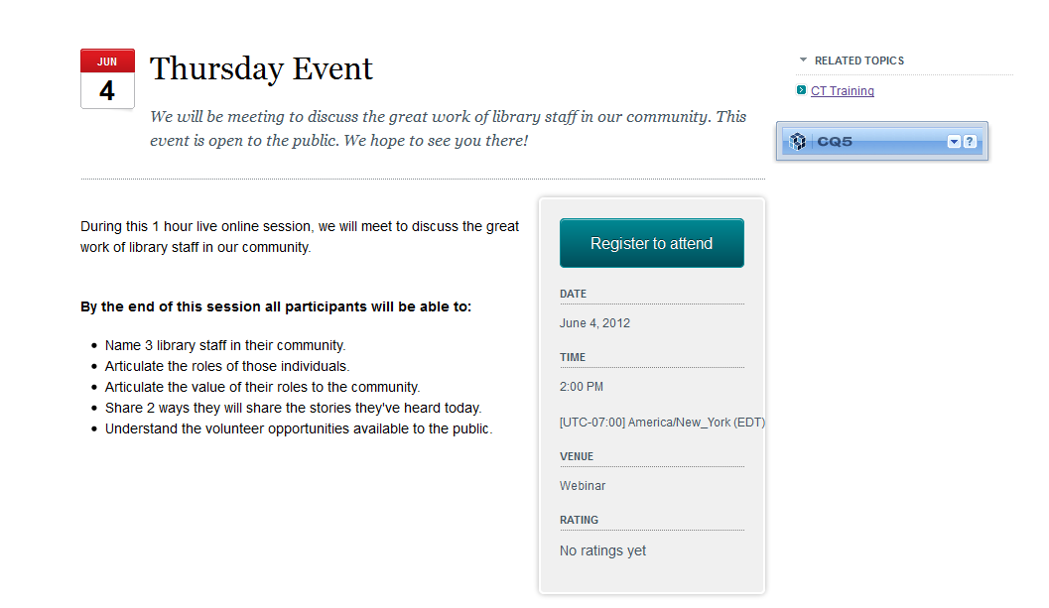
To return to Edit Mode click on the arrow

Slide 42
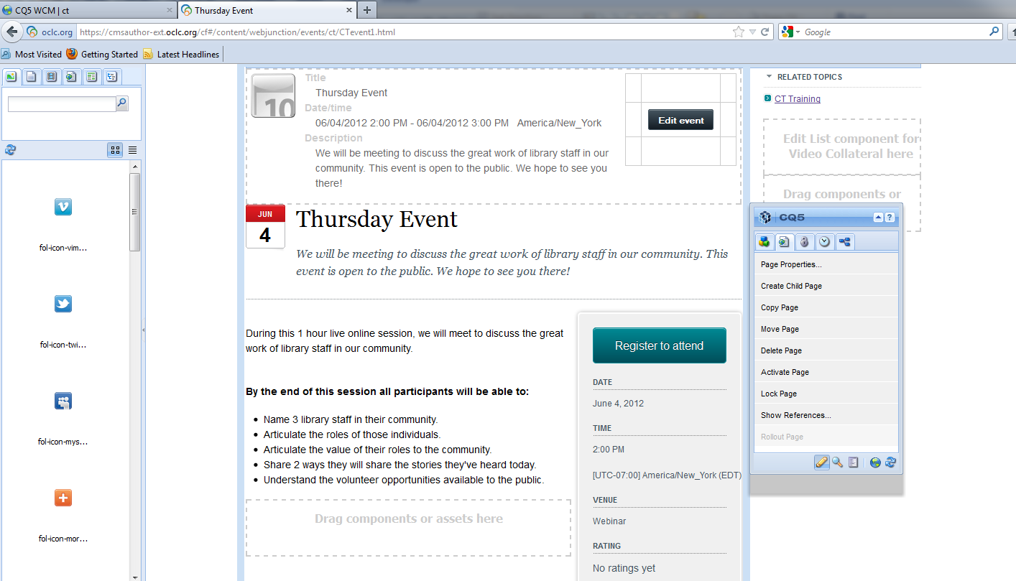
To return to Navigation View
close the tab

Slide 43
Confirm Event Surfaced

Slide 44
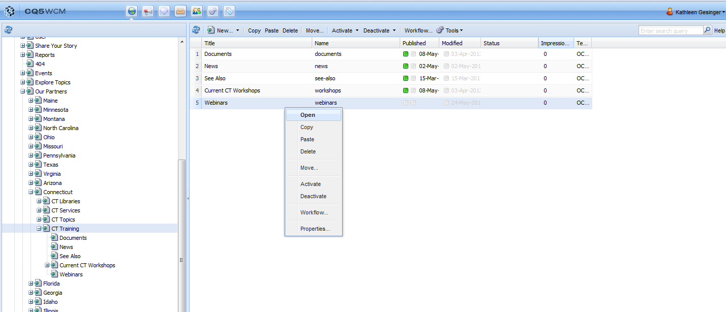
To confirm your Event has surfaced -Select topic page you want to open.

Slide 45
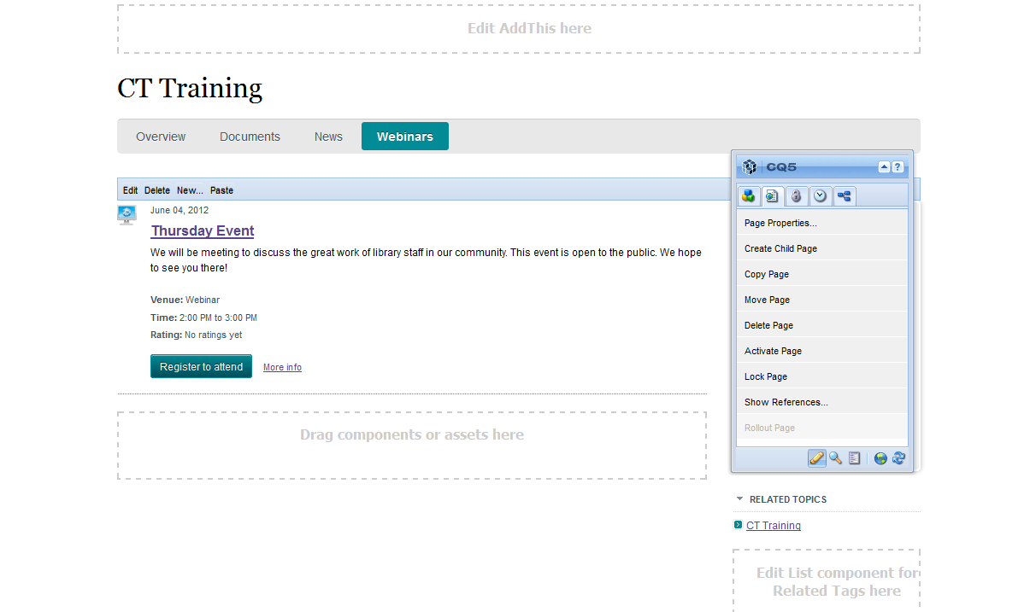
To Preview your new Event select the magnifying glass in the Sidekick

Slide 46
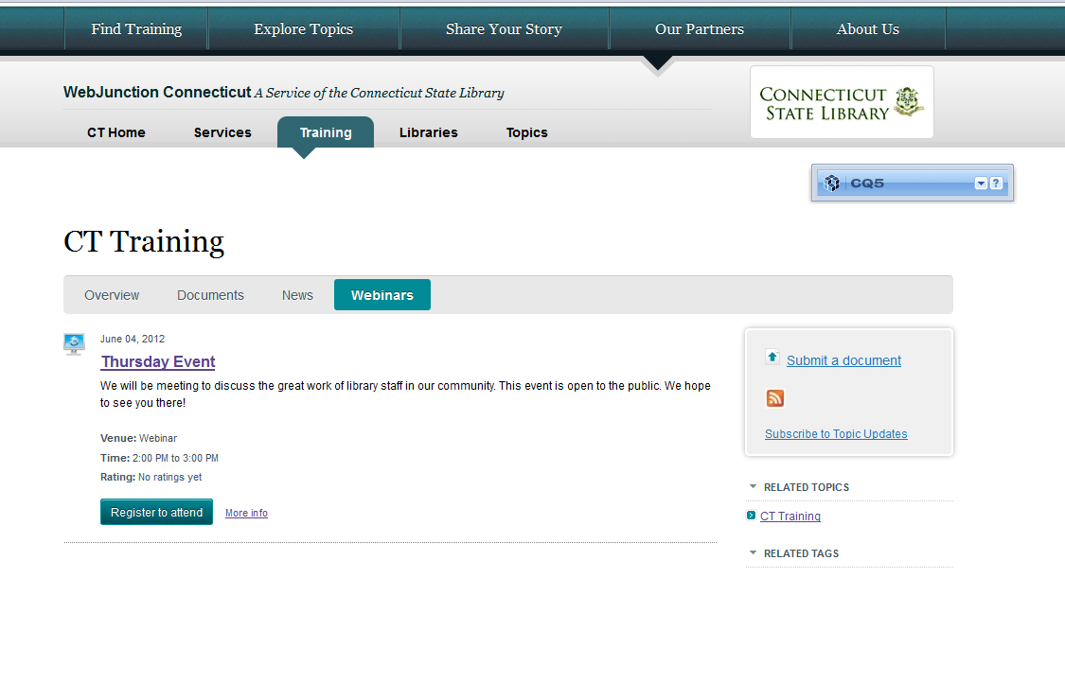
To return to Edit Mode click on the arrow

Slide 47
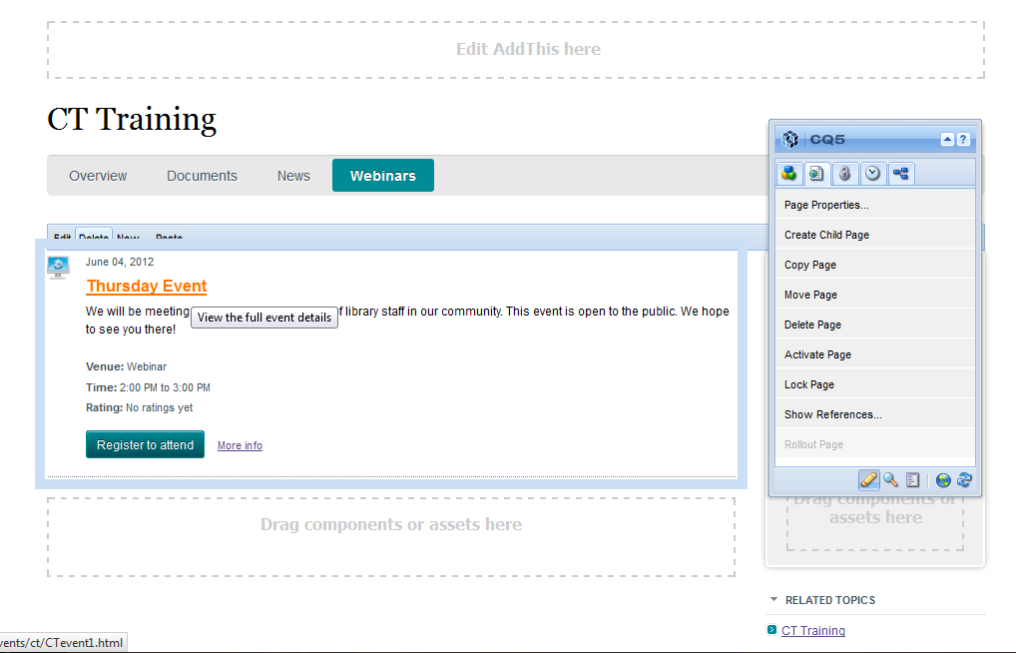
If everything looks good and you’re ready to publish, you can click on the Event Title

Slide 48
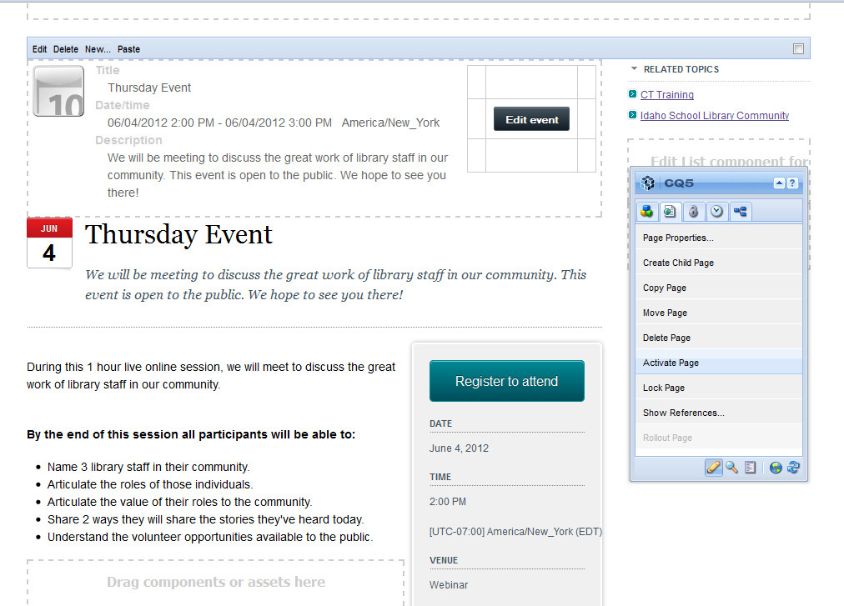
From the full Event Page, Select Activate Page from the Sidekick

Slide 49
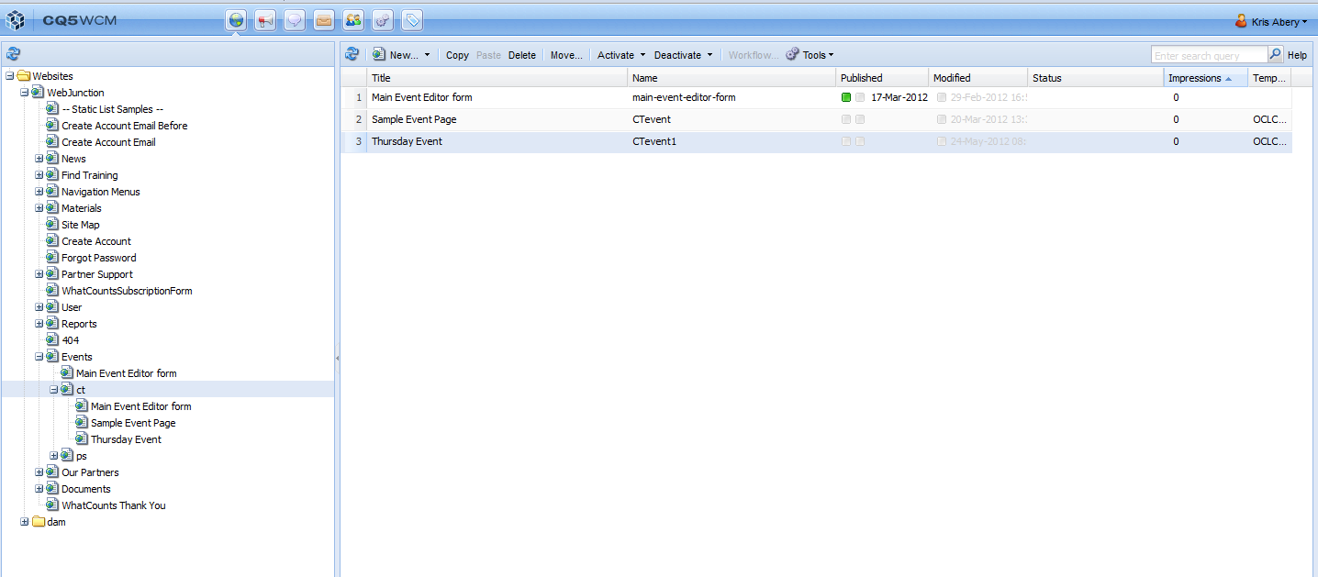
Or, Select Activate from the center pane of your Events navigation page.

