Slide 1
Project Compass: Libraries lead the workforce for the 21st Century
Notes:
Introductions
Logistics:
bathroom, breaks
packets: attendee list, reimbursement forms
workbooks

Slide 2



Project Compass is a partnership between WebJunction and the State Library of North Carolina.
It is funded by a grant from
The Institute of Museum and Library Services (IMLS).

Slide 3
Project Compass Year One
Libraries provide direction in tough times
Survey of patron needs and library responses
Summits with state agency staff (4 f2f, 1 online)
Launch “Workforce Resources” community of practice on WebJunction
Notes:
Goals of Project Compass:
Increase services to the unemployed
Promote strategic
partnerships
Foster collaboration and
knowledge exchange
between state and local libraries
Increase awareness of the critical role of libraries
Project Compass Year One
1. Conduct a survey of patron needs and library responses
An online survey collected data on increased patron demands on public libraries, libraries’ responses to those needs, and the state libraries’ support of the public libraries’ work.
The survey was sent to state library development directors (or equivalent) in 51 states in October. Read the summary of the survey results, published in December 2009.
2. Build curriculum and facilitate four regional summits
Between March and May 2010, we are offering four regional summits designed to build state library capacity for developing statewide partnerships and workforce development services.
Each state library will be invited to send two participants to one of the following summits:
March 10-12: Atlanta, GA
March 21-23: Portland, OR
May 5-7: Providence, RI
May 26-28: Denver, CO
3. Create and launch online community of practice and online summit module
An online version of the summits was developed on WebJunction, and offered in June 2010 for state representatives not present at a f2f summit
A community of practice for Workforce Resources is expanding with information.
All libraries are encouraged to contribute to the growing pool of resources.

Slide 4
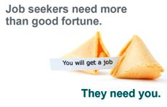
Project Compass Year Two
Libraries lead the workforce for the 21st Century
  Face-to-face workshops in areas with highest unemployment/highest need
  Other state and regional library conferences
  Online programming and curriculum
  Ongoing resource sharing on WebJunction
Notes:
Year two:
Based on rates of unemployment and the number of libraries within critical needs areas, to deliver local workforce recovery workshops to public library staff.
Deliver a “train-the-trainer” institute for trainers in 11 highest need states to deliver workforce recovery workshops in critical needs areas.
While local workshops will only take place in critical need areas, the program was designed to reach across the nation with support and resources for all public library staff serving the unemployed by:
Publishing workshop curriculum and all project materials on WebJunction.org
Producing local programs such as conference presentations at state or regional gatherings
Delivering free workforce recovery webinars.

Slide 5
The Library,
the Workforce
and the 21st Century
Notes:
An introduction to the IMLS 21st Century Skills Framework and its connection to libraries serving the needs of the workforce.
(see IMLS 21c report: http://www.imls.gov/assets/1/AssetManager/21stCenturySkills.pdf)
Project Compass is part of the IMLS Laura Bush 21st Century Librarian program, which means it is guided by the IMLS 21st century skills framework. The framework defines the critical role that libraries and museums play in helping citizens adapt to the fast-changing world we live and work in. Project Compass is particularly focused on how the framework aligns with libraries serving the needs of the workforce.

Slide 6
Project Compass
What are “21st century skills”?
Notes:
Question for audience: What do you think of when you hear “21st century skills”?
(collect popcorn responses and reflect on them; note if there is a predominance of technology-specific skills)

Slide 7
21st century skills for the workforce
Critical Thinking &
Problem Solving
Communication & Collaboration
Technology Literacy,
Media Literacy
Flexibility & Adaptability
Social & Cross-cultural Skills
Creative Thinking & Innovation
Productivity & Accountability
Teamwork
Global Awareness
What’s so new?
Notes:
These are 21st c skills identified by IMLS. This is not the complete list; these are the skills most pertinent to the workforce and their performance in today’s work world. How many times does “technology” appear? Only once! (complete list is on page 3 of the IMLS report)
You might be asking yourself “what’s so new about any of these skills?” It’s a fair question. All of these skills have been key to success for many years in some areas or professions, in particular, for those who work in libraries. Even the need to keep up with technology is certainly not unique to this new century.

Slide 8
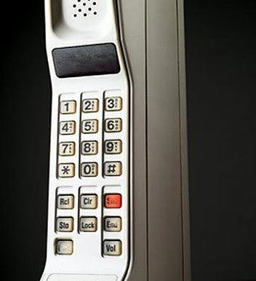
What skills do you need to use this 20th century piece of technology?
Notes:
Let’s look at a specific example. Does anyone remember the “brick phone”?
This is a mobile phone from the 1980’s – one of the first. If you were handed this phone, having never used one before, and told to place a phone call, I want you to imagine what skills you would need to operate this piece of technology.

Slide 9
What skills do you need to use this 20th century piece of technology?
Reading
Critical Thinking
Strong Forearms
Notes:
As you see, the numbers are clearly written on the buttons, so to place a call, you just need to be able to read and you will need some critical thinking skills to figure out the abbreviations (SND means send).
And yes, you will need strong forearms because these phones are HEAVY.

Slide 10

What skills do you need to use this 21st century piece of technology?
Notes:
Let’s say that you have never used/seen an iPhone before and you have to place a phone call using one. What skills do you need?

Slide 11
What skills do you need to use this 21st century piece of technology?
Problem Solving
Creative Thinking
Tech Literacy
Adaptability
Collaboration
Notes:
Problem Solving: Figuring out how to make it turn on!
Creative Thinking: Exploring the device and determining what the icons mean.
Technological literacy: Knowing what a touch screen is and how to operate it.
Adaptability: Learning to type using a touch screen.
Collaboration: finding someone else to help!
The transition from old rotary phones to touch tone to the “brick” phone happened in incremental steps. Then the technology took a leap to the smart phone.

Slide 12

Shift happens!
http://youtu.be/cL9Wu2kWwSY
Notes:
Aka “shift happens” video ---Several iterations of a video first released in 2007 by Karl Fisch, Scott McLeod, and Jeff Brenman
(Note: the sound track is all music so it’s not a great loss if you are unable to project through speakers.)
Some of the statistics are dated but the message remains powerful: the future is exponential!

Slide 13
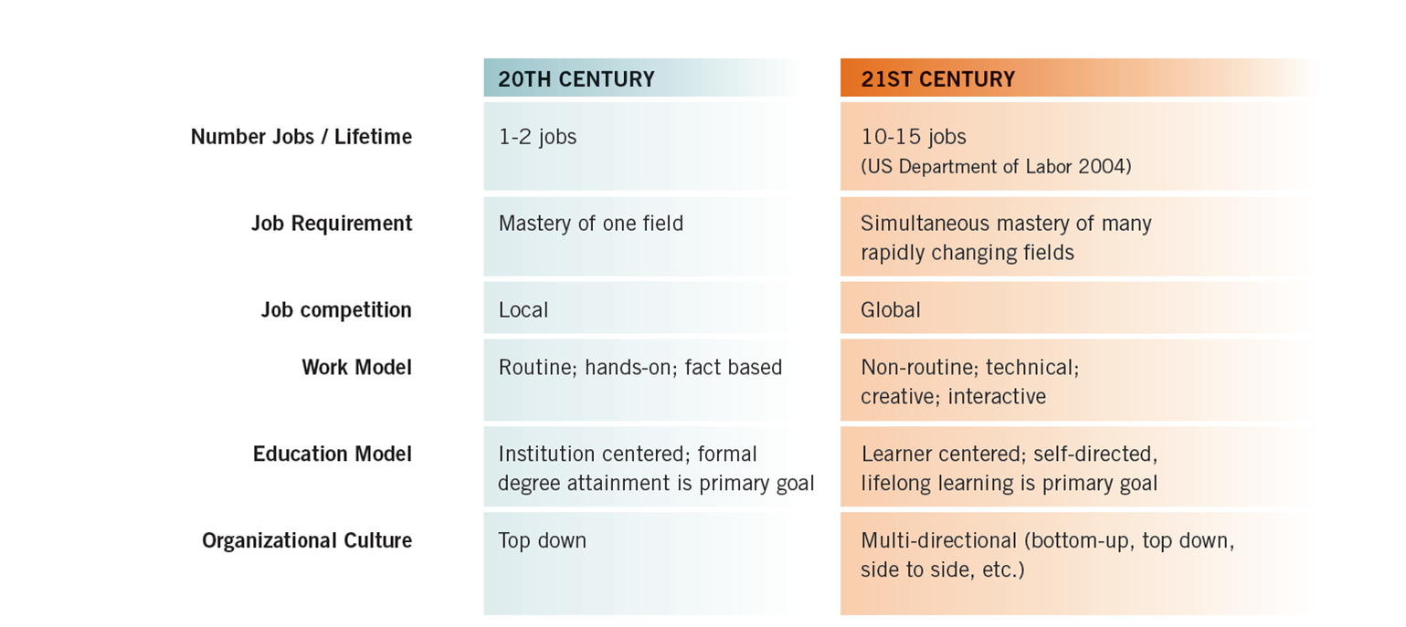
Shifting nature of the workforce
It’s a “globally interconnected information economy.”
Notes:
If making the switch to smartphones is a challenge, what does the bigger shift in demands for the workforce look like? This chart from the IMLS report sums up the shift from the traditional to the contemporary workplace.
(refer to 21st c Skills Bridge document –page 7 in the workbook. Note that the document correlates the IMLS 21c skills with a library’s responses to the needs of the unemployed)
Question for audience:
Looking at the list of 21st c skills, which ones are in increasing demand relative to the shifts in the workforce?
Example: what is the impact of holding more jobs in a lifetime? It could require heightened productivity, accountability, flexibility
Example: what about the move to non-routine technical work (work model)? It could require intensified abilities in creativity, teamwork, technology literacy
Example: the fact that job competition is now global requires a global awareness that may be entirely new to some segments of the workforce
Etc.
In this “globally interconnected information economy” all of these skills are heightened and intensified by the accelerated pace of change and by the shift from a manufacturing economy to a knowledge economy.

Slide 14
Lifelong learning
“Lifelong learning is not an option anymore;
it’s a necessity!
SMART is the new RICH.”
(Bernie Trilling, 21st Century Skills)
Notes:
(read quotation or give audience time to read) (quotation is from the book 21st Century Skills by Bernie Trilling, in which he urges the re-envisioning of the whole educational system to prepare today’s children for tomorrow’s world.)
This is what all the heightened demand for skills boils down to---the necessity of lifelong learning. The 21st century workforce does not indulge complacence.
This is great news for libraries! They have always been in the “business” of lifelong learning. Libraries are in a particularly core position to encourage continuous learning and improvement for adults beyond whatever formal schooling they may have had. Working with patrons who are impacted by the economic turmoil offers excellent opportunities, not only to build skills but to shift the mindset to a 21st c kind of thinking ---one that is agile and ready to embrace a lifetime of learning and expanding. Everyone wants to be RICH. Libraries are pivotal in cultivating and enabling everyone’s desire to be SMART.
Shifting the mindset ---let’s examine that more. Too often, people think 21c skills are about learning this or that new technology. In a recent IMLS webinar, the presenter asked the audience what skills will be needed 10-20 years from now. Technology figured prominently in the responses: “hand-held devices,” “embedded technologies,” being “computer savvy” etc. Another respondent thought that future technology will weaken the ability to “think on one’s own.” One insightful responder said, “Social networking is huge now... but 10 years from now it will have morphed into something else.” That is spot on! Whatever XX technology tool (fill in the blank) you are learning today, it “will have morphed into something else” tomorrow.
Yes, it is important for people to learn to use current tools. Just about every job application is now online. Even the most menial jobs require some level of interaction with a computer. Competition for knowledge industry jobs rewards those who stay steps ahead on the technology learning curve.
However, …

Slide 15
It’s not about what to learn.
It’s about HOW to learn.
Notes:
(read screen text)
Throughout the workshop, we’ll be looking at library responses to the needs of community members impacted by the recession. As you consider programs and services that your library can deliver to support job seekers and entrepreneurs and to increase patrons’ financial literacy, keep in mind the broader context of the 21st century skills framework. For each library response, think about preparing your patrons for the reality of continuous learning and help them build the attitude and skills they need to know HOW to learn.

Slide 16
What does it mean to be a
21st century library?
Notes:
So if lifelong learning is at the crux of 21st Century Skills, what does it mean to be a be a 21st Century Library?

Slide 17
20TH CENTURY LIBRARY | 21st CENTURY LIBRARY
Primarily content driven | Audience and content driven
Mostly tangible objects | Tangible and digital objects
One-way | Multi-directional
Focus on presentation and display | Focus on audience engagement, experiences
Acts independently | Acts in highly collaborative partnerships
Located in community | Embedded in community
Learning outcomes assumed, implied | Learning outcomes purposeful
1 2 3 4 5 6 7 8 9 10
Notes:
The 20th Century got us here, we aren’t throwing away our past, but we are embracing the present and future by using our 20th Century Library as a foundation to build upon.
It isn’t enough to be a repository for books anymore, we have to respond to the changing needs of our community, our audience.
Give examples: E-Readers, Databases, Online Services…
Libraries have always collaborated and formed Partnerships but now the effort is expanded with multiple partners for deeper reach into the community
Located in community (operates independently) versus Embedded (aligned with and acts as a leader on community needs/issues)
Learning outcomes:
(content knowledge and skills like critical thinking tend to be byproducts of programming) versus
(content knowledge and 21st century skills like critical thinking are visible, intentional outcomes of audience experiences)
Where does your library stand on this continuum?

Slide 18

They need the 21st century library.

Slide 19
Project Compass
56 Things
you (your library) can do for workforce renewal
Notes:
There are 7 wall posters which match the 7 areas in the “56 Things” handout. There are collections of ideas for actions you could take at your library to help people survive and thrive through the economic challenges. Many of the ideas do not require a lot of time or money but can make a difference for the people you serve.
Exercise:
You each have 3 dots to stick on the actions that you would like to take when you return to your library. This is not a commitment ---it’s more like window shopping, exploring the range of possibilities and stimulating the flow of ideas.
You may want to look through the handout first before you get up and plant your dots.
As we go through the rest of the workshop, you are encouraged to add ideas to the posters for any of these areas. There will be prizes for the “best” ideas.
Let’s look at the ideas that collected the most dots.

Slide 20
Introduction to Project Compass Pathways

Slide 21
a Pathway is…
A checklist of actions to help the workforce
Check what your library has already done
Circle where you would like to focus next
Find resources to help take the next steps
Notes:
Each pathway is designed as a worksheet that puts the workforce recovery topics into a hands-on, action-oriented format. The pathways function as checklists to prioritize how to move forward with workforce recovery.
Call attention to the Action Plan ----Note that these are pathways TO ACTION
the circled items in the pathways will inform what you select to focus on when you create your action plan later today

Slide 22
4 Pathways
Core Services
Job Seekers
Small Business
Personal Finance
Notes:
The topic pathways include: Core Services, Job Seekers, Small Business & Entrepreneurs, and Personal Finance.
We’ll look at all of them in more detail before the end of the day.
To begin with, we’ll focus on the first two (click for animation)

Slide 23
Connecting with community agencies
Providing basic computer skills training
Building partnerships
Marketing and communicating library services
Core Services
Why ?
People turn to the library
to get connected with social services
and to acquire basic skills and knowledge.
Notes:
Core Services
Includes:
Connecting with community agencies
Providing basic computer skills training
Building partnerships
Marketing and communicating library services
Why ? Many people turn to the library first to get connected with social services and to acquire basic skills and knowledge.

Slide 24
Understanding needs of unemployed workers
Connecting job seekers to resources
Providing programs and training
Building partnerships with workforce development agencies
Job Seekers
Why ?
Job seekers are still relying on their public library for this support.
Notes:
Job Seekers
Includes:
Understanding needs of unemployed workers
Connecting job seekers to resources
Providing programs and training
Building partnerships with workforce development agencies
Why ? Many job seekers are relying on their public library for this support.

Slide 25
5
sections
Discovery & Assessment
Collections
Training & Programming
Collaboration
Communication
Notes:
Each pathway has the same five sections or components: discovery & assessment, collections, programs/training, collaboration, communication
D&A: is about understanding the top needs of your community in order to develop the appropriate workforce recovery response.
Collections: helps you build a collection of relevant resources, bibliographies and pathfinders
T&P: suggests face-to-face or online programs and training that connect patrons to new ideas, skills, and opportunities that can improve their economic situation.
Collab: looks at ways to build relationships and collaborate with community-based agencies to extend your workforce recovery services.
Comm: is about how you promote the services offered through your library and communicate their value to the community.
At its core, the curriculum has a basic, non-linear structure. Each pathway has 5 goals for improving resources and services to the economically impacted: Discovery/Assessment, Collections, Training & Programming, Collaboration, and Communication. Library staff can focus on as many of these areas as they can and/or want to improve their resources/services. Each of these areas also incorporate 21st Century Skills to model 21st C. approaches to their patrons.

Slide 26
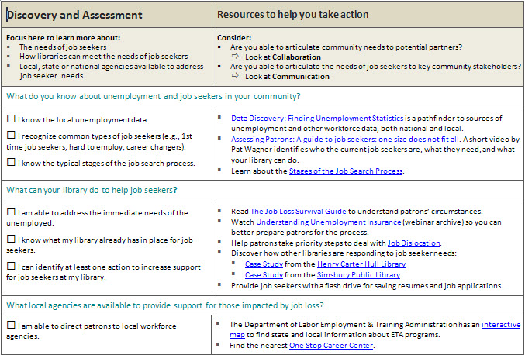
Job Seekers Pathway
Guiding question
Remember to integrate other approaches
Resources for each action
Notes:
(NOTE to Trainers: this slide has animations: activated “on click”)
Focus on Discovery & Assessment to learn more about:
The needs of your local business community
How libraries can contribute to workforce recovery
What local, state or national agencies are available to provide support for job seekers
**the guiding questions help to walk through the array of possible actions
**the checklist format allows library staff to see where they can focus their activities.
If they are already doing an item, they can check it off and move to the next area;
if not, they may decide it’s not an important action for their library at this time;
OR, they can circle it as a priority for taking action. The circled items will stand out as the things to focus on.
“Resources” are there to help library staff take action
Ideas, informational webinar archives and videos, case studies, examples of how other libraries have done something similar, templates and lesson plans
“Consider” how these actions integrate with other approaches (i.e., collaborating with partners, communicating the value of meeting community needs)

Slide 27
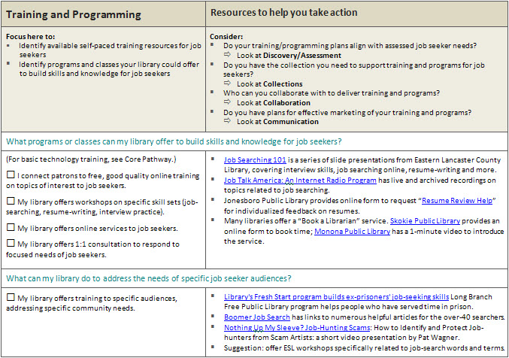
Job Seekers Pathway
Remember that these actions are inter-connected with all the other approaches
Yes but need more
Notes:
(NOTE to Trainers: this slide has animations: activated “on click”)
Focus here to:
Identify available self-paced training resources for job seekers
Identify programs and classes your library could offer to build skills and knowledge
It is likely that training and programming will be high priority actions, even if the library is already doing some things. Encourage participants to think about where they could do more.
The T&P set of actions are the most heavily integrated with all other approached in the pathway.

Slide 28
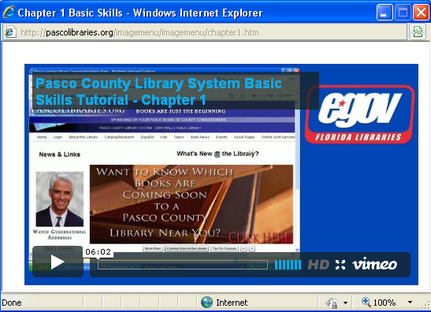
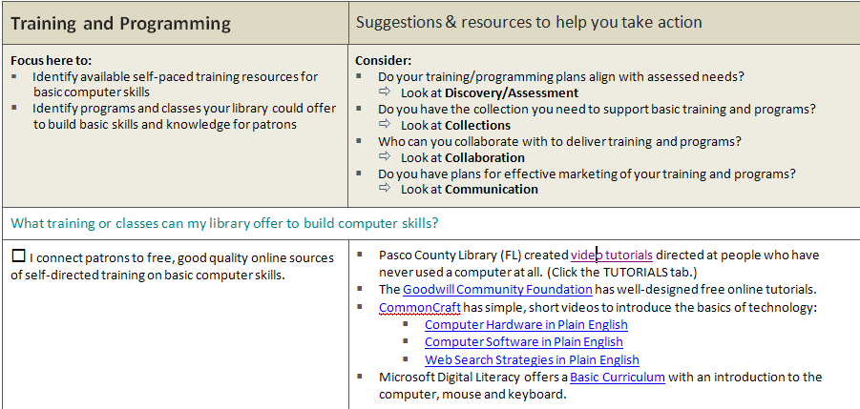
Core Services Pathway
Notes:
(NOTE to Trainers: this slide has animations: activated “on click”)
For a specific example of how the resources can help you take action, let’s look at the Training & Programming section of the Core Services pathway. If you’ve circled that you want to connect patrons with free, high quality online computer skills training, look at the recommended resources to see which of these will meet the need.
Example: Pasco County Library System in Florida has numerous ready-to-go tutorials, so you don’t have to reinvent the wheel.

Slide 29
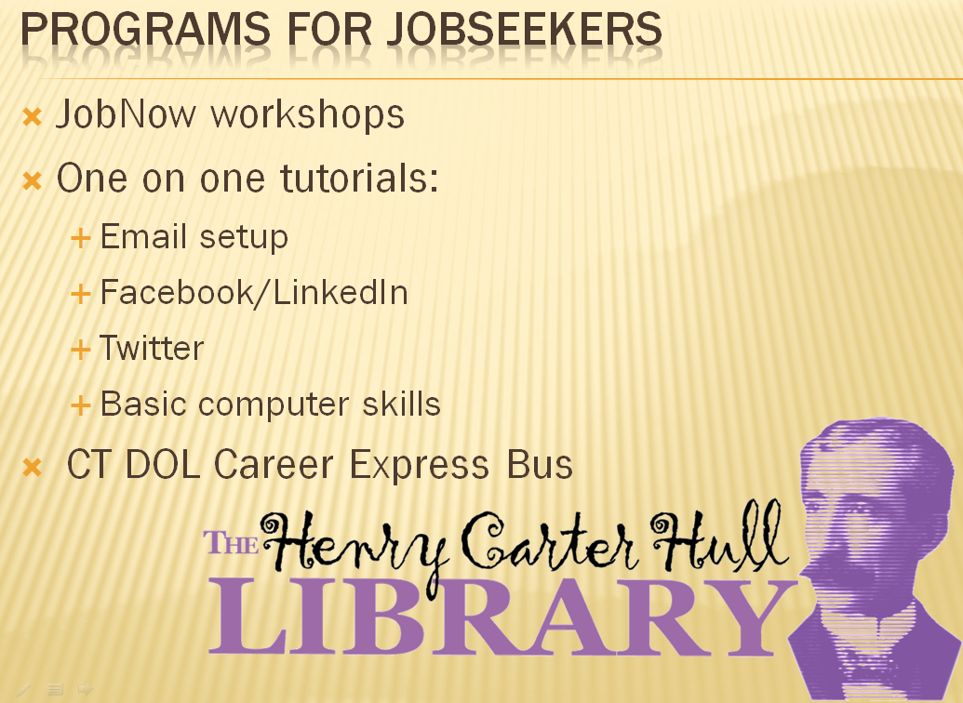
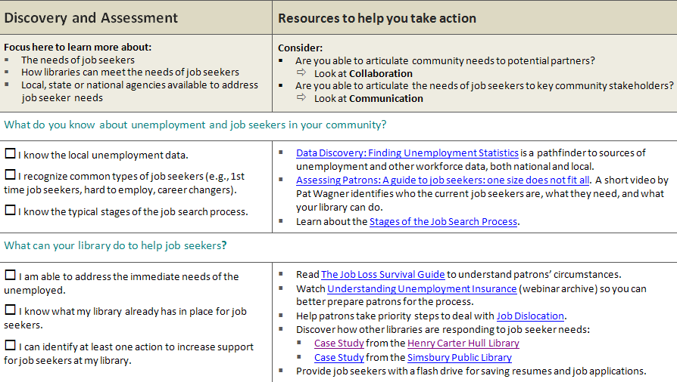
Job Seekers Pathway
Use the Resources to help you take action. Go to the online version to explore what others have done.
Notes:
(NOTE to Trainers: this slide has animations: activated “on click”)
And an example from the Job Seekers Pathway:
Discovery & Assessment is generally the first step in understanding the background issues of a pathway. Encourage participants to think about what they’ve already accomplished and where they could do more. Learning from what other libraries are doing can help participants get ideas for implementing new programs and services. The Henry Carter Hull Library offers workshops for groups as well as one-on-one tutorials covering computer skills that can help patrons find work in the 21st Century.

Slide 30
BREAK ☺
Notes:
Reminder about the “56 things” ideas ---add to the posters ---there will be prizes!

Slide 31
World Café Breakout

Slide 32
World Café process
Take 10 minutes to look through pathways on your own
  circle the priorities for what you’d like to do at your library
  check off those items already accomplished
Talk to your table group (20 min)
  discuss your priorities from the pathways
  share needs, experiences, resources, ideas
  write, doodle and draw key ideas on the paper
Move to a new table (20 min)
  identify ONE person to remain at each table—this person will provide a quick summary to the next group
  everyone else shake it up and regroup with different people
  write, doodle and draw key ideas on top of what’s already there
Identify one person from each table to summarize the ideas shared for the whole room (10 min)
Notes:
5-7 people per table ---no more than 2 from one library per table
Ask participants to look at both the Core Services and the Job Seekers pathways together.

Slide 33
World Café etiquette
Focus on what matters to you.
WRITE down your ideas on the paper.
Everyone contributes.
Listen to understand.
Link and connect ideas.
Listen together for insights and deeper questions.
play, doodle, draw ☺
Notes:
Point out the background of this slide ---you want the paper to be filled with notes and ideas
Everyone encouraged to write down their ideas as they are sharing verbally ----avoid assigning one person to be the scribe

Slide 34
Panel Discussion

Slide 35
Today’s Panelists
Panelist 1
  title, organization
Panelist 2
  title, organization
Panelist 3
  title, organization
Notes:
Sample questions:
Provide a brief overview of how your agency supports individuals in their job search.
For what services should libraries refer individuals to your agency?
What type of partnerships do you have with other community agencies?
Advantages and challenges to partnerships (and ways you’ve overcome the challenges!)
What are some service or programming responses that would be easiest for staff to implement
Those that can be done on a shoestring budget or with few staff

Slide 36
More
Project Compass Pathways

Slide 37
4 Pathways
Core Services
Job Seekers
Small Business
Personal Finance
Notes:
For the next round of discussions, we’ll take a look at the small business and personal financial skills pathways (click for animation)

Slide 38
Understanding how small business builds local economies
Connecting patrons with resources for small business
Providing training and programs to support small businesses
Small Business
Why ?
Starting new or sustaining existing local business creates jobs and stimulates the local economy.
Notes:
The Small Business & entrepreneurs Pathway explores the variety of ways that libraries can support small and local business growth. Small business stimulates the local economy, providing 60-80% of new jobs in this country.
The library can play a key role by:
Understanding how small business builds local economies
Connecting patrons with resources for small business
Providing training and programs to support small businesses

Slide 39
Understanding the impact of the economic downturn on personal financial stability
Providing resources, training and programs on applying for social services, refinancing a mortgage, getting out of debt, etc.
Personal Financial
Skills
Why ?
Whether unemployed or not, many patrons need to regain control of their personal finances.
Notes:
The Personal Financial Skills Pathway looks at the bigger picture of how the library can help patrons impacted by a continued weak economy. Although it may not lead directly to a job, it is a path that can increase self-reliance and restore a patron’s feeling of being in control.
Includes:
Understanding the impact of the economic downturn on personal financial stability
Providing resources, training and programs on applying for social services, refinancing a mortgage, getting out of debt, etc.

Slide 40
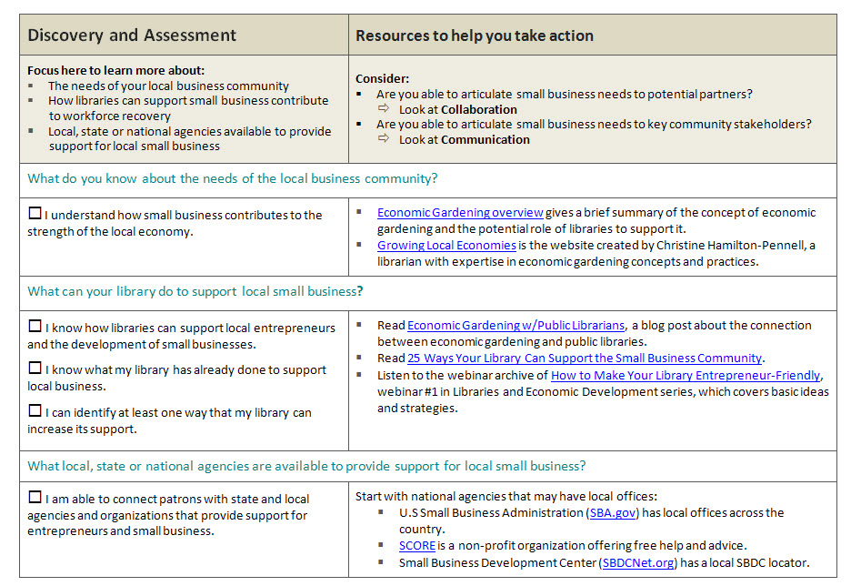
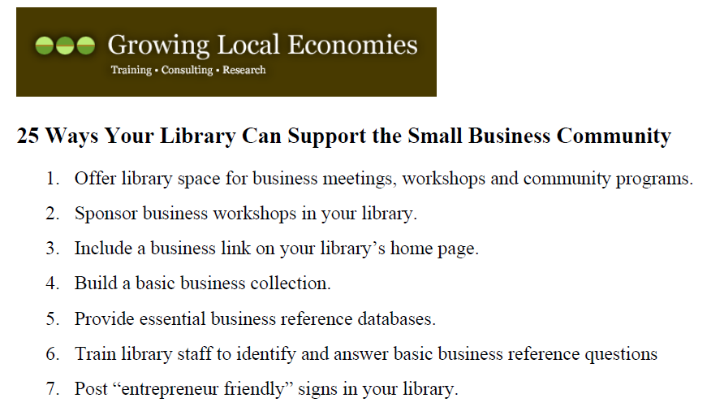
Small Business & Entrepreneurs Pathway
Guiding question
Remember to integrate other approaches
Resources for each action
Notes:
(Note: you may decide to skip this slide and the next slide---they repeat information given earlier about the pathway structure.)
Let’s walk through a pathway to see how it functions as a checklist and action-finder. We’re looking at the Small Business pathway, but you will find that all four pathways have the same structure and the same pattern of use.
The pathway is not intended to be linear. You can start at any point, depending on where you want to focus your efforts. However, no matter where you start, you will see that the components are all intertwined and integrated.
For any of the pathways, you would start with the Discovery & Assessment component if you want to learn more about:
The needs of your community
How libraries can support patrons along this pathway, in this case how to support small business development
What local, state or national agencies are available to provide additional support
**the guiding questions help to walk through the array of possible actions
**the checklist format allows you to see where you can focus your activities.
If you’re already doing an item, check it off and move to the next area;
if not, you may decide it’s not an important action for your library at this time;
OR, you can circle an item as a priority for taking action. The circled items will stand out as the things for you to focus on.
For the circled items, look in the right column at the “Resources,” which are there to help you take action
These include ideas, informational webinar archives and videos, case studies, examples of how other libraries have done something similar, templates and lesson plans
“Consider” how these actions integrate with other approaches (i.e., collaborating with partners, communicating the value of meeting community needs)

Slide 41
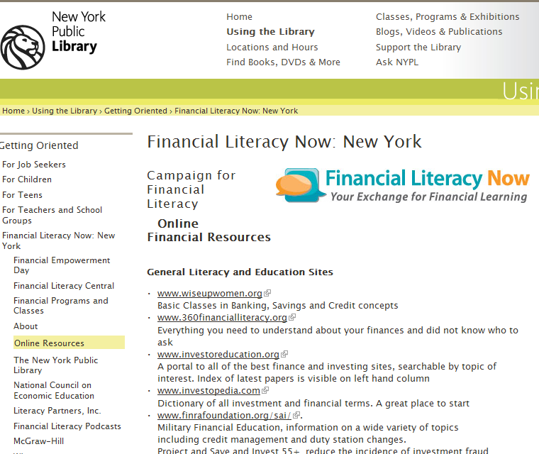
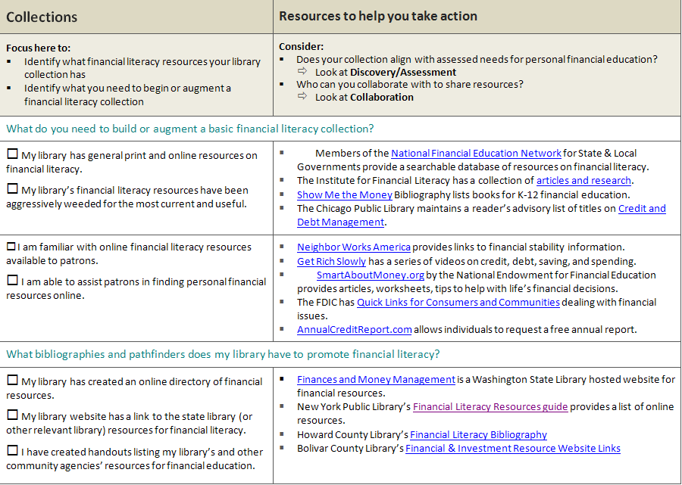
Personal Financial Skills Pathway
Use the Resources to help you take action. Go to the online version to explore what others have done.
Notes:
Are you wondering what to add to your collection on personal financial skills? Investigate the recommended resources. The NY Public Library Financial Literacy Now is a reputable source---you can link to or it can guide the selection of resources for your library, with adjustments for local context.

Slide 42
World Café Breakout

Slide 43
World Café process
Take 10 minutes to look through pathways on your own
  circle the priorities for what you’d like to do at your library
  check off those items already accomplished
Talk to your table group (20 min)
  discuss your priorities from the pathways
  share needs, experiences, resources, ideas
  write, doodle and draw key ideas on the paper
Move to a new table on the other side of the room (20 min)
  review the notes from the previous group and summarize verbally for each other
  everyone shake it up and regroup with different people
  write, doodle and draw key ideas on top of what’s already there
Identify one person from each table to summarize the ideas shared for the whole room(10 min)
Notes:
5-7 people per table
---difference from first breakout:
Half of the tables look at the small biz pathway; other half look at fin-lit ---then switch topics
More responsibility to write clear notes for the next group

Slide 44
World Café etiquette
Focus on what matters to you.
WRITE down your ideas on the paper.
Everyone contributes.
Listen to understand.
Link and connect ideas.
Listen together for insights and deeper questions.
play, doodle, draw ☺
Notes:
Point out the background of this slide ---you want the paper to be filled with notes and ideas
Everyone encouraged to write down their ideas as they are sharing verbally ----avoid assigning one person to be the scribe

Slide 45
BREAK ☺
Notes:
Mention the “56 things” ideas again ---there will be prizes!

Slide 46
Your Action Plan
Select circled areas on pathways for
focused actions
Identify relevant strategies, tools, partners, communication plans, etc.
Get a better idea of what success looks like
Notes:
The pathways “checklists” helped you to prioritize how to move forward with workforce recovery.
3 min to introduce: “this is a tool to take back to share with colleagues and administrators”
10 min to work on individual plan:
choose one priority that you had circled on the pathways and write it down;
Write down the next steps and what components are involved ---e.g., do you need to build a collection to support a new service? Do you need to find partners? Do you need to promote the new service?
Identify who you will work with, both library staff and external partners or contacts
Set some deadlines to aim for.
2-3 min to shuffle into groups of 3-4 ---can work with library colleagues or can seek fresh external perspective
15 min for groups:
each person present ONE priority action to group & ask for feedback from others
after 4-5 minutes, the next person takes a turn to present his/her priority and ask for feedback
Switch again so that everyone in the group has a chance to get feedback on how they plan to procedd with their priority

Slide 47
Staying Sane Discussion

Slide 48

Staying Sane
Ensuring YOU
stay sane
Helping patrons
stay sane
Notes:
http://janeheller.mlblogs.com/woman-tearing-hair-out.jpg
(Note: there may not be enough time for this segment)

Slide 49
Patron stress
sense of failure and grief
demands for new skill sets
The “new” job loss
“job security” is a thing of the past
“down-sizing” and the “jobless recovery”
cultural shifts in the workplace
Notes:
These are some of the characteristics of job loss in general and of the “new” type of job loss in the 21st century.
Does understanding the grief and fear help you when you faced with difficult behavior of job seekers?

Slide 50
YOUR stress
distressed patrons
increased traffic and patron demands
Staff stress
reduced staffing and hours
doing more with less
Attacks on the value of the library
Notes:
Resources on WJ: Pat Wagner video: keeping one’s cool in difficult times
+ links to articles on stress mgt & reduction
What are your stress reducing strategies?

Slide 51
Workforce Resources on
WebJunction

Slide 52
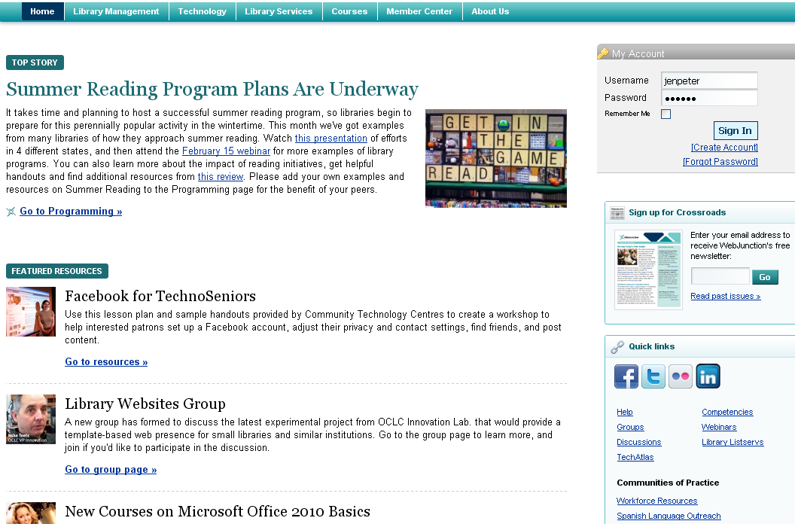
WebJunction.org
Notes:
Easiest way to get to Workforce Resources is via quick links on home page

Slide 53
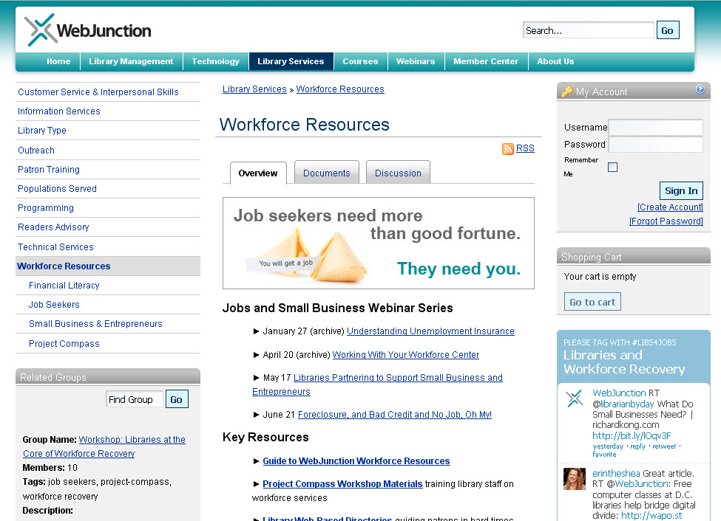
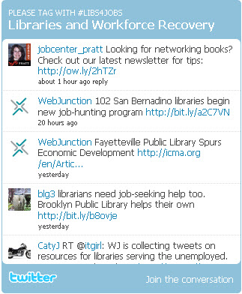
webjunction.org/workforce-resources
You
can tweet to
this hashtag!
See Member Center
for help with:
setting up an account,
posting to discussions,
creating documents.
See also archive of these tweets
Notes:
Left navigation shows sub-topics
Online workshop groups
Documents and discussions tabs
Key Resources
Member Center for info on registering, and posting to discussions or documents
Twitter feed with #libs4jobs hashtag (yes, YOU can add to it)

Slide 54
Key Resources
Digital version of each pathway
  with live links to all resources
All workshop curriculum materials and workbooks
  Free to download and repurpose
Links to upcoming and archived webinars related to workforce recovery
Content of two online workshops
The hashtag! #libs4jobs
Notes:
Live links on all the pathways!

Slide 55
Growing Workforce Resources
National community continues to contribute to:
  Resources
  Templates
  Questions/Answers
  Webinars
  Twitter #libs4jobs
No contribution or question is too small
…all are welcome!
This means YOU!
Notes:
Always growing!

Slide 56
What next?
Take the post-workshop survey
Share what you learned
  With colleagues
  With library administrators
Tell your success stories
  To the Project Compass team
  To your community
Questions?
Notes:
We can help you showcase the great workforce recovery efforts of your libraries– via documents, discussions, tweets or just send them to us!
Project Compass programming throughout the year – webinars and conference presentations
questions and parking lot issues

Slide 57
Ideas for
workforce renewal at your library
  Prizes!
  and takeaways
Notes:
“56 thing” ideas: prizes for the three “best”
Takeaways and “AHA” moments ----compass giveaways

Slide 58
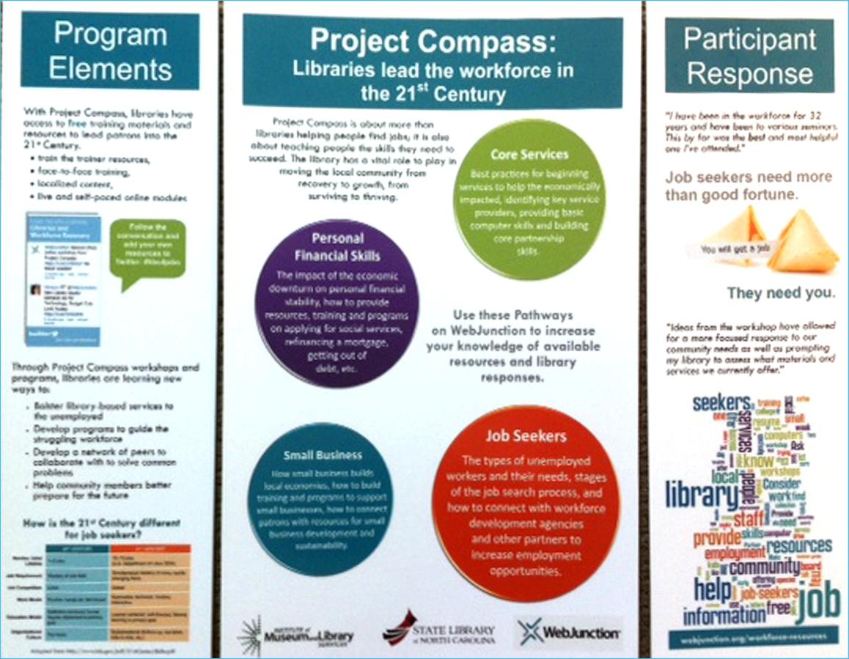
Thank you!

