Slide 1
Introduction to PowerPoint 2007
By: Rob Aavang

Slide 2
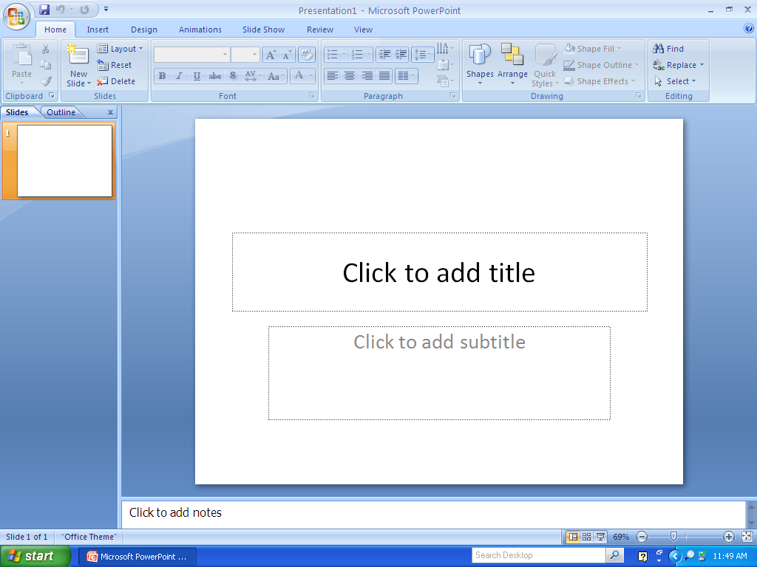
PowerPoint Layout
Office Button
Quick Access Toolbar
Font Group
Command Key with Drop-down
Home Tab in the Ribbon
Dialog Box Launcher
Title Page Slide
Object Placeholder
Notes Field
View Toolbar

Slide 3
Power Point Layout Definitions
Ribbon: A guide to locate the commands needed to perform tasks. Replaces the menu bar.
Arranged into 7 Tabs: Home, Insert, Design, Animations, Slide Show, Review and View.
Each Tab has Groups of related commands. Example: Font Group
Each Group has Command Keys which execute specific functions. Example Font size. Some command keys have drop-down arrows which will display more related functions for that command.
Office Button: Contains all the file management commands (New, Open, Save, Close, etc)
Quick Access Toolbar: Customizable toolbar with most used command keys: undo, redo, save
Click the drop-down arrow to add commands to the toolbar.
Dialog Box Launcher: Launches more functions related to that group
View Toolbar: Zoom in/out and change views of presentation: Normal, Slide Sorter, and Slide Show Views.
Notes Field: Add speakers notes to your presentation that will not show in the slide show.
Title Page Slide: Default slide when PowerPoint opens. Click to enter presentation text.
Object Placeholder: Add text, tables, charts, graphics, pictures, clipart, and multimedia clips to a Object Placeholder.

