Slide 1
A note for presenters
This slide deck came from reviewing the resources listed at the end of the doc. Review them before presenting, especially the ones by UW and ALA
There are plenty of notes to help you out, but take the time to put your own spin on it.
Brought to you by Kristen Calvert at Dallas Public Library. I’ve given a version of this presentation to public service staff multiple times! I hope it helps you and your team!

Slide 2


Media Literacy
A Guide for Library Staff
Notes:
Intros As information providers and hubs for lifelong learning, libraries have always been resources for helping communities develop media literacy skills. Now, in the midst of AI, and in an age when we increasingly rely on digital media for information and communication, these critical thinking skills are more important than ever.

Slide 3
What is information literacy?
Information literacy includes the ability to identify, find, evaluate, and use information effectively
Knowing how to find the information needed for any task or decision at hand
Critical thinking skills and knowing whether it’s the right information for the intended purpose
Notes:
ML is a part of information literacy. A key facet of library service is finding the right information and providing access to that information.

Slide 4
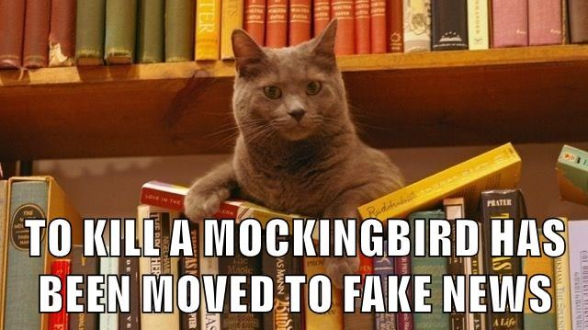
What is media literacy?
Media literacy means developing critical thinking skills around all types of media
Building an understanding of how media messages shape our culture and safety
Understanding who creates media, who owns it and how that impacts what we see
Understanding how groups are represented, like who is marginalized, who is highlighted and why
Notes:
The National Association for Media Literacy Education (NAMLE) defines media literacy as “the ability to access, analyze, evaluate, create and act using all forms of communication.
Media literacy encompasses learning about multiple genres of media, including journalism, entertainment (films, music, television), persuasive (advertising, promotion), and propaganda.
a media-literate adult should be able to access, share and create media across multiple formats and platforms while utilizing critical thinking skills to evaluate the purpose and potential impact of the material.
Traditionally, libraries have been about information literacy- helping people get the right information to meet their needs. Media literacy is a part of this.

Slide 5

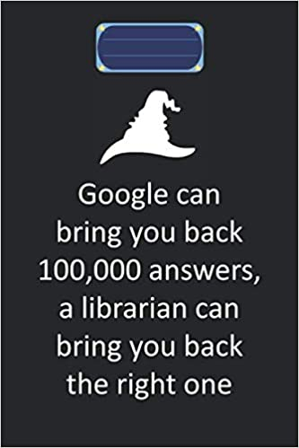
What’s the library’s role?
Understanding what it is your customer is really looking for
Digging deeper than Google
Teaching these skills and helping your customers think critically
Notes:
Many people who use the internet and consume media of all types, don’t realize that the organization of information/media has changed. They take everything in at face value or mistrust the wrong things.
This is why it’s important to provide quality information and understand what it really is your customer is looking for when they ask a question.
It’s really easy to Google something and find a quick answer. And sometimes that’s okay. But how deeply are you looking at Google when you search it? How deeply is your customer looking at it? Let’s consider.
(From 60 Minutes Expose’) Google conducted 90percent of the world’s internet searches in a year. When billions of people asked trillions of questions, it was Google that provided the answer, using computer algorithms known only to Google. Bing only has 2 percent of the market
Video John Oliver- 9:42-11:30, through whole emotional roller coaster you neve even left Google. 2/3 of searches on Google ended without ever clicking to another web property. And sometimes the info Google shows you in the preview is used without the site’s consent. This is before AI generated content was at the top of every search as well, and many times that information isn’t correct.
If you think about it, many adults have never been taught media lit skills. Many didn’t grow up with the internet. Many have very poor information lit skills and lack critical thinking skills. So, it’s our job to help these customers, who are no longer in school, think critically about where they get information. This is also why it’s important for us to dig deeper than Google. If a customer asks you for help, and you tell them let me google that, or according to Google… you are not doing anything they can’t do themselves, from a computer or a phone. You should dig deeper. What site are you looking at? How do you know that information is quality? Can you show your customer why you used the information you did?

Slide 6
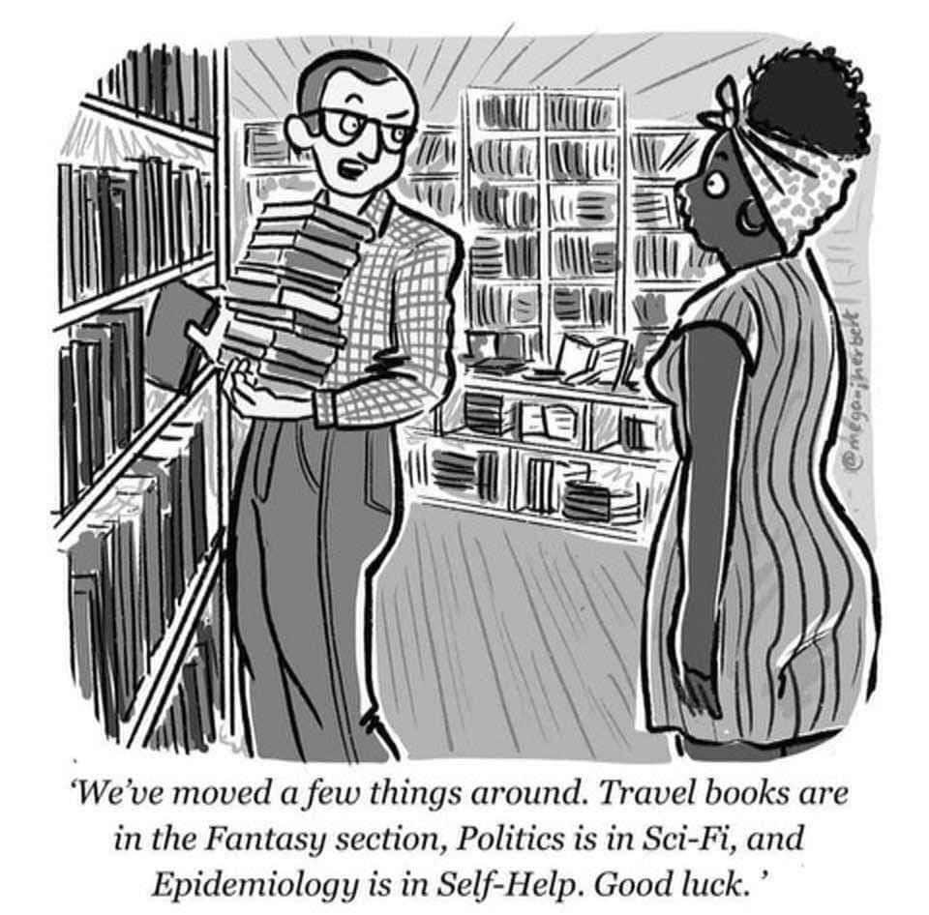
Diving Deeper
Architecture of the internet
Media landscape and economics
Disinformation and Misinformation
AI
Comic by @meganjherbert

Slide 7

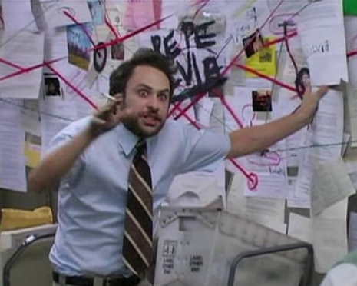
Architecture of the Internet
There is a largely invisible system at work that tailors and personalizes online content based on where on the internet you’ve been and what various sites think you might like
  Cookies
  Algorithms
  Filter bubbles
  Confirmation bias
Notes:
According to the Pew Research Center, “roughly eight-in-ten U.S. adults go online at least daily.” The fact that many people don’t know how the internet works is compounded by the fact that most online companies are less than forthcoming about how they work. Talk about Google algorithm and SEO articles.
Although you make individual decisions and choices when you go online, such as which websites to visit and which apps to use, there is also a largely invisible system at work that tailors and personalizes online content based on where on the internet you’ve been before and what various sites and platforms think you might like. This invisible system is sometimes referred to as the “architecture of the internet,” and it includes such concepts as cookies and algorithms.
COOKIES: A piece of data stored on a person’s computer by a website to enable the site to “remember” useful information, such as previous browsing history on the site or sign-in information.
ALGORITHMS: A set of instructions to be followed, usually applied in computer code, to carry out a task. Algorithms drive content amplification, whether that’s the next video on YouTube, ad on Facebook, or product on Amazon. Also, the algorithms serve a very specific economic purpose: to keep you using the app or website in order to serve more ads.
Feed!
FILTER BUBBLES: Intellectual isolation that results from information served primarily through search engines that filter results based on personalized data, creating a “bubble” that isolates the user from information that may not align with their existing viewpoints.
CONFIRMATION BIAS: The tendency to prioritize information that confirms or aligns with one’s previous viewpoint and discount the opinions that do not.
There are positive and negative consequences to this architecture. If you purchase an item on Amazon, the website will suggest similar items you might like. Many consumers find this convenient, and retailers do it to boost sales. But this same process is to blame for filter bubbles and echo chambers— that is, online spaces where we encounter information and perspectives we already agree with. This often leads to confirmation bias, the tendency to seek and validate information that aligns with our existing beliefs, and in turn, overwhelmingly discount disconfirming evidence, even if it is based in observable truths.

Slide 8
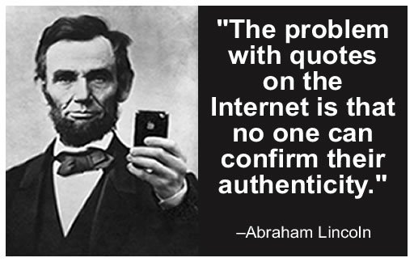
Media Landscape and Economics
Who owns the news
Consolidation of the media
Increased content
Disintermediation of content
Frictionless experience
Algorithms (again)
Notes:
Consider how the media industry has changed in recent decades. In 1983, 90 percent of all U.S.-based media was created and controlled by 50 companies. Mergers brought this number down to 25 in 1992, and further mergers have brought this down to just five today. Those five companies are AT&T, Comcast, Disney, Viacom, and Fox, who collectively own 90 percent of the professional media content currently being produced in the United States. Mergers continue to narrow the field today.
This media consolidation has led to criticism of media outlets as being obligated to commercial and political centers of power rather than service to public interests and democratic process. Less competition has led to more content that is largely the same.
Meanwhile, the internet has brought us all more content than we know what to do with, created by professionals and amateurs alike. Therefore, it is now even more important for us as consumers to consider what kinds of media we consume and the thinking processes that we enact during that consumption. To start, we must think about what we are consuming. Is it entertainment? Is it promotion? Is it advertising? Is it journalism? We consume each of these types of media in different ways, and we have different ways of thinking about each.
Have you ever looked at who owns the place where you consume media from? This is something you can think about when you’re evaluating the credibility of a news source and looking at bias. If you’re unfamiliar with the source and wondering if it’s credible, take a look at who owns it and how it’s funded. Look at PEW research to see what the most trusted sources of information are and which are less bias.
What articles are written and what articles are not, or what’s breaking news versus not and what bias is given to a story, can all be impacted by who owns the news. It’s important to know who owns specific media outlets because it can help you better understand bias in reporting. This is also why it can be important to look at multiple examples of news. Owners may have a political interest that shapes news coverage. For instance, a media outlet owned by an oil company might downplay coverage about global warming. Advertising and financial pressure can also play a role here. Publicly owned media is ideally less bias. At the same time, government run media (Russia/China) can be used to push propaganda
It’s also important to think about the media landscape here- The media landscape has also shifted dramatically in recent history, with more and more content available without a middleman (think YouTube). This means a lot of what we take in does not have an editor who is cutting 250 words or doing other work to look for bias.
At the same time, The Rise of Digital & Decline of Print, plus internet and social media have disrupted traditional media. This all happened really fast, in comparison to how long journalism has been around, if you think about it. This has created the 24/7 news cycle and age of instant information. This leads to faster reporting but also increases the risk of misinformation and sensationalism.
Many print outlets have either gone digital or shut down, and local newspapers have been especially hard-hit, creating media deserts- cities with no local news outlet. Not having a local news outlet correlates to increases in things like polarization, or specifically, in book bans.
AI is increasingly used for writing articles, summarizing news, and creating visuals. Impact: Can speed up reporting, but also raises concerns about accuracy, bias, and job losses in journalism.
Journalists constantly have to change a news story based on space constraints. What information is kept and what isn’t shapes public understanding of what happened. Cutting a story can affect depth, context, and audience interpretation. When background details are left out, it can be harder to understand complex issues, for instance. It can also lead to oversimplifying complex issues. Cross checking sources can help here
DISINTERMEDIATED: This describes a system of media creation and sharing that is largely characterized by direct contact between the creator and the consumer, without an intermediary that makes decisions about the quality or relevance of the media that is presented to the consumer. Many of the media messages that are shared on social media platforms are disintermediated, meaning that the message is spread from the producer to the consumer without an intermediary, or gatekeeper, such as an editor, who might determine its reliability or quality. (YouTube)
FRICTIONLESS: Social media platforms provide an increasingly frictionless experience to users, meaning that it is relatively easy to consume, share, or post media messages on them—often without much thought to their reliability or quality.
COMPUTER ALGORITHMS: Due to the sheer magnitude of messages that are shared on social media platforms, computer algorithms play a significant role in filtering the information that is presented to consumers. These are sets of instructions that determine how information is displayed on these sites. While algorithms can be tuned to highlight certain types of information, they largely do so to drive longer periods of engagement on the platforms that they support.

Slide 9
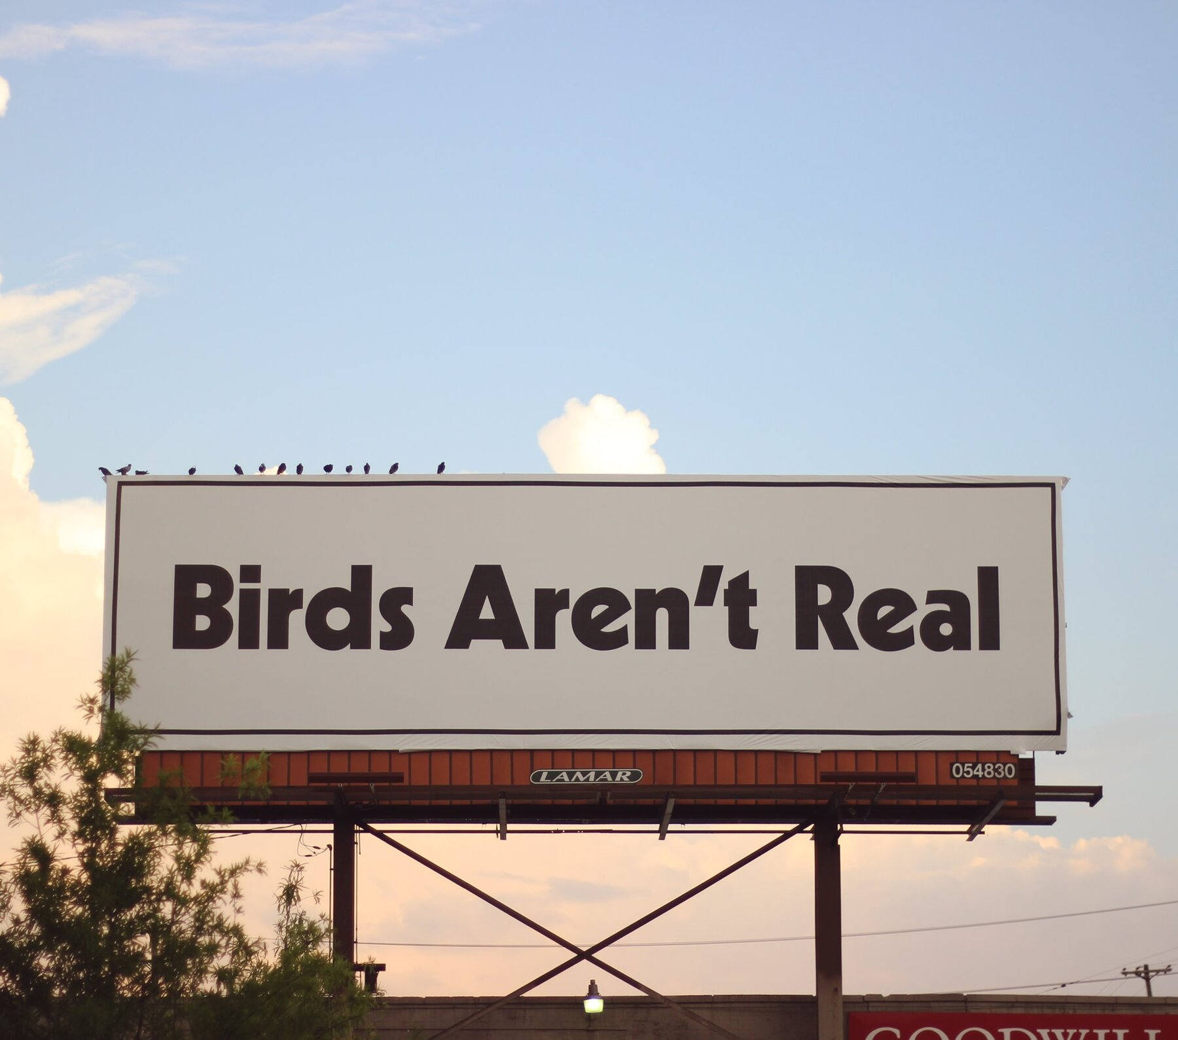
Disinformation and Misinformation
Misinformation is when false information is shared, but no harm is meant
Disinformation is when false information is knowingly shared to cause harm
Malinformation is when genuine information is shared to cause harm, often by moving information designed to stay private into the public sphere
Notes:
Fake news, misinformation, and disinformation often have plausible roots in truth, are deliberately created and disseminated for profit, and can be shared and spread to others in the blink of an eye on social media. However, despite these complications, libraries and information organizations are in prime positions to assist students and patrons with disputing misinformation, disinformation, and malinformation. This is where media and information literacy come into play.
Birds Aren’t Real- (From NYT)- Gen Z-fueled conspiracy theory, which posits that birds don’t exist and are really drone replicas installed by the U.S. government to spy on Americans. Hundreds of thousands of young people have joined the movement, wearing Birds Aren’t Real T-shirts, swarming rallies and spreading the slogan.
the creator of Birds Aren’t Real and the movement’s followers are in on a joke: They know that birds are, in fact, real and that their theory is made up.
What Birds Aren’t Real truly is, they say, is a parody social movement with a purpose. In a post-truth world dominated by online conspiracy theories, young people have coalesced around the effort to thumb their nose at, fight and poke fun at misinformation.
Misinformation is when false information is shared, but no harm is meant.
Disinformation is when false information is knowingly shared to cause harm.
Malinformation is when genuine information is shared to cause harm, often by moving information designed to stay private into the public sphere.

Slide 10
The Role of AI
AI can be a helpful tool!
  Alexa
  Lyft/Uber
  ChatGPT (as a tool, not as an all-knowing entity
AI can also be used to be devious!
  AI Generated Phishing Scams
  AI scam calls
Notes:
Unpopular opinion but AI has benefits, like efficiency and atomization and enhanced productivity and idea generation. For now, it’s here and it’s important for information professionals to understand how it works, as patrons will ask questions about it or use it themselves. Note that this presentation does not dive into the ethics of data centers.
It can also lead to spreading disinformation and misinformation because it can be used to create deepfakes (AI can generate realistic fake images, videos and audio, making it easier to spread false narratives, for instance, showing you something a politician did that they never actually did), AI can create convincing but false news articles, social media posts, and fake websites, automated bots can mass produce misleading content.
AI also hallucinates, generating incorrect but believable information. If the AI is trained on false data, it can reinforce and spread misinformation unintentionally . And this happens with the use of common chat services more than most people think.
The rise of deepfakes and AI generated content have contributed to the erosion of trust in the media.

Slide 11

Using AI
Look out for confirmation bias
"Hallucinations"
Taking credit of the work of others
Check sources!
AI generated image
Notes:
Try this: Use ChatGPT or another bot to ask about something you know a lot about. Read the results and continue asking questions. You might be surprised to learn how much is false. Also, search Google for the same thing and you’ll notice some of ChatGPT’s opinions come from sources like Reddit. At the very best, AI should be treated no different than an acquaintance that you don’t completely trust. You should always verify information it has given you.

Slide 12

How to Spot AI images
You can’t
If it pertains to news, fact check
Reverse image search
AI generated images
Notes:
It’s becoming increasingly harder to spot AI. Don’t try to identify a picture or a source based on weird hands or ears. When looking at any pictures on the internet, unless they come from a credible cited source, assume that the image is AI until you know otherwise. You can fact check (Katy Perry and the MET Gala) or reverse image search.

Slide 13
Civics
Civics encompasses a person’s rights and responsibilities within society
Civic information comes from
  The media (especially news media)
  Government documents
Libraries play a role in
  Access
  Analyzing and evaluating
  As a limited public forum
Notes:
Civics encompasses a person’s rights and responsibilities within society. To exercise their rights, such as voting and the freedom of speech and assembly, and to fully participate in the democratic process, individuals need access to reliable and trustworthy information on which to base their decisions.
Where does civic information come from? Media, especially news media, is one important source, as journalists investigate and report on the actions, debates, and decisions of government officials and agencies. Government documents are primary sources and offer insight into agencies and elected officials.
In a democratic society where freedoms like speech, press, and assembly are meant in part as a check on government, the free exchange of ideas and engagement in open and civil debate can also come under the umbrella of civics. And this is interesting right now, at a time when a significant group of people do not trust the media.
So what do we do?
Libraries have an important role to play in the civic life of their patrons. We provide access to government and media information and assist our patrons in analyzing and evaluating that information. We are guided by the core values of libraries, access, service and intellectual freedom.
Beyond providing physical or virtual access to information and technology, libraries can encourage and facilitate conversations where community members exchange ideas and debate important questions. Public libraries are often considered limited public forums, or spaces. Did you know that Carnegie had originally thought of libraries as a community gathering space as much as a place to access knowledge? Now, when access is happening in new ways, besides books, we have an opportunity to really be that space for community engagement. People need that safe space to learn and talk to each other.
Libraries offer space for civic conversation, but we enhance that physical or virtual space through our collections, resources, and programming, which allow our communities to access, create, and share information and engage with each other.
Scenarios

Slide 14
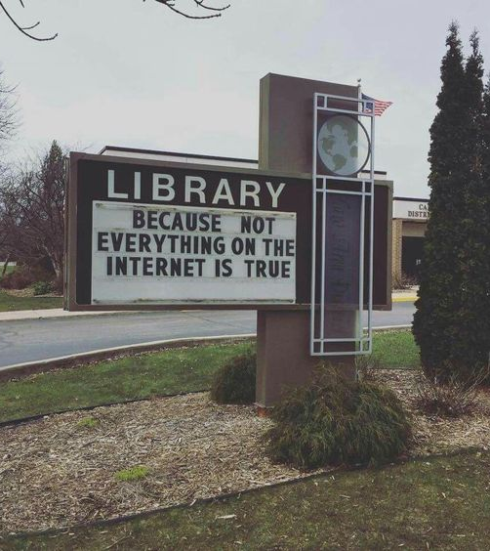
Meeting Customers Where They Are!
Reference Desk Interactions
Civic Engagement
Programs
Caro Area District Library, in Caro Michigan
Notes:
Libraries have an important role to play in the civic life of their patrons. We provide access to government and media information and assist our patrons in analyzing and evaluating that information. We are guided by the core values of libraries, access, service and intellectual freedom.
libraries can encourage and facilitate conversations where community members exchange ideas and debate important questions. Public libraries are often considered limited public forums, or spaces. Did you know that Carnegie had originally thought of libraries as a community gathering space as much as a place to access knowledge?
Libraries offer space for civic conversation, but we enhance that physical or virtual space through our collections, resources, and programming, which allow our communities to access, create, and share information and engage with each other.

Slide 15

At the Reference Desk
The desk can be an informal teaching setting
Media lit offers an opportunity to deflect from sharing your own opinion
Be ready to address why the patron thinks their information source is reliable and how that’s determined
Speaking with patrons about AI
Image provided with permission from Dallas Public Library
Image provided with permission from Dallas Public Library
Notes:
It’s really easy to shut down a conversation with a patron that I guided by misinformation or disinformation, because it can sound like the patron is just sharing their opinion or that they don’t want to hear what you have to say anyway. And a lot of times these interactions with customers centered around misinformation and disinformation can be emotionally or politically fueled. but often times, these interactions are our opportunity to share media literacy skills with a patron. If a conversation starts, first do a self-check- are you in the right headspace for this conversation right now? If you’re not, it’s ok. But I do encourage you to have these conversations with patrons. IT’s an opportunity to plant a seed of fact and truth in a world with a lot of untruth.
When a patron asks us a question and we want to say “I can’t talk about politics at work,” instead consider asking ”where did you find that information?” or ”what sources are you looking at regularly?”
Speaking with patrons about AI carries a lot of the same connotations. And they may feel silly or embarrassed if the thing they are talking about turns out to be AI generated. A lot of times, if you are debunking, it can help to show your work on the computer screen.

Slide 16
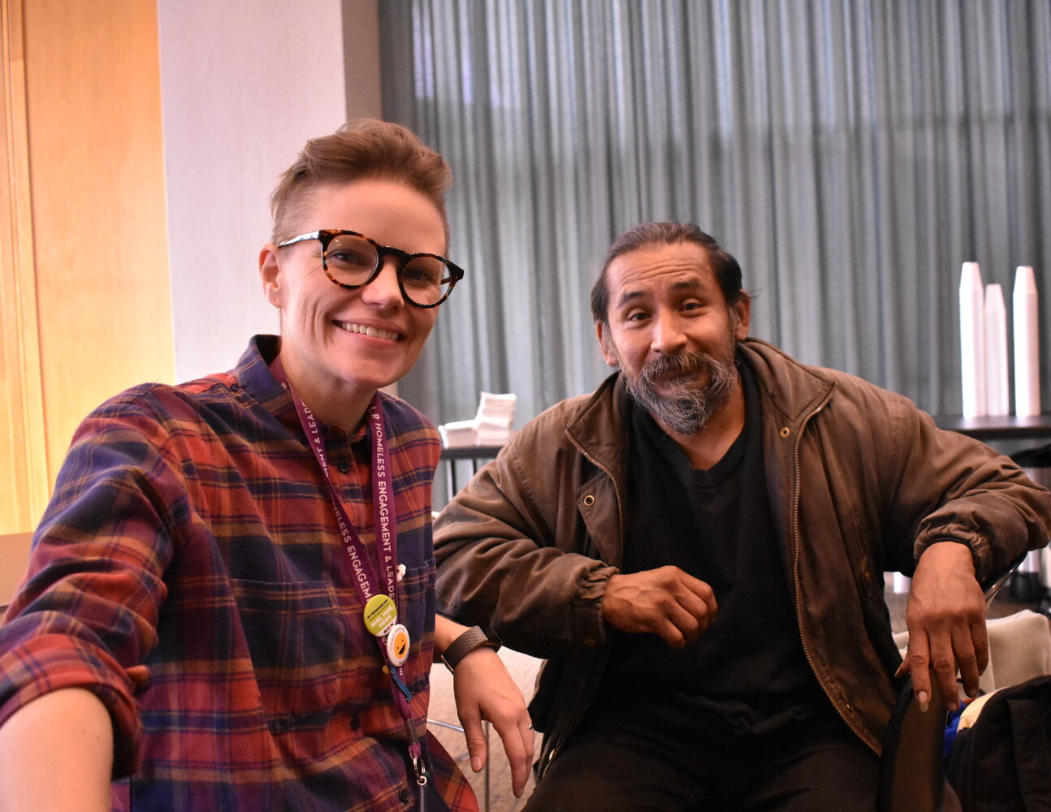
Creating a moment of connection
Be a super communicator
It takes empathy, patience and vulnerability
Have resources ready
Remember, you are a trusted messenger
Image provided with permission from Dallas Public Library
Notes:
So let’s say you decide to have the conversation and go down the rabbit hole. You are going to be a lot more successful in your interaction if you create a moment of connection. Super communicators book example:
Dr has convo with patients and relies on statistics, outcomes and survival rates, medical charts, xrays, and logic. Even though he gave all this data, patients werent likely to follow it and he was baffled/frustrated bc he genuinely wanted the best outcome for the patient. The dr had a moment of breakthrough and realized he was having a practical conversation with someone and they were having an emotional conversation- he wasn't meeting them where they are. He started practicing vulnerability to bridge the gap- in addition to a recovery plan, he started sharing anecdotes from his life that mirrored their internal concerns- if a patient was scared of surgery he might mention a time he felt anxious about something out of control in his life. The data didn't change but the connection did. Once the patient felt seen, their brains became less defensive and they became more collaborative in their thinking- they weren't just following medical advice, they were following the advice of someone who met them on their level that they trusted. Scientifically, when you have this sort of matching conversation, brain waves actually start to align, making the facts and data easier to digest later in the convo. This allows you to break through the wall of being the government service worker and get on the level of whoever you’re talking to. They will feel more comfortable with you and you’re developing trust to share facts. You’re in this together!
You do need to have resources ready to share but using just facts won’t get you there
PEN America talks about this idea of trusted messengers- there are folks in the community who are not necessarily experts but people trust- pastors, barbers, coaches, bartenders- in many ways libraries are trusted messengers too (and we are experts) so it’s important for us to take the time to share accurate information

Slide 17
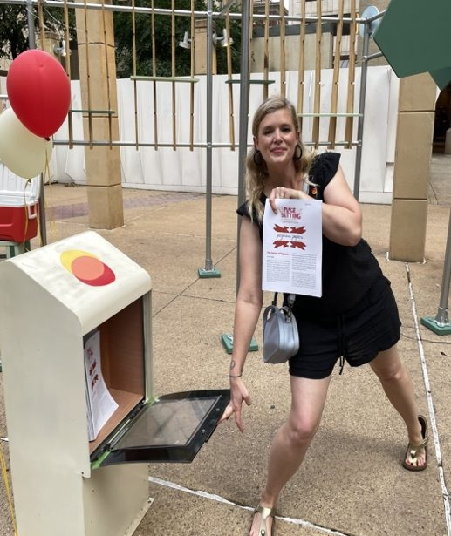
Media Literacy & Programming
Book clubs
Movie screenings
Tech classes
Creative ideas
Image provided with permission from Dallas Public Library
Notes:
Book clubs Relate themes to current events
Discuss how media portrays those events and why
Ask about related media lit principles
de about programming
Tech classes Discuss media literacy as you would internet safety
Point out trusted sources of information
Discuss responsibility of creator when creating media
Teach information bias, curation and creating responsibly
Creative ideas
Partnering with local media
Creating your own newspaper
AI Shakespeare
Disinformation crime scene

Slide 18
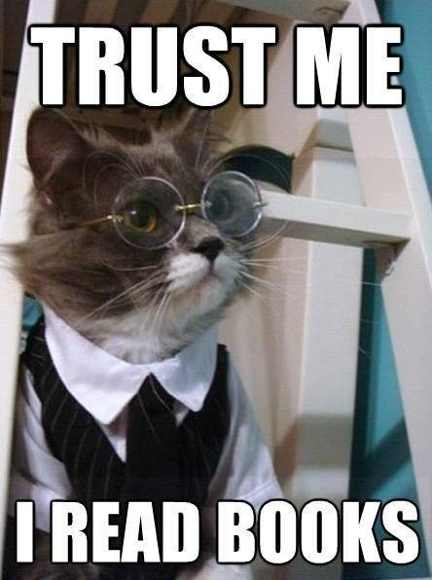
Book Clubs, Screenings and Discussions
Relate themes to current events
Discuss how media portrays those events and why
Ask about related media lit principles

Slide 19
Tech Classes
Discuss media literacy as you would internet safety
Point out trusted sources of information
Discuss responsibility of creator when creating media
Teach information bias, curation and creating responsibly

Slide 20
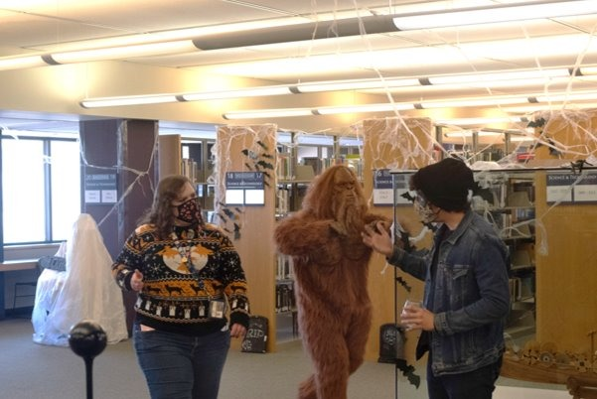
Getting Creative
Partnering with local media
Creating your own newspaper
AI Shakespeare
Disinformation crime scene
Image provided with permission from Dallas Public Library
Notes:
These are programs we have done in Dallas. You may want to use your own library’s programs as examples or talk about programs you have had in the past that could have had a piece about media literacy in them. For instance, AI Shakespeare was a component of a Renaissance Faire style day that we had at the library.
Deadly Disinformation Crime Scene
Digital Literacy program ideas- AI Shakespeare and others
Your Vote Rocks: Unity Concert
More Unity Concert info
Media Makers: Inside the Newsroom
More Inside the Newsroom info

Slide 21
Scenarios
Break into discussion groups or roleplay scenarios as a group

Slide 22

Scenario: 5G Towers
“I read on Facebook that those 5G towers they put up cause all sorts of issues, like cancer, and they could’ve even been where Covid 19 came from.”
Notes:
I’ve been hearing a lot about this. Would you like me to help you find some information on this subject?
I can tell you feel strongly about this! Have you found specific outlets to help you shape your opinions?
That’s a good question! Have you seen this resource on the topic?

Slide 23

Scenario: Disney and drinking age
“I saw a news story that Disney is battling the State of Florida to lower the drinking age to 18. That’s crazy! Why would they do that? Is it even legal?”
Notes:
Oh that’s so interesting! I’m from Florida, but I haven’t heard about that.”
Let’s take a look at that and try to find the source. Knowing the source might help us determine if it’s biased or even false!”

Slide 24

Scenario: The Pope’s New Clothes
“I’m catholic and I saw the Facebook post of the pope dressed up like he’s from Hollywood or something. I think that’s sacrilegious. What do you think?
AI generated image
Notes:
First, create a moment of connection then:
“I think I’ve seen this image before. Let me run an image search for it.”
There are some discrepancies with this image that make me think it’s AI generated. Let me show you why.”

Slide 25

Scenario: Medical misinformation
“I read on Facebook that a man accidentally spilled a bottle of Pepto Bismol in his aquarium. Now his four pet turtles have turned into giant, pizza-loving vigilantes. Has anyone else experienced this side effect?”
AI generated image
Notes:
First, create a moment of connection then: I have a cat and I’d be worried if something like that happened to her.
Let’s see if we can get more information. Do you remember who posted the Facebook post?

Slide 26

Scenario: Katy Perry
I saw a photo of Katy Perry at the Met Gala. Her dress was amazing and I’m wondering what designer created it. It looks like there are real butterflies on it.
AI generated image
AI generated image
Notes:
Assuming you search for the image and see that Katy Perry wasn’t at the MET Gala- “I have interesting news- those butterflies look so real because the picture is AI. Something like that has happened to me before too- I was looking at (insert whatever it is). Let me show you how I realized it was AI.”

Slide 27
Resources
University of Washington’s Empowering Informed Communities Resource Hub
National Association for Media Literacy Education
PEN America Trusted Messenger Guidebook
Snopes.com
Politifact.com
American Library Association Media Literacy Guides
Questions?
Notes:
To whoever is presenting this, I encourage you to review these resources first, especially the ones from UW and ALA

