Slide 1
I Love The Library
Rob Aavang
Huntley Area Public Library

Slide 2
Reasons why I love the library:
Books
Movies
Online Resources
Great Staff
Computer Classes

Slide 3

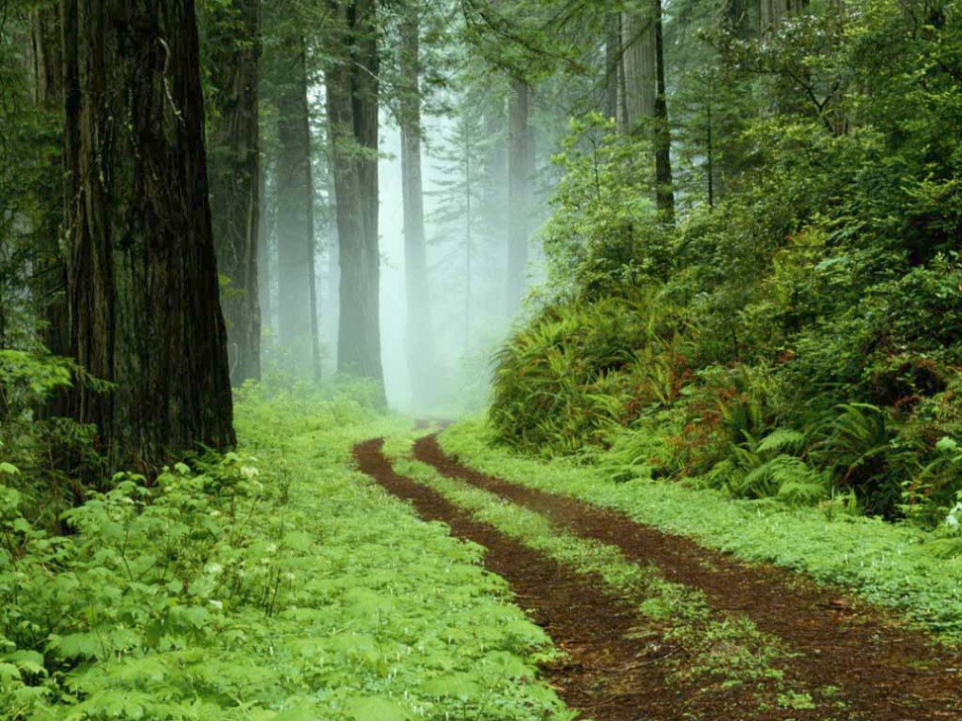
This is how I feel at my library:

Slide 4
When I leave the library I always feel:
Notes:
This is an example of a “Notes” printout of a slide. Presenters type their speaking notes for each slide in the “Notes” field below the slide.
Example:
Create a Title and Content slide
In the Title Text Box:
Type: When I leave the library I always feel:
In the Object Placeholder:
Click: “Clip Art” icon.
A window will open to the right of the slide where you can search for clip art.
Under: “Search for”
Type: happy faces
A gallery of clip art will be displayed that fits your search criteria.
Click: (on a picture you like)
The image will be applied to the Placeholder Box.
To add more clip art: Insert Tab → Clip Art (under the Illustrations Group)
Notes are not seen during a slide show. They only appear by selecting “Notes Pages” under the printing options. Office Button → Print → Print What drop-down → Notes Pages.

Slide 5
What I checkout at the library:
Non-Fiction
Movies
Fiction

Slide 6
My rating of the library (1-10):
Customer Serv. | Book Selection | Movie Selection | Library Size
10 | 9 | 10 | 5

Slide 7
My rating of the library (1-10):

Slide 8
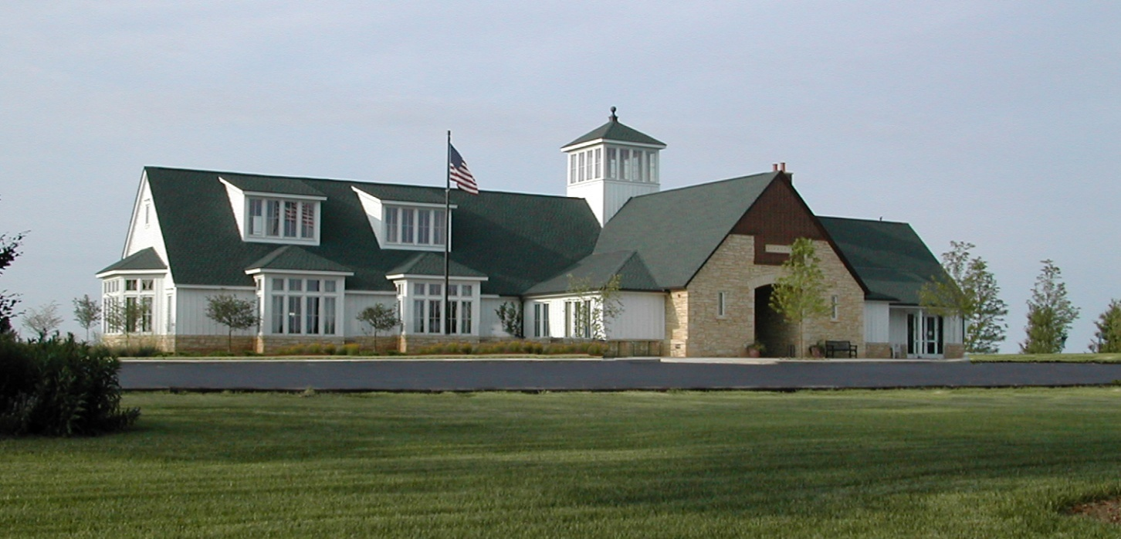
Thank you for coming!

