Slide 1
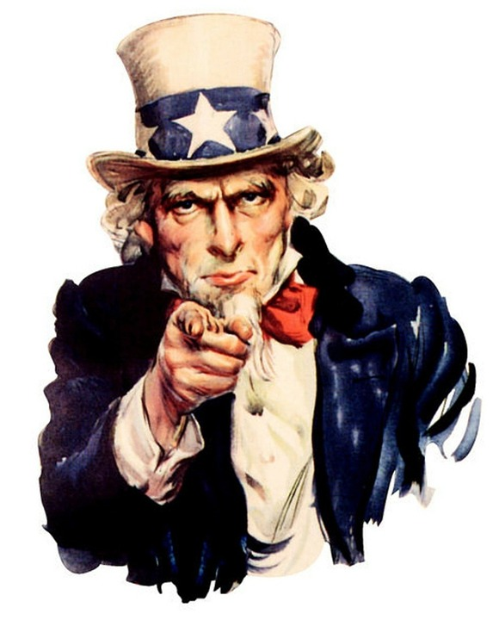
TAXES:
E-Filing and Refund Help
Learn how to e-file and get tips for getting the biggest refund possible from expert volunteers using United Way’s www.myfreetaxes.com. This is available for free to those making under $66,000 per year.
Details: kclibrary.org | 816.701.3400
Choose one of the following sessions:
Saturday, Feb. 3 | 1:00-2:30 p.m. | Ruiz Branch, 2017 W. Pennway St.
Thursday, Feb. 8 | 6:00-7:30 p.m. | Waldo Branch, 201 E. 75th St.
Saturday, Feb. 10 | 10:00-11:30 a.m. | North-East Branch, 6000 Wilson Rd.
Thursday, Feb. 15 | 6:00-7:30 p.m. | Trails West, 11401 E. 23rd St.
Wednesday, Feb. 21 | 4:00-5:30 p.m. | Southeast Branch, 6242 Swope Pkwy.
Wednesday, Feb. 28 | 4:00-5:30 p.m. | Central Library, 14 W. 10th St.

