Slide 1
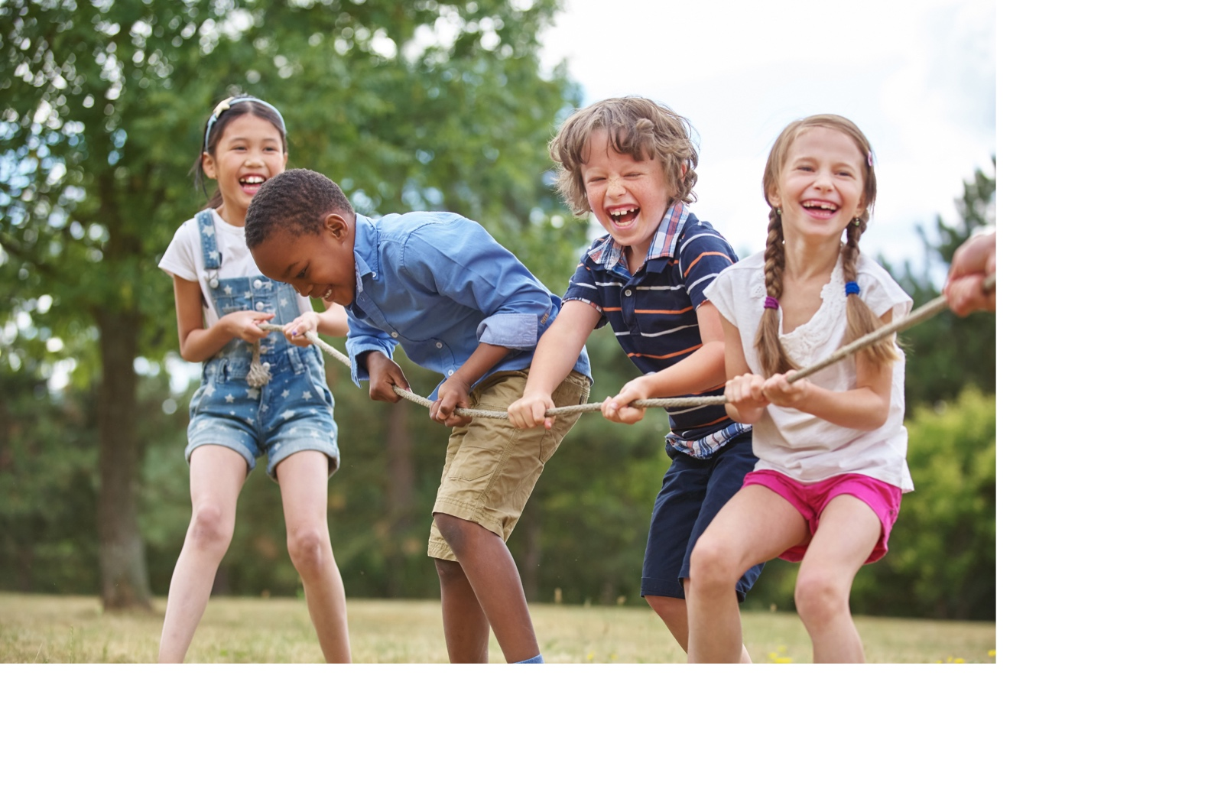
Before we begin…
What is your secret library superpower?
What’s your library superhero name?
For ideas, click on link in chat: http://superhero.namegeneratorfun.com
Follow the prompts
Share your superhero name/superpower in the chat!
Notes:
For the 30 minutes before we begin to get people engaged

Slide 2
Post and tag a photo of yourself today!
Notes:
Tell them to take a photo of them in their workspace right now and post to hashtag on twitter, fb or Instagram!

Slide 3
Today’s program brought to you by
ARSL (Association for Rural and Small Libraries)
WebJunction
IFLA (International Federation of Library Associations)

Slide 4
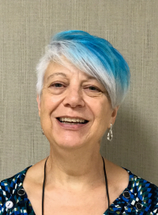
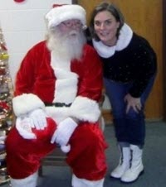
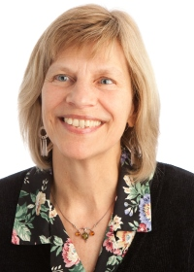
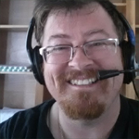
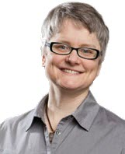
Your facilitators today
Gail Sheldon
ARSL Board, Alabama Public Library Service
Jennifer Pearson
ARSL Board, Marshall County Memorial Library (TN)
Betha Gutsche
WebJunction
Kieran Hixon
President-Elect, ARSL, Colorado State Library
Jennifer Peterson
WebJunction
Jennifer Pearson, ARSL
Kieran Hixon, ARSL
Gail Sheldon, ARSL
Notes:
Jennifer Pearson, ARSL board member, IFLA Global Vision North American regional discussion representative, and director Marshall County Memorial Library (TN)

Slide 5
IFLA’s GLOBAL VISION
Notes:
Talk first about the general vision and what is meant by a united library field:
“We firmly believe that only a unified and connected library field will be able to fulfil one of the true potentials of libraries: to build literate, informed and participative societies.”
“IFLA needs your expert input and participation in the Global Vision discussion so we can make the library field as ready as possible for what tomorrow might bring.”

Slide 6
Global Vision Discussion Values
LEARNING – We believe that knowledge and expertise to transform the field exists everywhere
TRANSFORMATION – We believe the need for change in the field is imperative
COLLABORATION – We believe working with others is critical to success
TRANSPARENCY – We believe open processes result in sustained engagement, trust, and impact
INCLUSION – We believe inclusion and diversity are sources of strength
Notes:
The objectives of the meeting are:
1. A united and connected group of participants;
2. Participants are inspired and motivated by the outcome of the meeting;
3. Participants understand their own role in achieving their vision and that of others;
4. Participants understand challenges in achieving their vision, now and in the future;
5. Participants see the ways to overcome the challenges;
6. Participants are eager to continue the conversation and organise their own meetings in line with the IFLA Global Vision discussion framework.

Slide 7
Small and Rural libraries in the Global Vision
Your voices are important to this work!
Notes:
Talk about these questions
Why are your voices important to this work?
Think about what makes small and rural libraries unique

Slide 8
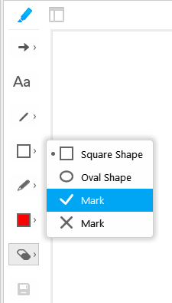
Annotation Tools
Find the grey marker pen in top left corner of the presentation screen.
Click to open the tool buttons in a column on the left side; the marker pen will turn blue.
Check mark
Click on square shape, half-way down.
Use the drop-down menu and choose the check mark.
Click on slide to indicate choice.
Notes:
BE SURE TO SAY THAT IF THEY DON’T HAVE ACCESS TO THE TOOLS, THEY CAN ALWAYS POST THEIR RESPONSES TO CHAT AND WE CAN ADD TO SLIDE FOR THEM!

Slide 9
How many years have you worked in libraries?
0-5 years
6-10 years
11-20 years
21-30+ years
Notes:
Suggestions:
Ask participants to use checkmarks to indicate the number of years
Do you want to narrow the question to “How many years have you worked in small and rural libraries?”

Slide 10
The Global Vision Conversation
Think about what challenges, issues, opportunities you share with all libraries
Remember
There are no right or wrong answers
Your experience will guide your answers
If you have an answer that no one else has given– it’s important to share it. It might change the world.
Notes:
Suggestion:
Introduce the purpose and format of the conversation and the following questions, as the previous question didn’t really need this framing.

Slide 11
Libraries in 2022 – Your Vision
Imagine the year is 2022, what have libraries achieved?
What would a newspaper headline say?
What keywords come to mind in your vision?
Share in Chat!
Notes:
Ask participants to share in CHAT.

Slide 12
Libraries in 2022– Your Vision
Notes:
SLIDE FOR SCRIBING

Slide 13
A vision on libraries
Q1. What do you see as the core values of libraries?
Q2. What are libraries exceptionally good at?
Q3. What could libraries do more of?
Q4. What could libraries do less of?
Q5. What are the main challenges to libraries?
Notes:
BE CLEAR that we’ll go through these questions one at a time

Slide 14
Q1. What do you see as the core values of libraries?
Notes:
Format so that there’s more definition/space between options – clear spaces for checkmarks
ADDING A 2ND COLUMN FOR MORE CHOICES
VOTING: place a checkmark to the left of the value –choose your top 3 values

Slide 15
Q2. What are libraries exceptionally good at?

Slide 16
Q3. What could libraries do more of?
Q4. What could libraries do less of?
More of |  | Less of
Notes:
both questions on one slide to save time, but will go through the questions and THEN invite them to use their 3 choices for each.

Slide 17
Q5. What are the main challenges to libraries?

Slide 18
A united library field
Q6. What would be the characteristics of a united library field?
Q7. What could be the focus of a united library field?

Slide 19
Q6. What would be the characteristics of a united library field?

Slide 20
Q7. What could be the focus of a united library field?

Slide 21
Wrap up and cool down
Thank you for sharing your voices and visions!

Slide 22
Next Steps
A summary of your contributions will be shared with IFLA
Vote! https://globalvision.ifla.org/vote
IFLA Global Vision report published in early 2018
Future workplan to achieve collective vision!
Visit https://globalvision.ifla.org
Stay tuned for news about the IFLA Global Vision discussion following #iflaGlobalVision
Notes:
This material will provide a basis for the IFLA Global Vision report which will be published in early 2018. Based on the report results, there will be a second round of meetings which will lead to the development of a work plan for how achieve the collective vision identified in an aligned, collaborative way.

Slide 23
IFLA's Global Vision:
An Interactive Discussion at ARSL
September 7
2:15-3:15pm or 4:00-5pm
Room: Entrada A
arsl.info

Slide 24
arsl.info
Become an ARSL Member Today!
Join us for more ARSL webinars
Receive quarterly member e-newsletter
Connect via member’s only Listserv
Annual Conference 2017
September 7-9, St. George, Utah
Annual Conference 2018
September 12-15, Springfield, Illinois

