Slide 1
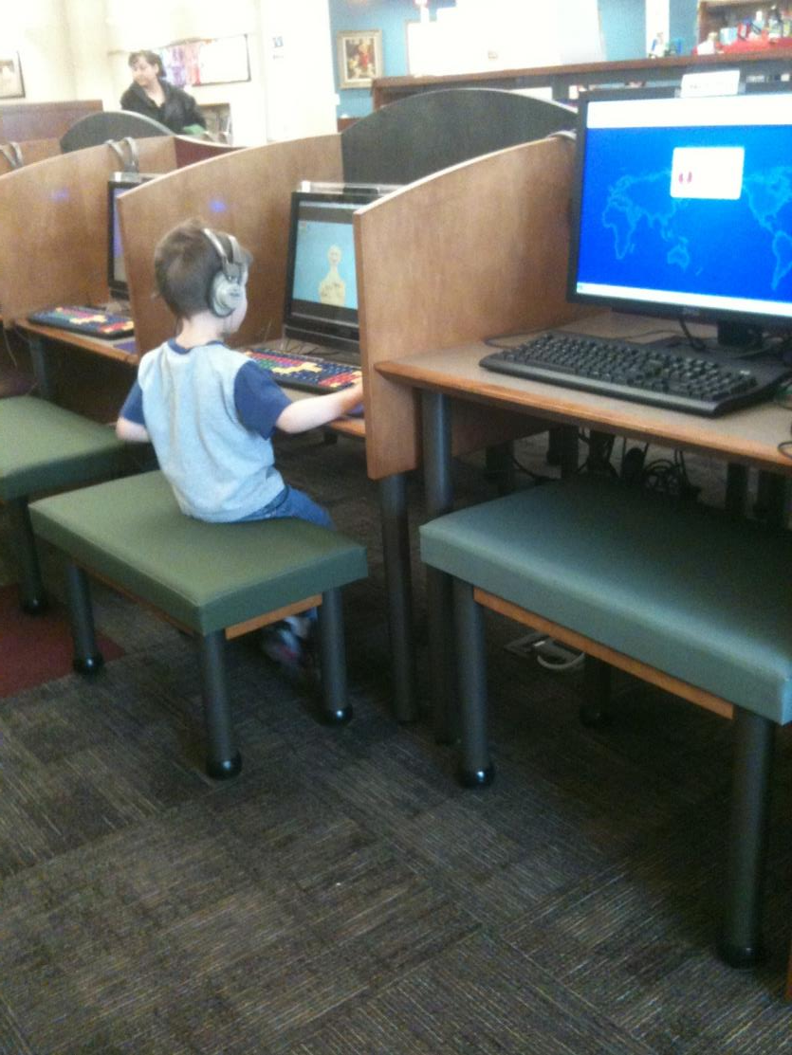
“The America
I love still
exists at the
front desks
of our public
libraries.”
- Kurt Vonnegut

Slide 2
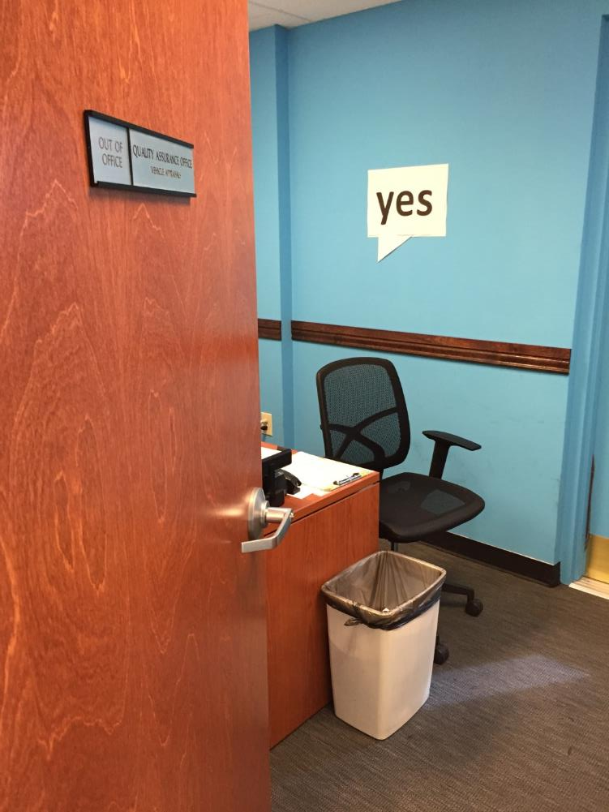
Creating a ‘Culture of Yes’ at Your Library and In Your Community
Kieran Hixon & Sharon Morris Colorado State Library

Slide 3
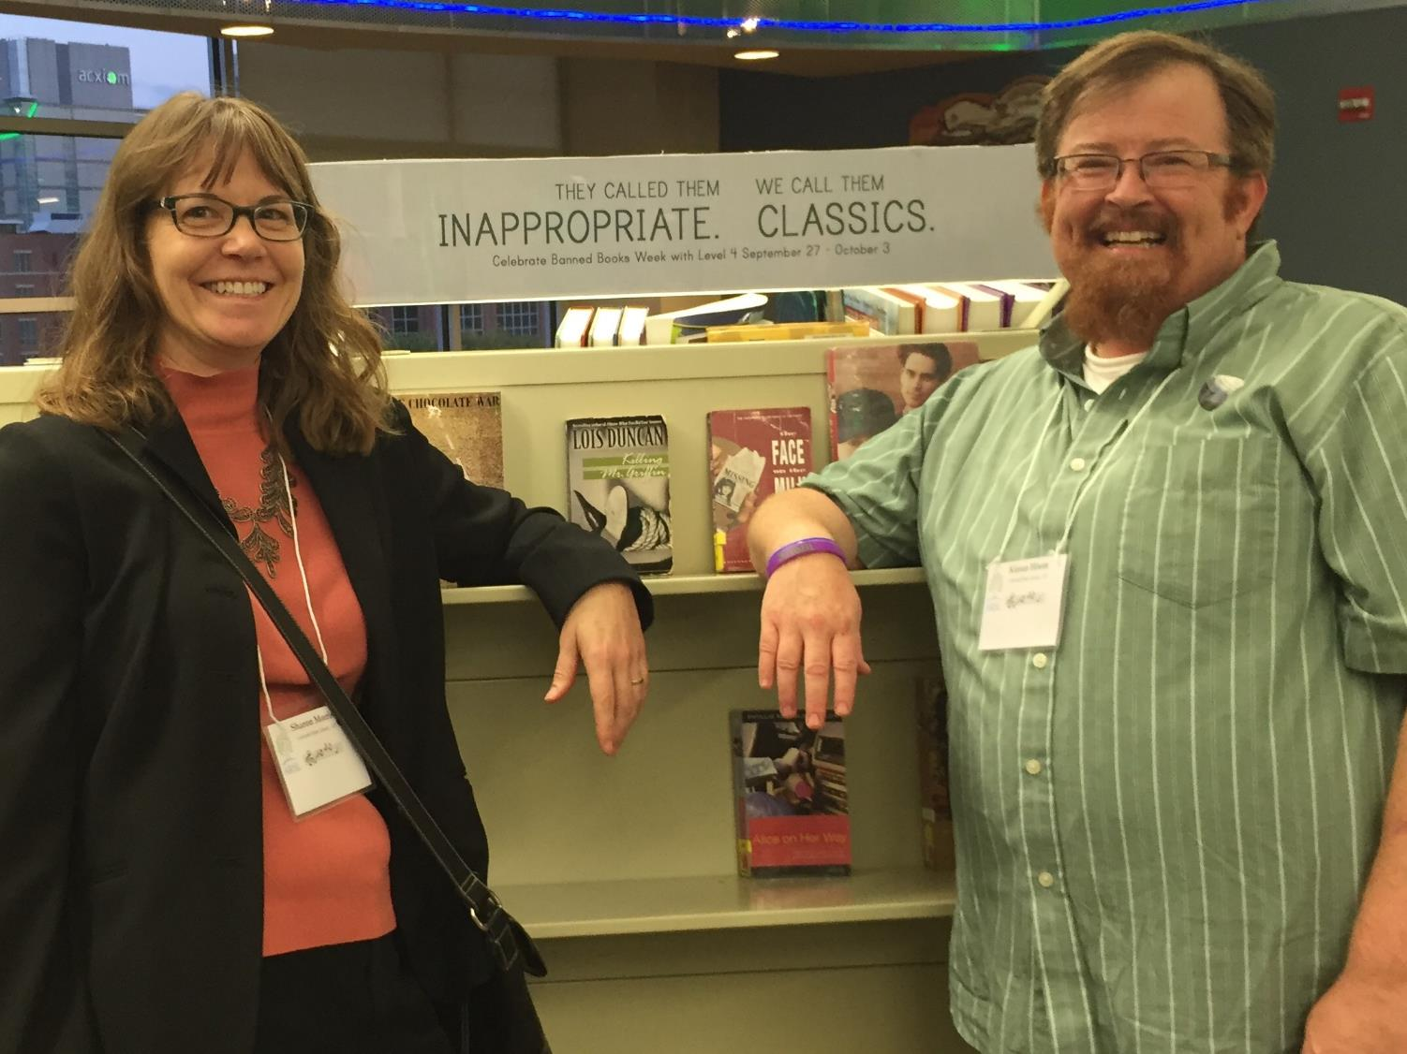

Slide 4
Observed at a library…

Slide 6
First Impressions?

Slide 7
Library First Impressions

Slide 8
Library – Yes, but

Slide 11
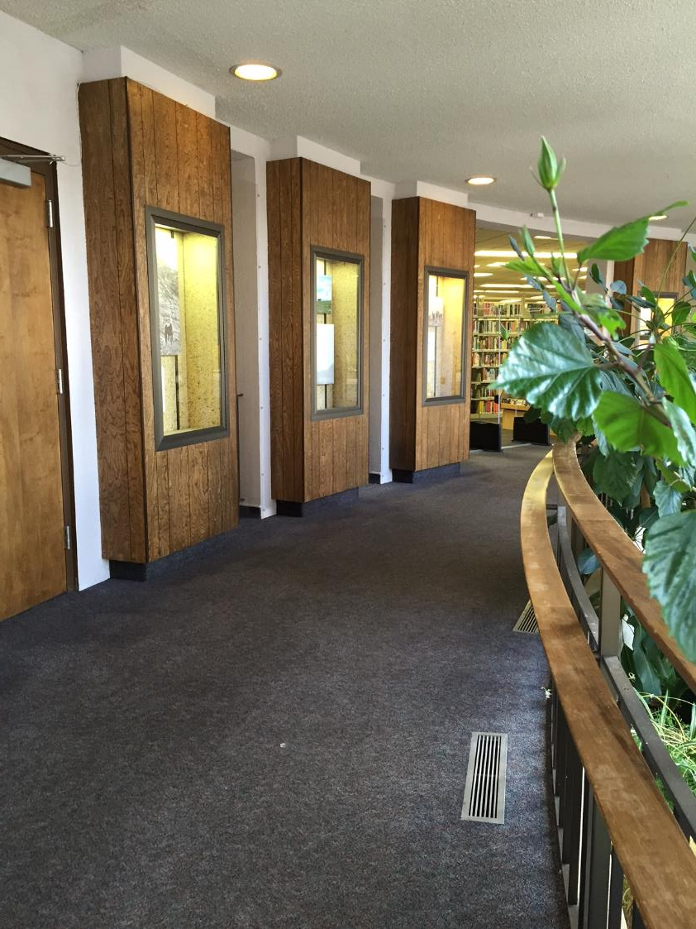

Slide 15
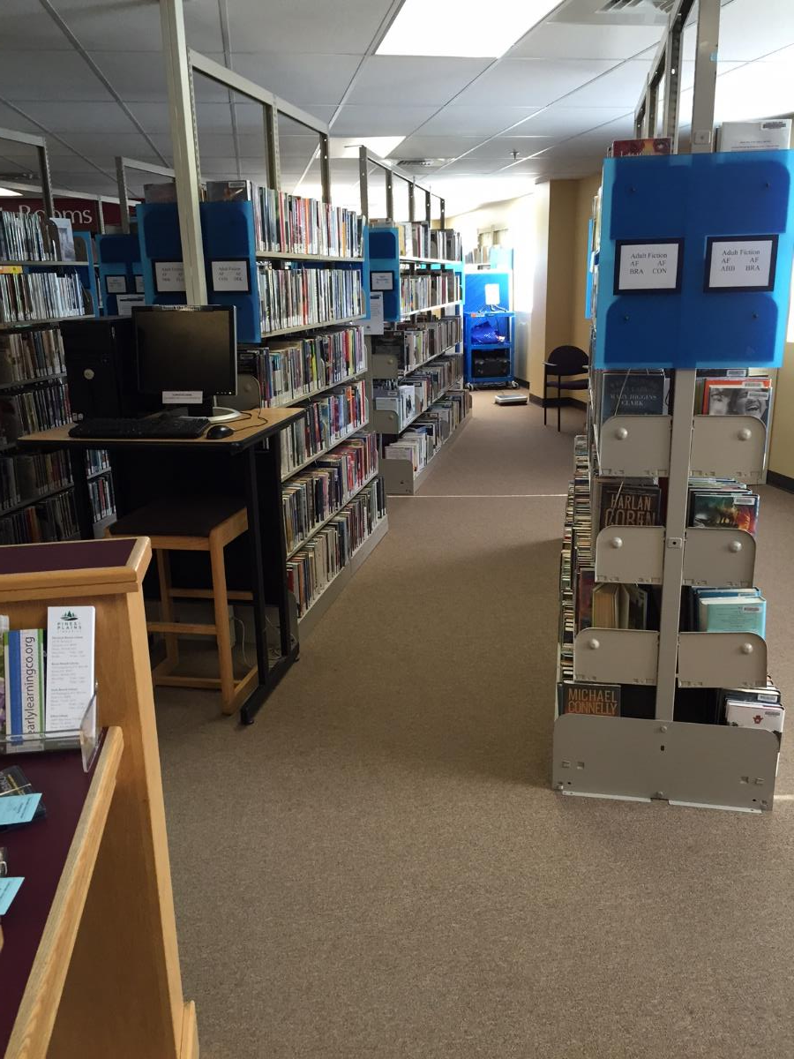
Collections

Slide 16
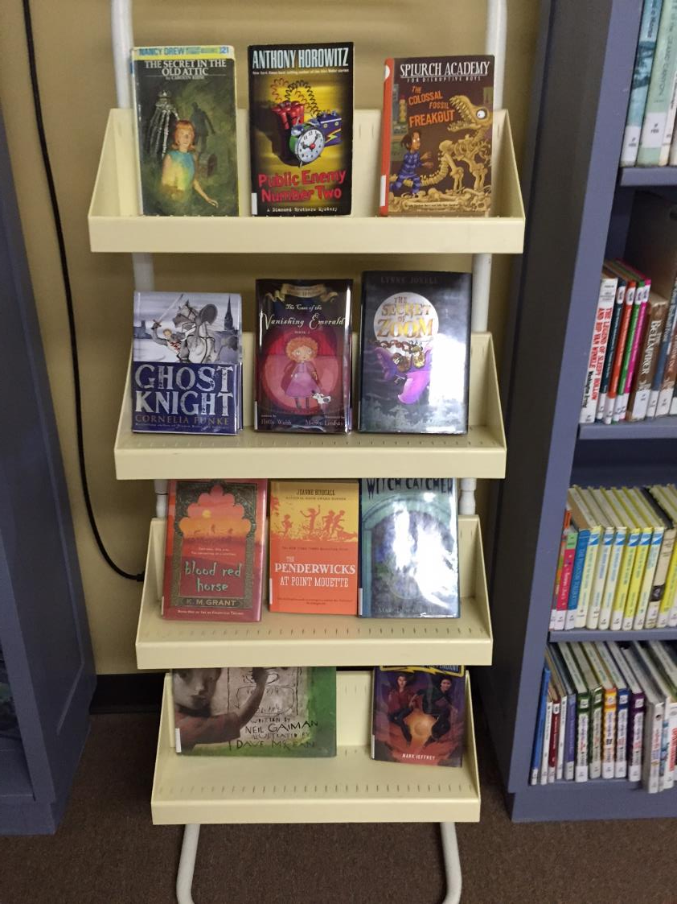
Yes, but …

Slide 17
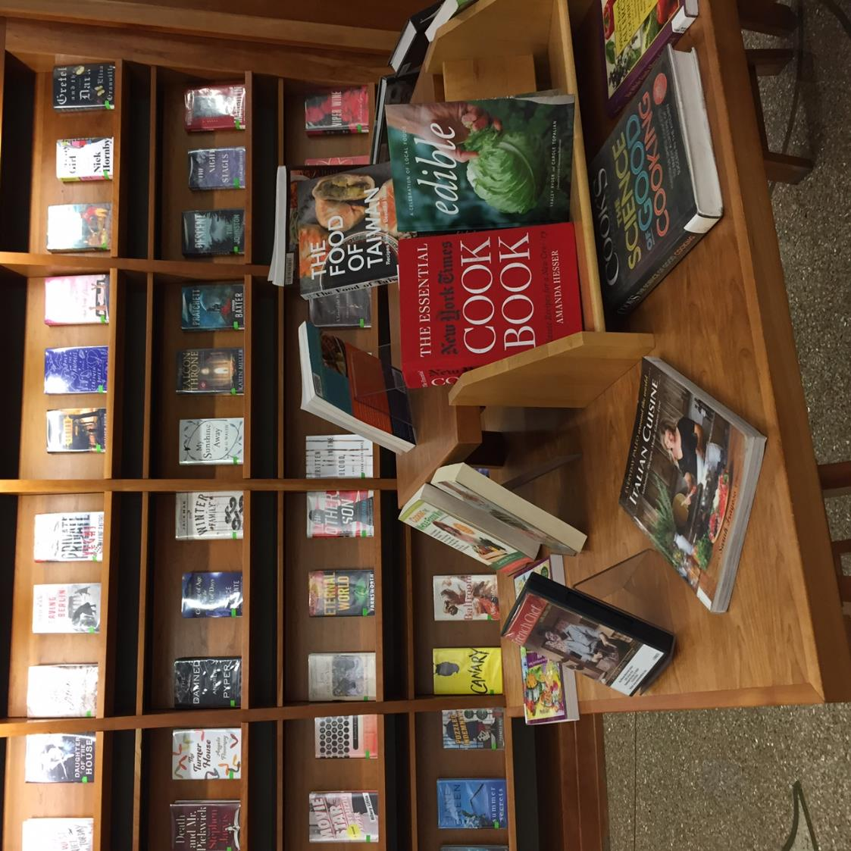

Slide 18
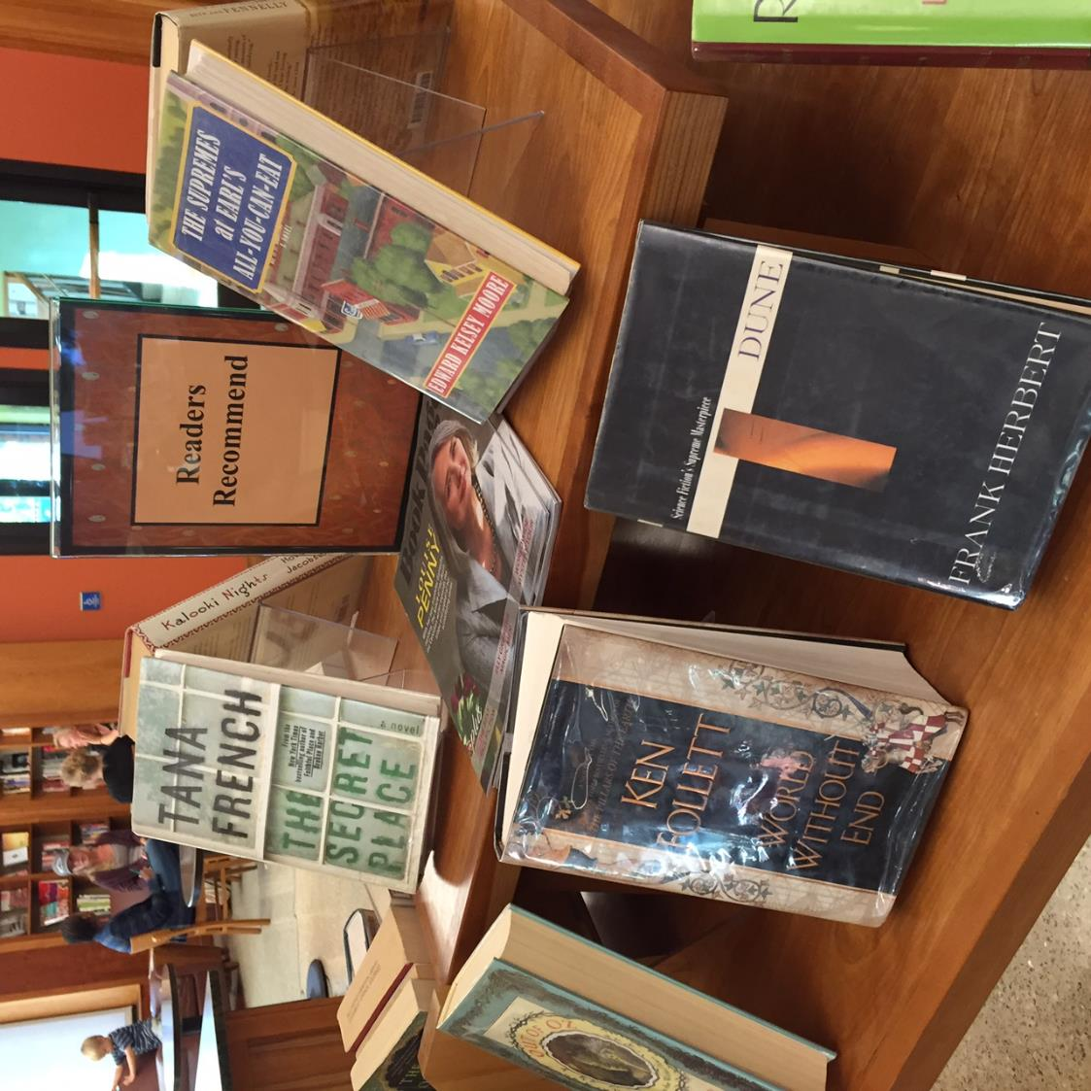

Slide 19
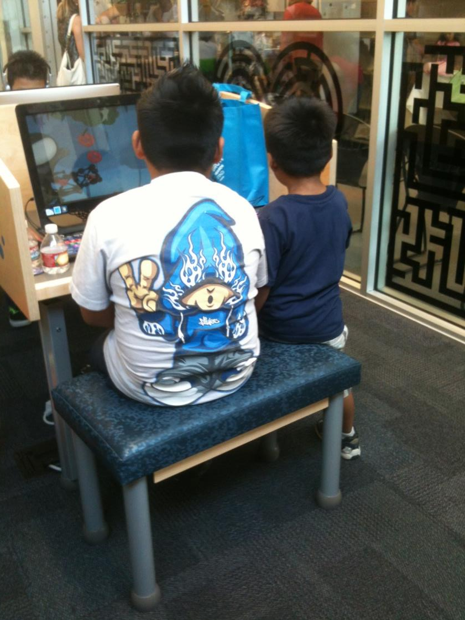
Customer
Service

Slide 20
Empowering
Engaging
Encouraging
Predictive
Responsive

Slide 21
Policies

Slide 22
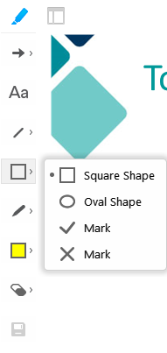
Annotation Tools
The tool buttons will open in a row on the left side of your screen, once you click on the marker, at the top left corner of the screen.
Check mark
Click on square, half-way down.
Use the drop-down menu and choose the check mark.
Click on slide to indicate choice.

Slide 23
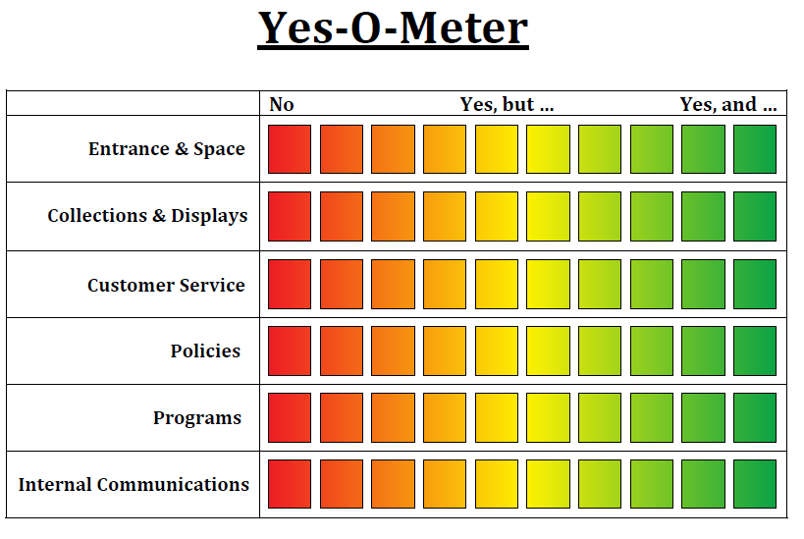
Think & Share – Three Things

Slide 24
Summary & Outcomes
Discover at least three ways to go from good enough to unexpectedly amazing
Look at the value of “Yes, and…” as it applies to displays, policies & services at your library
Share and learn techniques for shifting your library culture to invigorate the relationships between your staff and your community

Slide 25
“Always say ‘yes’
to the present moment...
“Say ‘yes’ to life and see how life
starts suddenly to work for you
rather than against you.”
- Eckhart Tolle

Slide 26
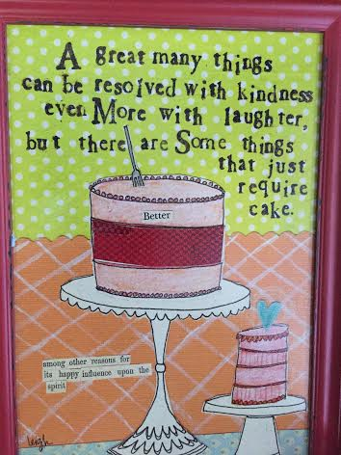

Slide 27
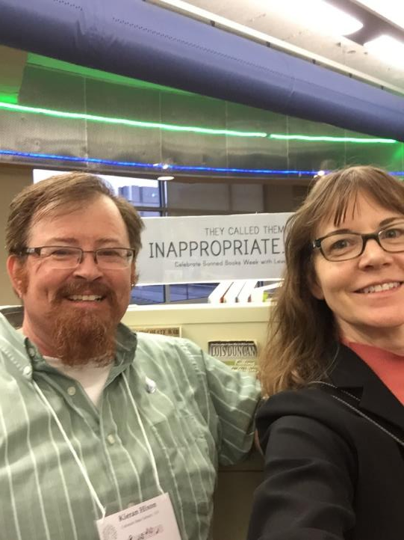
Thank you!
Kieran Hixon
kieran@coloradovirtuallibrary.org
Sharon Morris
Morris_s@cde.state.co.us

