Slide 1

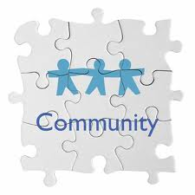



Public Health and Public Libraries:
Librarians as Health Literacy First Responders
Lydia N. Collins
Consumer Health Coordinator (NN/LM MAR)
Anita Kinney
Program Analyst, United States Access Board
Christian I.J. Minter
Nebraska/Education Coordinator, (NN/LM MCR)

Slide 2

Health Literacy:
Why It Matters

Slide 3
What is Health Literacy?
“The degree to which an individual has the capacity to obtain, communicate, process, and understand basic health information and services to make appropriate health decisions.”
Patient Protection and Affordable Care Act of 2010, Title V

Slide 4

“Cost” of Low Health Literacy
36% of the U.S. adult population (87 million people) have basic or below basic health literacy.
Low health literacy costs the U.S. approximately $106 billion to $236 billion annually.
URL for The Health Literacy of America’s Adults Report (2006)
URL for Low Health Literacy: Implications for National Policy (2007)

Slide 5
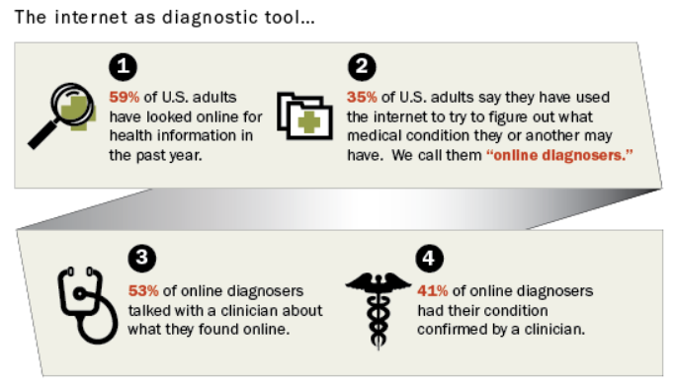
Seeking Health Information Online
URL for Pew Health Online 2013

Slide 6
Health Literacy & Your Community

Slide 7
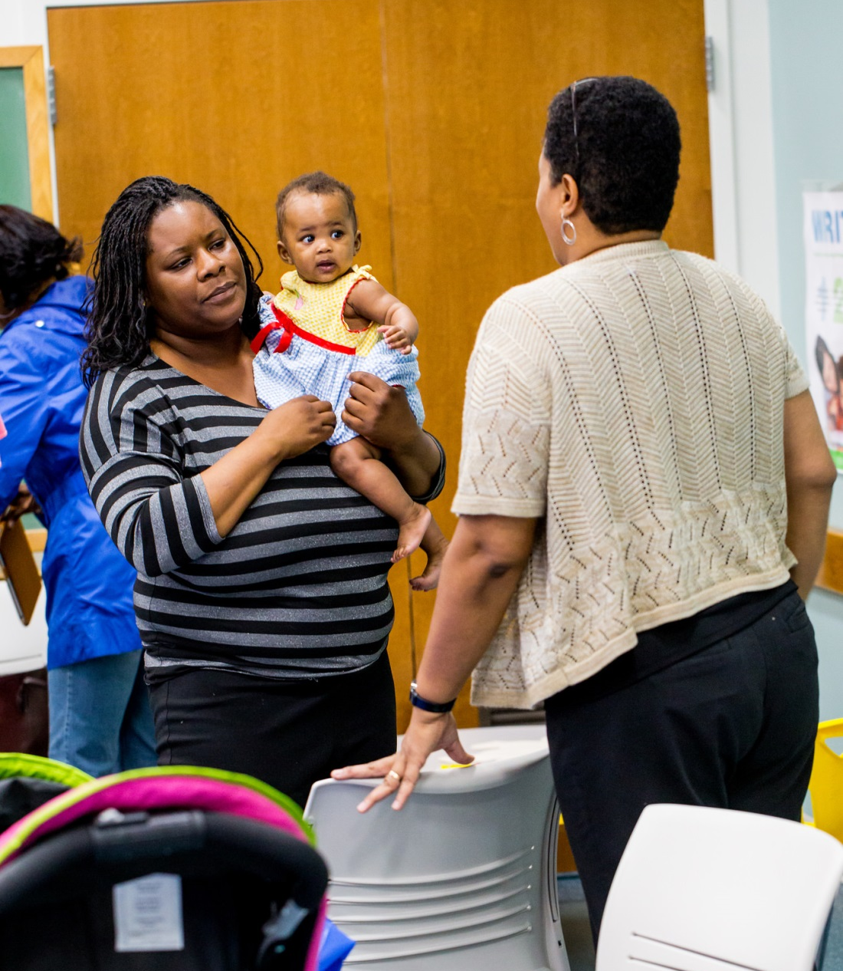
Changing Health Behaviors through Education
Prenatal and postnatal care can drastically affect a child’s development: children’s librarians can make a difference!
Photo credit: Prince George’s County Memorial Library System

Slide 8

Back to Sleep Campaign
Objectives of Campaign
Reduce the risks of SIDS by 10% over a 5 year period
Increase awareness/knowledge of risks of SIDS
Increase awareness/knowledge of parent actions to reduce risk of SIDS
In Canada
Photo credit: “Tools of Change”

Slide 9
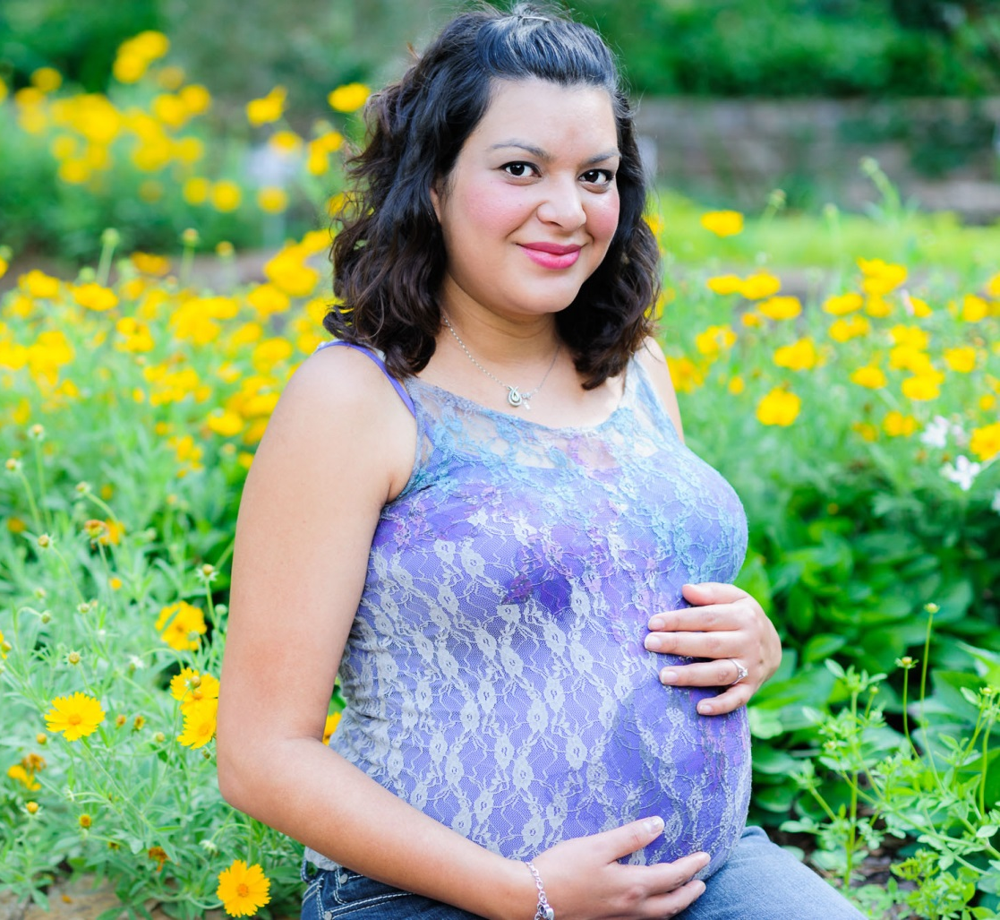
Health Disparities Between Communities
Latina women have the highest rate of children affected by spina bifida
This is a neural tube defect linked to low folic acid consumption during pregnancy.
Spina bifida was reduced in Hispanic communities through effective public health campaigns.
Photo Credit: medicalxpress.com

Slide 10
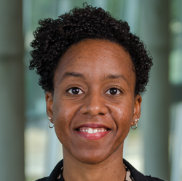
NLM and NN/LM
(Training and Resources)

Slide 11

U.S. National Library of Medicine
Established in 1836
One of the institutes of the National Institutes of Health (NIH)
World’s largest biomedical library
Produces free, authoritative electronic health information resources
130+ health information databases
URL for NLM

Slide 12
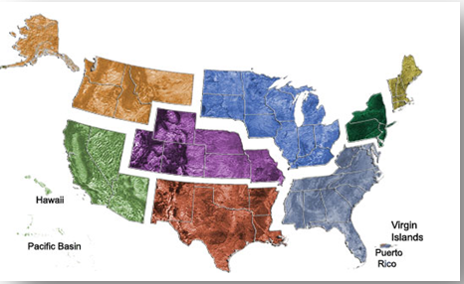
National Network of Libraries of Medicine (NN/LM)
Nation-wide program coordinated by the National Library of Medicine
Established in the National Library of Medicine Act (1965)
Core component of NLM outreach
8 Regional Offices
Mission: Provide health professionals and the general public with equal access to health information
URL for NN/LM

Slide 13
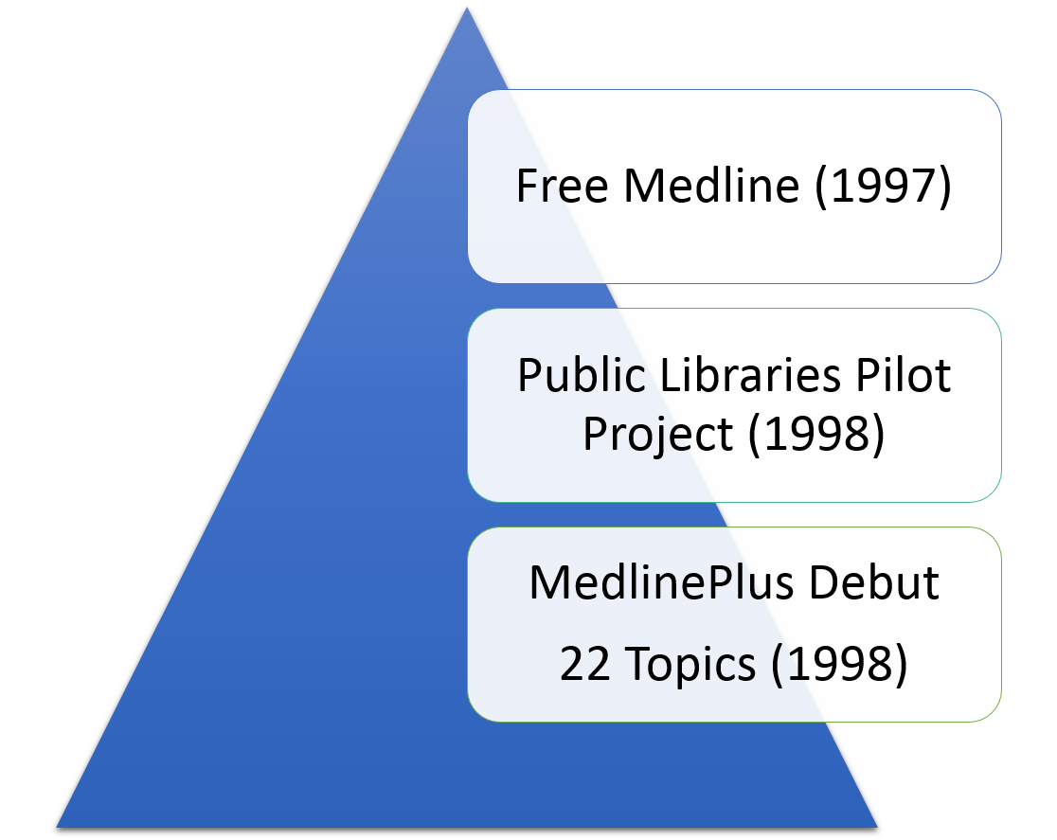
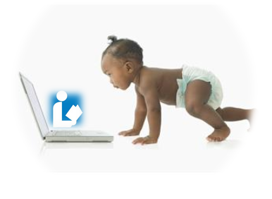

NN/LM & The Birth of Consumer Health Outreach

Slide 14
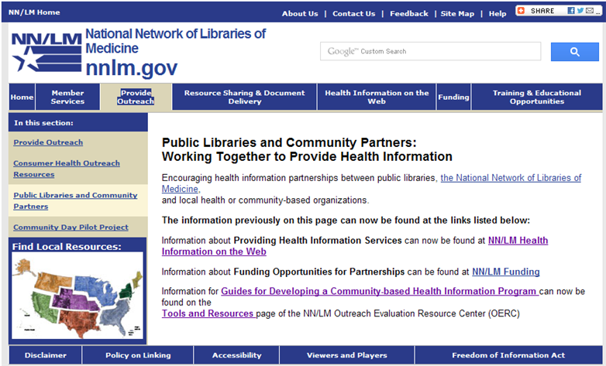

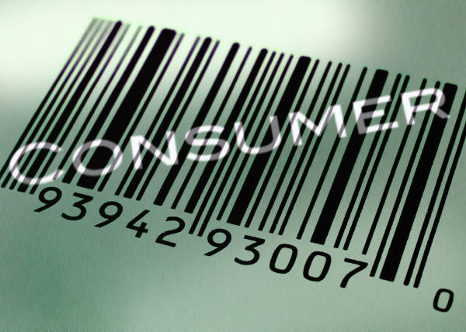
NN/LM Mission Expanded
Implementation:
  Training
  Funding
  Exhibiting
  New RML staff position
Expanded to include:
  Outreach to the general public
    Focus on special and underserved populations
  Collaborations with public libraries, community and faith-based organizations
URL for Public Libraries as Community Partners (NNLM)

Slide 15
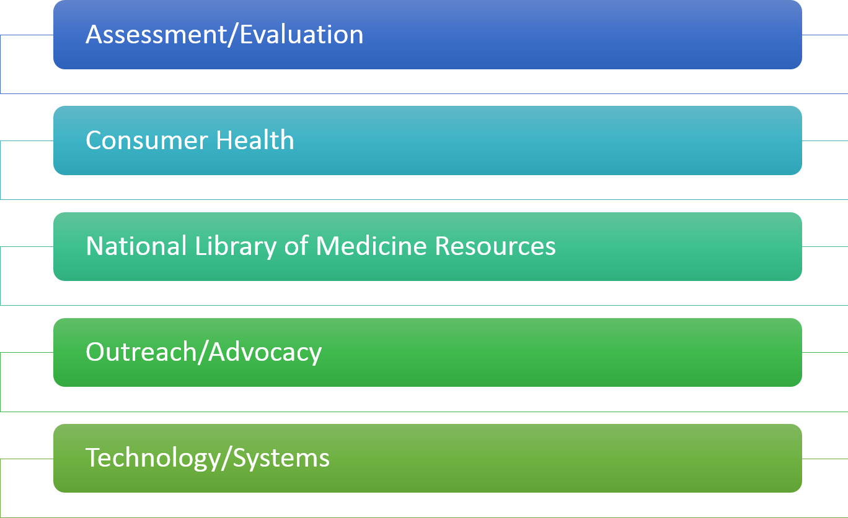
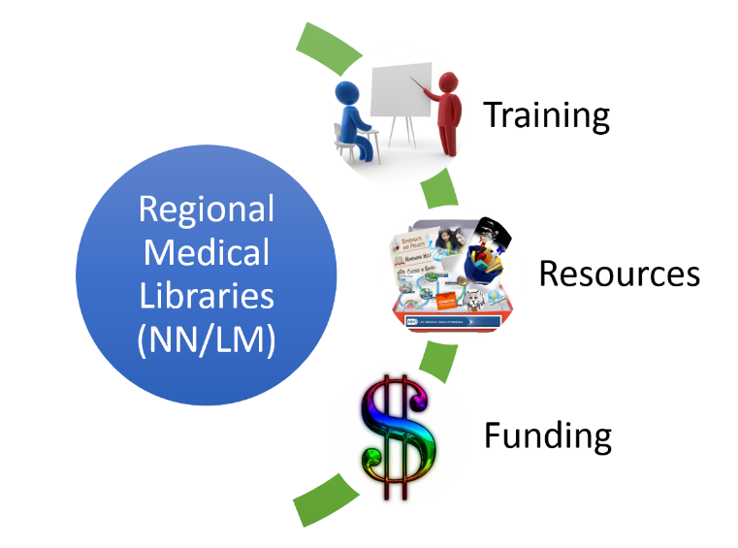
Support from Your Regional Medical Library
URL for NN/LM Training Page
URL for NN/LM Funding Information

Slide 16
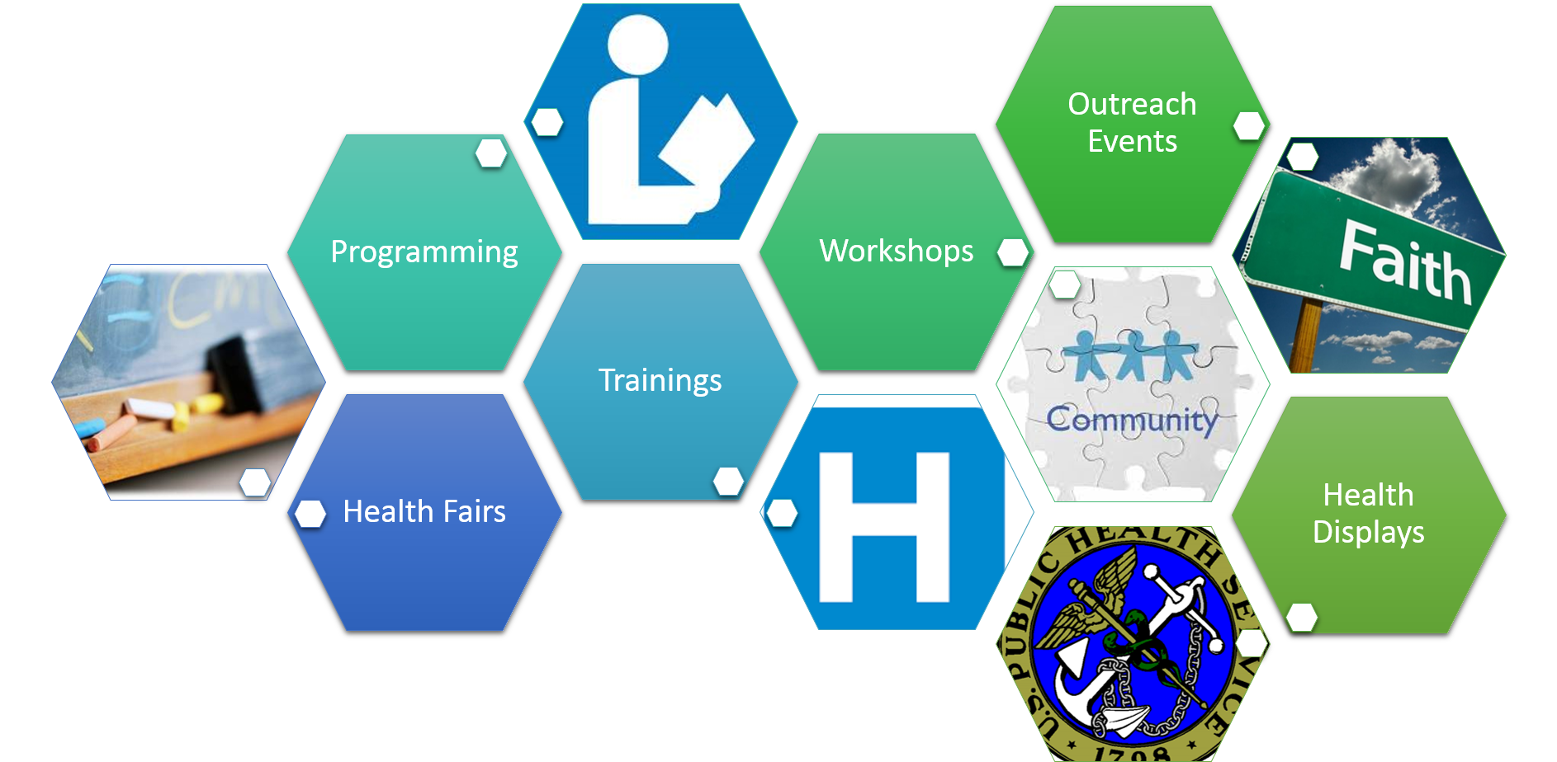
Strength in Partnerships

Slide 17
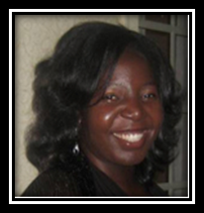
NLM Consumer Health Resources and
Health Programming Ideas

Slide 18
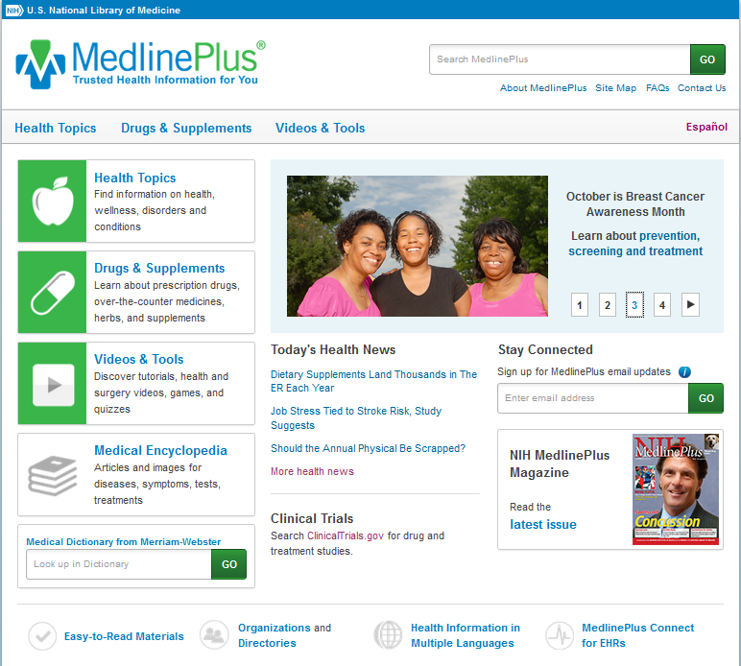
MedlinePlus
URL for MedlinePlus

Slide 19
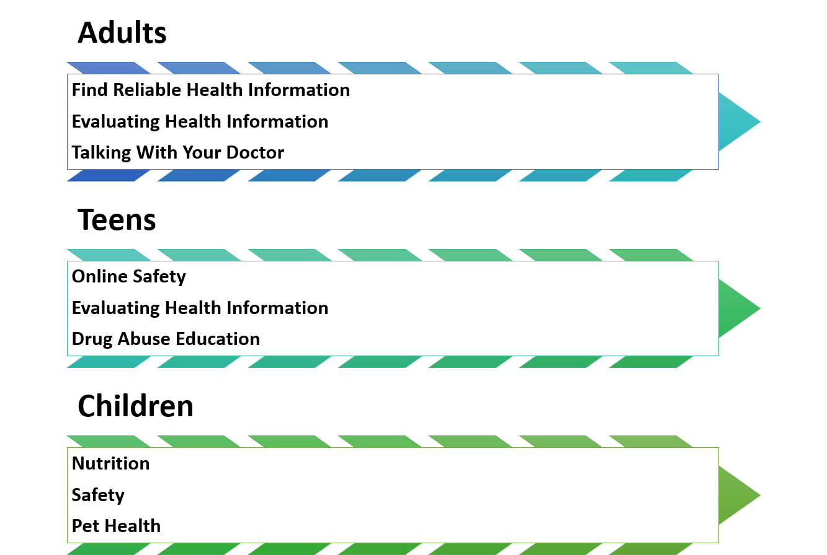
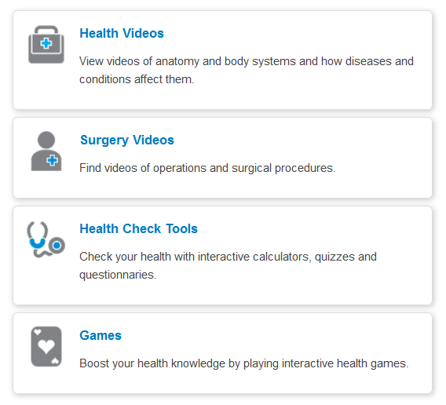
MedlinePlus Program Ideas
URL for Videos & Tools (MedlinePlus)

Slide 20
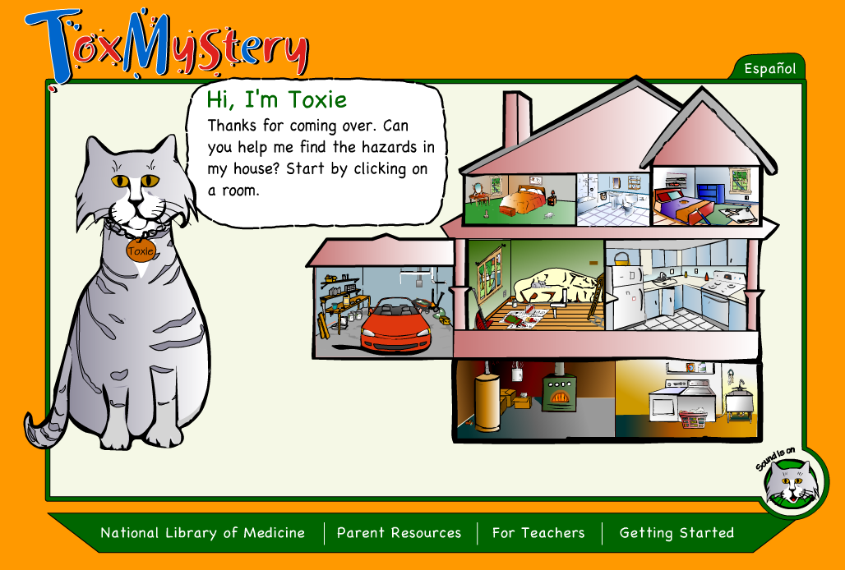
ToxMystery
Toxie the Cat helps children (ages 7-11) find the hazards hidden in each room and offers hints when needed.
Available in English and Spanish
“For Teachers” section includes 3 lesson plans with student worksheets/activities”
Parent Resources
URL for ToxMystery

Slide 21
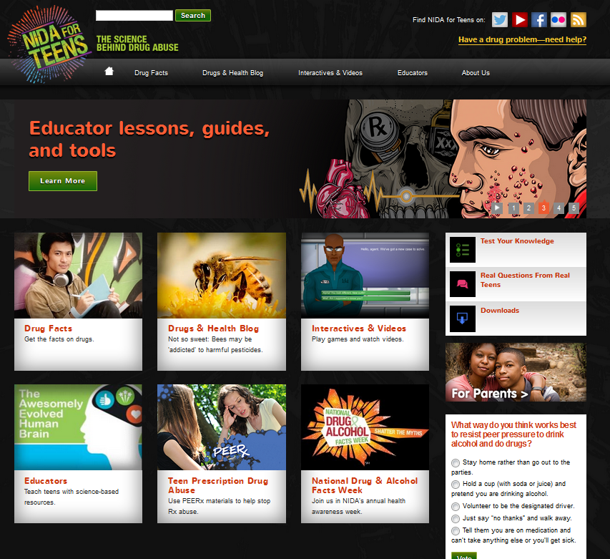
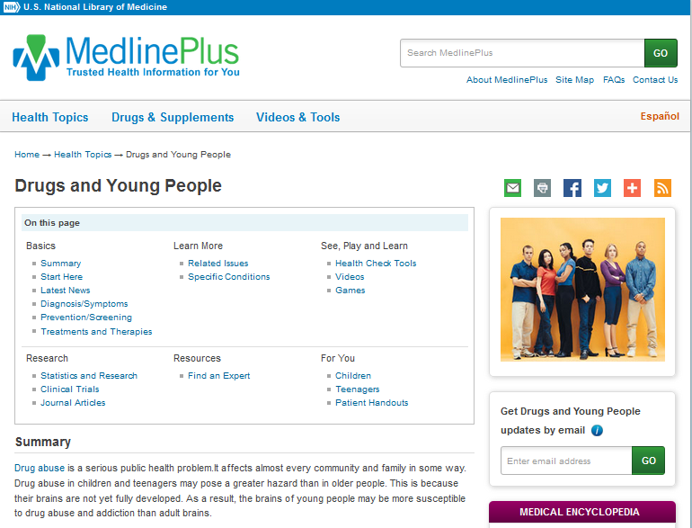
Drug Information Program Ideas (Teens)
URL for NIDA for Teens
URL for Drugs and Young People (MedlinePlus)

Slide 22
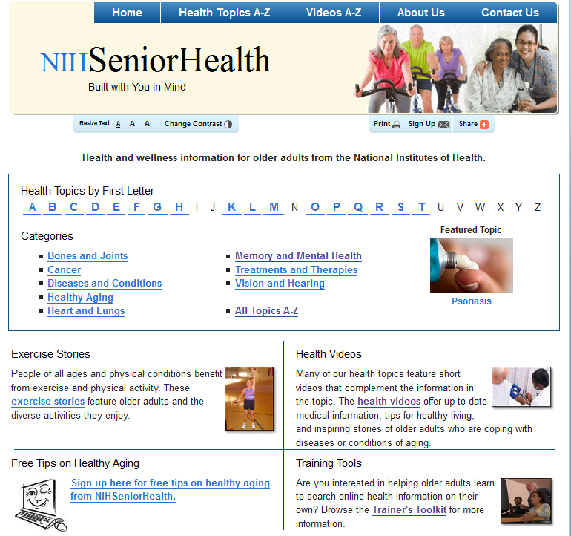
NIHSeniorHealth
URL for NIHSeniorHealth and URL for NIHSeniorHealth Trainer’s Toolkit

Slide 23
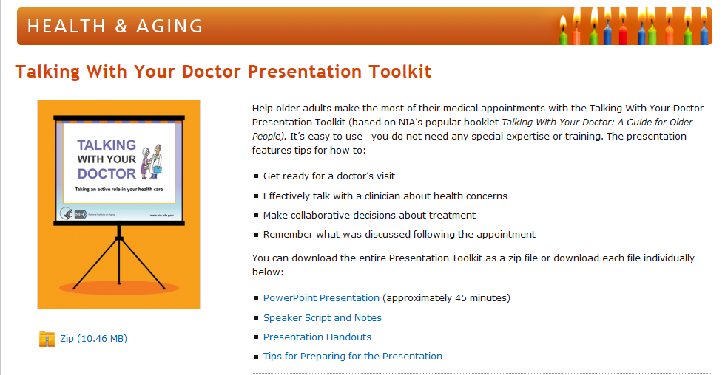
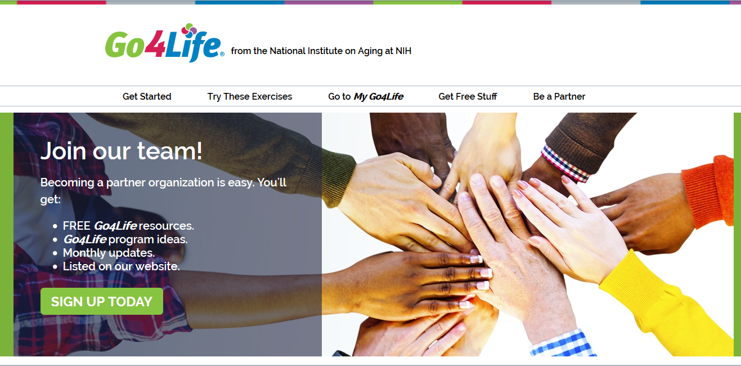


NIHSeniorHealth Program Ideas
URL for Talking With Your Doctor Presentation Toolkit
URL for Go4Life Campaign Partner Information
URL for Go4Life Get Free Stuff

Slide 24
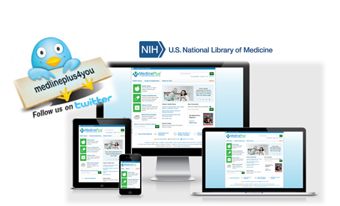
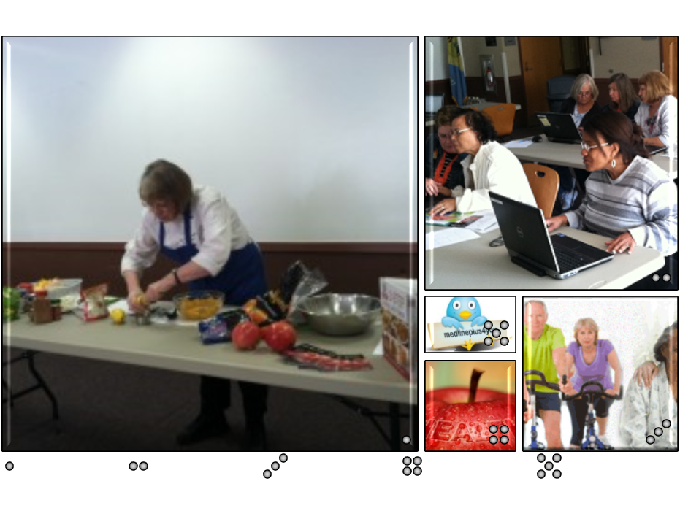
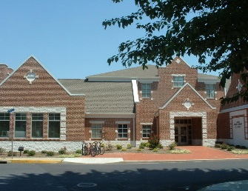

NN/LM MAR: Region 1
Cooking for Good Health
Laurel Public Library
Laurel, DE

Slide 25
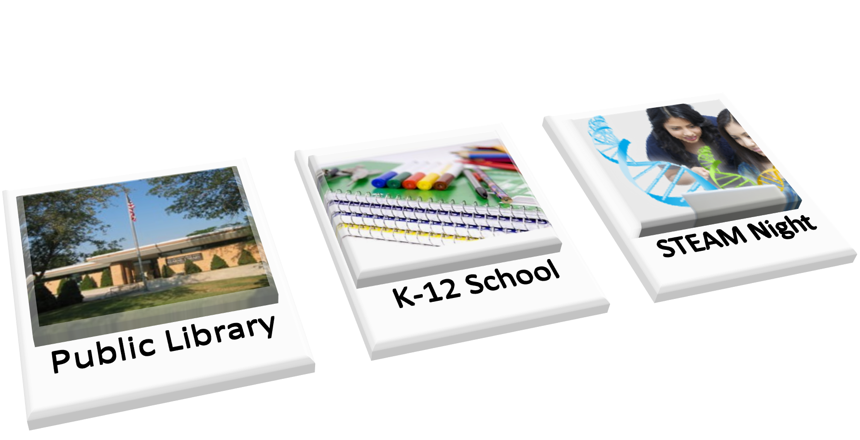
NN/LM MCR: Region 4

Slide 26

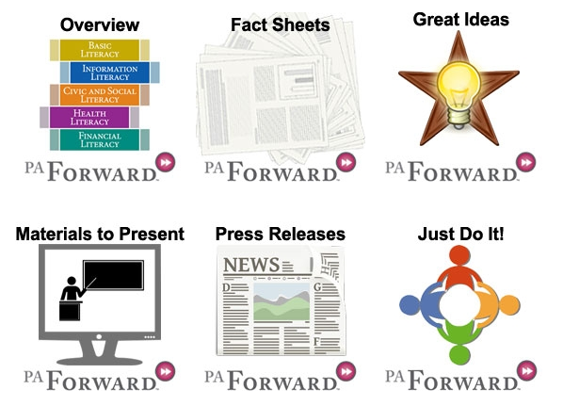
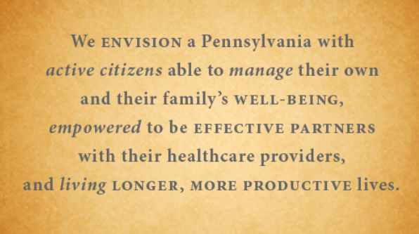
PA Forward-PaLA
URL for PA Forward web site
URL to PA Forward Toolkit

Slide 27
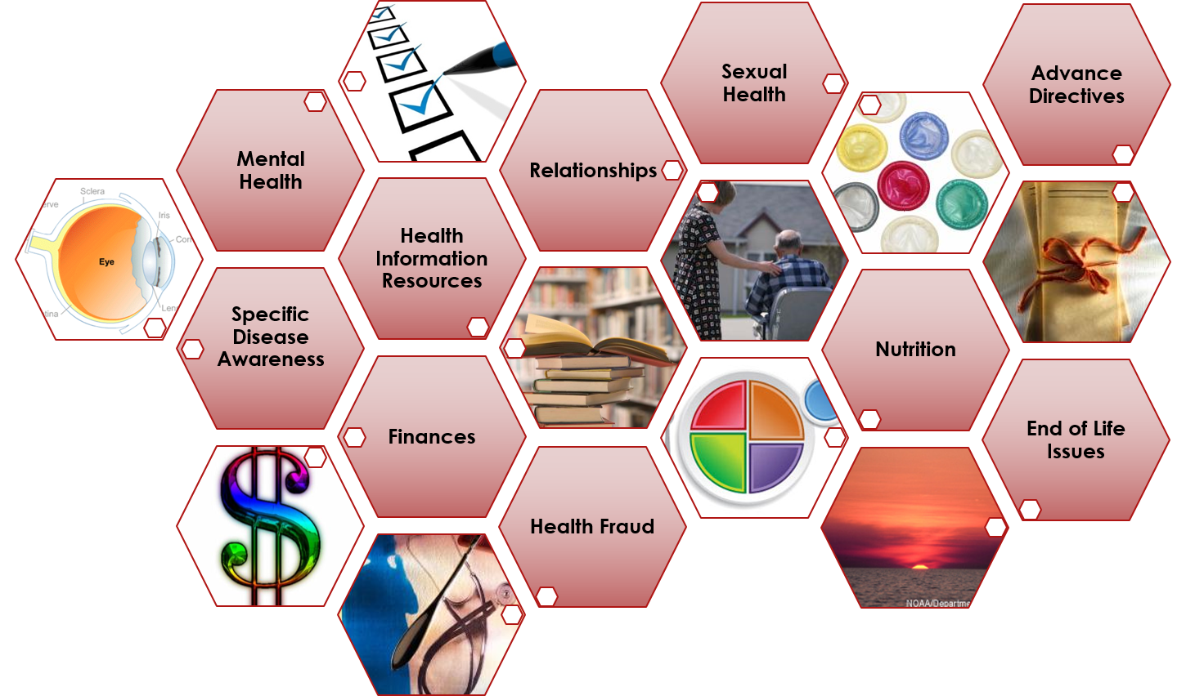
Health Program Ideas

Slide 28

Consumer Health Toolkit
What’s inside…
Consumer Health Resources
  Health Check Tools
  Mobile Apps & Sites
Consumer Health
Information Services
  Community Needs Assessment
  Reference Services
Technology & Health
  Health-related Audio and Video Podcasts
  Personal Health Records and Electronic Health Records
Workplace Wellness
  Creating Healthy Libraries
  Planning and Implementing Wellness Programs
and more
URL for Consumer Health Toolkit

Slide 29



Summer Reading 2016: Wellness, Fitness & Sports
Children: On Your Mark, Get Set, Read
Teens: Get in the Game: Read
Adults: Exercise Your Mind – Read
URL for NN/LM MAR Training

Slide 30


Take-Away Points
No activity is too small
Partner with local agencies
Look to NLM for great resources!
Contact your local NN/LM office to support your efforts!!

Slide 31

Thank You
Lydia N. Collins
NN/LM MAR Consumer Health Coordinator
lydia@pitt.edu
Anita Kinney
Program Analyst, United States Access Board
anitaskinney@gmail.com
Christian I.J. Minter
Nebraska/Education Coordinator, (NN/LM MCR)
christian.minter@unmc.edu
This project has been funded in whole or in part with Federal funds from the National Library of Medicine, National Institutes of Health, Department of Health and Human Services, under Contract No. HHS-N-276-2011-00003-C with the University of Pittsburgh, Health Sciences Library System and under Contract No. HHS-N-276-2011-00006-C with the University of Utah Spencer S. Eccles Health Sciences Library

