Slide 1
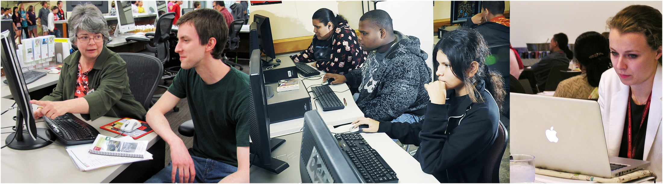
Designing & Delivering
Online Training
Library CE Institute
Online Session 4
WebJunction – Infopeople – IMLS

Slide 2
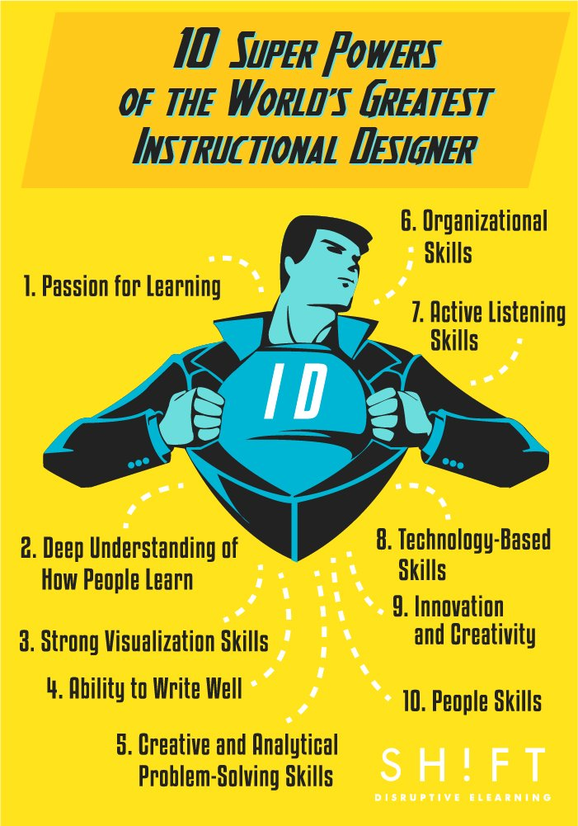

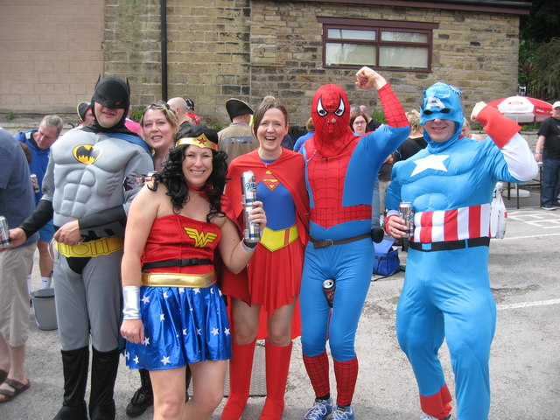
EdTech Infographics

Slide 3
Agenda for today
Project Check-ins
Group Coaching Sessions
Project Case Studies – WJ & Infopeople
Learning Objectives

Slide 4
Project check-ins:
challenges, successes discoveries, tips

Slide 5
Working Groups
Change
Course Topic:
mitigating change
Leadership
Course Topic:
giving constructive feedback
Technology
Course Topic:
social media etiquette
Youth
Course Title:
Encouraging Early Literacy
Bonus!
Course Title:
10 Ways to Make Work Fun (Again)

Slide 6
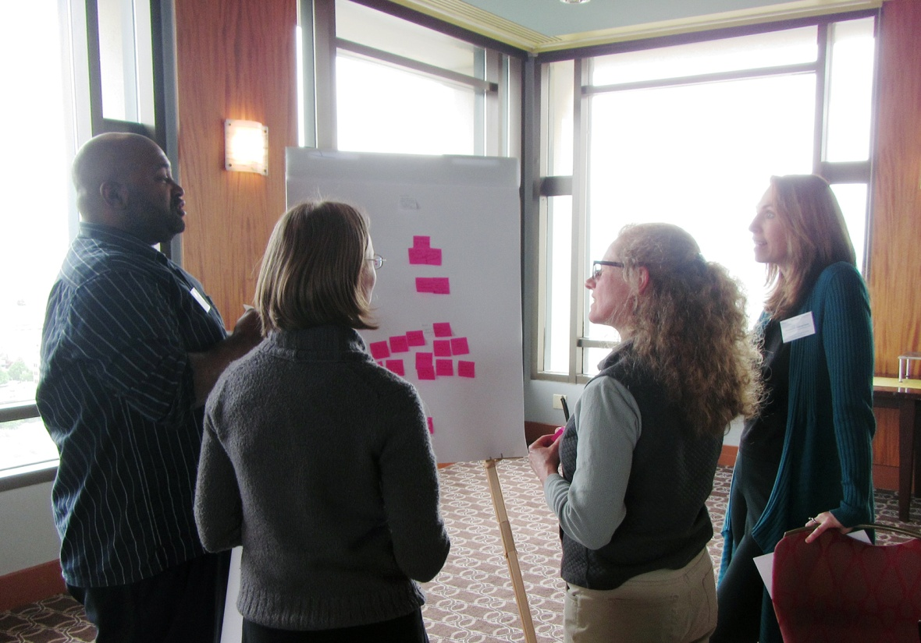
Group: change
Topic: mitigating change
Members
Katherine Adelberg
Maurice Coleman
Katie Fearer
Stephanie Zimmerman

Slide 7
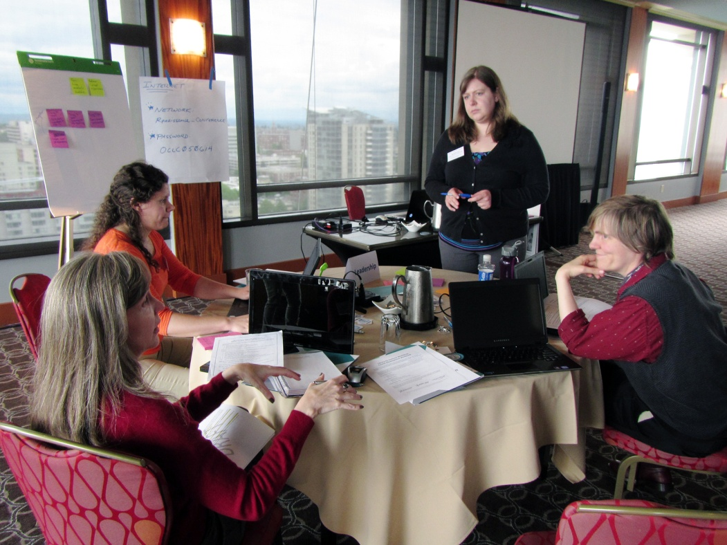
Group: leadership
Topic: Giving constructive feedback
Members
Tiffany Hayes
Christine Kreger
Meredith Lowe
Kelly Jo Woodside

Slide 8
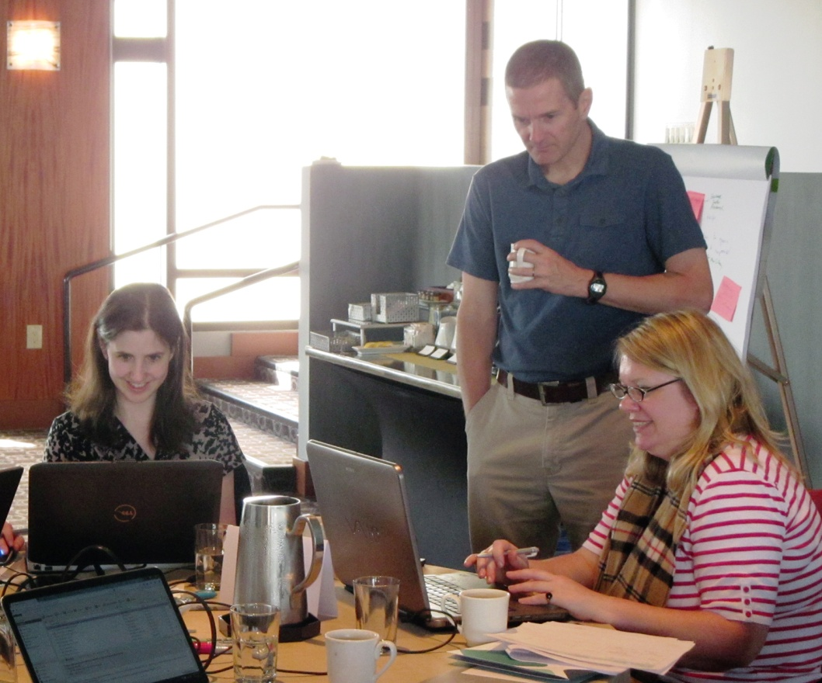
Group: technology
Topic: social media etiquette
Members
Amy Calhoun
Jamie Matczak

Slide 9
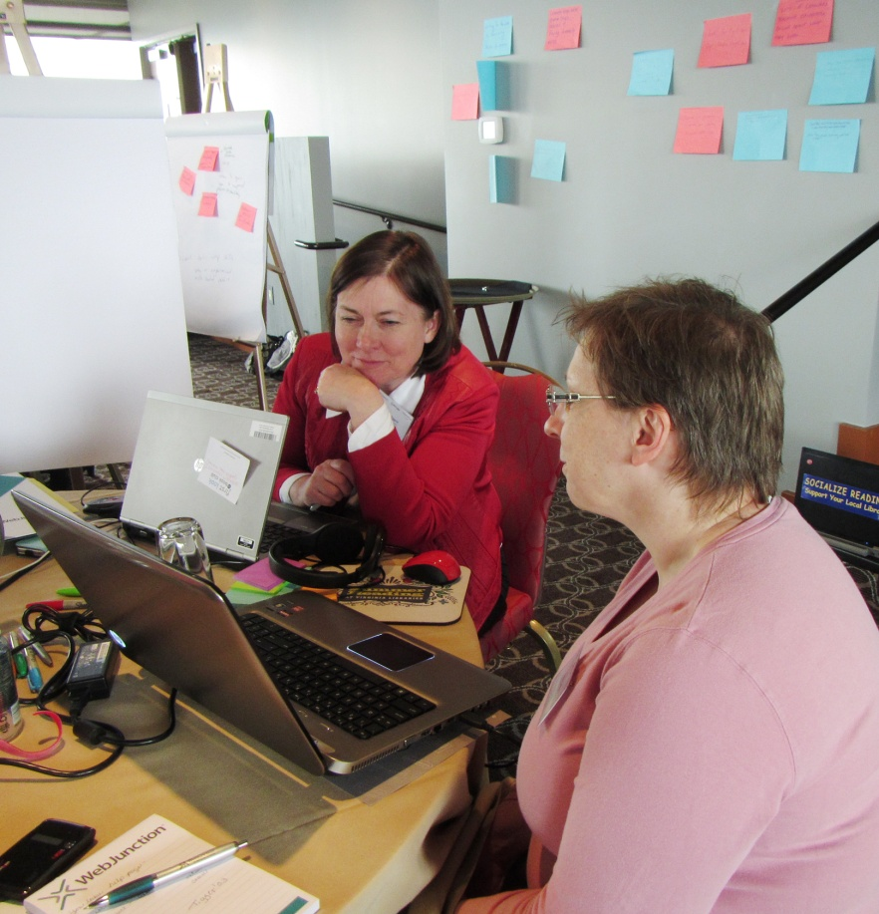
Group: youth / staff training
Course Title:
Encouraging Early Literacy
Course Title:
10 Ways to Make Work Fun (Again)
Members
Enid Costley
Colleen Eggett

Slide 10
Group Coaching Sessions

Slide 11
Got questions?
Let’s talk.
Set up some time with Mike & Kathleen to meet with you virtually.
Walk through content – either storyboard, outline or Storyline.
Beginning next week and into July.

Slide 12
What you have time for
Find
Your
20%
What you cover
What they’ll hear
What they’ll remember
What they’ll USE
DESIGN STARTS HERE
From Bozarth, J. (2008). From Analysis to Evaluation: Tools, Tips, and Techniques for Trainers. San Francisco: Pfeiffer.

Slide 13
Got content?
WJ Course Model: build on existing content that has already resonated with some learners
Identify areas where you could enhance content to instill learning through practice
Layout content / consider your design – how does it reinforce learning through practice or exploration?
Notes:
Content – Chunking -

Slide 14
Practice using Storyline
Start small – test approaches in a sample course file, then start to incorporate into
real content
Explore existing course examples and see what seasoned self-paced instructional designers are doing. Then try one thing.
Notes:
SWATCH first

Slide 15
Case Studies
WJ & Infopeople

Slide 16
Model/Case Study
WJ & Infopeople working together to draft and will share soon
Map out a helpful course creation process
“If I were to do it all again….” lessons
Reminder: learning takes learning and doing
Notes:
There is a lot of library-specific training content – it’s just not online or in a self-paced format. Yet.
Start with existing content. Something that takes 1 hour to present live.

Slide 17
Learning Objectives: Library CE Training Institute

Slide 18
Beyond learning objects
Why are we doing this again?
Change the mindset about online learning
Promote collaboration in elearning development and delivery
Create replicable models for creating library-specific content
Increase the access, reach and impact of library training programs

Slide 19
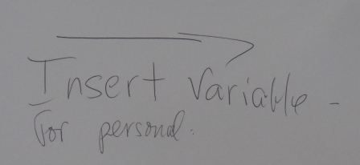
Project Plan Checkin
Virtual Collaboration and Communication
Track
Analyze
Design
Develop
Publish
Evaluation and Revision
You are here
Notes:
Where are we in the process…Heads down, learning, sharing, creating!
Let’s review the steps in that plan and see where we are.

Slide 20
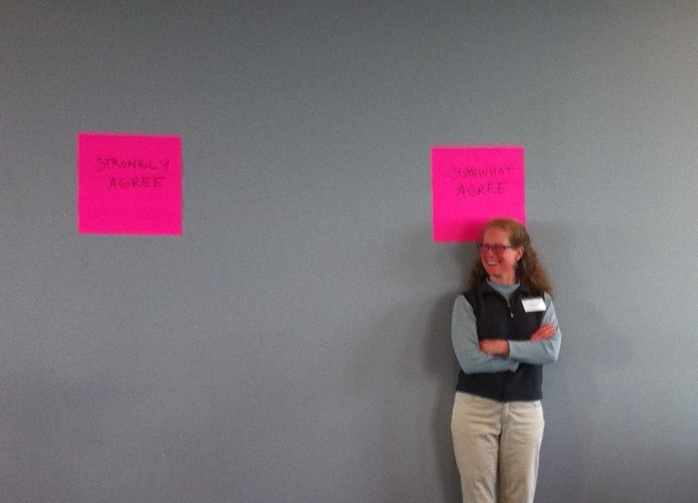
Change the mindset
Articulate the distinct advantages of online learning and learn strategies to make effective use of online formats for adult learners
Promote the advantages of online learning to others
Define strategies to support and empower learners
Self-paced e-learning offers the possibility for creating uniquely valuable learning experiences.
Notes:
Remember Katie was our lone ‘somewhat agree’ in the stand/deliver exercise:
ask everyone to stand next to the post-it that fits their level of agreement with the statements:
self-paced e-learning offers the possibility for creating uniquely valuable learning experiences.

Slide 21
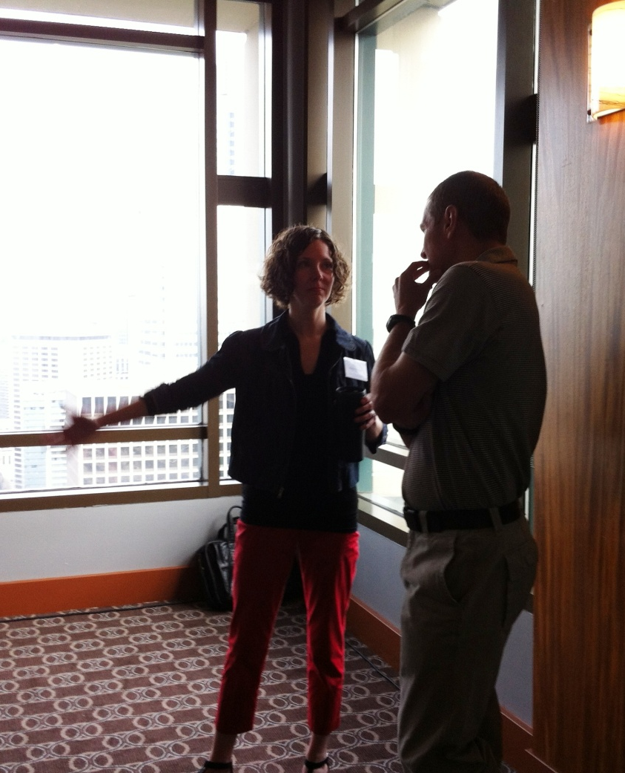
Pitch Perfect
Have you had a conversation with a “resistor” who needed convincing?
‘Resistor’ persona
Strongest reactions/traction
How did it go?
What would you say differently?

Slide 22

Promote collaboration
Describe benefits of and strategies for collaboration across the CE field
Identify working groups and devise plans for working together to create learning objects
Develop strategies for ongoing collaboration for future content creation
Connect with their organizations to increase coordination of CE providers
Notes:
Right now, focused within our teams
Will next move to understanding how we can expand our collaborations across teams and beyond
You’re providing leadership in CE field!
Keep this objective on your radar as we move forward…

Slide 23
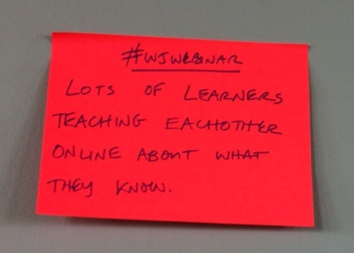
Create replicable models
Apply existing knowledge and learn new skills in the use of content creation tools
Devise pilot models for rapid, cost-effective development of elearning content
Increase skills with tools to create good quality, platform-agnostic, modular, easily shareable learning objects
Identify a plan to teach the model to others

Slide 24
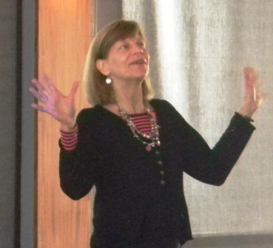
Increase the access, reach and impact
Extend the reach of their training efforts via online access
Incorporate a quality-assurance process in their models
Select topics that build 21st century library competencies
Address topics in a way that is nationally relevant

Slide 25
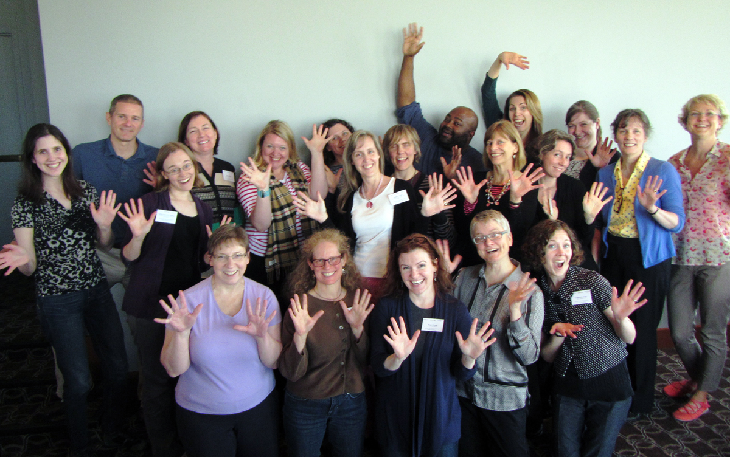
You are AMAZING!

Slide 26



The Library CE Institute
is a partnership of
WebJunction and Infopeople
It is generously supported by a
grant from the Institute of
Museum & Library Services (IMLS)
Notes:
Partnership of WJ & IP funded by a grant from IMLS
As part of the SCEC project

