Slide 1
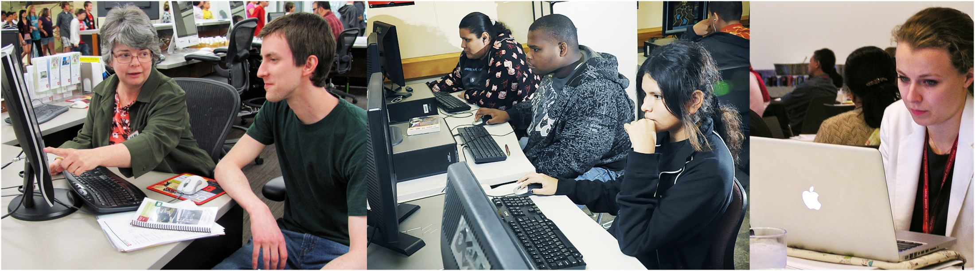
Designing & Delivering
Online Training
Library CE Institute
Online Kickoff
WebJunction – Infopeople – IMLS

Slide 2



The Library CE Institute
is a partnership of
WebJunction and Infopeople
It is generously supported by a
grant from the Institute of
Museum & Library Services (IMLS)
Notes:
Partnership of WJ & IP funded by a grant from IMLS
As part of the SCEC project

Slide 3




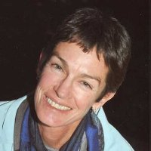


Facilitators
Betha Gutsche
Kathleen Gesinger
Lisa Barnhart
Jennifer Peterson
Eileen O’Shea
Megan
Knapp
Mike
Taylor

Slide 4



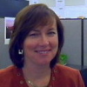








Amy Calhoun
Maurice Coleman
Enid Costley
Colleen Eggett
Katie Fearer
Tiffany Hayes
Katherine
Adelberg
Christine Kreger
Meredith Lowe
Jamie Matczak
Kelly Woodside
Stephanie Zimmerman
Notes:
Warm-up activity:
--keep track of who gets the right answer first (in chat)
Facilitators not included in guessing
!! Winners: grab pointer arrows

Slide 5

Virtual chocolate: winners choose one
Notes:
Award slide: virtual chocolate
we’re all learning, all learners
Katherine Adelberg: “I realized that my teacher, a member of the Chicago Symphony and an amazing musician, was still learning too.”

Slide 6
Kickoff Agenda
Why are we here?
E-Learning rocks!
Library learning for the 21st century
  Competencies
  Priority topics
Introducing Storyline
Coming next week

Slide 7

Why are we here?
“…libraries are at the forefront
in the movement to create
a nation of learners”
—IMLS Strategic Plan 2012-16
Notes:
IMLS Vision … empowered citizens of all ages in era of rapid change, new challenges
In order to optimize library capacity to achieve this vision, lib staff
SCEC Grant: “if libraries are to effectively respond to the rapid changes in technology and society, then library staff and other information workers must embrace the concept of continuous learning, and their institutions must support the learning that will drive organizational success.”

Slide 8
Vision for the CE Institute
Provide library staff with
more opportunities for
and broader access to
high-quality, library-relevant learning …
and to work collaboratively
to achieve results

Slide 9
Institute Timeline
Online
Kick-off
Seattle
Workshop
Projects complete
Working groups begin design & dev of courses
April
May
June
July
Install Storyline; preliminary focus on topic
Working groups continue design/dev
through virtual collaboration;
support from project team and Articulate SME
Online
Session 2
Online
Session 3

Slide 10
E-learning Rocks!

Slide 11
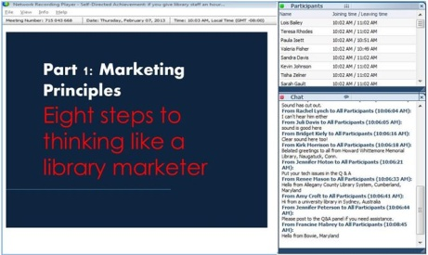
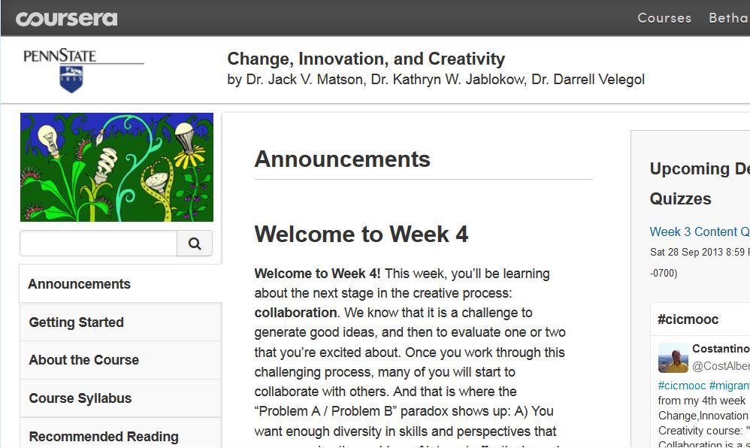

Flavors of e-learning
1
Live Online
2
Asynchronous
Instructor-led
3
Self-Paced
Notes:
Refer to ‘modes’ handout

Slide 12
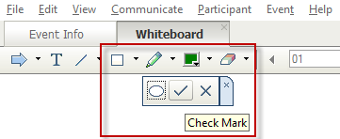
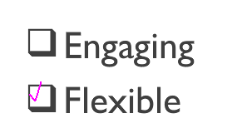
Using the check mark
Go to the toolbar at top of the screen.
Find the square and click on small arrow to access check mark.
Click on checkmark.
Then click on your answer selection.
1.
2.
3.

Slide 13

E-learning is awesome!
Totally agree
Somewhat agree
Neutral
Somewhat disagree
Seriously disagree

Slide 14
Awesome
Not so much
Notes:
Explore perceptions of self-paced elearning from POV of library staff, trainers, and organizations
from survey: “get my organization's members on board with online learning

Slide 15
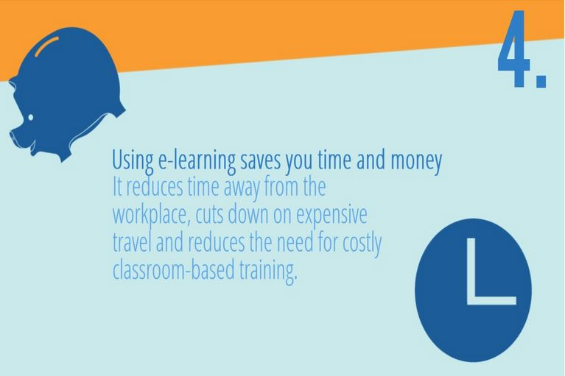
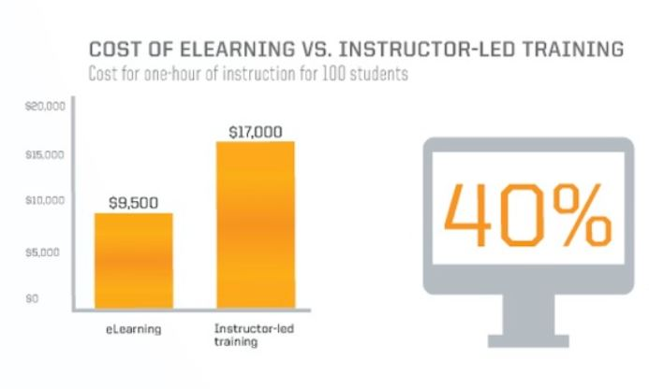
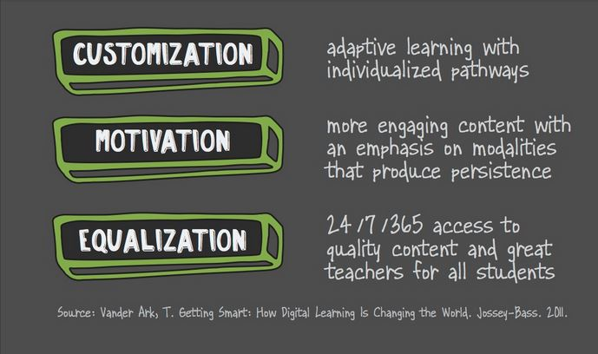
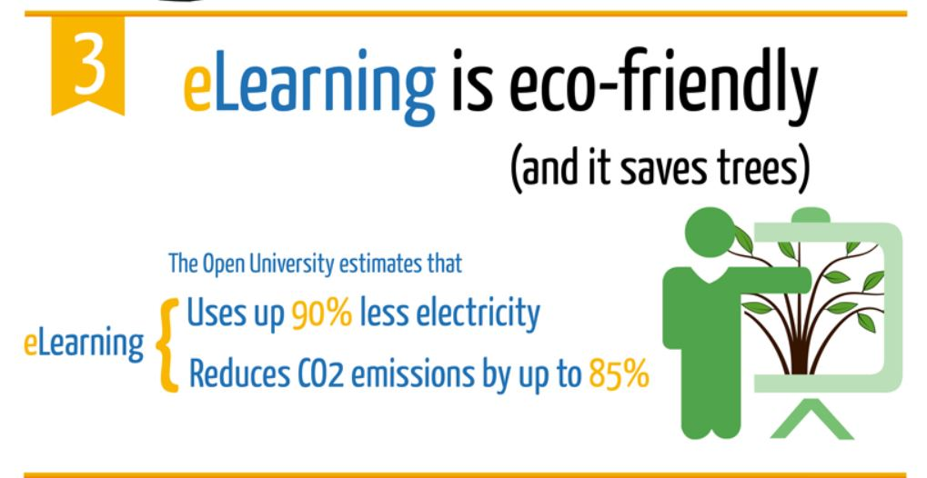
Let us count the ways…
Notes:
Scenario: You have a branch manager don’t see value of E; what will you say to convince them?
Identify key advantages of e-learning (beyond cost/time-savings)
---start w/ cost section of infographic---
Infographics:
Time-money: 7 Advantage of E-l: http://www.learningpool.com/7-advantages-e-learning-infographic/
Cost-2: State of Digital Education: http://www.knewton.com/digital-education/
Motivation etc: Busting Myths about Online Learning: http://edtechreview.in/e-learning/610-busting-myths-about-online-learning
E-learning is awesome infographic: http://elearninginfographics.com/what-makes-elearning-awesome-infographic/

Slide 16
21st Century Learning

Slide 17
Competency Index 2014
21st century skills
Accountability
Community engagement
Notes:
First published by WJ in 2009;
http://www.webjunction.org/documents/webjunction/Competency_Index_for_the_Library_Field.html
*21c skills
reflect increased emphasis on communication, collaboration, critical thinking and creativity.
Refer to 9 IMLS 21c skills sets: http://www.imls.gov/assets/1/AssetManager/21stCenturySkills.pdf
*Accountability:
importance of ongoing data collection and evaluation to measure and demonstrate impact
*engagement
continuously focusing and prioritizing efforts according to changing community needs

Slide 18
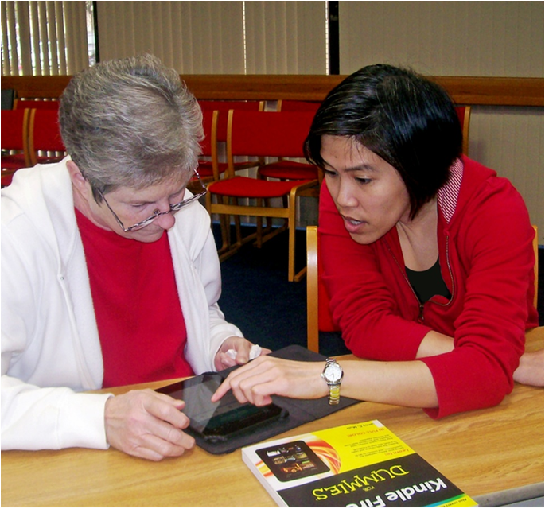
Essential competencies
Embraces change
Creative
Innovative
Takes action
Works collaboratively
Critical thinker
Uses systems thinking
Notes:
IMLS skills
--Critical Thinking and Problem Solving
--Creativity and Innovation
--Communication and Collaboration
--Cross-Disciplinary Thinking
Essential personal/interpersonal competencies
Embraces and adapts to change with curiosity and enthusiasm
Works creatively with others, staying open to diverse ideas and perspectives
Acts on creative ideas to make useful contributions to the library, the community and/or the field
Reasons effectively; Hones critical thinking skills
Uses systems thinking, analyzing how parts of a whole interact with each other to produce overall outcomes in complex systems

Slide 19
Topics Roadmap

Slide 20
Priority topics
Adapting to change
Advocacy
Communication
Customer service
Ebooks/ e-resources/ mobile devices
Leadership
New directors (management)
Programming (adults, YA, children)
Notes:
Intro “roadmap” and priority topics
Ask to open roadmap document
Which do you think are priorities for your audience? (checkmarks)

Slide 21
Priorities: local ↔ national
How will you align the priorities
of your organization with the
broader CE needs of the field?
Notes:
Activity: participants discuss their perceptions of priority topics for their orgs; start thinking about aligning with national needs; plan how to research/identify gaps/needs to prepare for session #2

Slide 22
Questionnaire Results

Slide 23
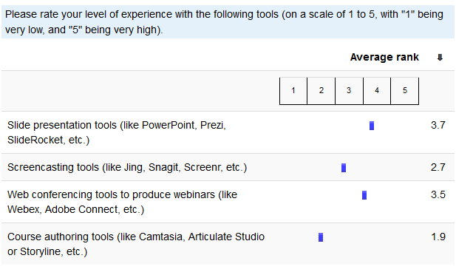
Questionnaire Results: Summary

Slide 24
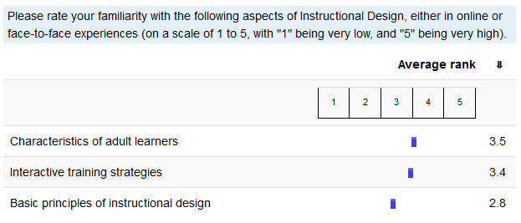
Questionnaire Results: Summary

Slide 25

Questionnaire Results: Goals
“I hope to become familiar enough with basic concepts and tools of online learning to develop staff training modules on topics we already teach in-person.”
“Improve my training module development skills and increase fun and effectiveness of the presentations I deliver and design.”
“Increase my range of e-learning tools and skills (and help others in my organization build their skills as well), help get my organization's members on board with online learning, get new ideas for online CE we might offer.”
“I'd like to learn more about how to support our instructors in terms of instructional design and tool use. I'm also interested in pursuing CE partnerships.”

Slide 26
Questionnaire Results: Goals
Overarching idea: create engaging, effective online learning experiences.
Instructional Design
Characteristics of adult learners
Connecting with (online) learners
Concepts and Tools of Online Learning
Best practices & tips
“Amp up" existing training
Collaboration
Learn from peers
Build CE partnerships
Staff retention of learning
Translate training from face-to-face format
Produce training for those with limited time
Notes:
General themes emerged

Slide 27
Introducing Storyline

Slide 28
Questionnaire Results: Goals
Overarching idea: create engaging, effective online learning experiences.
Instructional Design
Characteristics of adult learners
Connecting with (online) learners
Concepts and Tools of Online Learning
Best practices & tips
“Amp up" existing training
Collaboration
Learn from peers
Build CE partnerships
Staff retention of learning
Translate training from face-to-face format
Produce training for those with limited time
Notes:
We are so excited about the themes that emerged from the questionnaire! You are all in the right place! We will be looking at Instructional Design concepts, Online learning tools, and will be practicing how we can all best experience and be a leader in the collaboration across states and library types.

Slide 29
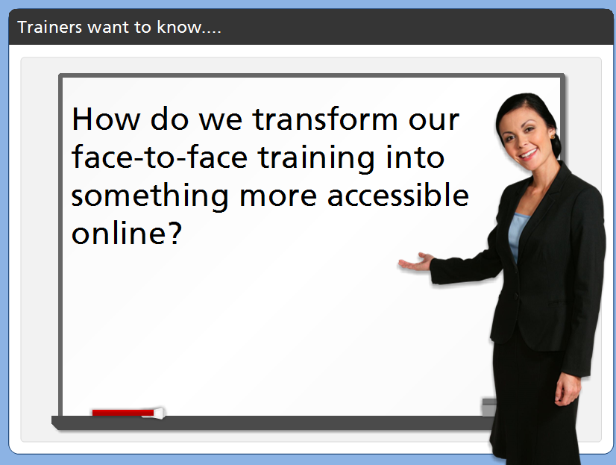
Notes:
A big question that we’ll be focused on is how do we transform or leverage existing content that we’ve run face-2-face? We’re doing a good job on some trainings already, but we want to make it more accessible!

Slide 30
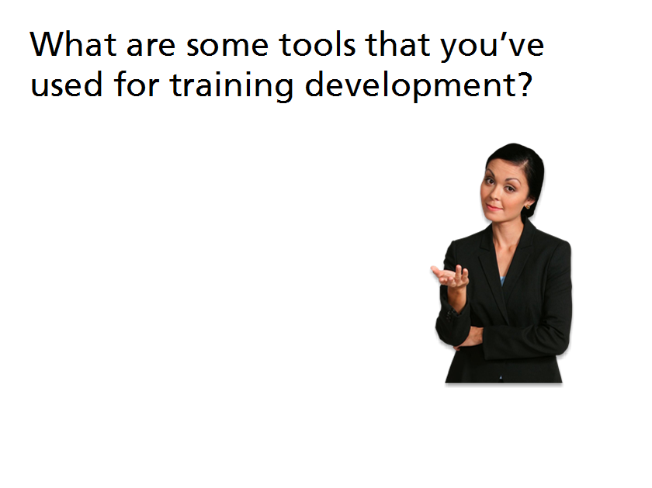
Notes:
What are some tools that you’ve used for training development?
In chat – please share any of the tools you’ve used for training development. This may be an online tool or something as simple as sticky notes used to plan! The sky’s the limit in this exercise!

Slide 31
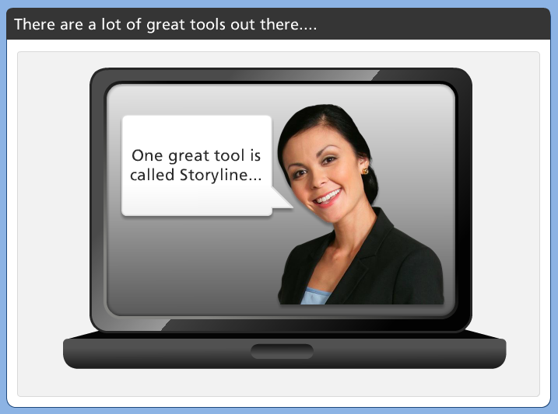
Notes:
There are a lot of great tools to help out there!
Our goal is to help trainers use existing content and make it more interactive and easily sharable.
Platform agnostic = a piece of software that can run on any operating system and can be incorporated into any LMS. Can be published in a format that can be uploaded into any LMS.

Slide 32
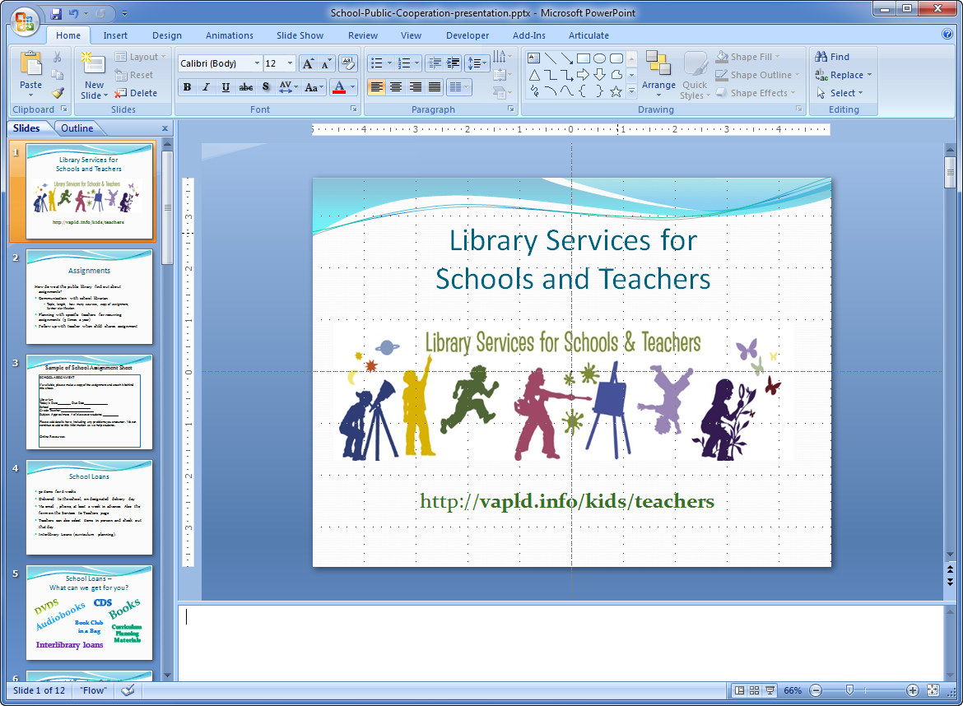
You can begin with existing PowerPoint content….
Notes:
How many of you can tell me what tool this view is showcasing?
Leverage existing training content through ppt > and packaging it into an online tool that can be highly interactive.

Slide 33
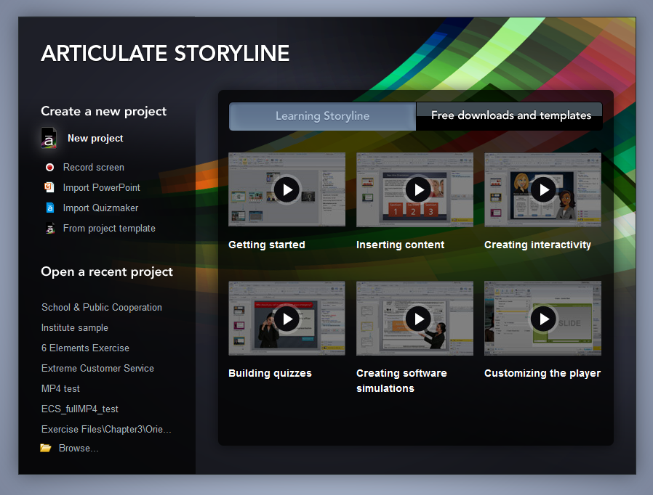
Import that PowerPoint content into Storyline….
Notes:
Import existing PowerPoint deck into Storyline.

Slide 34
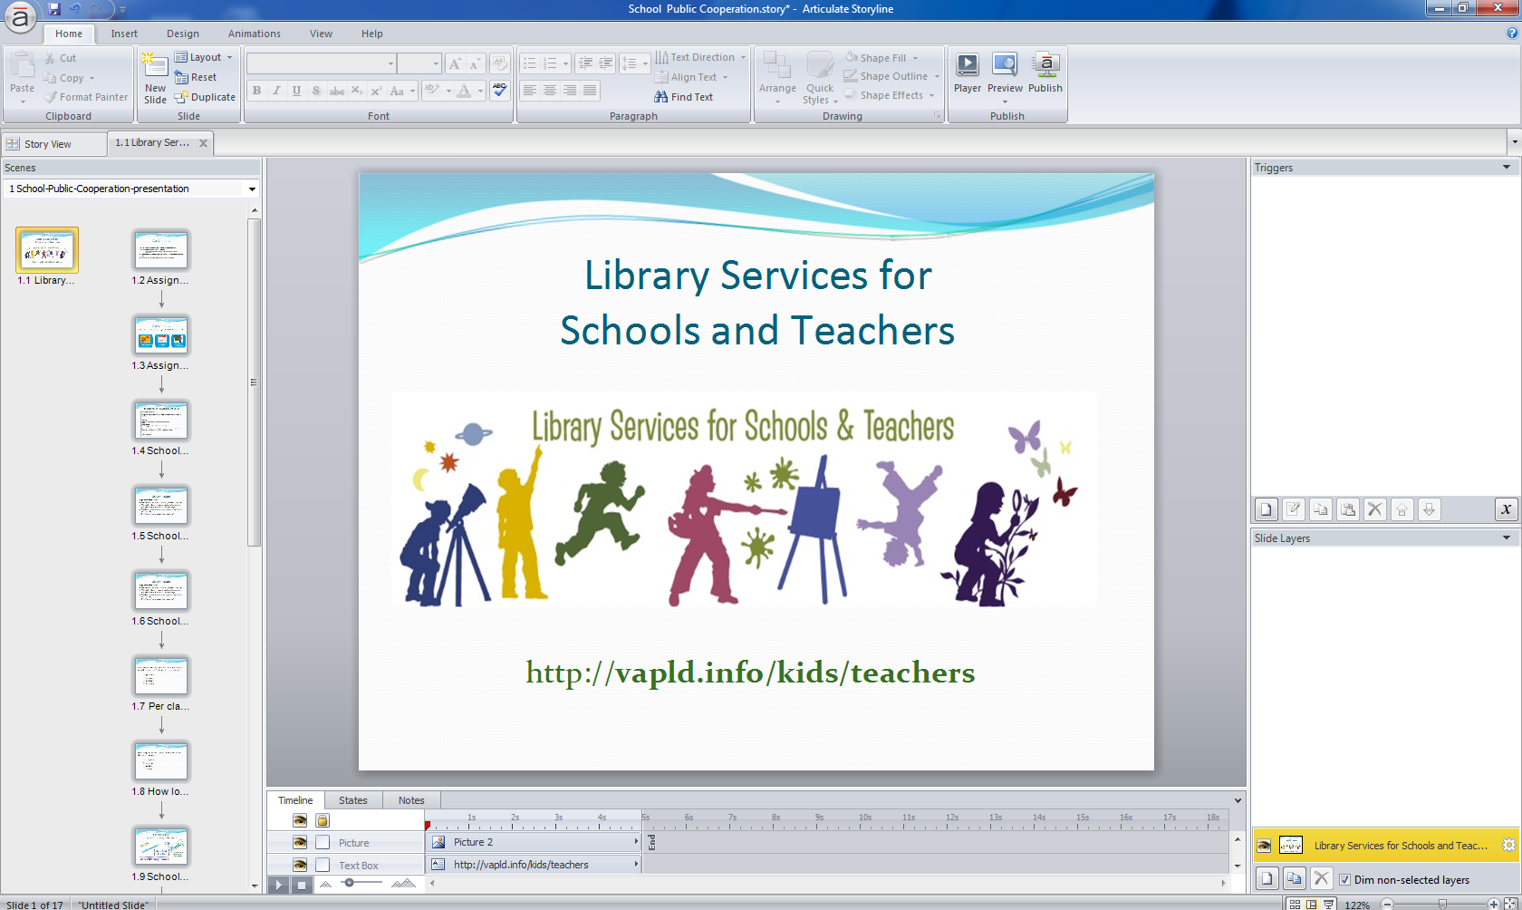
Import that PowerPoint content into Storyline….
Notes:
Storyline showing an imported PowerPoint deck.

Slide 35

And, very quickly, create a course “wrapper”….
Notes:
Our goal is to use existing content and make it easily sharable, building in more and more interaction as you go.
Platform agnostic = a piece of software that can run on any operating system and can be incorporated into any LMS. Can be published in a format that can be uploaded into any LMS.

Slide 36


Adjust the “player view”:
change color, remove navigation, etc.

Slide 37
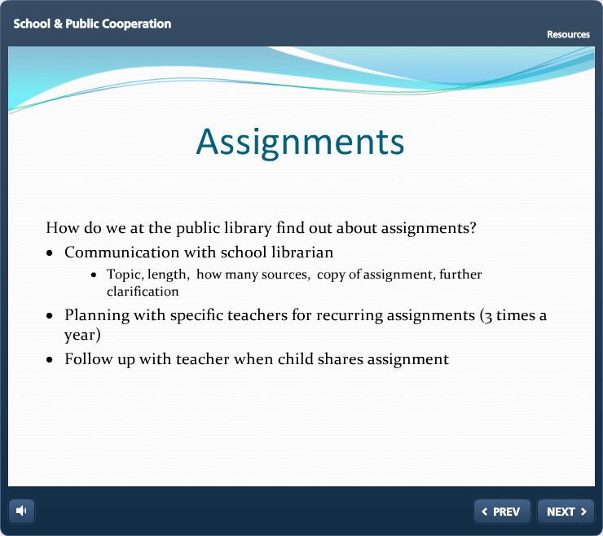
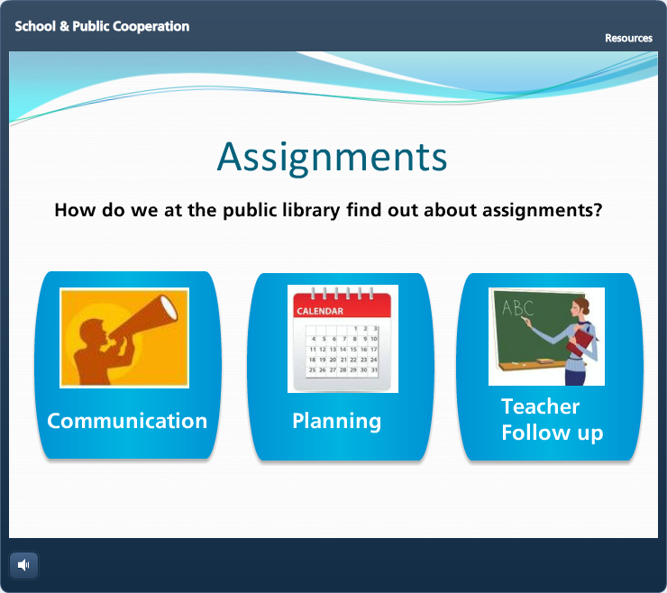
“Amp up your slides” and consider self-directed
navigation for your learners

Slide 38
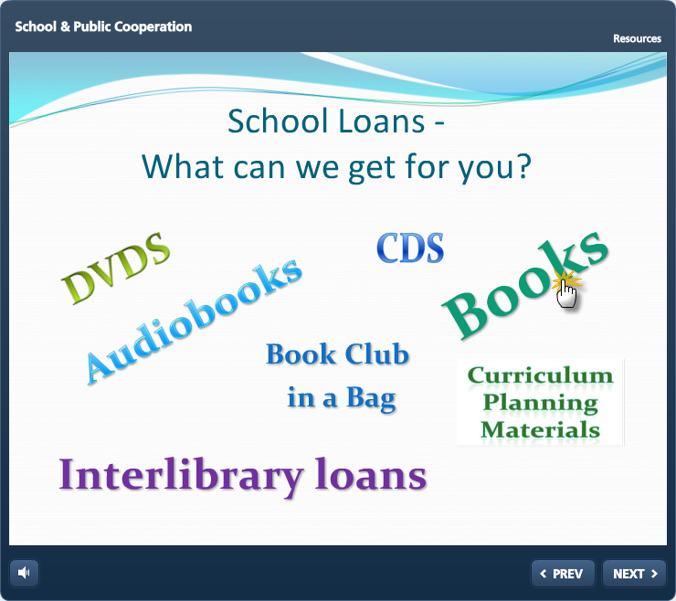
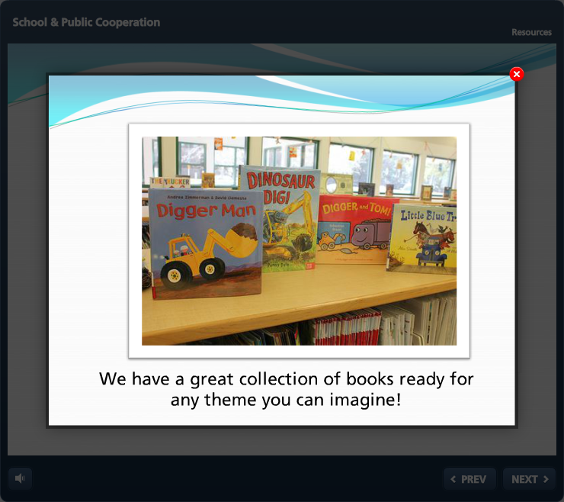
Begin to add basic interactions on the screen….
Notes:
Our goal is to use existing content and easily sharable –
Platform agnostic = a piece of software that can run on any operating system and can be incorporated into any LMS. Can be published in a format that can be uploaded into any LMS.

Slide 39
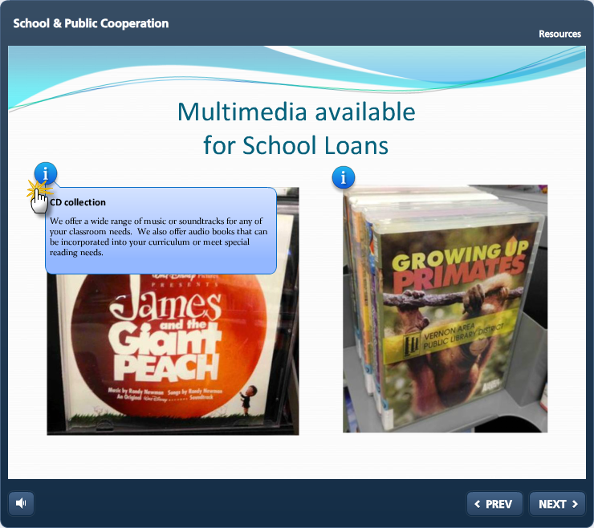

Slide 40
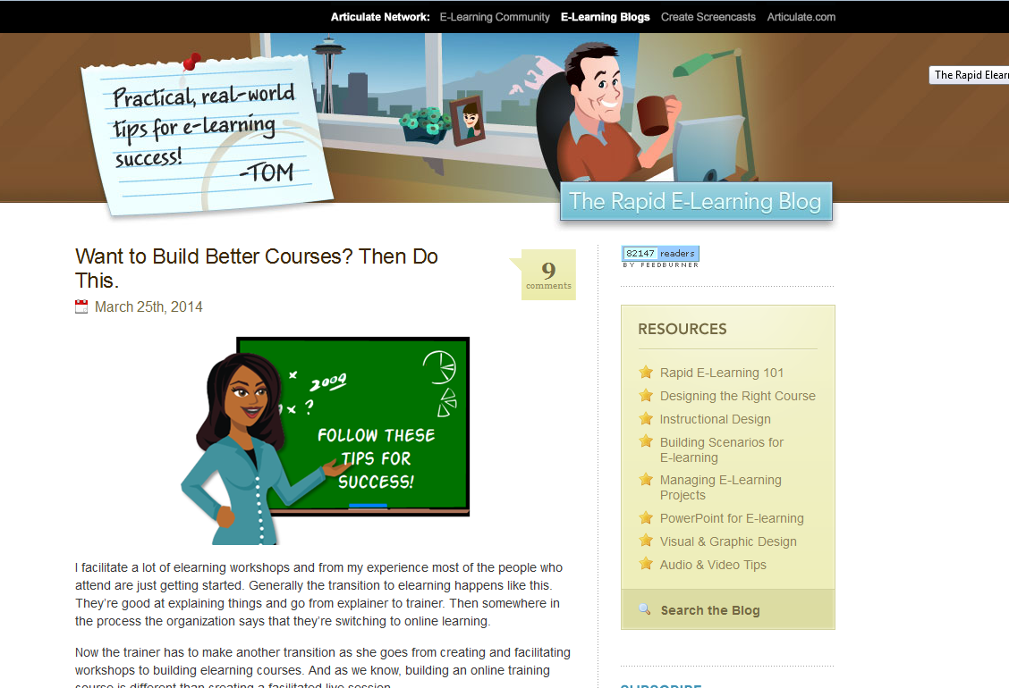
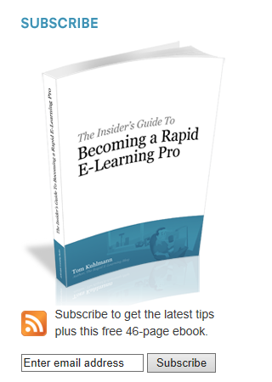
Great Resource …
The Rapid E-Learning Blog – Subscribe today!

Slide 41
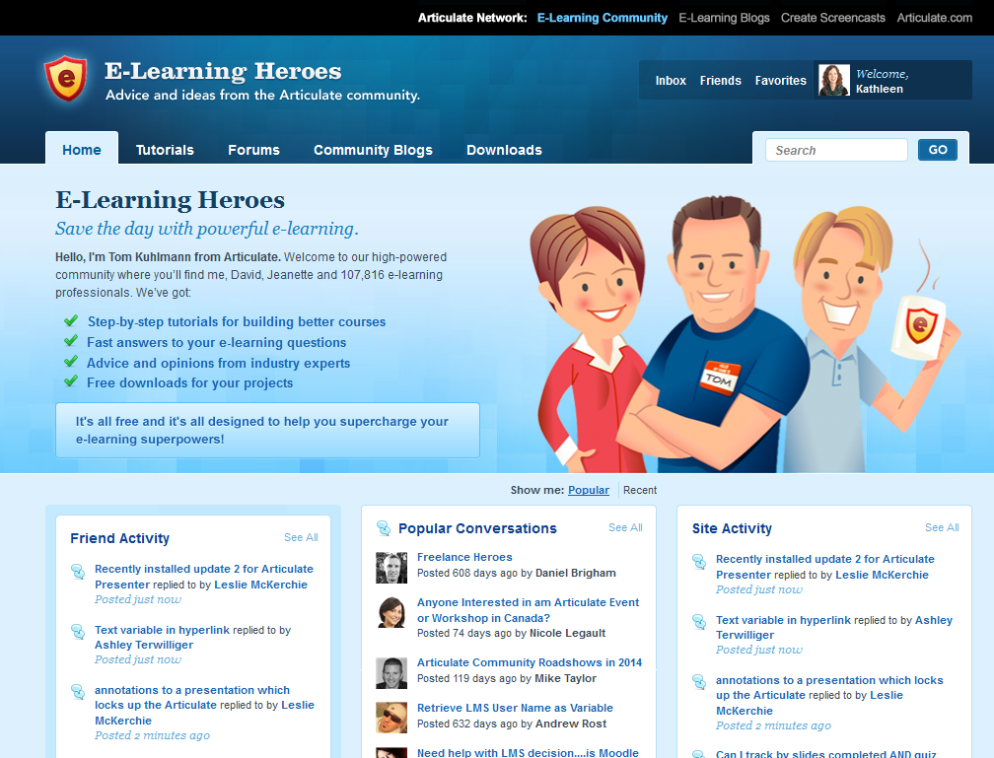
Great Resource …
Meet the E-Learning Heroes – there are a lot out there!

Slide 42
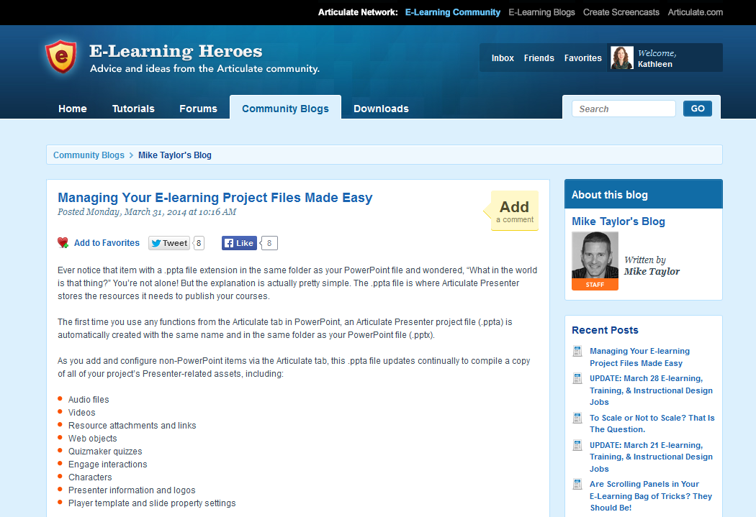
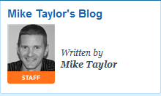
Great Resource …
Community Blogs & Tutorials - Mike Taylor, Articulate Staff

Slide 43
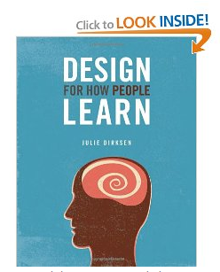
An added bonus…
Design For How People Learn, by Julie Dirksen, will teach you how to leverage the fundamental concepts of instructional design both to improve your own learning and to engage your audience.

Slide 44
1. For next week…
Explore the roadmap of priority topics and CE opportunities for library-specific learning
Identify your priority topics:
    gather information/research and confer with your organizations to identify gaps/needs;
    be prepared to share your top 3-4 topic needs in session 2

Slide 45
2. For next week…
Begin to explore Storyline and course creation ideas with these 3 resources:
  Rapid E-Learning Blog
  Training Designer's Guide to Saving the World
  Getting Started with Articulate Storyline

Slide 46


We’re taking the plunge…
together!

