Slide 1

Webinars:
Orientation for Participants
Jennifer Peterson
petersoj@oclc.org

Slide 2

Orient participants to the platform
before the webinar begins to:
  Introduce the features and tools
  Cover common potential technology problems and solutions
  Provide a stream of conversation to
  welcome people as they join the session
  Allow for better focus on the content
  when the formal session begins
WebJunction uses the following slides to create this positive learning environment.
Where am I?
Notes:
WebJunction begins cycling through the orientation slides 20 minutes before the formal program begins. Since participants are joining at any time prior to the official start time, the information in the slides is repeated, usually about 3 times.

Slide 3
Time zones are very confusing!
Welcome!
The webinar will begin at
1:00 Eastern/10:00 Pacific
Notes:
Note: callouts on the slides are for instructional purposes here. They are not included in the actual orientation slides shown to participants.
If you have participants joining from multiple time zones, be clear about the start time here.

Slide 4

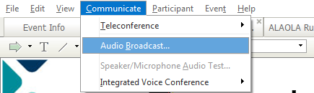

Audio Tips
Today’s audio is streaming to your computer’s speakers or headphones.
Too loud or soft? Adjust volume level in the Audio broadcast box:
Lost all sound? Hear an echo? Click on the small radio tower icon (above chat box) OR go to the Communicate menu (at the top of the screen) and select Audio Broadcast to refresh your connection.
Provide troubleshooting tips early.
Notes:
4
Audio issues are the most common problems that participants experience. Often, the fix is simple and under the control of the participants. Cover the basic and simple tips here.

Slide 5
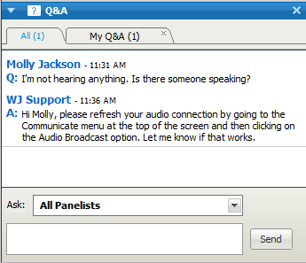
Need Help?
Please post technical support questions into the Q&A Panel.
If possible, separate out technical questions.
Step 1: Type the problem in
the dialog box.
Step 2: Click Send.
Notes:
Due to the large attendance at WebJunction webinars, we ask that participants use the Q&A panel in the interface, and leave the Chat panel open for discussion related to the topic.
Best practice: we have a dedicated technical support person who monitors the Q&A panel and responds to individuals with support questions. This minimizes disruption of the presentation/training.

Slide 6
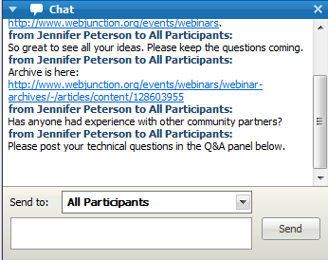
Chat Etiquette
Use Chat to talk with attendees and presenters about the topic.
Do not post technical questions to Chat.
Encourage questions, comments, links, at any time.
And if you’re tweeting, use this hashtag: #wjwebinar
Notes:
We ask participants not to post tech support questions in chat.
We also use a Twitter hashtag for our webinars; many participants like to live tweet and/or follow tweets relating to the webinar.

Slide 7
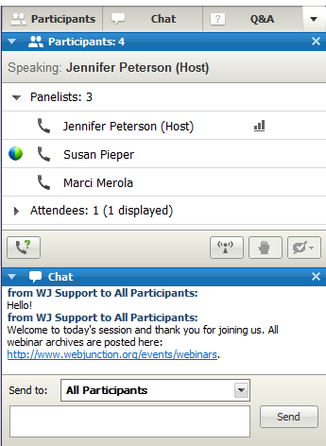
Customize your experience
Panels can be opened or closed by clicking on the panel name at the top of the column, or by using the X in the individual panel.
Hover over edge of
panels to drag and resize.
Notes:
The Webex interface can be customized. Some participants complain that chat is too distracting. They have the option of closing the chat panel.

Slide 8
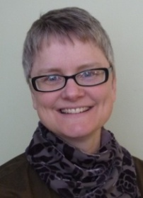
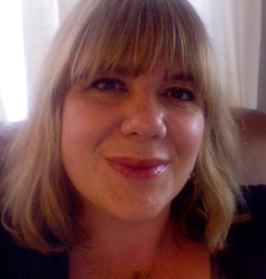
Remember to post to Q&A panel if you need technical assistance.
Other Technical problems?
Contact WebEx support
Event Number: 716 559 000
Phone: 1-866-229-3239
Co-Produced by:
Jennifer Peterson
WebJunction Community Manager
Produced by:
Zola Maddison
WebJunction Project Coordinator
Notes:
8
We provide the Webex technical support information for those who have tech problems beyond what we can help with.
Best practice: show the (smiling) faces of your backup team: producer and tech support.

Slide 9
Stay Informed
Share how they can find more learning resources at beginning and end.
On WebJunction
  webjunction.org
Crossroads (monthly newsletter)
  Subscribe on homepage
Events
  webjunction.org/calendar
Notes:
The webinar host transitions to the main topic with this slide:
“Thank you everyone for coming to today’s webinar. I will send an email out afterwards with links to the archive. You will be sent to a survey as you leave. We really appreciate your feedback on our webinar series.”

Slide 10
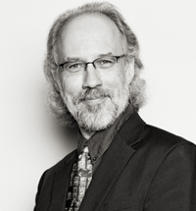
Today’s Presenter
Photo and very short bio of presenter
Jamie LaRue
Director,
Douglas County Libraries,
Colorado
Notes:
And then the formal session begins.
Best practice: keep introductions and bio’s very short! Feedback from our participants tells us that they don’t want to waste time listening to a string of credentials.

