Slide 1
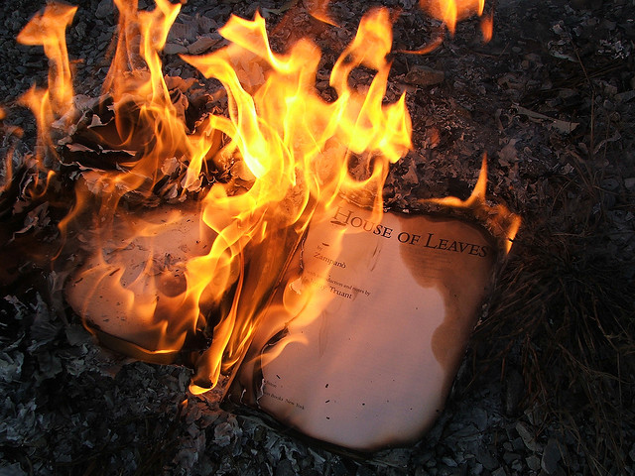
Burning Ideas
Ebooks and Libraries: A Legal Perspective
Burning © LearningLark 2009. Some Rights Reserved. Attribution 2.0 Generic http://tinyurl.com/24oenrw
E-Reader Summit & Technology Showcase
Arizona State Library, Archives and Public Records
Sept 20, 2010
Mary Minow, J.D., A.M.L.S.
LibraryLaw.com
Notes:
http://cgfa.sunsite.dk/munch/p-munch12.htm

Slide 2


Legal Disclaimer
Legal information
Not legal advice!
Notes:
http://microgravity.grc.nasa.gov/6712/webpics/handshake.GIF

Slide 3
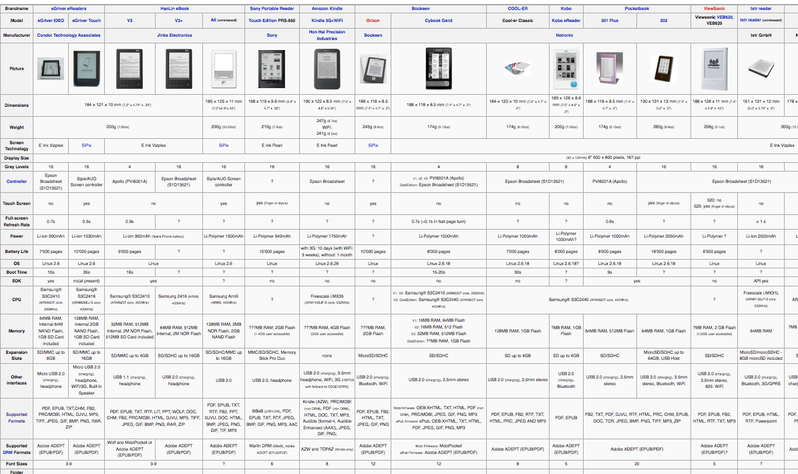
Can’t We All Just Get Along?
wiki.mobileread.com/wiki/E-book_Reader_Matrix
Formats are small part of the battle –can convert e.g. Calibre
DRM is bigger hurdle
Notes:
calibre is a free and open source e-book library management application developed by users of e-books for users of e-books. It has a cornucopia of features divided into the following main categories: Library Management calibre manages your e-book collection for you. It is designed around the concept of the logical book, i.e., a single entry in your library that may correspond to actual e-book files in several formats.
calibre can sort the books in your library by: Title, Author, Date added, Date published, Size, Rating, Series, etc.
In addition, it supports extra searchable metadata:
Tags: A flexible system for categorizing your collection however you like
Comments: A long form entry that you can use for book description, notes, reviews, etc.
You can easily search your book collection for a particular book. calibre supports searching any and all of the fields mentioned above. You can construct advanced search queries by clicking the helpful "Advanced search" button to the left of the search bar.
You can export arbitrary subsets of your collection to your hard disk arranged in a fully customizable folder structure.
Finally, calibre will even go out onto the internet to find book metadata based on existing title/author or ISBN information. It can download various types of metadata and covers for your books, automatically. The metadata system is written using plugins so that different types of metadata sources can be supported in the future.
E-book conversion calibre can convert from a huge number of formats to a huge number of formats. It supports all the major e-book formats. The full list of formats can be found here.

Slide 4

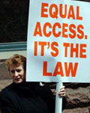
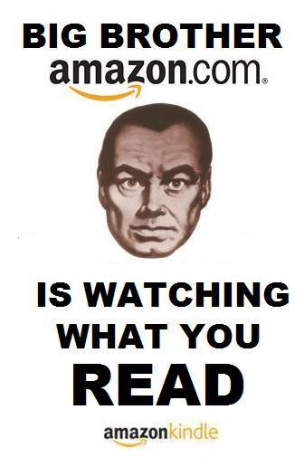
Ebooks and Libraries: Legal Issues
Control Your Content – Let me count the ways…
Licenses
DRM
Rising issues
Disability Access
Privacy
The Future
Big Brother © Mike Licht 2009 Some Rights Reserved Attribution 2.0 Generic http://tinyurl.com/2dheq5h
Notes:
Fire image http://www.fs.usda.gov/Internet/FSE_MEDIA/stelprdb5035968.jpg

Slide 5
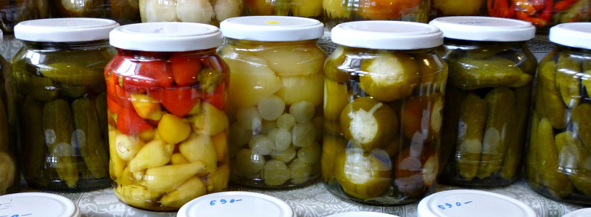
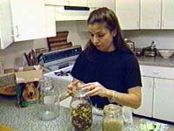
Control your CONTENT (count the ways…)
PCLED
Notes:
http://www.cdc.gov/ncidod/diseases/hanta/images/hv119m.jpg

Slide 6

First, Control content – with chains
P hysical
C
L
E
Owner of physical item
keep others out

Slide 7
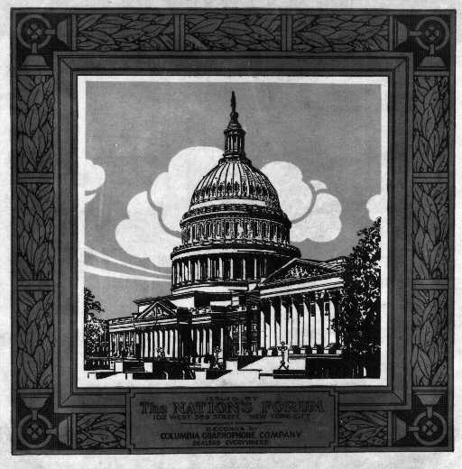
Second, Control content with copyright law
P
C
L
E
D
Copyright
Authors usually sign © over to publishers

Slide 8


Copyright – Life of author plus 70 years
Owned originally by author
Sold (in whole or in part) to publisher
$750 - $30,000 per infringement
BACKLIST – Digital rights usually remain with author
New York Times Co. v. Tasini, 533 U.S. 483 (2001)
Notes:
http://www.fdic.gov/consumers/consumer/news/cnfall08/ money image
Mention author cases

Slide 9
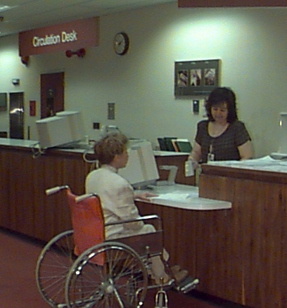
Copyright Law allows Libraries & Friends to:
Loan books
Sell used books
(17 U.S.C. Sect. 109)
Notes:
http://www.nlm.nih.gov/share/image/circ_desk.jpg

Slide 10
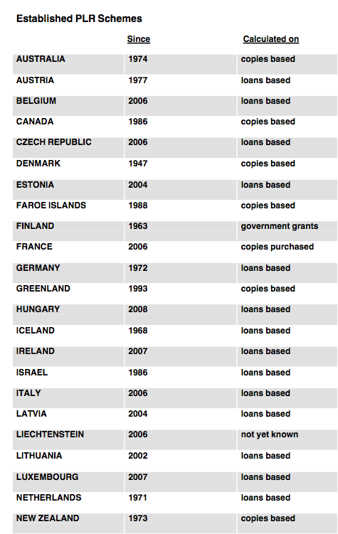
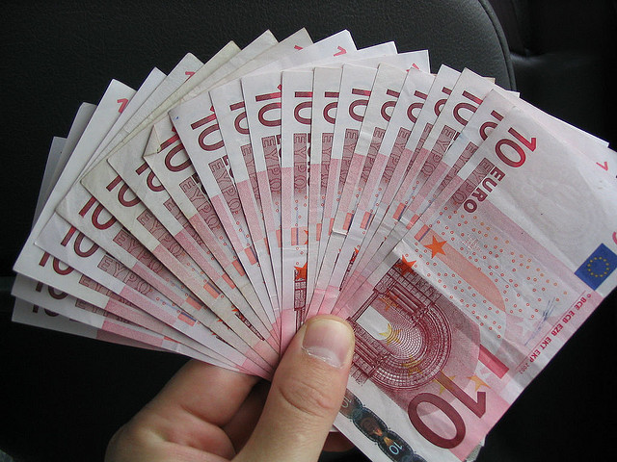
Don’t take for granted!
First Sale Doctrine in United States
Public Lending Right
Not true everywhere!Public Lending Right = libraries pay authors when books are loaned
Euros © Will Spaetzel 2004. Some Rights Reserved. Attribution-NonCommercial-ShareAlike 2.0 Generic www.flickr.com/photos/redune/5073664/
Notes:
The two main methods of ◊calculation are as follows: (a) payment on the basis of how often an author’s works are lent out; and (b) payment per copy of an author’s work held in libraries

Slide 11
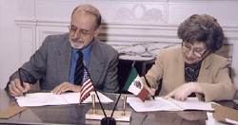
Third, Control content with licenses
P
C
L
E
D
Cicense
LIBRARIAN
VENDOR
VENDORS NEED LAYER OF CONTROL
Copyright only protects authors/publishers

Slide 12
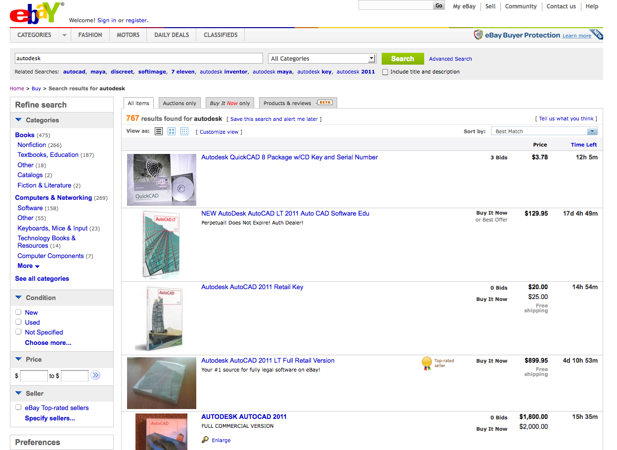
License Trumps First Sale
TERMS OF SERVICE
Recent federal appellate court case:
Man sold sealed software package from garage sale - on eBAY
Court: He did not have legitimate title (ownership) to the software, no right of First Sale
LIBRARIES? We don’t have title to our titles. Limited uses.
Vernor v. Autodesk, 2010 U.S. App. LEXIS 18957 (9th Cir. Wash. Sept. 10, 2010)
Notes:
See also http://blog.ericgoldman.org/archives/2010/09/vernor_v_autode.htm

Slide 13
Licenses
We just buy it once and put it on 6 kindles!
We buy ebooks to keep forever
We license ebooks on an annual basis
We license books for one user at a time
We license simultaneous uses
it depends on the license terms

Slide 14
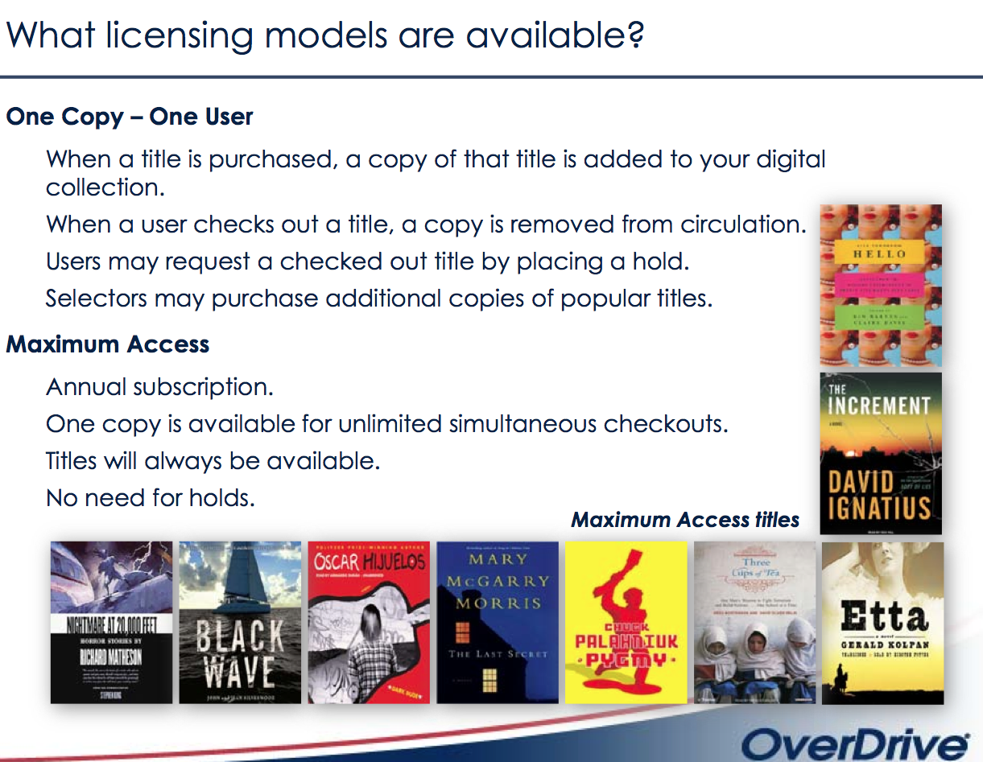
msl.state.mt.us/For_Librarians/For_All_Librarians/Downloadable_E-Content/default.asp
Notes:
www.overdrive.com/files/Training-CollectionChecklist.pdf

Slide 15
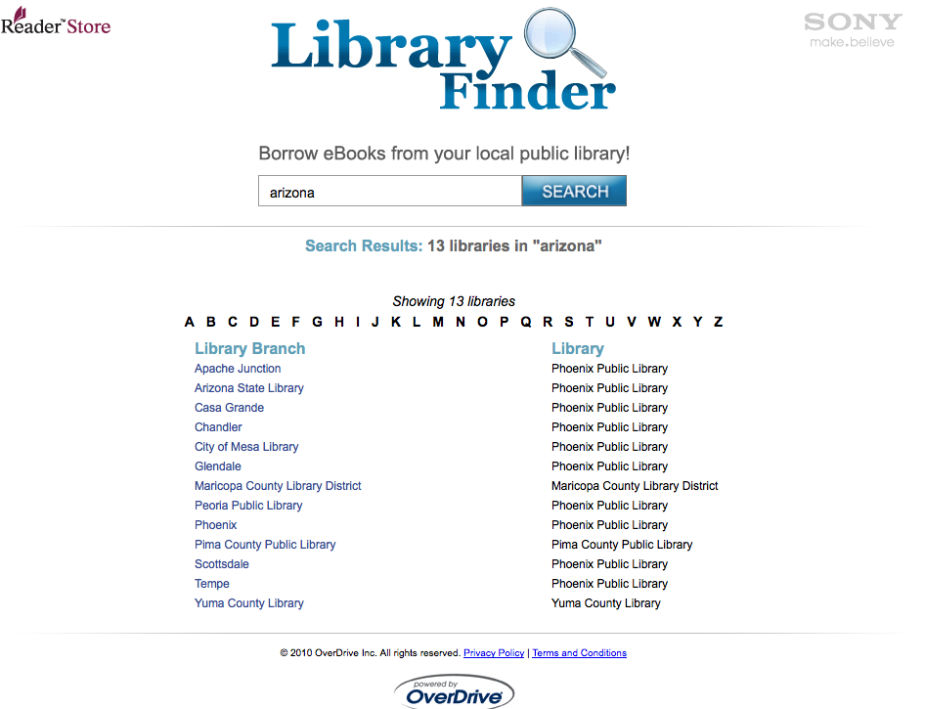
Can We Loan Out Ebook READERS?
SONY IS CLEAR:
ADVERTISES LIBRARY PARTICIPANTS
Kindle and Kobo: Not clear
Deciding factor:
risk tolerance
Libraries doing it
… you may not sell, rent, lease, distribute, or otherwise assign any rights to the Digital Content to any third party…

Slide 16

Fourth Layer: Encryption, Passwords…
P
C
L
D
Encryption
and Digital Rights Mgmt
(DRM)
Notes:
http://www.usdoj.gov/kidspage/do-dont/privacy.gif

Slide 17
What is DRM?
Digital Rights Management
Digital padlock used to control
viewing, copying, printing
SELF HELP – PROTECTS CONTENT
Not the same as Copyright
… a layering of content controls
File types are a tiny battle
Notes:
I liken it to a (Barnes & Noble) clerk coming to my house when I'm not home, taking a book I bought from them from my bookshelf and leaving cash in its place,” wrote Sunny Lady, invoking the Internet Age-old argument about digital rights management (DRM) technology that limits use of content and devices. “It's a violation of my property and this is a perfect example of why people (rightly) hate DRM.” http://www.msnbc.msn.com/id/32014285/ns/technology_and_science-tech_and_gadgets/

Slide 18

Why so many flavors of DRM?
Keep customers from shopping elsewhere Not a library model Winner? May be cloud-based Work on any device
Notes:
http://www.ninds.nih.gov/disorders/headache/press_headache.htm
Sony
ePub + Adobe DRM
Barnes & Noble
ePub + B&N/Adobe DRM
Amazon
mobi (azw) + Amazon DRM

Slide 19
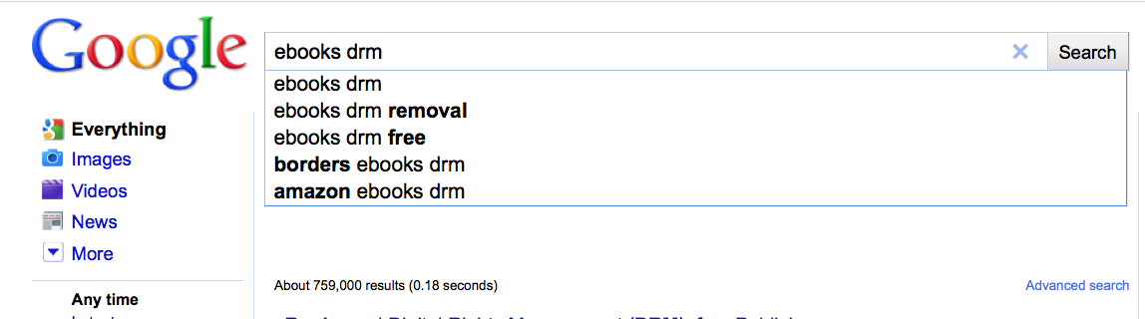
DRM Removal – Is it Legal?
ITIItwoudIIItI
It would be … if it weren’t for the DMCA

Slide 20
Fifth Layer:
Digital Millennium Copyright Act
P
C
L
E
D
MCA
Notes:
http://www.usdoj.gov/kidspage/do-dont/privacy.gif

Slide 21

DMCA: law that criminalizes tampering with digital locks
1998 Digital Millennium Copyright Act DMCA
2001 Dmitry Sklyarov arrested at Defcon conference after speech on hacking Adobe eBooks DRM
2002 Acquitted. No intent to violate law.
Notes:
http://www.internetfraud.usdoj.gov/graphics/maninjail.gif
Jury foreman Dennis Strader said the jurors agreed ElcomSoft's product was illegal but acquitted the company because they believed the company didn't mean to violate the law.
"We didn't understand why a million-dollar company would put on their Web page an illegal thing that would (ruin) their whole business if they were caught," he said in an interview after the verdict. Strader added that the panel found the DMCA itself confusing, making it easy for jurors to believe that executives from Russia might not fully understand it.
ElcomSoft didn't dispute the potential for its Advanced eBook Processor program to remove usage restrictions on e-book files, it did claim that removing such usage restrictions allowed people to read their legally purchased e-books on different computers, which is considered "fair use" under the law. Also allowed printing, text-to-speech
fter intense public pressure, especially from the programmer community,-Adobe backed off. During cross-examination, Adobe even admitted that it had hired two companies to search the Internet, but neither company could find a single stolen e-book that had been cracked with ElcomSoft's program. A jury eventually acquitted ElcomSoft and Dmitry Sklyarov of all charges, but not before Dmitry had spent three weeks in a U.S. jail. … and detained in US for five months
Skylarov NEVER accused of violating copyright or helping others to violate copyright.
Read more: http://news.cnet.com/2100-1023-978176.html#ixzz0zGzE9n3L

Slide 22


Current Exemptions (OKAY TO TAMPER)* issued by Librarian of Congress July 26, 2010 – expire in 3 yrs
Ebook controls on read-aloud functions
… when all existing editions block accessibility
Cell phone apps interoperability
Cell phones carriers (e.g. ATT, Verizon)
DVD clips
Video game testing
Obsolete dongles
“wireless telephone handsets”
*For conditions, see www.loc.gov/today/pr/2010/10-169.html
**Still illegal to sell tampering tools
Notes:
Hacker picture at http://supercomputing.fnal.gov/SC2008/presentations/Tarpit/Images/
Fireworks: http://www.cdc.gov/homeandrecreationalsafety/images/fireworks_300x180.jpg
6) Literary works distributed in ebook format when all existing ebook editions of the work (including digital text editions made available by authorized entities) contain access controls that prevent the enabling either of the book’s read-aloud function or of screen readers that render the text into a specialized format.
2)Computer programs that enable wireless telephone handsets to execute software applications, where circumvention is accomplished for the sole purpose of enabling interoperability of such applications, when they have been lawfully obtained, with computer programs on the telephone handset.

Slide 23

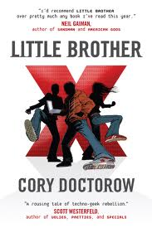
Doctorow's First Law: Any time someone puts a lock on something that belongs to you, and won't give you a key, they're not doing it for your benefit.
Real Example: Cory Doctorow’s story
Physical book – (what’s that?)
Copyright – Doctorow/Random House
OK with free downloads
License – Doctorow wanted to allow “anything that is permitted by your local copyright law.” No.
Ecryption/DRM- Audible insisted on Little Brother
Audible okayed DRM-free Makers
Apple insisted on DRM in iTunes store
DMCA - criminal to tamper…
Doctorow © Jonathan Worth, n.d. Some Rights Reserved. http://tinyurl.com/2eaeqsx
www.publishersweekly.com/pw/by-topic/columns-and-blogs/cory-doctorow/article/44012-doctorow-s-first-law.html
Notes:
I tried to remedy this creatively by asking Audible to allow me to add some preliminary language to the audio edition, something that said, "notwithstanding any agreement you clicked on to buy this book, Cory Doctorow and Random House Audio, as the copyright holders, hereby give you their blessing to do anything that is permitted by your local copyright law." In other words: don't break the law, but feel free to do anything else—the same terms under which your car, dishwasher, and every traditional book on your bookshelf was sold to you. Again, Audible declined.
From Wikipedia which notes this credit:
Cory Doctorow, photographed by Jonathan Worth
Date 10 September 2009(2009-09-10), 14:03:48
Source originally posted to Flickr as Portrait by Jonathan Worth 2, credit Jonathan Worth, link to http://jonathanworth.com
Author Jonathan Worth
Creative Commons Attribution-Share Alike 2.0 Generic license.

Slide 24
REVIEW: Content Controls
PCLED
Physical Ownership
Copyright
Licenses and agreements
Encryption and Digital Rights
Management
Digital Millennium Copyright Act
(DMCA)
Attribution-NonCommercial-NoDerivs 2.0 Generic
Notes:
http://www.cdc.gov/ncidod/diseases/hanta/images/hv119m.jpg
Attribution-NonCommercial-NoDerivs 2.0 Generic

Slide 25
Ebooks and Libraries: Legal Issues
Control Your Content – Let me count the ways…
Licenses
DRM
Rising issues
Disability Access
Privacy
The Future
Big Brother © Mike Licht 2009 Some Rights Reserved Attribution 2.0 Generic http://tinyurl.com/2dheq5h
Notes:
Fire image http://www.fs.usda.gov/Internet/FSE_MEDIA/stelprdb5035968.jpg

Slide 26
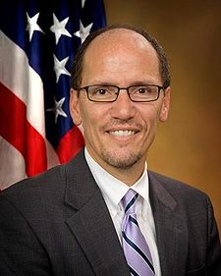
Disability Access at Universities
Department of Justice settlements
“We acted swiftly on the complaints we received from the National Federation of the Blind about the use of the Amazon Kindle”
“… we will continue to make sure other institutions nationwide are aware of their accessibility obligations.”
Arizona State University and others agree not to use inaccessible e-readers
www.ada.gov/arizona_state_university.htm
t
Thomas E. Perez Assistant Attorney General remarks June 10, 2010 tinyurl.com/adakindle
National Federation of the Blind and American Council of the Blind v Arizona State University
Notes:
http://www.prnewswire.com/news-releases/remarks-as-prepared-for-delivery-by-assistant-attorney-general-thomas-e-perez-at-the-national-disability-rights-network-annual-conference-96075509.html
June 10, 2010 Excerpt from Remarks as Prepared for Delivery By Assistant Attorney General Thomas E. Perez at the National Disability Rights Network Annual Conference
"In the 21st century, technology drives so much of our work and our lives, and it seems to advance daily. Technology has revolutionized our economy and culture. It has made obtaining information, entertainment, education and goods easier and more efficient. But many of these technologies, from Web sites to cell phones, from ticket kiosks to TV set-top devices, are either in whole or in part inaccessible to persons who are blind and other people with disabilities.
We know that inaccessible technologies can pose significant challenges to individuals with disabilities, and we must remain vigilant to ensure new technologies don't leave individuals with disabilities in their wake.
We acted swiftly on the complaints we received from the National Federation of the Blind about the use of the Amazon Kindle at universities, and we reached agreements with five major universities: Princeton; the University of Arizona; Pace; Case Western; and Reed College. Those institutions have agreed not to use inaccessible electronic readers, and we will continue to make sure other institutions nationwide are aware of their accessibility obligations."
http://blog.govdelivery.com/usodep/2010/06/letter-from-department-of-justice-department-of-education-to-college-university-presidents-on-electr.html OPEN LETTER TO PRESIDENTS OF Universities
May 2009 Pilot progam

Slide 27
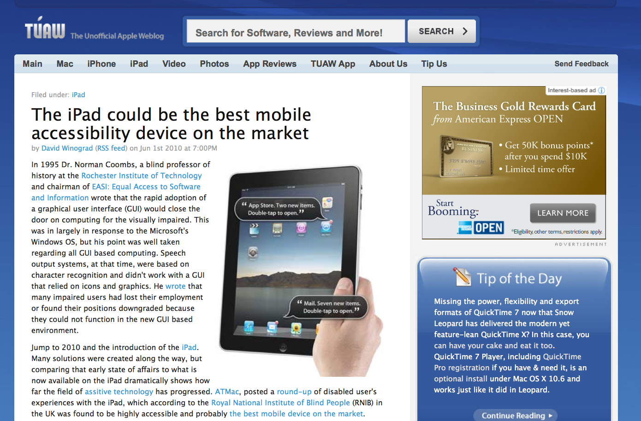
Library Lessons: Evaluate Accessibility
Choose accessible readers
or
choose titles that library already has in accessible format (including print)
Remember: OKAY to remove DRM if no accessible copies on the market
Stay up to date with readingrights.org
Evaluates Kindle 3
Notes:
http://www.tuaw.com/2010/06/01/the-ipad-could-be-the-best-mobile-accessibility-device-on-the-ma/
From reading rights coalition:
Amazon has just announced its newest Kindle, the Kindle 3, which, according to Amazon, has text-to-speech enabled menus that make the device independently operable. This is a significant victory, directly tied to the advocacy efforts of the Reading Rights Coalition and the work of many of its members.
There is still more work to be done to make the device fully accessible, however. The web browser is not accessible and there is no audible signal or battery strength information. You have to purchase and download the e-books from your PC, rather than directly from the device. However, in a phone call a year ago that included many members of the RRC, we urged Amazon to put speed ahead of perfection. While we would have preferred more speed, we cannot complain about the decision. Amazon is committed to addressing the remaining accessibility issues going forward.
….
There have been two transformative moments in my professional career that I associate with gaining equal access to the printed word. The first was in the mid-'90s, when, as a university researcher, my department obtained a braille embosser and access to the fledgling Internet. One afternoon, a graduate assistant who worked with me casually dropped a braille copy of the cover article from that week's Time magazine on my desk. For the first time, I could read the same text as my sighted colleagues at the same time they did.
The second transformative moment took place Monday evening, April 5, 2010. On that night, I purchased a book from a book store, exactly as my sighted neighbors and colleagues would. I then sat in my den and read that book on the same device as my sighted counterparts.
Just as the introduction of VoiceOver for the Mac and iPhone suddenly and dramatically changed our expectations for ourselves and for those who provide access technology to our community, I believe the advent of accessible iBooks will be viewed by future generations as one of the landmark events in the lives of the blind.
In the next several months, technology companies will file written comments to the U.S. Access Board responding to proposed changes in federal standards for technology and information accessibility. It is safe to say that these companies will assert that providing equal access to e-publications is expensive, overly complicated, and generally unworkable. On April 3, Apple wrote a new iBook on accessibility, and thanks to the company's example, all the other commentaries justifying inaccessibility can now be placed in the fiction collection, where they belong.
http://www.afb.org/afbpress/pub.asp?DocID=aw110206
From Kurt Schiller, Information Today, Feb 2010
"There are two pieces that need to be accessible," says Kerscher, who is also president of the International Digital Publishing Forum, the organization behind the EPUB open ebook standard. "The first piece is the content," he says. "The EPUB specification and the DAISY specification provide full accessibility in terms of the content. The second piece is a reader that delivers the content to the end user in an acceptable way. So this is the handshake that takes place between the content and the reading system. And the problem that we have had since the beginning with ebooks is that the user interfaces for commercial ebooks have not been accessible."

Slide 28
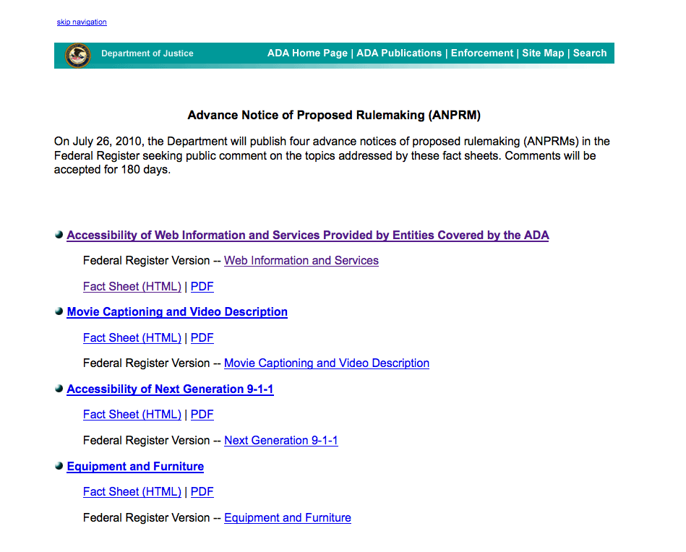
Accessibility Law undergoing change NOW
Public Comments due Jan. 24, 2011
www.ada.gov/anprm2010.htm

Slide 29
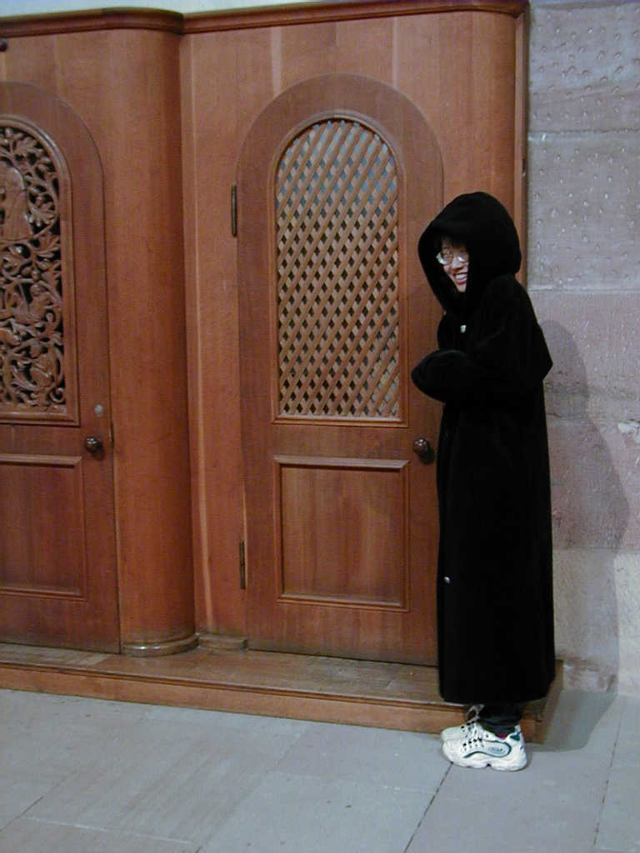
Privacy: Librarian as holy confidant
“A librarian's sacred duty is to the library patron. When you speak with a librarian, it is similar to speaking with a holy person.”
Eric Kaufman, “Firm Librarians: How They Enrich Your Experience,” New York Law Journal (June 5, 2000).
Photo by Chester Liu, used with permission
Notes:
http://kali.pse.umass.edu/~cht/personal/photos/travel/Germany-Belgium/222-confessional.jpg

Slide 30
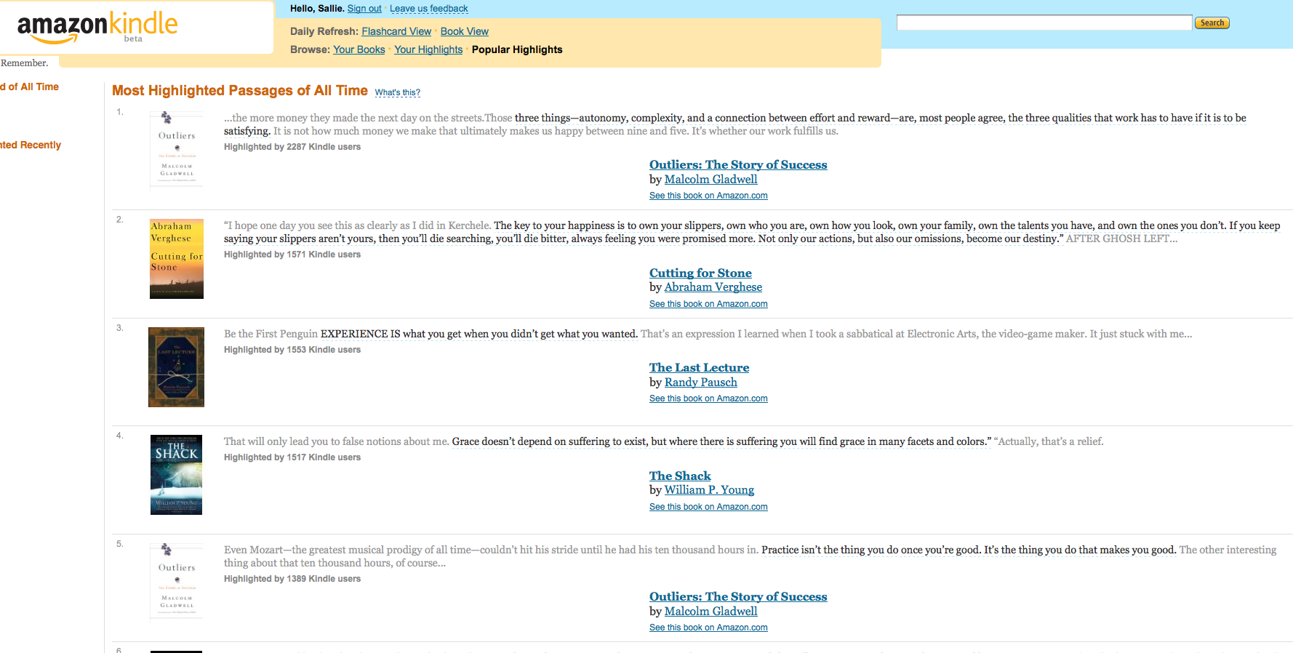
Kindle – Popular Highlights

Slide 31

The Future – in our hands?
PCLED
Privacy – need to authenticate without tracking
Accessibility – comment now
… MOVING TO CLOUD COMPUTING
Notes:
http://www.nbii.gov/portal/server.pt/gateway/PTARGS_0_2_8116_1106_3528_43/http%3B/cbi-lap7.cbi.cr.usgs.gov%3B7097/publishedcontent/publish/ecological_topics/invasive_species/isin_intro_modeling/wizard.png
Title:A Happy Medium: Ebooks, Licensing, and DRMPersonal Author:Schiller, KurtJournal Name:Information TodaySource:Information Today v. 27 no. 2 (February 2010) p. 1, 42, 44
"One thing initially that has driven [DRM's] sometimes-implementation is that everyone sees what has happened in the music industry," says Scott Bain, litigation counsel for the Software & Information Industry Association (SIIA). "When they moved to digital and made the decision to have CDs that were unprotected ... once you let that cat out of the bag, it never goes back in. And I think people have observed that, and I think it's fair to say that people in the publishing industry want to learn from that example."
Comparing ebooks to digital music provides a striking contrast: While the first MP3 players (such as the Diamond Rio, which hit the market more than a decade ago in 1998) made no allowance for DRM or copy protection, the first portable e-readers included DRM provisions from the beginning and were built around the notion of legally purchased books. And while the recording industry was essentially blindsided by the widespread piracy that accompanied the ever-popular MP3s, the publishing industry dug in from the start, anticipating that piracy would quickly become an issue. It secured its content behind a protective layer of rights and encryption.

Slide 32

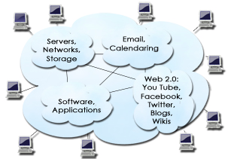
The Future: In the CLOUD
Gmail
Facebook
And next…

Slide 33
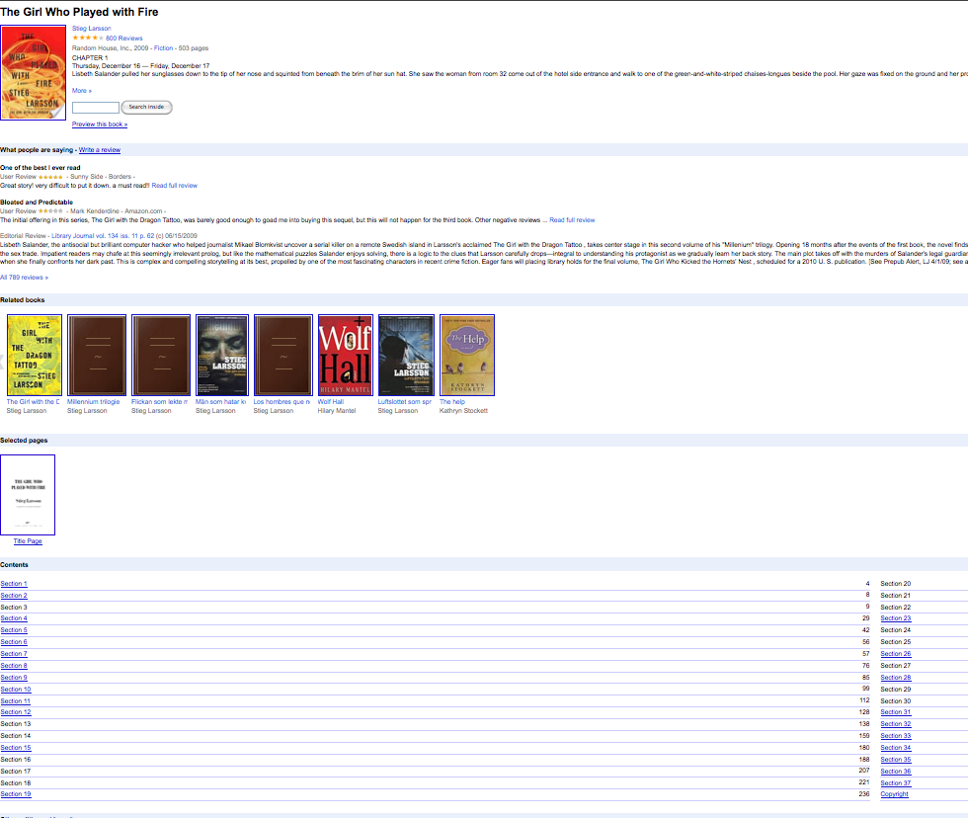
Google Editions
Any device with Internet connection
Reader’s personal library when signed in
35,000 publishers
Millions of titles
Older titles scanned from library shelves, if Google Book settlement approved
…….NO LIBRARY MODEL
Google Books today
20% preview free
Google Editions soon
100% for sale

Slide 34
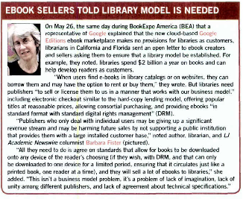
Library Journal July 2010

Slide 35
Open Letter to Ebook Creators and Sellers
Libraries have long, mutually beneficial relationship with publishers & vendors
Libraries will help you sell popular e-books.
- Spend $2 billion/year on books
- Help people develop a passion for reading as children
- Help readers learn about technology
We need
- Popular titles at reasonable prices
- E-books in standard format with standard DRM
- Licenses for individual libraries and consortia
Thank you!
Linda Crowe
Pacific Library Partnership
Charlie Parker, Al Carlson
Tampa Bay Library Consortium
et al
Your thoughts? Send to ALA OITP Carrie Russell crussell@alawash.org

