Slide 1
Welcome! The webinar will begin at 2:00 Eastern/11:00 Pacific

Slide 2
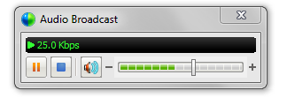
Audio Tips
Today’s audio is streaming to your computer’s speakers or headphones.
Too loud or soft? Adjust volume level in the Audio broadcast box:
Lost all sound? Hear an echo? At the top of the screen, go to the Communicate menu and select Audio Broadcast to refresh your connection.
Notes:
2

Slide 3
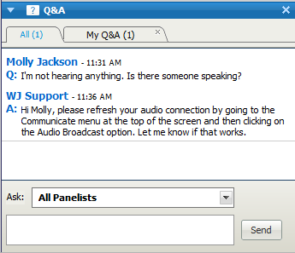
Need Help?
Please post technical support questions into the Q&A Panel.
Step 1: Type the problem in the dialog box.
Step 2: Click Send.

Slide 4
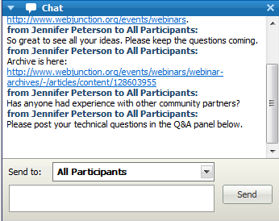
Chat Etiquette
Use Chat to talk with attendees and presenters about the topic.
Do not post technical questions to Chat.
And if you’re tweeting, use this hashtag: #libprogram

Slide 5
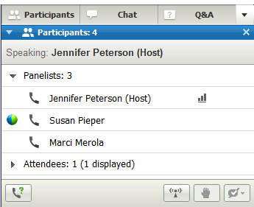
Telephone Access
If you not able to listen via your computer, you may join by phone.
Step 1: Click on Phone Icon under the Participants list.
Step 2: Call the toll-free number provided.
Step 3: Enter the Access Code and Attendee ID provided.
Notes:
http://www.webjunction.org/membercenter/userguide#webex

Slide 6
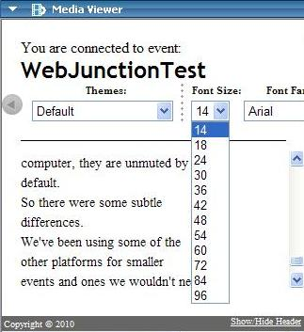
Closed Captioning is available
Open Media Viewer from Panel options.
Adjust font.
Select Show/Hide Header.

Slide 7
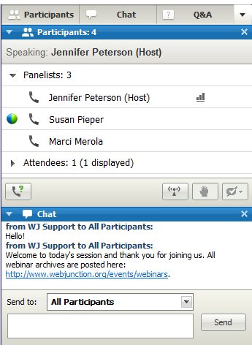
Customize your experience
Panels can be opened or closed by clicking on the panel name at the top of the column, or by using the X in the individual panel.
Hover over edge of panels to drag and resize.

Slide 8
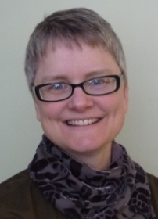
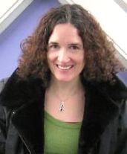
Remember to post to Q&A panel if you need technical assistance.
Other Technical problems?
Contact WebEx support
Event Number: 714 059 090
Phone: 1-866-229-3239
Co-Produced by:
Jennifer Peterson
WebJunction Community Manager
Co-Produced by:
Sharon Streams
WebJunction Senior Manager
Community Services
Notes:
8

Slide 9
Thanks to the generous support of the following state library agencies, WebJunction offers webinar programs for free to all who wish to attend:
Arizona State Library, Archives and Public Records
Connecticut State Library
Florida Department of State’s Division of Library and Information Services
Georgia Public Library Service
Idaho Commission for Libraries
Illinois State Library
Indiana State Library
State Library of Kansas
Maine State Library
Minnesota State Library Agency & Minitex
Missouri State Library
State Library of North Carolina
State Library of Ohio
Access Pennsylvania
Texas State Library & Archives Commission
Library of Virginia
Washington State Library

Slide 10
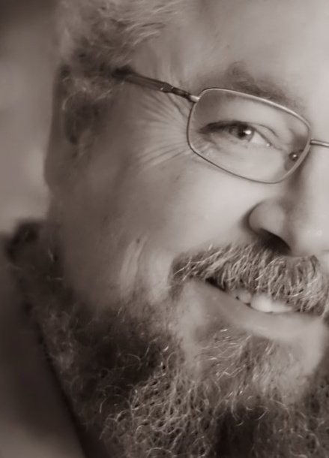
Today’s Presenter
Joey P. Holmes
Library Assistant
Laurens County Library
Laurens, SC
Notes:
Roy Tennant works on projects related to improving the technological infrastructure of libraries, museums, and archives. Specific areas in which he is active are OCLC Web Services, the OCLC Developer Network, and Technical Advances for Innovation in Cultural Heritage Institutions (TAI-CHI).
Prior to joining OCLC in May 2007, Roy worked for the University of California for over 20 years, first at UC Berkeley, then the California Digital Library. His experience included managing the process for UC Berkeley libraries to automate circulation, establishing the first Digital Library SunSITE, and launching the eScholarship Repository and eScholarship Editions for the California Digital Library.
Roy is the owner of the Web4Lib and XML4Lib electronic discussions, and the creator and editor of Current Cites, a current awareness newsletter published every month for nearly 20 years.
Roy has written five books on technology in libraries, wrote a column for Library Journal for ten years, and has numerous articles in other professional journals and magazines.

Slide 11
Adult Programs on a $0 Budget! (And the PR Systems used to Promote them)
(And the PR Systems used to Promote them)

Slide 12
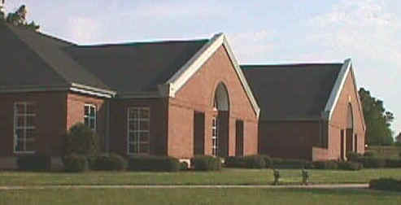
with Joey P. Holmes
Library Assistant
Laurens County Library
Laurens, SC

Slide 13
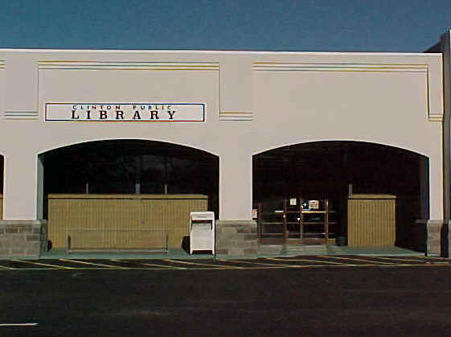
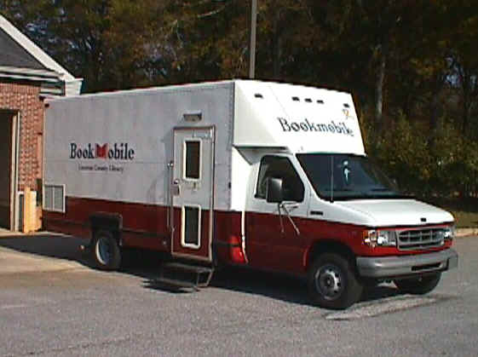
Laurens County Public Library System
Laurens County Library
Clinton Public Library
Bookmobile

Slide 14
Laurens County Library
9 Full time employees
3 Part time
Building is roughly the size of a football field
Average 450 visitors per day
650 Square foot meeting room

Slide 15
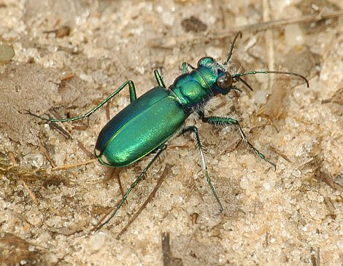
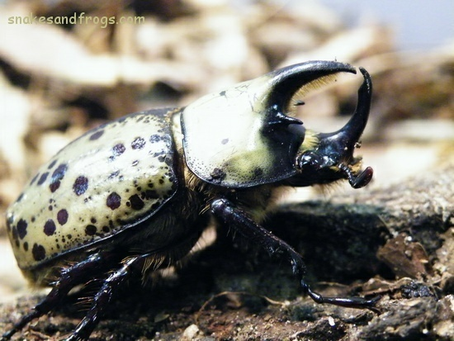
JPH is relatively new to Library work (starting with circulation, calling arrived holds, managing the outside sign, bulletin boards/displays) JPH has a background in Criminal Justice & Outdoor Recreation/Wildlife Science

Slide 16
Bells and Whistles

Slide 17
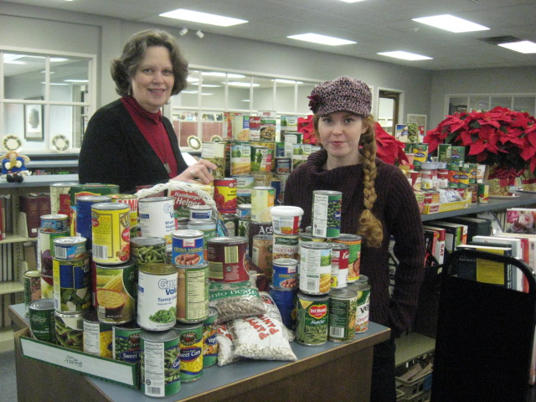
JPH encouraged new LCPL Director to contact the press about “Food For Fines.” She said I should be in charge of PR.

Slide 18
PUBLIC IMAGE
&
PUBLIC RELATIONS

Slide 19
Public Image (Something we CAN control)

Slide 20
From “Family Guy” "What's a library, dad?" "Oh, it's just a place where homeless people come to shave and go BM." (Chris and Peter in Peter Griffin: Husband, Father...Brother?)

Slide 21
We should be in the newspaper, a LOT! (for positive reasons)

Slide 22
Every time library is mentioned in the press/media the public image of the library as a place that brings the community together the Library’s Public Image is enhanced. People are more aware of the library and what it offers. People begin to think and say, “There is always something going on at the library.” THEN Our PUBLIC IMAGE Improves!
THEN
Our PUBLIC IMAGE
begins to improve!

Slide 23
Facebook Page: You know you’re from Laurens when ……
Post by M. D. L., May, 2011:
“I just moved to Laurens from Simpsonville and I think we are really gonna like it! Looks like this library has some really cool events and downtown is pretty and interesting.”

Slide 24
Improved PUBLIC IMAGE leads to increases in visits/use. Increased visits/use mean we are more valuable to the community, which in turn, makes us more valuable to the political “powers-that-be.” This helps secure our future.

Slide 25
PUBLIC RELATIONS

Slide 27
PR needs events & other newsworthy activities to regularly function.
IF we want to be in the news once a month, we put on an event/program once a month!

Slide 28
What kind of Event/Program? Who can do a Event/Program for us? How much will this Event/Program cost?

Slide 29
Traditional Programs
Authors (Book Signings)
Classes
Lectures
Etc.
Concerts
(Education + entertainment = edutainment)

Slide 30
Free is good.
We try to pick presenters who have something to gain by coming to the library and doing a program.
Authors sell books.
Musicians cell CDs, etc.
This type program is often one that comes at no cost to the library.

Slide 31
Who Do you know
Friend
Relative
Associate
Acquaintance
Co-worker
Who has special knowledge to inform or entertain?
Who is willing to do a program?
JUST ASK THEM!

Slide 32
Decide on THE Event Book the Event

Slide 33
Need Money for a Program?
$0 Budget!
Don’t let that stop you!

Slide 34
FUNDING/FUND RAISING FOR PROGRAMS Specialty events etc.

Slide 35
NEED $500?
Ask one person for $500
Or ask 10 people
for $50 each.
Or
Ask 20 people for $25 Each

Slide 36
PROMOTE THE EVENT

Slide 37
CREATE PROMO MATERIALS
(Send to Ann Szypulski for approval)

Slide 38
Flyers (Created on MS Publisher) Used at both Laurens and Clinton Libraries on the Front Desk, Doors, Bulletin Board, (and sometimes in other special locations).

Slide 39
Press Item
Award Winning Preservation Architect to Speak
at Friends of the Library Annual Meeting.
Martin Meek, winner of the prestigious Governors Lifetime Achievement award for Historical Preservation in 2010 will be talking about mill village preservation at the Friends of the Library annual meeting March 20 at 2:30 PM. This meeting will be held at the Laurens County Library on West Main Street in Laurens.
Martin Meek is principal and owner of the architectural firm, Campbell, Meek, and Associates in Spartanburg, SC. With over 37 years of architectural experience, he is well known for historic preservation work and has supervised projects in Greenville, Spartanburg, Gaffney, Rock Hill, Darlington and Bennettsville, just to name a few. Indeed, he has participated in more than 25 different historical preservation projects that involved over 29 million dollars worth of development.
Mr. Meek has been the City of Spartanburg’s Historic Preservation Architect Consultant since 1984. He served on the South Carolina review board for the National Register of Historic Places for two terms. He works within “The Secretary of the Interior’s Standard’s for the Treatment of Historic Properties” and “The Historic American Building Survey Standards for Architectural Documentation of Historic Structures.”
During his program at the Laurens Library Mr. Meek will address the history of mill villages, their current conditions, and ways they can be used to benefit us now and into the future.
Life in Laurens is based on a heritage of agriculture and textiles. We all deserve to know more about our past and how to preserve it.
This meeting is free and open to the public.
Laurens County Library 1017 West Main Street Laurens, SC. 29360 864-681-READ (7323) www.lcpl.org Now on FACEBOOK!”

Slide 40
Bookmarks We hand out about 20-30 per day

Slide 41
Outside Sign (6 lines, 14 characters per line)

Slide 42
Facebook and Facebook Event

Slide 43
Facebook & Facebook Events
The library sets up the event/announcement
LCPL has 334 “Likers”
JPH invites my friends/share the event
JPH has 866 “Friends”
JPH posts event on “You Know You’re from Laurens” Facebook Page.
“YKYFL” seen by 3417 people!

Slide 44
PROMOTE WHERE?
In-House;
Charlie Miller………………..Branch Manager
Peggy Kennedy …………….……LCPL Website
Leigh Tumblin….…Email contact with home-school Families

Slide 45
Sending out the Press (We try to do this 3 weeks prior to the event)

Slide 46
Newspapers
Laurens County Advertiser
Clinton Chronicle
Ware Shoals Observer
Woodruff News
Newberry Observer
(For really big events we might consider sending a press release to the Greenville News, Spartanburg Herald-Journal or the Greenwood Index-Journal)

Slide 47
Local News Websites
Golaurens.com
Goclinton.com

Slide 48
Local Radio Stations
WLBG
WPCC
WNCW

Slide 49
Local Television Stations
WHNS (Fox) Channel 21
WYFF (NBC) Channel 4
WSPA (CBS) Channel 7

Slide 50
Others who should know
Main Street Laurens
Chamber of Commerce
Piedmont Rural Telephone Cooperative
Humanities Council SC
School District 55 Arts
State Library
SC Dept Parks Recreation and Tourism

Slide 51
Magazines
South Carolina Living
Sandlapper
Southern Living
Greenwood Magazine
Don’t forget the “Things-to-do” type magazines you pick up in lobbies, waiting areas of restaurants, etc.

Slide 52
Scouts
Boy Scouts, Blue Ridge Council
Boy Scouts, Palmetto Council
Girl Scouts, Mountains to the Midlands Council

Slide 53
PROGRAMS!

Slide 54
Early Attempts
Spring of 2008, Nature Study Series with JPH
Poorly-fairly attended!
February 2009, Author John Jeter book sale/signing
16 Attended!
March 8, 2009, Friends of the Library
(Author Dori Sanders book sale/signing)
96 Attended!
July 16, 2009, Hunter Holmes "Laurens Blues Legacy" 102 Attended!

Slide 55
I Have a Plan…
Following the success of “Laurens Blues Legacy” in July of 2009 I started looking closely at other SC libraries and what kind of programs they were presenting.
By early December of 2009 I had scheduled a program per month for the year 2010.

Slide 56
2010 Programs
January (1-7-10) Knit Night!.....................................................................................35 Attended!
February (2-4-10) Scrapbooking……………………………………………….………….………..…….. 23 Attended!
February (2-18-10) Knit Night II…………………………………….…………………………..……….. 57 Attended!
March (3-4-10) “The Rabbit lady” Loretta Hayward……………….…………….……..……….. 124 Attended!
March (3-14-10) Friends of the Library…………………………………….……………………………..21 Attended!
March (3-18-10) Knit Night III……………………………..…………………………………….…………….12 Attended!
April (4-1-10) Wildlife Photographer Gene Ott……………………………………...………..……….27 Attended!
April (4-15-10) Author Dale Rains Book Sale/signing………………………………………………….5 Attended!
May (5- 6-10) Hunter Holmes “Laurens Blues Legacy”……………………..…….……………... 104 Attended!
May (5-20-10) Pat Patterson w/ History of Carolina Beach Music………………….…….……34 Attended!
June (6-3-10) “Roses” with Billy Patterson of Roses Unlimited………………….………..…..16 Attended!

Slide 57
CANCELED!
Mark the Flyers “Canceled”
Announce on Facebook (and on the Facebook event)
Contact online news outlets and online message boards
Change outside sign

Slide 58
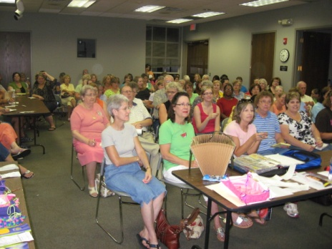
The Coupon Lady
101 Attended!

Slide 59
September 2010
September (9-2-10) Beginning Genealogy
38 Attended!
September (9-15-10) Social Security Website
5 Attended!
September (9-20-10) Internet Safety
7 Attended!

Slide 60
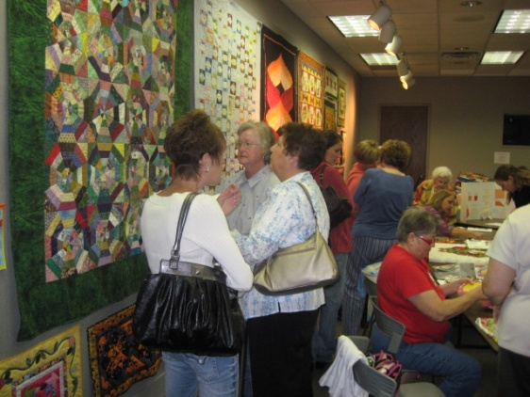
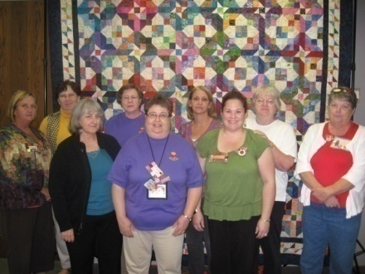
Quilt Show!
68 Attended!

Slide 61
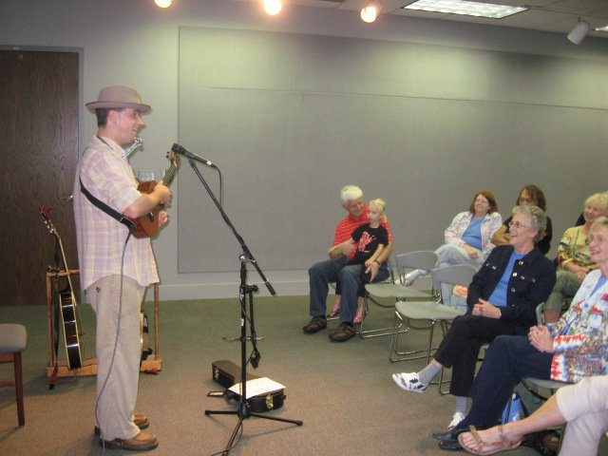
Ukulele Fun with Lil’ Rev
52 Attended!

Slide 62
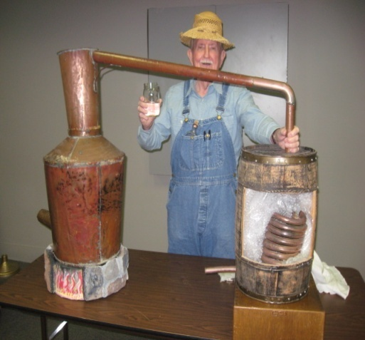
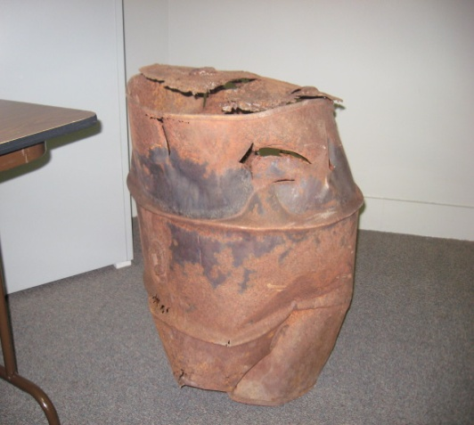
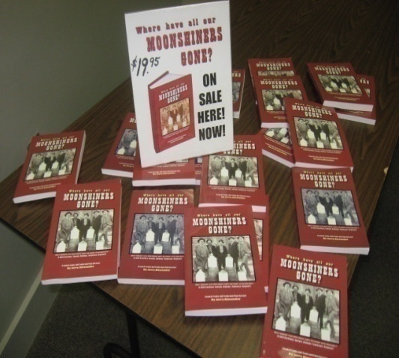
Moonshine!
32 Attended!

Slide 63
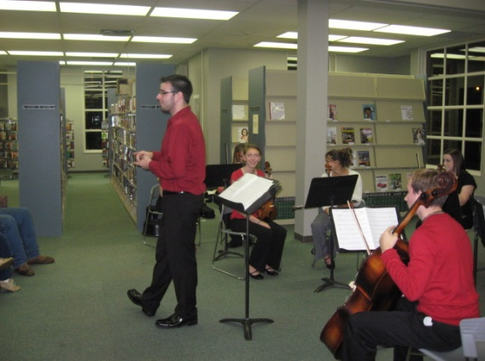
Laurens High Orchestra
130 Attended!

Slide 64
2010 Stats
764 Attend JPH Programs
122 Attend Programs Planned by others
Total of 886 Attend Programs in 2010 (not including teen and children events/programs)

Slide 65
2011 PROGRAMS

Slide 66
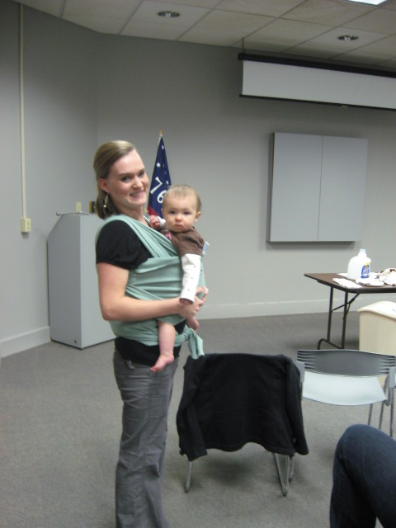
New Mommy: Old School!
19 Attended!

Slide 67
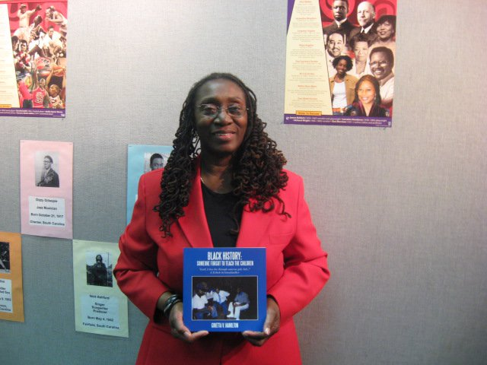
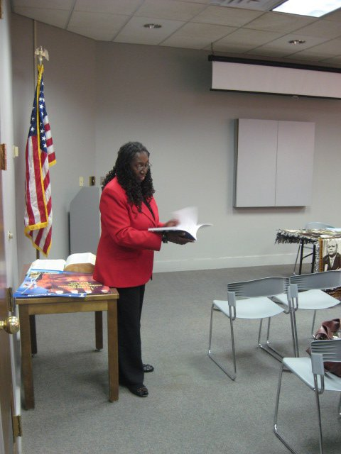
Black History: Someone Forgot to Teach the Children
34 Attended!

Slide 68
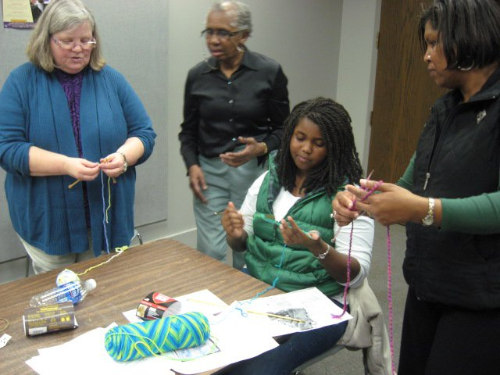
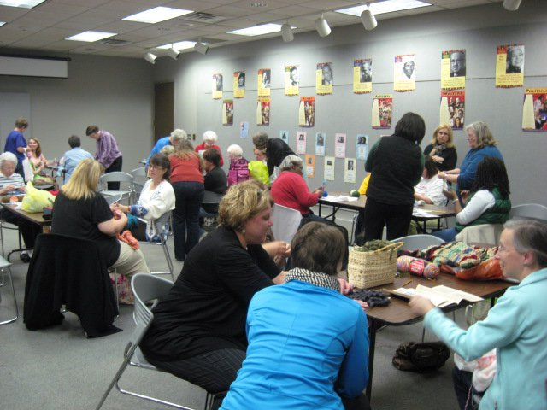
Knit Night!
31 Attended!

Slide 69
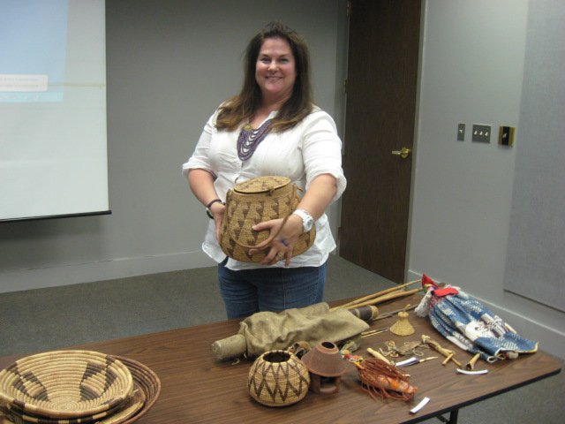
Peace Corps!
17 Attended!

Slide 70
Friends of the Library Annual Meeting Mill Village Preservation with Martin Meek
65 Attended!

Slide 71
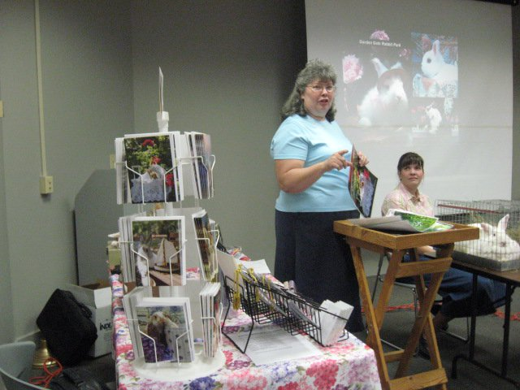
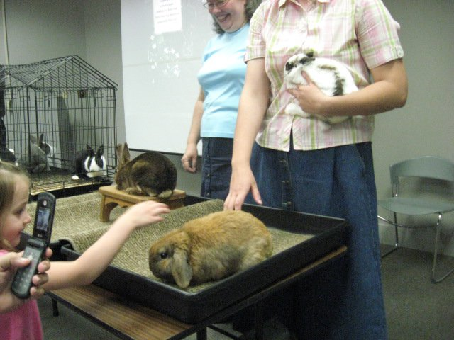
The Rabbit Lady!
77 Attended!

Slide 72
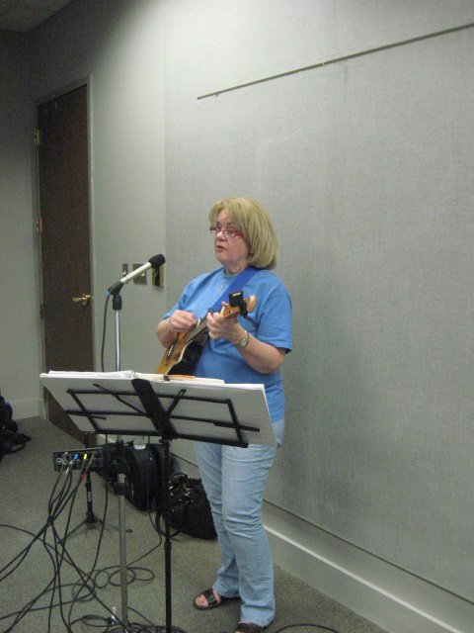
Ukulele Fun with the YesterUkes!
82 Attended!

Slide 73
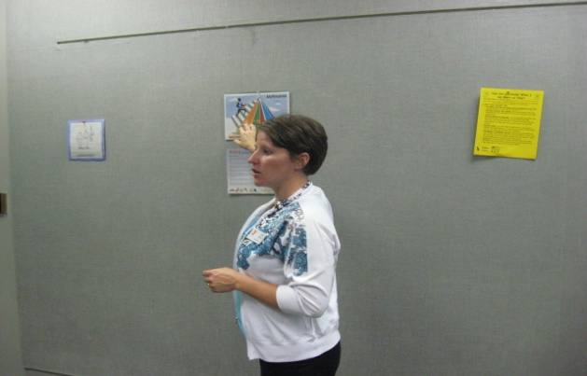
Fitness For Beginners
13 Attended!

Slide 74
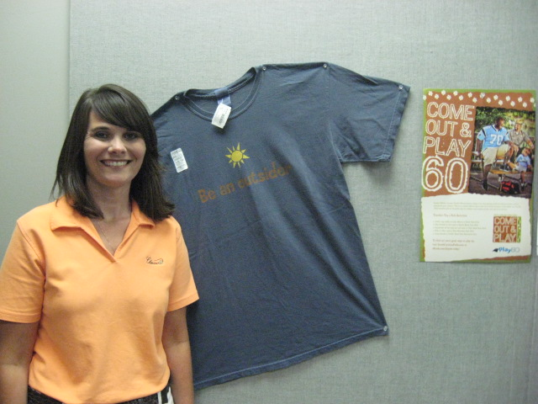
South Carolina State Parks!
16 Attended!

Slide 75
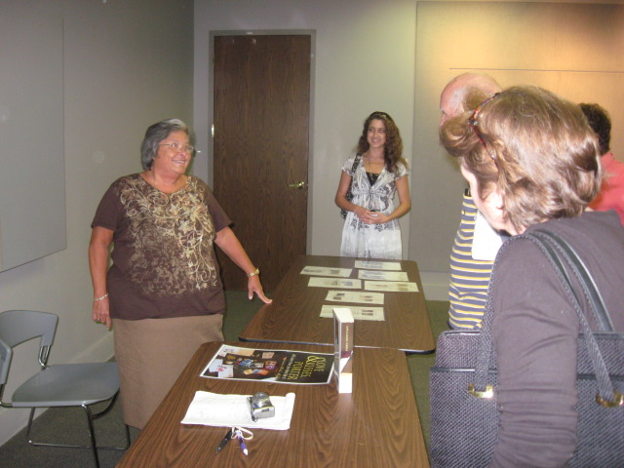
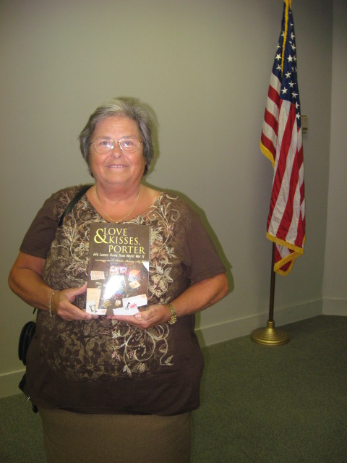
Love & Kisses, Porter
13 Attended!

Slide 76
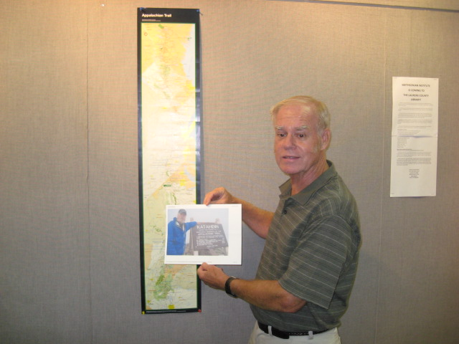
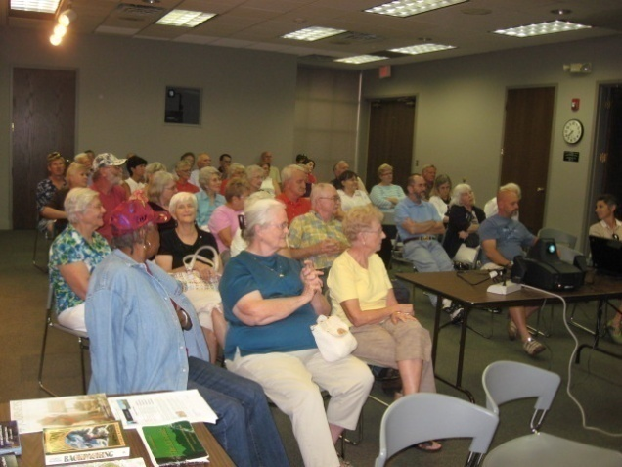
Appalachian Trail Adventures
46 Attended!

Slide 77
Acoustic Jam Session
30 Attended!

Slide 78
NEW HARMONIES Celebrating American Roots Music
The Laurens County Library
For 6 weeks in Autumn of 2011, will display
800 square feet
of
Smithsonian Institute Exhibits about
American Roots Music!

Slide 79
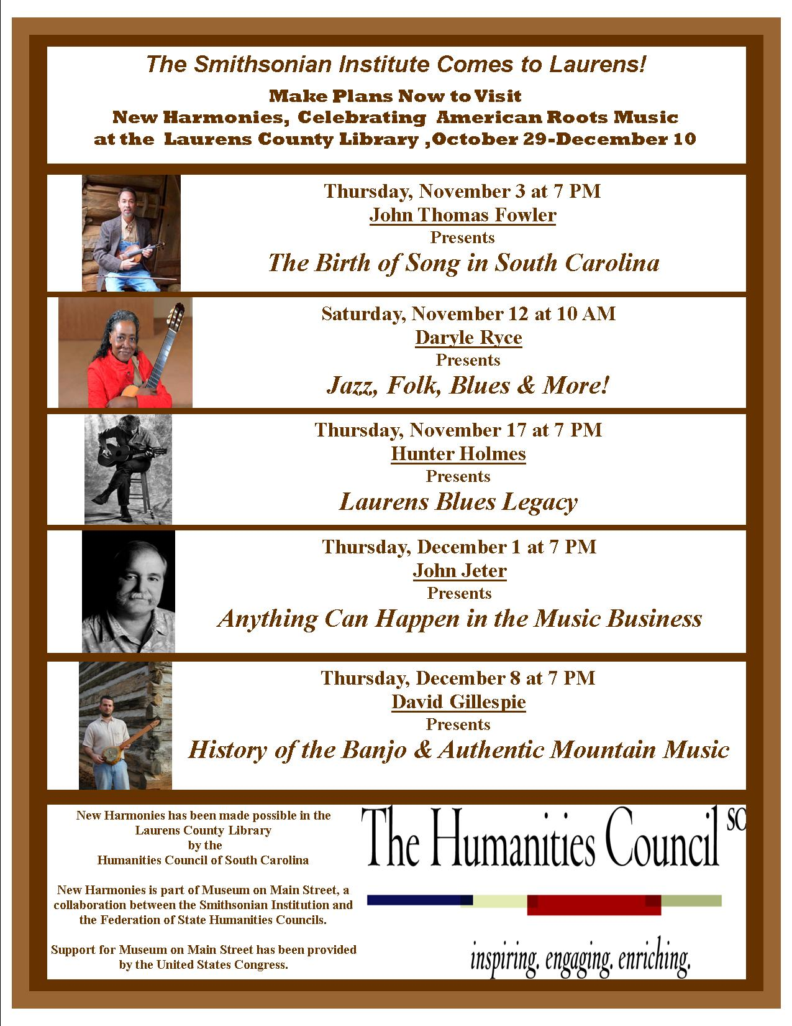

Slide 80
NEW HARMONIES GRAND OPENING/RIBBON-CUTTING
Television News Coverage!
Coverage from 2 local Newspapers!
News website Golaurens!
WLBG Radio Coverage!
180 Attended!

Slide 81
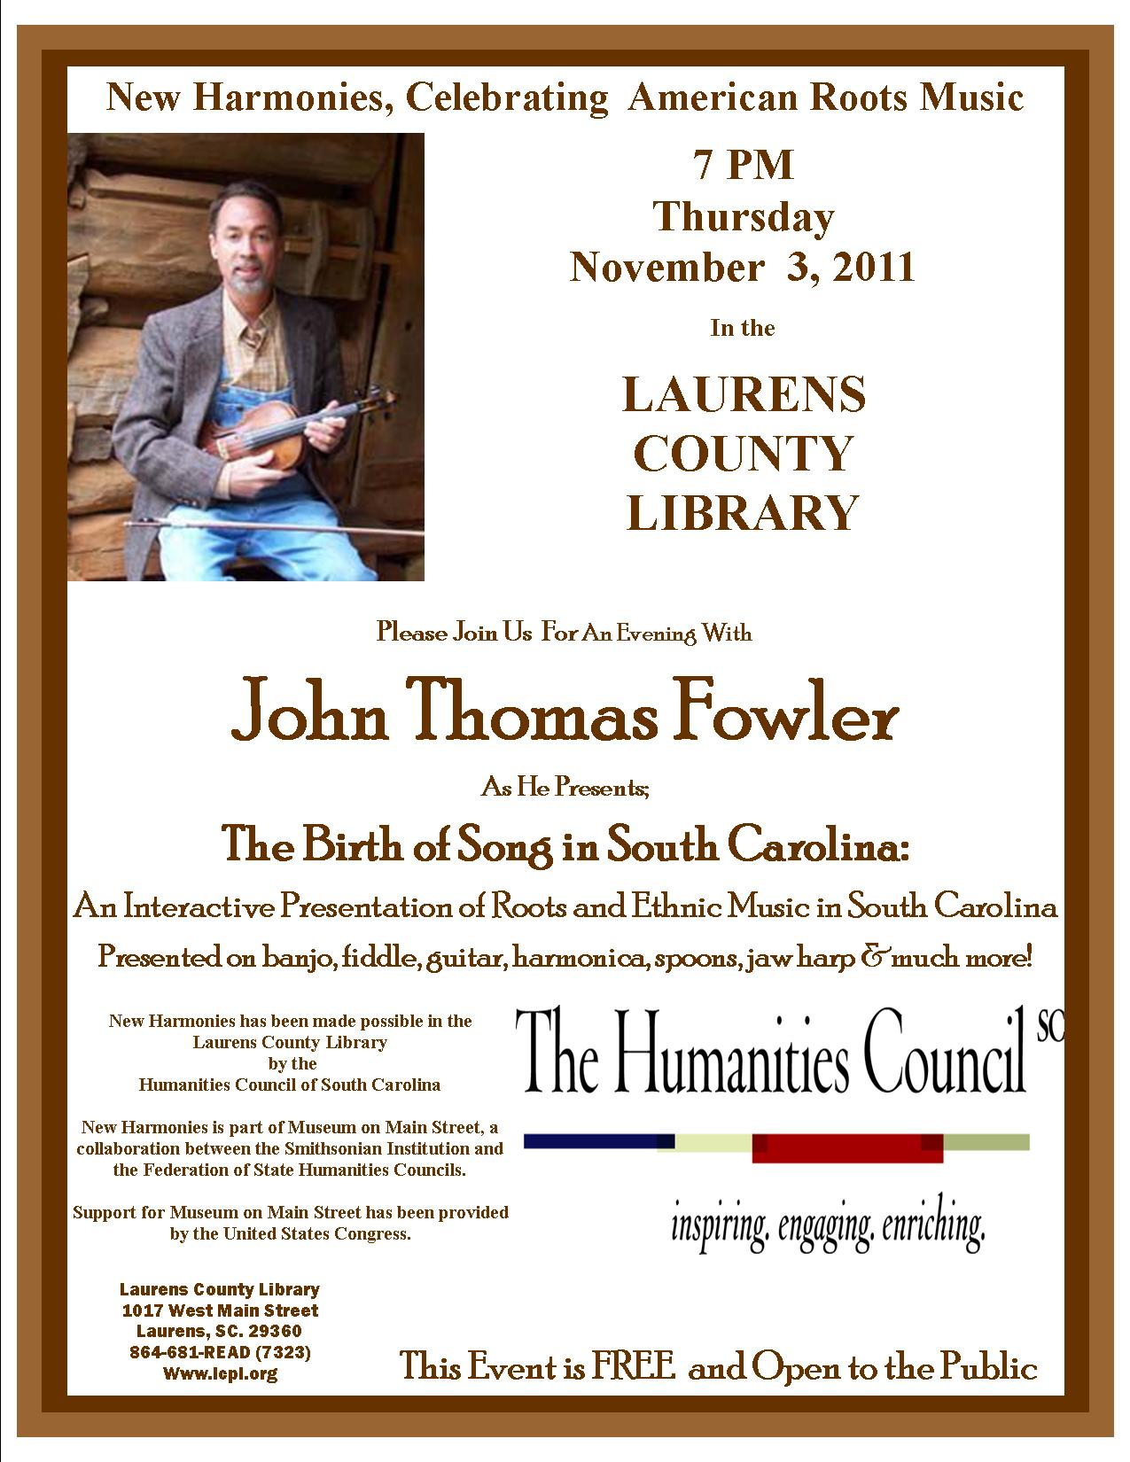
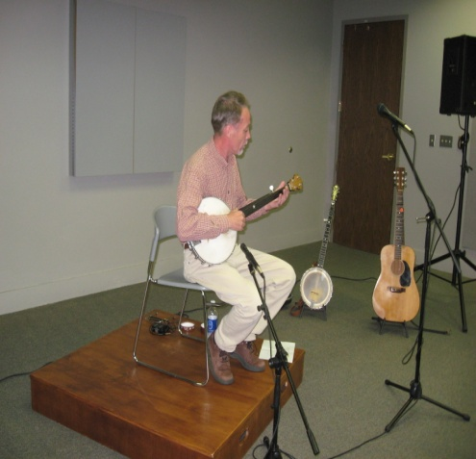
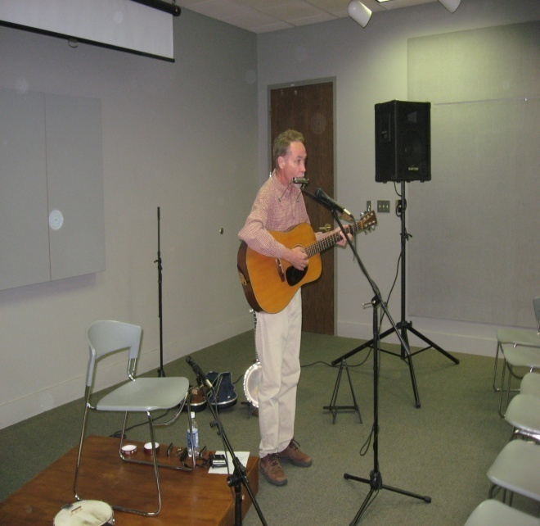
49 Attended!

Slide 82
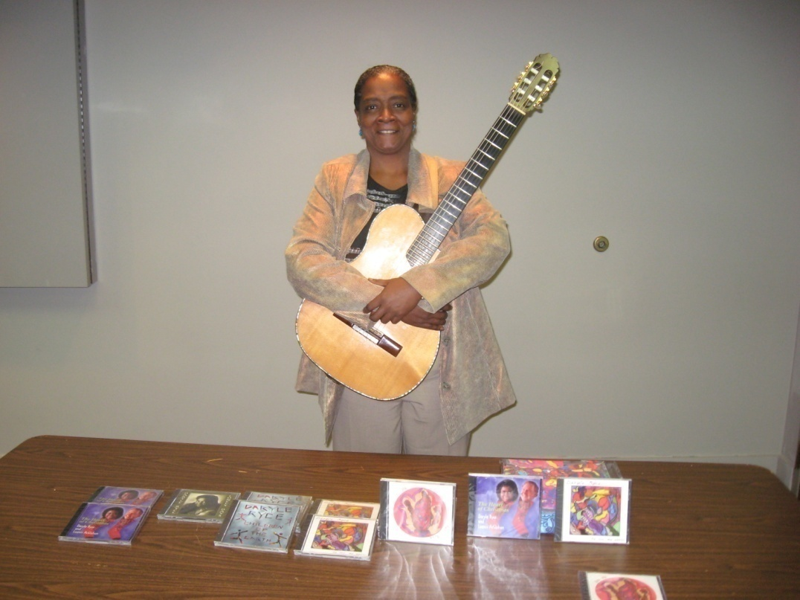
36 Attended!

Slide 83
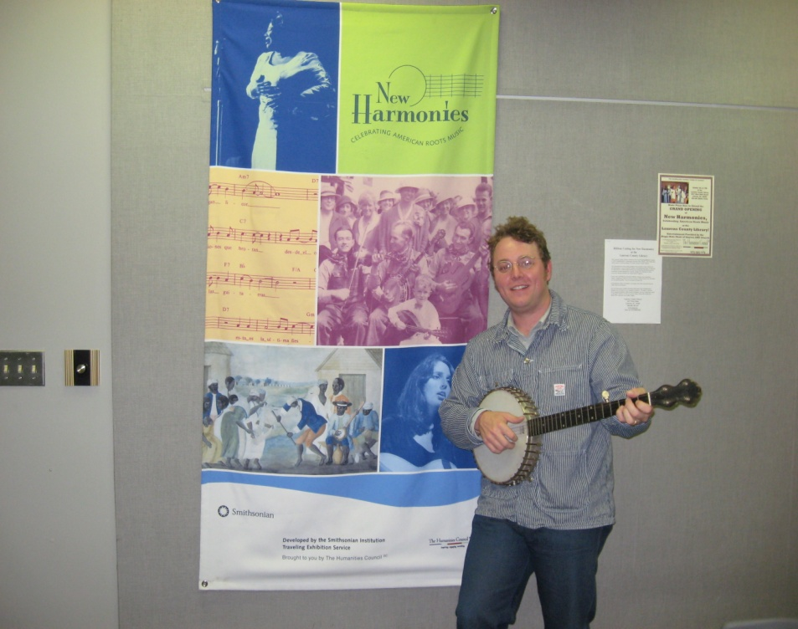
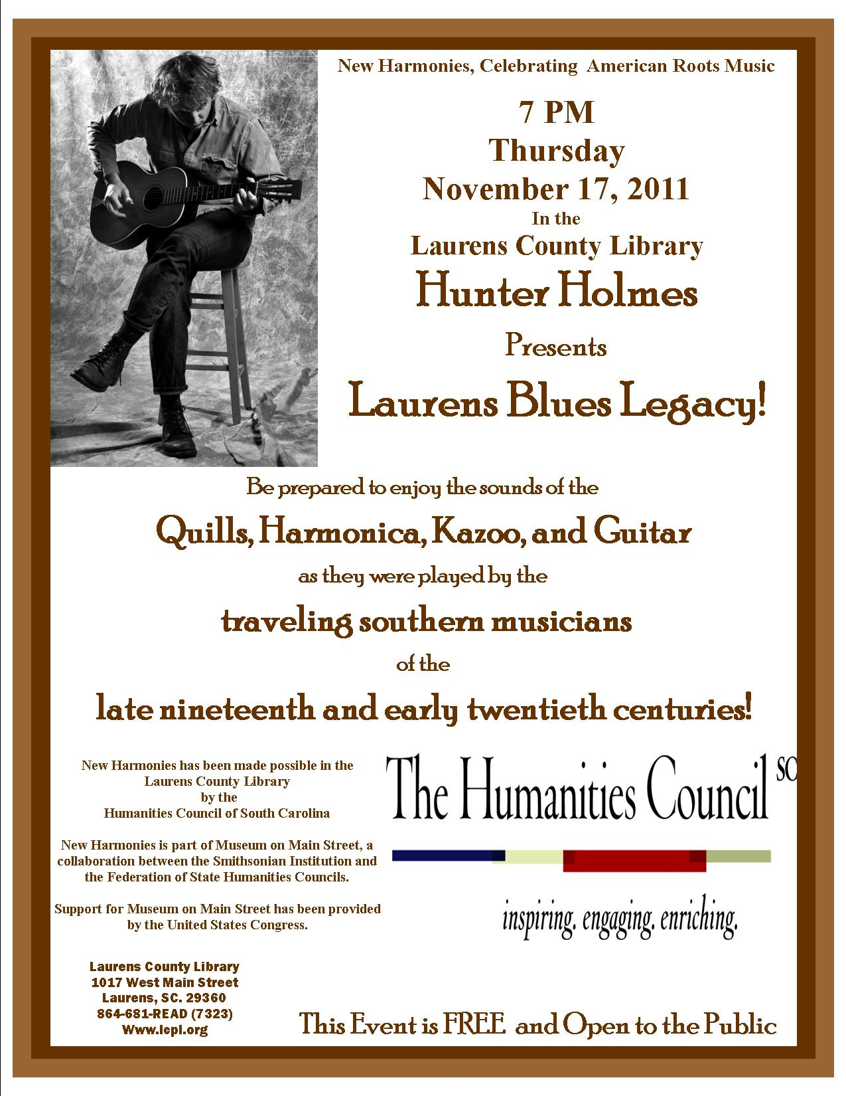
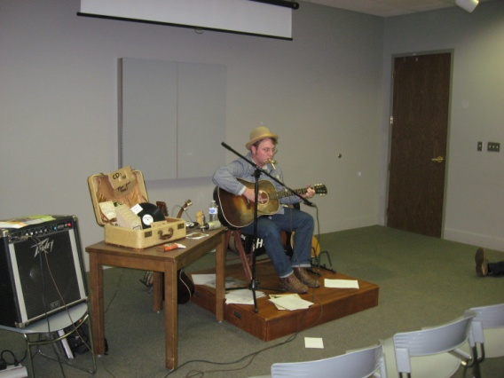
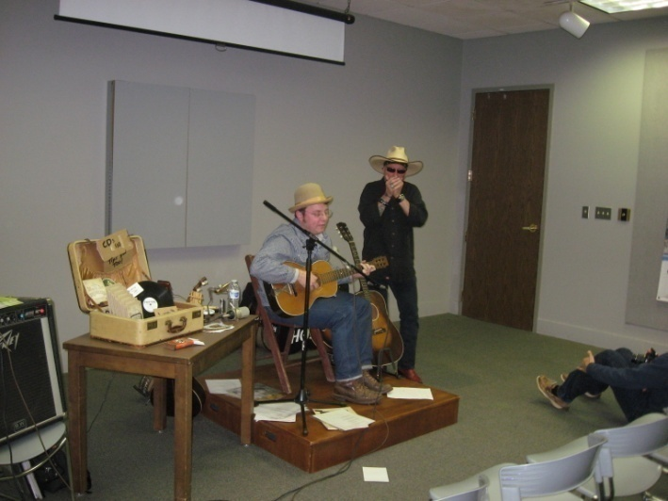
66 Attended!

Slide 84
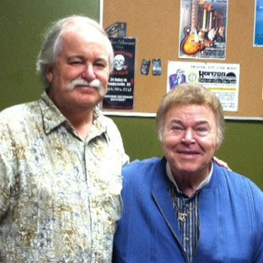
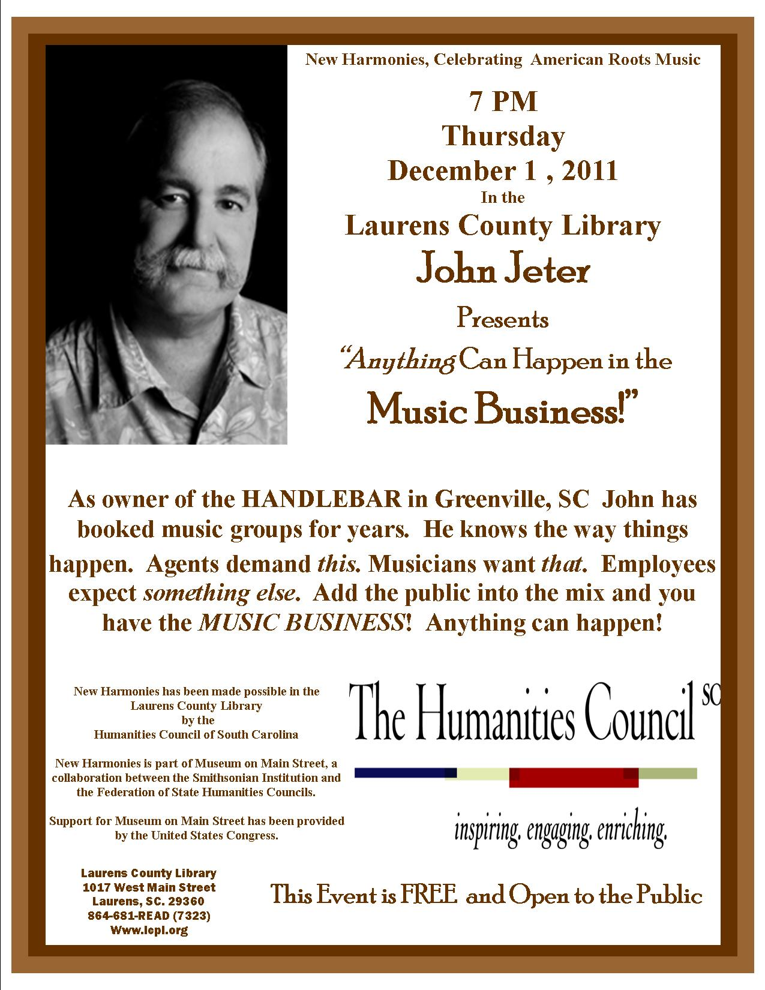
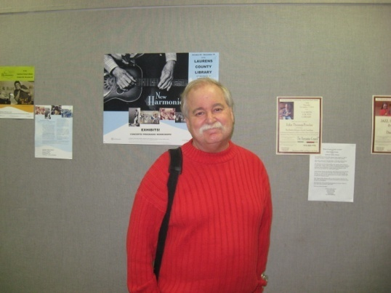
45 Attended!

Slide 85
67 Attended!

Slide 86
2011 Stats
744 people attended programs planned by JPH

Slide 87
2012
PROGRAMS
AT THE
LAURENS COUNTY LIBRARY

Slide 88
Possible Programs Include
Chess night
Roxanne; Going Veggie! Going Vegan! Gluten Free and loving it!
Antique Appraisals
Zoo outreach dept.
Master Gardener
International Travel/Hunting/Safari Adventures
Okefenokee Swamp
Laurens County’s Railroad History
Military Band/ensemble
Knit Night
Authors/book signings
Rock Art/Native American Culture
Texting for Seniors
Zumba!

Slide 89
YOUR TURN!
January……………
February…………
March…………….
April……………….
May……………….
June……………….
July………………..
August…………..
September…….
October………..
November…….
December…….

Slide 90
KEEP SCORE
April
1.
2.
3.
4.
5. “Nat Lib Week” on Golaurens & Goclinton
6. “Nat Lib Week” in Advertiser
“YesterUkes” in Advertiser
“iTeens Talent Show” in Chronicle
7.
8.
9. “Nat Lib Week” in the Laurens Advertiser EXTRA
10.
11.
12. “Nat Lib Week” on Golaurens
13. “Nat Lib Week” in Chronicle
“Clinton Evening Storytime” in Chronicle
14. Send out press on “Fitness for Beginners”
15.
16.
17. “Fitness for Beginners” on Golaurens
18. “Fitness for Beginners” on Golaurens
19.
20. “Fitness for Beginners” in Chronicle
21.
22.
23.
24.
25.
26.
27.
28.
29.
30. “Fitness for Beginners” on WLBG Radio
“Clinton Evening Storytime” on WLBG Radio
We had press
13 Times
during 30 days!
Also keep track of your
Program Attendance!
(helps YOU know what kind of programs work in YOUR Library!)

Slide 91
jholmes@lcpl.org
Find me and friend me
on facebook!
Joey Holmes
Laurens County Public Library System

Slide 92
Questions?

Slide 93
Stay Involved
On WebJunction
webjunction.org/explore-topics/programming.html
Association for Rural & Small Libraries
www.arsl.info
Become an ARSL Member Today!
Join us for more ARSL webinars
Receive quarterly member e-newsletter
Get discount on Annual Conference
September 27-29, 2012
Raleigh, NC

