Slide 1
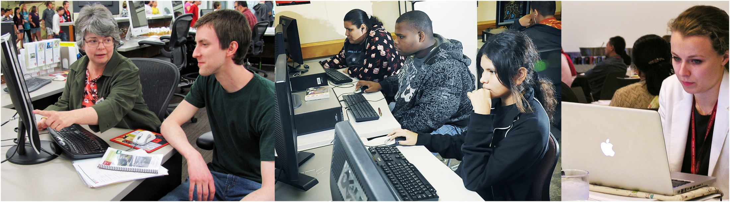
Designing & Delivering
Online Training
Library CE Institute
Online Session 5
WebJunction – Infopeople – IMLS

Slide 2


We took the plunge…
together!

Slide 3

http://blog.travefy.com/2013/07/beach-etiquette/
Notes:
http://blog.travefy.com/2013/07/beach-etiquette/

Slide 4
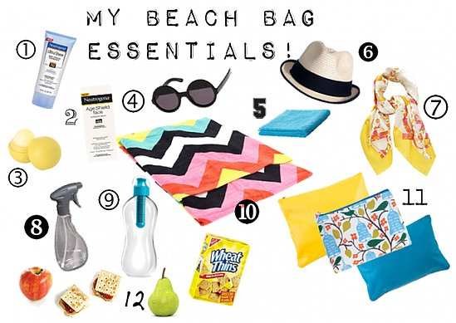
http://www.bellasugar.com/Michelle-Phan-Reveals-Her-Beach-Bag-Essentials-18537595
Notes:
Packing your course development beach bag!
http://www.bellasugar.com/Michelle-Phan-Reveals-Her-Beach-Bag-Essentials-18537595

Slide 5
My course development essentials
6.
1.
4.
2.
5.
3.
7.
10.
9.
8.
11.
12.
Notes:
Packing your course development beach bag! In chat, share the key course development essentials that you wouldn’t leave home without!

Slide 6
Agenda for today
Sharing Your Project
Biggest Wins! Biggest Challenges!
Moving Forward & Staying Connected
Sharing With the Field

Slide 7
Sharing your projects
Sharing your projects
Notes:
Sharing your projects
Biggest wins! Biggest Challenges!
Moving Ahead &Staying Connected
Sharing With the Field

Slide 8
Working Groups
Change
Coping with Change
Leadership
Providing Constructive Employee Feedback
Technology
Building a Positive Social Media Presence
Youth
Encouraging Early Literacy
Staff Training
Making work fun again

Slide 9
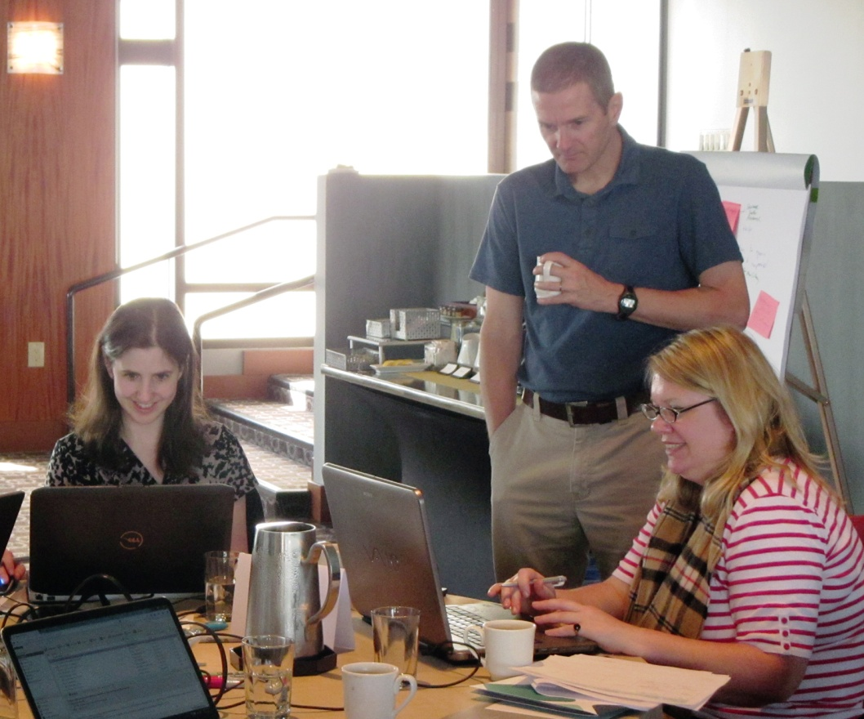
Building a Positive Social Media Presence
Course Description:
Over 70% of adults are now using a social
networking site of some kind, and these online
interactions can have real-life implications. This
course provides guidelines for what should and
should not be shared online, how to build social
capital and how to put your best foot forward
when using social media.
Objectives:
Describe the benefits of building a positive social media presence.
Make informed decisions about sharing personal information on social media.
Employ strategies for posting information that build positive social media capital.
Members
Amy Calhoun
Jamie Matczak

Slide 10
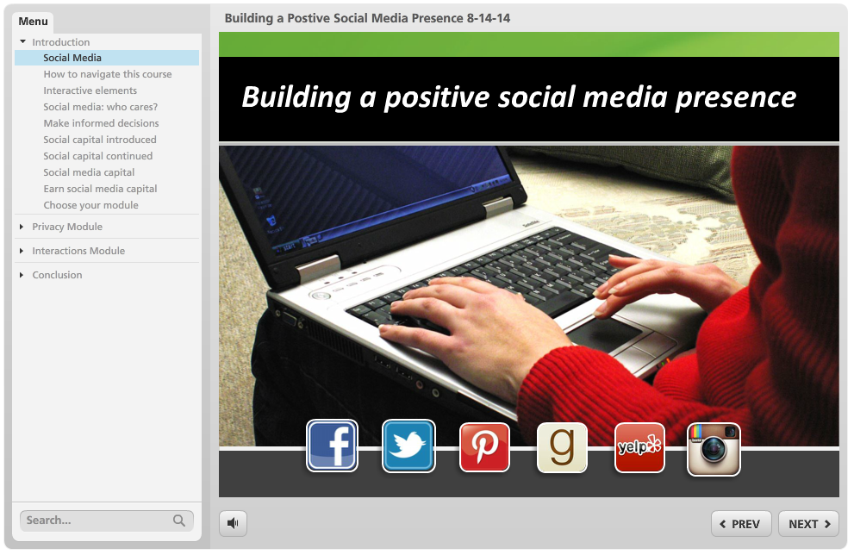
Building a Positive Social Media Presence
Notes:
Building a Positive Social Media Presence
Course Description: Over 70% of adults are now using a social networking site of some kind, and these online interactions can have real-life implications. This course provides guidelines for what should and should not be shared online, how to build social capital and how to put your best foot forward when using social media.
Objectives:
Describe the benefits of building a positive social media presence.
Make informed decisions about sharing personal information on social media.
Employ strategies for posting information that build positive social media capital.
Designers:
Jamie Matczak – Nicolet Federated Library System
Amy Calhoun – Sacramento Public Library

Slide 11
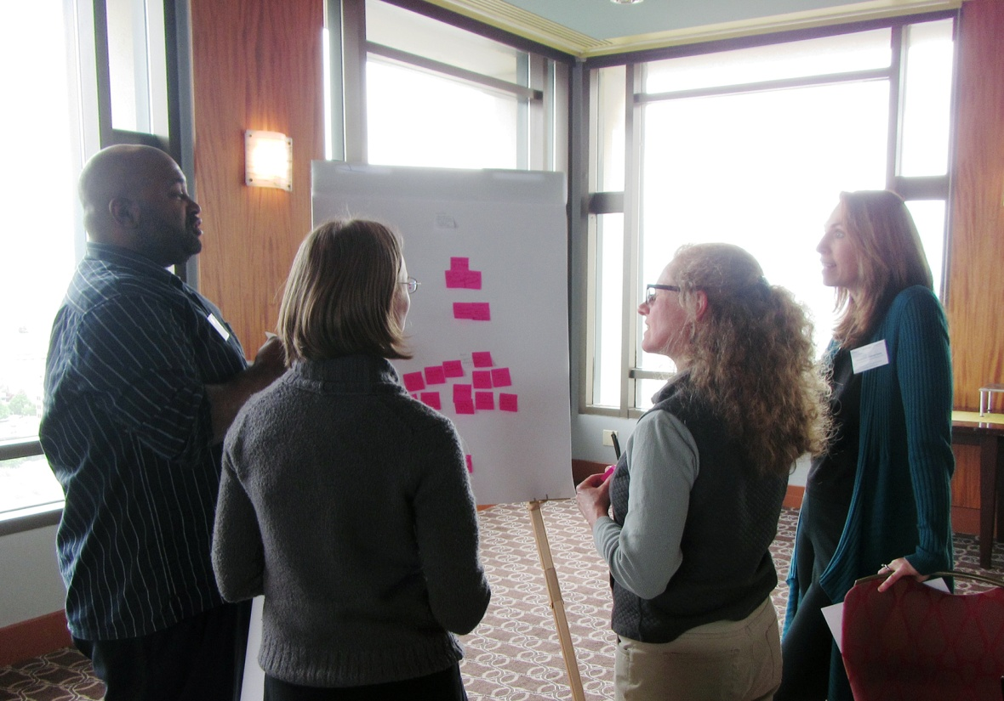
Coping with Change
Course Description: In this course, you will apply strategies to mitigate the unsettling aspects of change. You will learn skills to help you cope with change and capitalize on it.
Objectives [high-level]:
Describe what change is.
Learn how to cope with change.
Incorporate & capitalize in
the midst of change.
Course Designers:
Katherine Adelberg
Maurice Coleman
Katie Fearer
Stephanie Zimmerman
Notes:
Coping with Change
Course Description: In this course, you will apply strategies to mitigate the unsettling aspects of change. You will learn skills to help you cope with change and capitalize on it.
Objectives:
Describe what change is.
As a result of this course, learners will be able to…
Define what change is.
Accept the reality that change is going to happen and that it is normal.
Compare the three different levels or orders of change.
List the five myths versus the reality of change.
Use the STATE model for positive conversations about change.
Learn how to cope with change.
As a result of this course, learners will be able to…
Explain the different ways we resist change.
Use eight coping strategies to deal with change
Incorporate & Capitalize in the midst of change.
As a result of this course, learners will be able to…
Embrace the opportunity to reflect
Take advantage of change to reexamine normal behavior
Become empowered and not a victim
Harness change to your benefit
Designers:
Katherine Adelberg - Kentucky Department for Libraries & Archives
Maurice Coleman - Harford County Public Library (MD)
Katie Fearer - Alaska State Library
Stephanie Zimmerman - Library System of Lancaster County (PA)

Slide 12
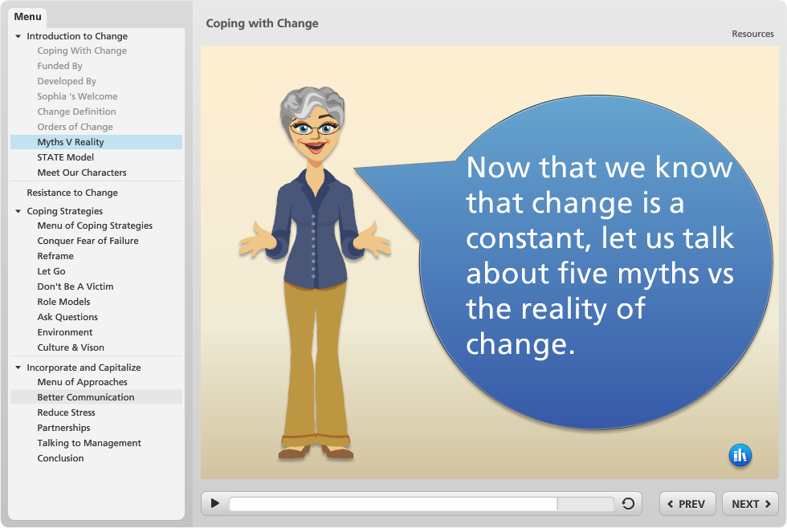
Coping with Change
Notes:
Coping with Change
Course Description: In this course, you will apply strategies to mitigate the unsettling aspects of change. You will learn skills to help you cope with change and capitalize on it.
Objectives:
Describe what change is.
As a result of this course, learners will be able to…
Define what change is.
Accept the reality that change is going to happen and that it is normal.
Compare the three different levels or orders of change.
List the five myths versus the reality of change.
Use the STATE model for positive conversations about change.
Learn how to cope with change.
As a result of this course, learners will be able to…
Explain the different ways we resist change.
Use eight coping strategies to deal with change
Incorporate & Capitalize in the midst of change.
As a result of this course, learners will be able to…
Embrace the opportunity to reflect
Take advantage of change to reexamine normal behavior
Become empowered and not a victim
Harness change to your benefit
Designers:
Katherine Adelberg - Kentucky Department for Libraries & Archives
Maurice Coleman - Harford County Public Library (MD)
Katie Fearer - Alaska State Library
Stephanie Zimmerman - Library System of Lancaster County (PA)

Slide 13
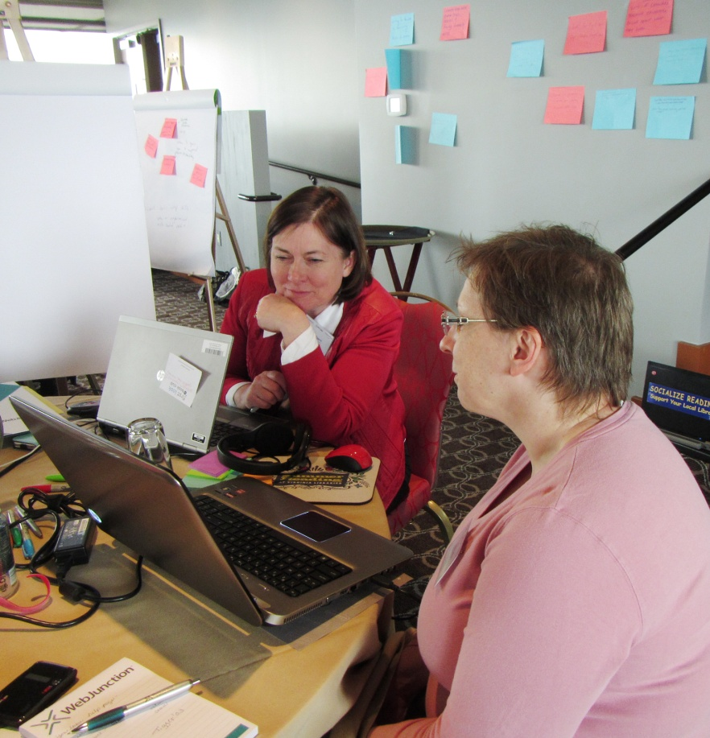
Encouraging Early Literacy
Course Description:
It takes a Library to encourage
children. Everyone in the Library can
support, promote and encourage early
literacy. This self-paced online course
provides an overview of early literacy
and ways library staff can interact with
children to encourage singing, talking,
reading, writing and playing.
Members
Enid Costley,
Library of Virginia
Notes:
Encouraging Early Literacy
Course Description: It takes a Library to encourage children. Everyone in the Library can support, promote and encourage early literacy. This self-paced online course provides an overview of early literacy and ways library staff can interact with children to encourage singing, talking, reading, writing and playing.
Our thanks to Public Library Association and Association for Library Services to Children for Every Child Ready to Read, and course content provided by Saroj Ghoting, national trainer on early literacy.
Objectives:
Public Service Competencies – Children’s Services
Provides experiences, resources and interactions that fuel a love of learning.
Models and promotes a welcoming, supportive, and nonjudgmental attitude towards children and their families.
Promotes awareness of children’s services to other staff members and contributes to their training in relation to the delivery of those services.
Provides services that enhanced literacy and reading skills.
Designer:
Enid Costley, Library of Virginia

Slide 14
Encouraging Early Literacy
Objectives:
Public Service Competencies – Children’s Services
Provides experiences, resources and interactions that fuel a love of learning.
Models and promotes a welcoming, supportive, and nonjudgmental attitude towards children and their families.
Promotes awareness of children’s services to other staff members and contributes to their training in relation to the delivery of those services.
Provides services that enhanced literacy and reading skills.
Members
Enid Costley,
Library of Virginia
Notes:
Encouraging Early Literacy
Course Description: It takes a Library to encourage children. Everyone in the Library can support, promote and encourage early literacy. This self-paced online course provides an overview of early literacy and ways library staff can interact with children to encourage singing, talking, reading, writing and playing.
Our thanks to Public Library Association and Association for Library Services to Children for Every Child Ready to Read, and course content provided by Saroj Ghoting, national trainer on early literacy.
Objectives:
Public Service Competencies – Children’s Services
Provides experiences, resources and interactions that fuel a love of learning.
Models and promotes a welcoming, supportive, and nonjudgmental attitude towards children and their families.
Promotes awareness of children’s services to other staff members and contributes to their training in relation to the delivery of those services.
Provides services that enhanced literacy and reading skills.
Designer:
Enid Costley, Library of Virginia

Slide 15
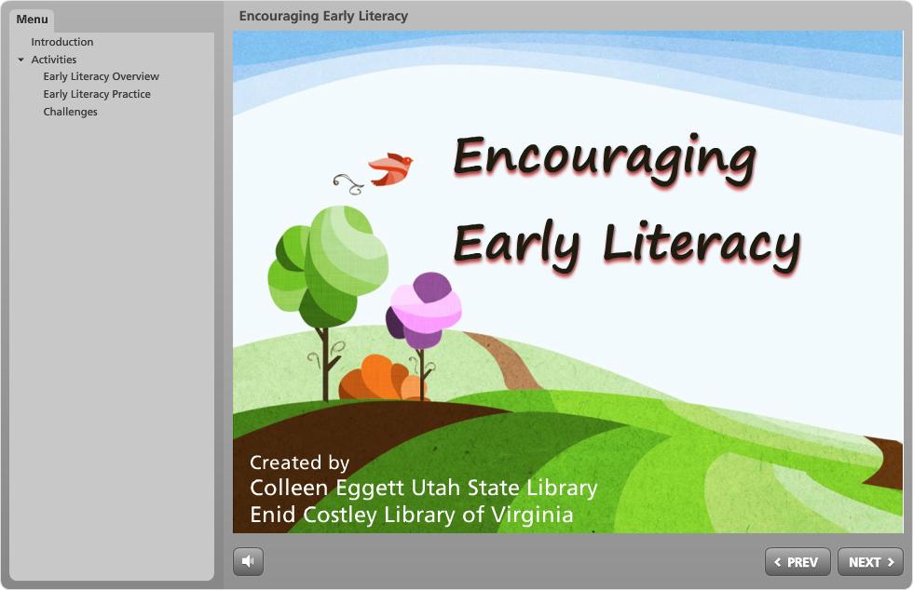
Encouraging Early Literacy
Notes:
Encouraging Early Literacy
Course Description: It takes a Library to encourage children. Everyone in the Library can support, promote and encourage early literacy. This self-paced online course provides an overview of early literacy and ways library staff can interact with children to encourage singing, talking, reading, writing and playing.
Our thanks to Public Library Association and Association for Library Services to Children for Every Child Ready to Read, and course content provided by Saroj Ghoting, national trainer on early literacy.
Objectives:
Public Service Competencies – Children’s Services
Provides experiences, resources and interactions that fuel a love of learning.
Models and promotes a welcoming, supportive, and nonjudgmental attitude towards children and their families.
Promotes awareness of children’s services to other staff members and contributes to their training in relation to the delivery of those services.
Provides services that enhanced literacy and reading skills.
Designer:
Enid Costley, Library of Virginia

Slide 16
Having fun at work again
Course Description:
Don't let the pressures of working at the library bring you or your staff down. People want a work environment that is challenging, encourages trial and error, and makes them feel that they matter. It's time to make the workplace exciting again, all throughout the library's culture. Here are some things to do to make work fun again.
Objectives:
Helping libraries cope with increasing pressures at work
Providing meaningful things staff members can do to have fun
Improving the work culture of libraries
Members
Colleen Eggett,
Training Coordinator, Utah State Library
Notes:
Having fun at work again
Course Description: Don't let the pressures of working at the library bring you or your staff down. People want a work environment that is challenging, encourages trial and error, and makes them feel that they matter. It's time to make the workplace exciting again, all throughout the library's culture. Here are some things to do to make work fun again.
Objectives:
Helping libraries cope with increasing pressures at work
Providing meaningful things staff members can do to have fun
Improving the work culture of libraries
Designer:
Colleen Eggett, Training Coordinator, Utah State Library

Slide 17
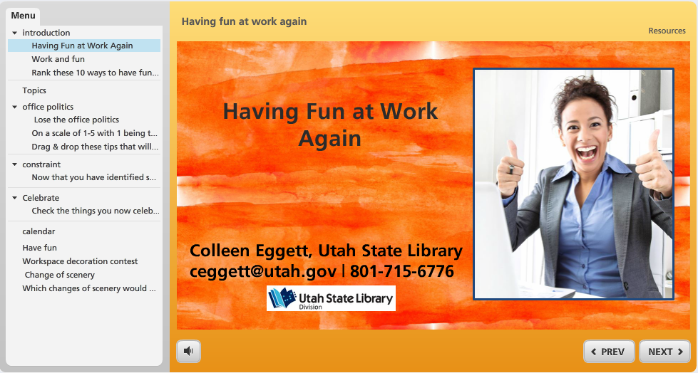
Having fun at work again
Notes:
Having fun at work again
Course Description: Don't let the pressures of working at the library bring you or your staff down. People want a work environment that is challenging, encourages trial and error, and makes them feel that they matter. It's time to make the workplace exciting again, all throughout the library's culture. Here are some things to do to make work fun again.
Objectives:
Helping libraries cope with increasing pressures at work
Providing meaningful things staff members can do to have fun
Improving the work culture of libraries
Designer:
Colleen Eggett, Training Coordinator, Utah State Library

Slide 18
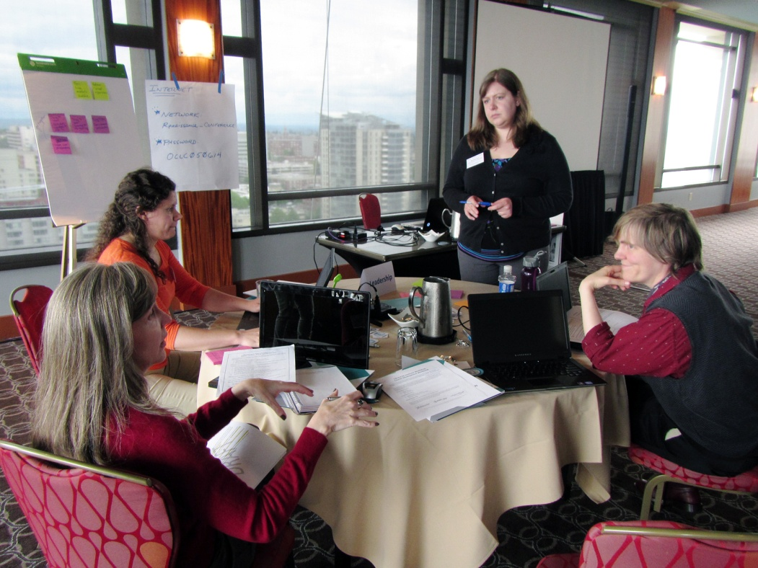
Providing Constructive Employee Feedback
Course Description:
Giving feedback to staff is one of the most
important parts of being a manager or
supervisor, yet we often avoid giving
feedback, especially to those who need it
most. This course will help you improve your
skills in providing constructive feedback to
your staff.
Objectives:
Articulate advantages of giving feedback
Describe the qualities of constructive feedback
Identify organization specific resources to support/enhance desired behaviors
Apply strategies for handling difficult conversations
Course Designers:
Tiffany Hayes
Christine Kreger
Meredith Lowe
Kelly Jo Woodside

Slide 19
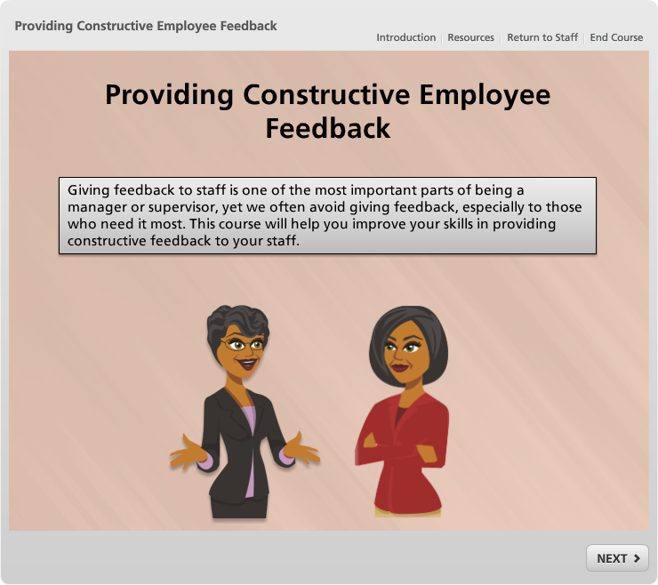
Providing Constructive Employee Feedback

Slide 20
Biggest Wins &
Biggest Challenges

Slide 21
Biggest wins!
Notes:
Activity: Biggest wins in Course Development
Claim ‘territory’ (arrows)
Each participant lists biggest wins (text)
Share and Discuss (facilitated)

Slide 22
Biggest challenges!
Notes:
Activity: Biggest Challenges to Course Development
Claim ‘territory’ (arrows)
Each participant lists biggest wins (text)
Share and Discuss (facilitated)

Slide 23
Moving Forward & Staying Connected
Notes:
- Applying your skills – keep creating content?
Goals of the grant > great new skills > how do you anticipate
Continued collaboration – staying connected?
Maintaining your awesome new professional connections. Keep working/learning together!

Slide 24

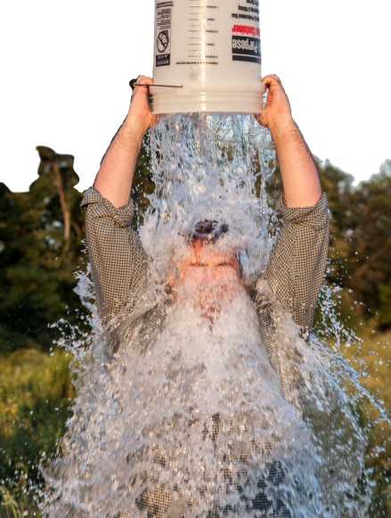
Where are you on this continuum?
I can’t wait to create another self-paced elearning course!
I’d rather pour a bucket of ice water on my head!
Ice bucket challenge by Anthony Quintano on Flickr
Notes:
ice bucket challenge: https://www.flickr.com/photos/quintanomedia/14848289439

Slide 25
Seriously …
How do you plan
to apply
your new skills?
Notes:
- Applying your skills – keep creating content?
Goals of the grant: increase access for learners, fill gaps in priority topics, increase skills of CE developers

Slide 26

Remember the blend

Slide 27
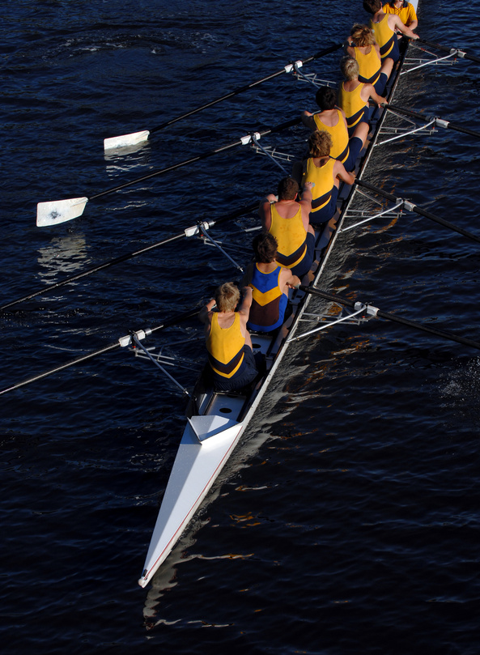
Continuing the collaboration
with library CE colleagues
Notes:
Continued collaboration – staying connected?
Maintaining your awesome new professional connections. Keep working/learning together!

Slide 28
Sharing with the Field

Slide 29
We’ll share…
Library CE Training Institute Curriculum
Your Courses in learn.webjunction.org - end of September
Program and courses featured in October Crossroads
Final IMLS Report
Summary of models – recommended model

Slide 30
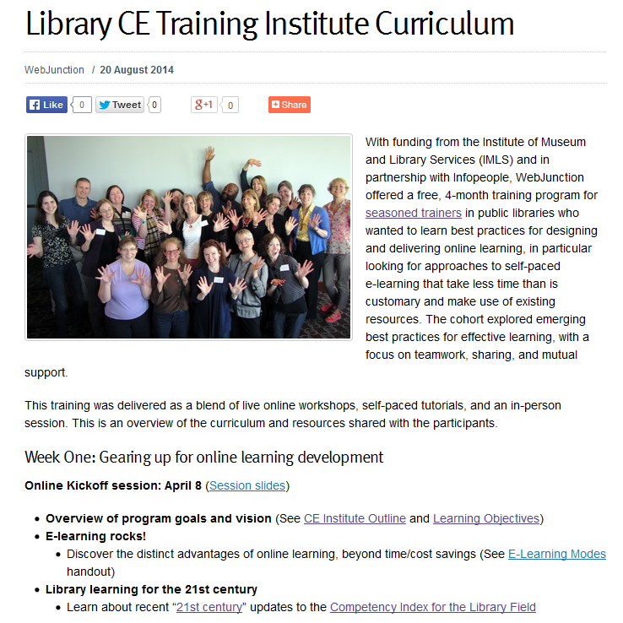
Notes:
http://webjunction.org/news/webjunction/library-ce-training-institute-curriculum.html (will look at adding other resources to share more broadly, like link resources shared at the workshop, the Instructional Design Resources and Articulate Resources.)

Slide 31
You’ll share…
Curriculum
Advantages of online learning, and strategies to support learners and advocates
The courses you created!

Slide 32
How will you share?

Slide 33
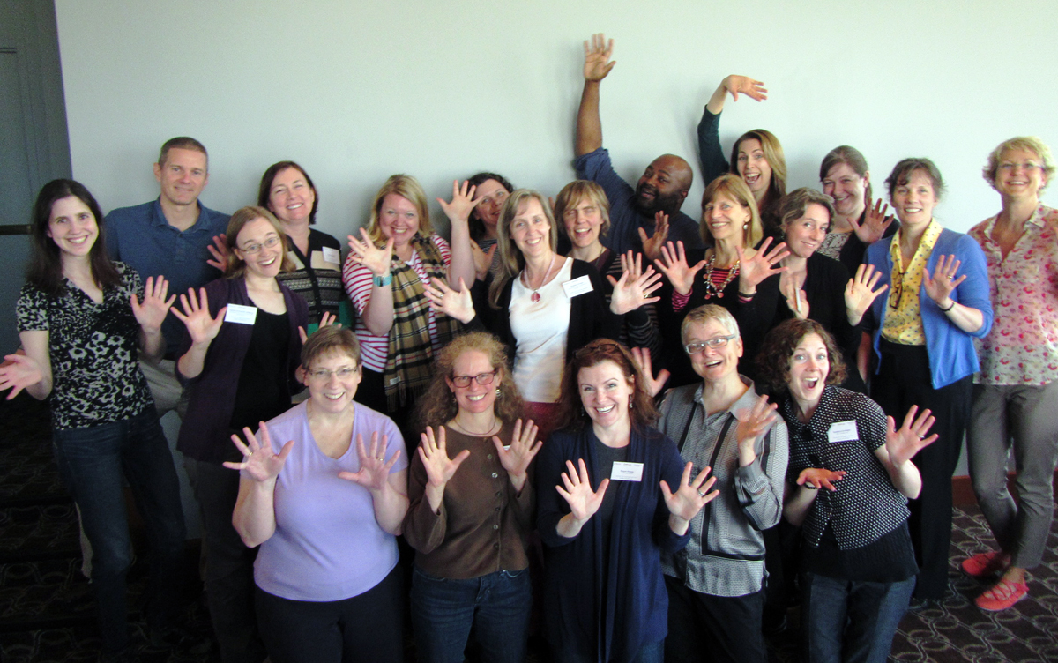
YOU DID IT!

Slide 34



The Library CE Institute
is a partnership of
WebJunction and Infopeople
It is generously supported by a
grant from the Institute of
Museum & Library Services (IMLS)
Notes:
Partnership of WJ & IP funded by a grant from IMLS
As part of the SCEC project

